Slide 1


PANIMALAR ENGINEERING COLLEGE
Department of Computer Science and Engineering
CS8811 PROJECT WORK
Offensive Language Detection Using Machine Learning Classifiers
Project Guide: Dr. L. Jabasheela
Presented By:
Silas Dhayanand S 211419104252
Batch Number: C24

Slide 2
Introduction
Offensive language detection is an important application of machine learning that aims to automatically identify and flag text that contains offensive content.
This project involves building a machine learning classifier that can accurately detect offensive language in text.
The classifier will be trained on a dataset of labeled examples, where each example is labeled as offensive or non-offensive.
In recent years, offensive language detection has become increasingly important in social media platforms, online forums, and other digital environments where users can post content anonymously. The goal is to identify and remove harmful content to create a safer and more welcoming online community for all users.

Slide 4
Problem Statement
The need for this project arises from the increasing prevalence of offensive language in online platforms.
Offensive language can include hate speech, cyberbullying, and other forms of harmful content.
The development of an accurate and reliable machine learning classifier for offensive language detection. The classifier should be able to account for variations in language use and capture subtle nuances that distinguish offensive from non-offensive language.
Overall, the objective of this project is to build a machine learning classifier that can effectively detect offensive language in text and contribute to the creation of a safer online environment.

Slide 5
Technology Stack
Python
Scikit-learn
Pandas
Joblib

Slide 6
System Architecture
Data Pre-processing: The input text data is pre-processed to convert it into a format that can be used for training the machine learning classifier.
Feature Extraction: The pre-processed text data is then transformed into a feature vector representation that can be used for training the machine learning classifier.
Machine Learning Model: A machine learning model is trained on the feature vectors to predict whether a given text example is offensive or non-offensive.
Model Evaluation: The trained machine learning model is evaluated using metrics such as accuracy, precision, recall, and F1-score.
Deployment: Once the machine learning model has been trained and evaluated, it can be deployed in a production environment where it can automatically detect offensive language in text.

Slide 7
System Design
Input Text Data
Data Pre-processing
Machine Learning Model
Feature Vector
Model Evaluation
Deployment

Slide 8
Use CaseDiagram
Train Model
Evaluate Model
Detect Offensive Language

Slide 9
Module Description
Train Dataset: The test dataset contains offensive and non-offensive text examples so that the ML model can test and train itself to be more accurate
Test Dataset: The test dataset also contains offensive and non-offensive text that the ML model can test it’s classifying proficiency after learning from the train dataset
Python Script: The python script contains the code that makes prediction about the text and measures it’s accuracy using precision, recall, F1 score

Slide 10
Training
Before using the module to detect offensive language we must first train it using a dataset containing of offensive and non-offensive text.
The dataset must contain preferably a large number of offensive and non-offensive sentences that are labelled appropriately.
In-order to get maximum accuracy and precision the machine learning model must be trained using a large and extremely varied number of examples

Slide 11
Testing
After undergoing training using a dataset that contains a large amount of extremely varied offensive and non-offensive text examples the test dataset is used.
After training the model, the performance of the model is evaluated on the testing set.
The accuracy and classification report are used to evaluate the model

Slide 12
Python Script
The python script is used to carry out the training and testing of the machine learning model on the datasets.
CountVectorizer(): It is used to convert the text data in the training and testing datasets to numerical data that can be used for machine learning.
MultinomialNB(): It creates a new instance of the MultinomialNB algorithm and train it using the numerical data and labels from the training dataset.

Slide 13
Results
With our training datasets and test datasets, the Naïve Bayes algorithm based classifier gets an overall accuracy score of 76%.
Naive Bayes is a popular choice for offensive language detection due to its speed, efficiency, and ability to work well with small datasets.
Naive Bayes is a popular choice for offensive language detection due to its speed, efficiency, and ability to work well with small datasets.

Slide 14
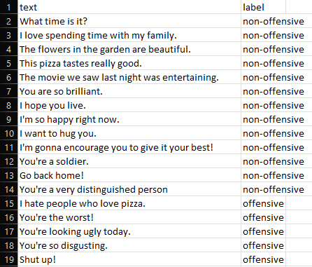
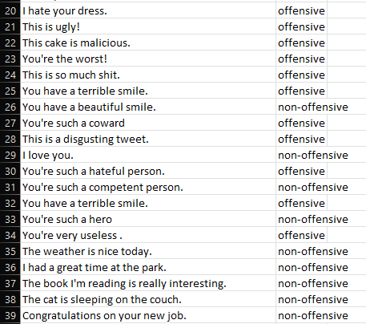
Screenshots
Train Dataset

Slide 15
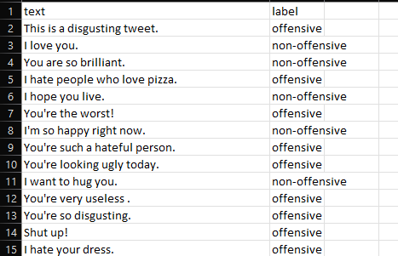
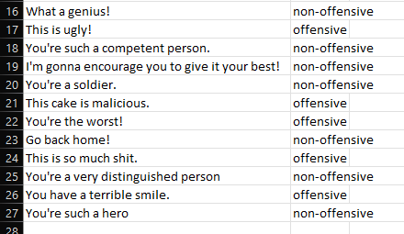
Test Dataset

Slide 16
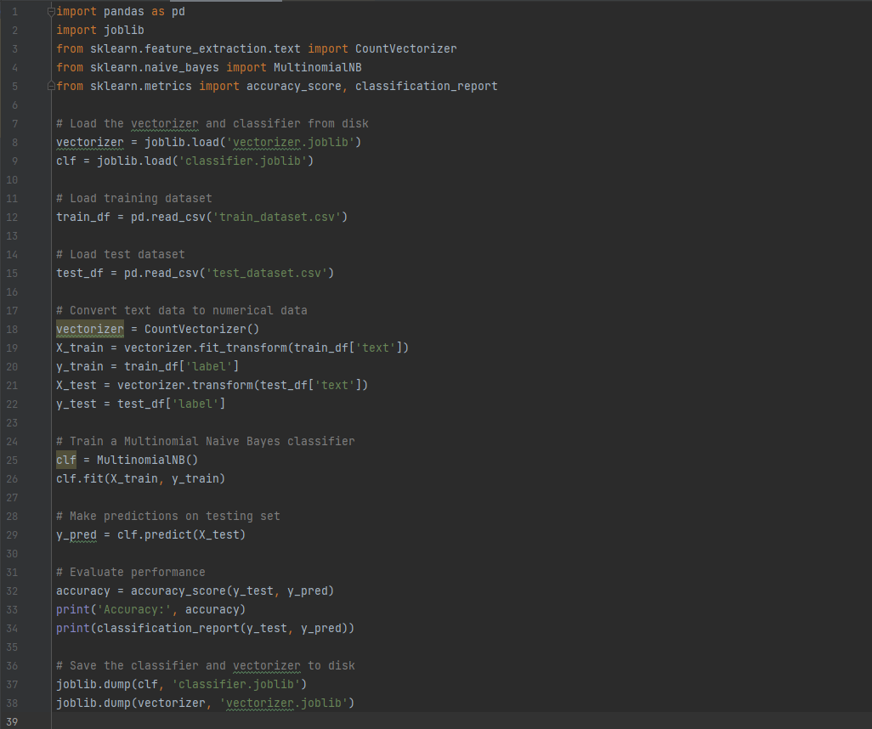
Source Code

Slide 17
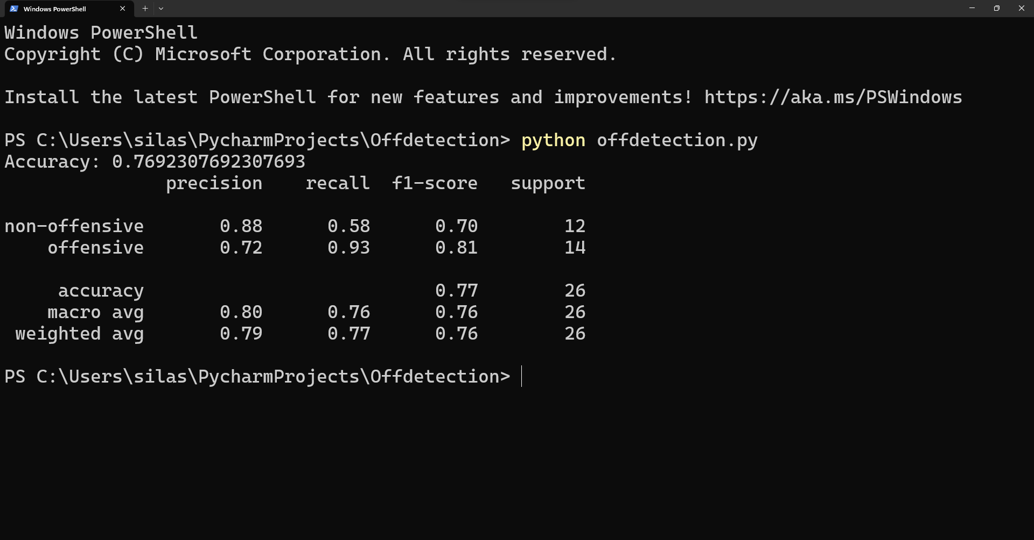
Output

Slide 18
Conclusion
This project is a feasible and effective solution for identifying and classifying offensive language in text data.
The use of the CountVectorizer and Multinomial Naive Bayes algorithm ensures high accuracy in identifying offensive language in text data.
Its implementation can contribute to a safer and more inclusive online environment, which is essential in today's digital age.

Slide 19
References
[1] "Offensive Language Detection: A Review" by V. Bansal, R. Bhatia, and A. Rana (2020)
[2] "A Survey on Offensive Language Detection Techniques" by N. Farhan and T. Kim (2020)
[3] "Hate Speech and Offensive Language Detection: A Comprehensive Review" by A. Singh and A. Singh (2021)
[4] "Survey of Methods for Offensive Language Detection" by N. Akhtar and W. Hu (2020)
[5] "Offensive Language Detection: A Systematic Literature Review" by C. Rojas, L. M. Sanchez, and M. M. Crespo (2021)

