Slide 1
Project: Image Caption Generator
Members:
Silas Kati – 26
Deepak Siddardha – 35
Akash Dabral – 03
Sai Ujwal – 37
Project Guide:
Ms. P. Mansa Devi
Assistant Professor
Dept. of CSE, GITAM

Slide 2
Problem Statement
Can we give a machine the ability to describe an image just like humans?

Slide 3
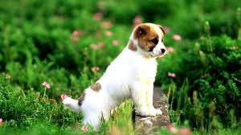
Introduction
What do you see in this picture?
Some might say “A white dog in a grassy area”, or “White dog with brown spots” or even “A dog on grass and some pink flowers”.

Slide 4
Cont. Introduction
All of these captions are relevant for this image and there may be some others also.
It’s so easy for us, as human beings, to just have a glance at a picture and describe it in an appropriate language.
But, can a computer program take an image as input and produce a relevant caption as output?

Slide 5
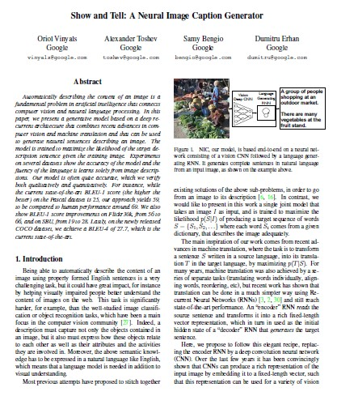
Inspiration
Research paper published by Google researchers in 2014 named “Show and Tell: A Neural Image Caption Generator”.
Proposed a single joint model that generates captions for the images.

Slide 6
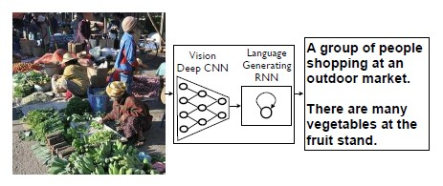
What does the project do?
Fig 1: We based our project, end-to-end, on an neural network consisting of a vision CNN (Xception) followed by a language generating RNN (LSTM). It generates complete sentences in natural language from an input image, as shown on the example above.

Slide 7
Applications
Self driving cars
Aid to the blind - Nvidia research is trying to create such a product.
CCTV camera surveillance
Automatic Captioning can also help, make Google Image Search as good as Google Search, as then every image could be first converted into a caption and then search can be performed based on the caption.

Slide 8
Dataset Gathering and Cleaning
Datasets searched for this problem
Flickr 8k (containing 8k images) #selected for this project
Flickr 30k (containing 30k images)
MS COCO (containing 180k images)
Smaller dataset created of 15 images

Slide 9
Cont. Dataset Gathering and Cleaning
The Flickr 8k dataset is bifurcated as follows:
Training Set — 6000 images
Validation Set — 1000 images
Test Set — 1000 images

Slide 10
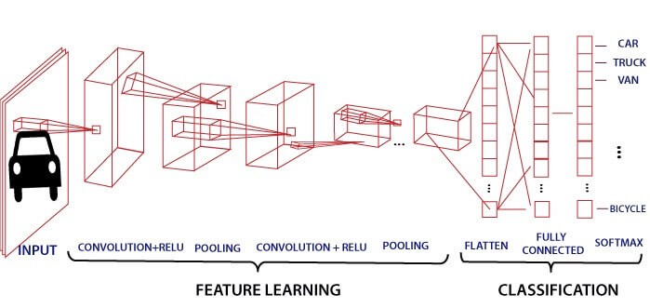
Workings of a basic CNN
Fig 2: Basic structure of a CNN

Slide 11
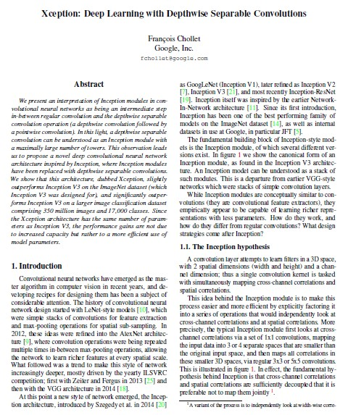
Which CNN is best suited?
Research paper published by a Google researcher in 2017 named “Xception: Deep Learning with Depthwise Separable Convolutions”.

Slide 12
Various CNNs considered
Performance when tested on ImageNet dataset
VGG – 16 ~71.5%
Inception V3 ~78.2%
Xception ~79.0%
#As per Francois Chollet. Xception: Deep Learning with Depthwise Separable Convolutions - 2017 IEEE Conference on Computer Vision and Pattern Recognition
Top – 1 accuracy

Slide 13
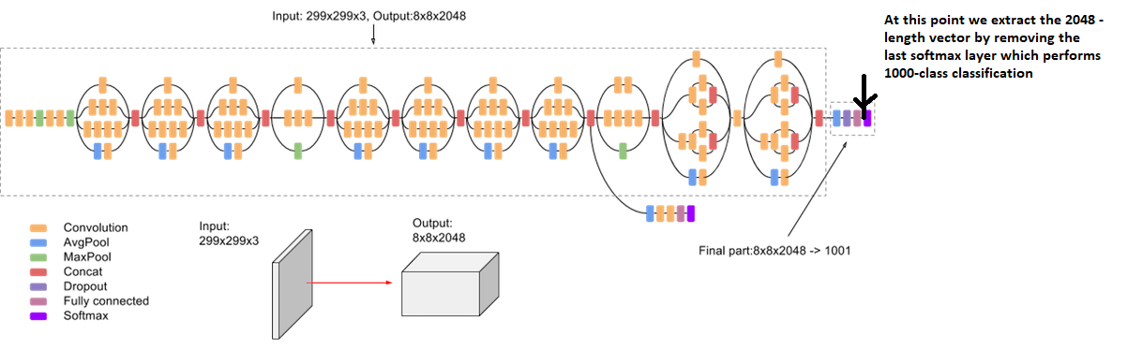
Feature Vector Extraction from Xception
Fig 3: Model structure of Xception CNN

Slide 14
Xception CNN
Xception slightly outperforms Inception V3 on the ImageNet dataset, and vastly outperforms it on a larger image classification dataset with 17,000 classes.
More importantly, it has the same number of model parameters as Inception, implying a greater computational efficiency.

Slide 15
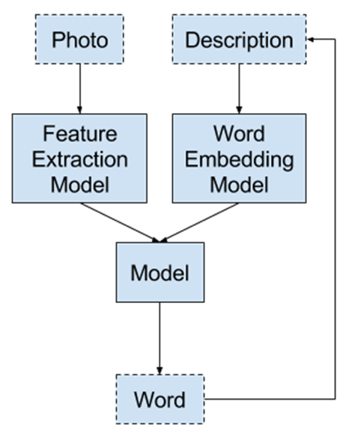
Many-to-one Sequence Prediction
Fig. 4: Generating next word from already generated sequence.
Given an input photo and a sequence of words that were already
created to this model, it attempts to guess the next word in the
definition. The end result is a textual description generated
through recursively making calls to the model.

Slide 16
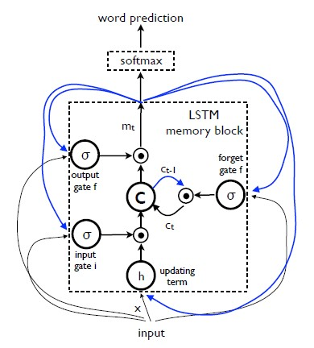
LSTM model
Fig 5: LSTM: the memory block contains a cell c which is
controlled by three gates. In blue we show the recurrent
connections – the output m at time t − 1 is fed back to
the memory at time t via the three gates; the cell value
is fed back via the forget gate; the predicted word at
time t−1 is fed back in addition to the memory output m
at time t into the softmax for word prediction.

Slide 17
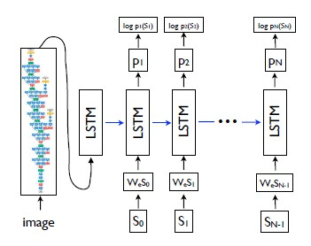
Model Structure
Fig 6: Extracting features from image using Xception CNN and feeding it to LSTM for word generation

Slide 18
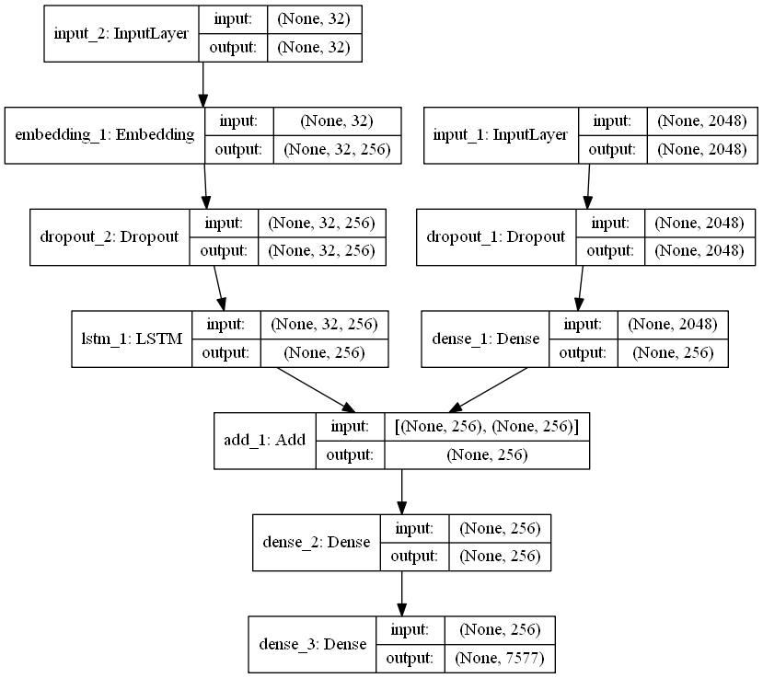
Model Structure
Fig. 7: Model structure

Slide 19
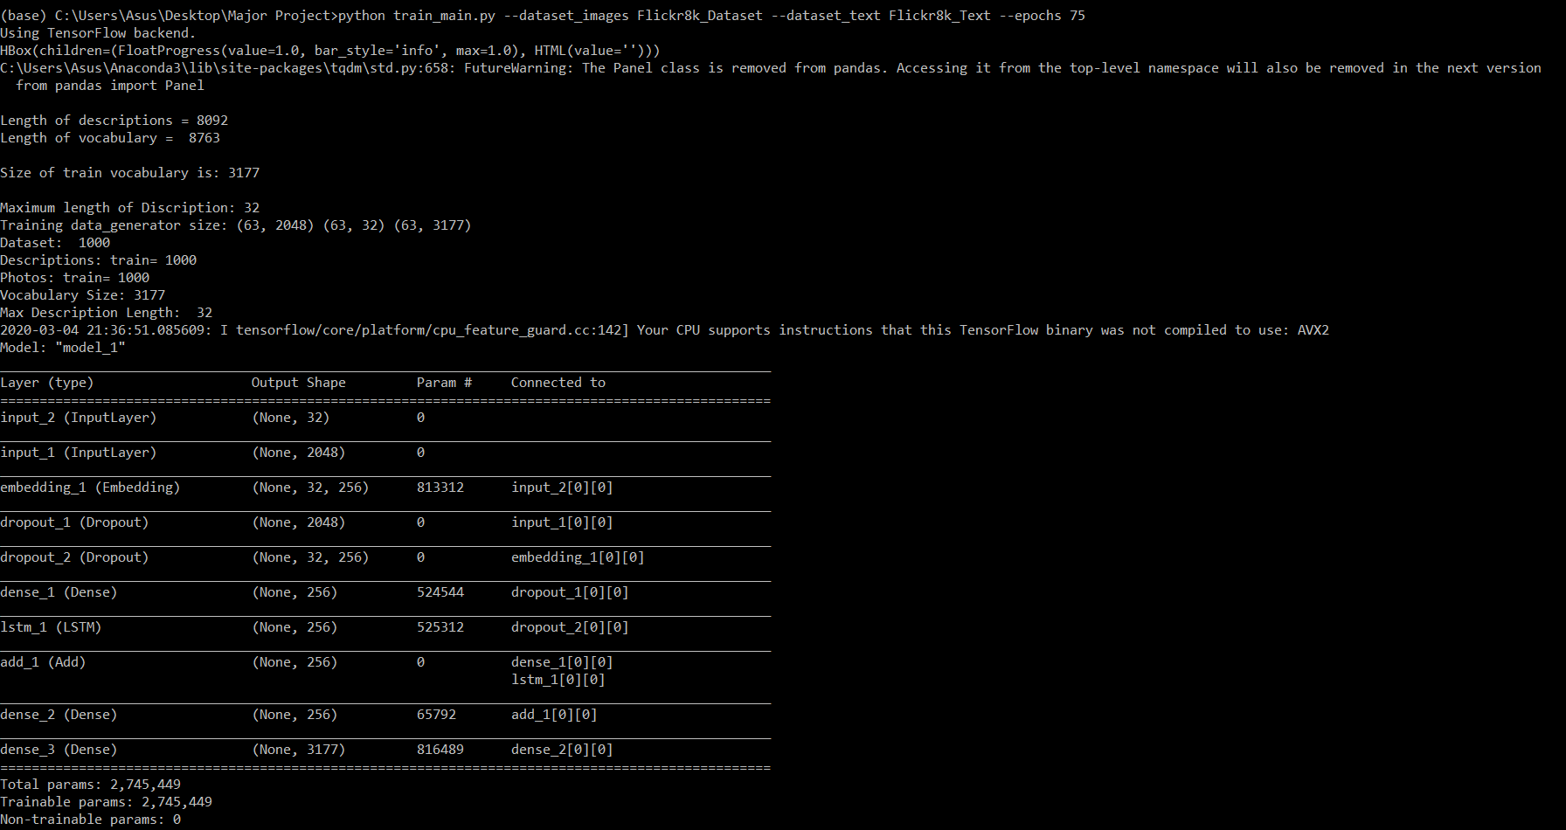
Cont. Model Structure
Fig 8: Model structure

Slide 20
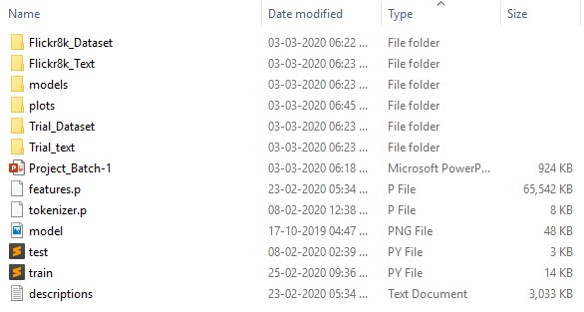
Project Directory
Fig 9: Project directory

Slide 21
Machine Specifications
Laptop with Intel i3 5005U – 2.00 GHz processor and 16GB RAM.
Google Collaboratory

Slide 22
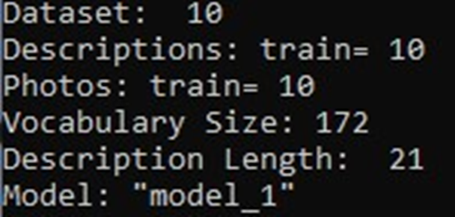

Model training on small dataset
Fig 10: Descriptions of 15 images
Fig 11: Training dataset size = 10

Slide 23
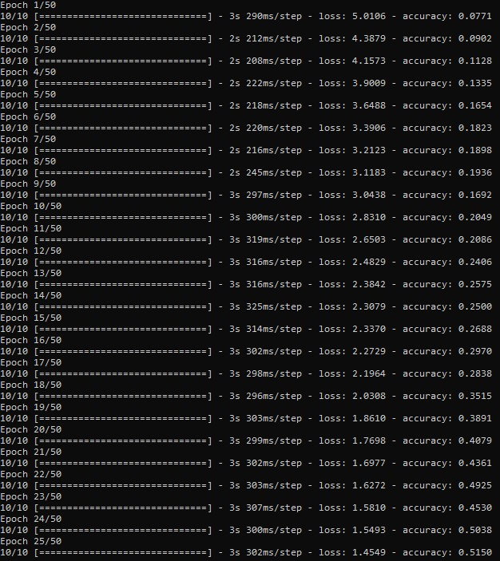
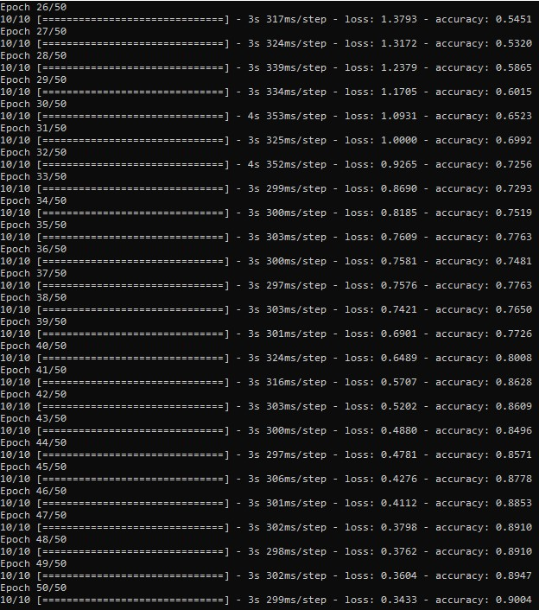
Cont. Model training on small dataset
Fig 12: Training of model for epoch = 50 (1-25)
Fig 13: Training of model for epoch = 50 (25-50)

Slide 24
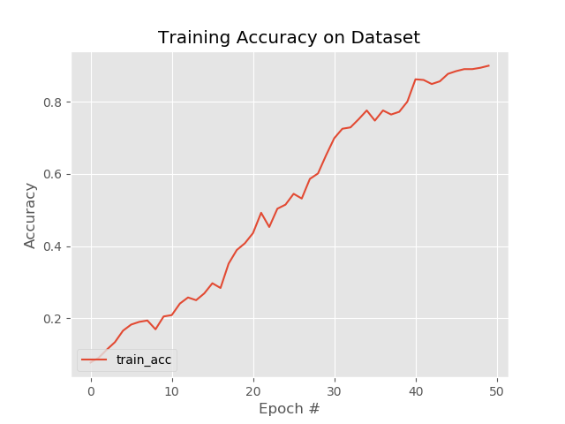
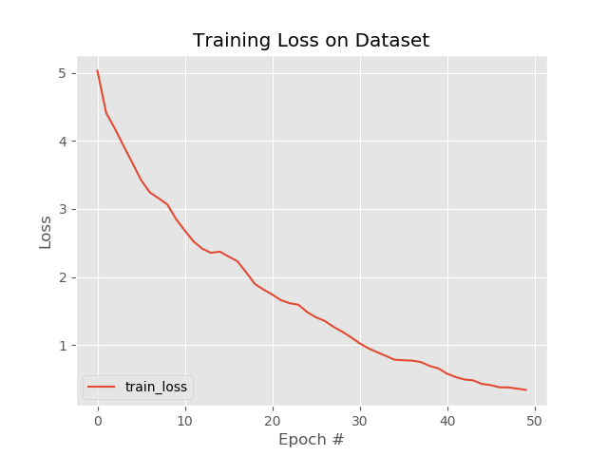
Performance metrics on small dataset
Fig 14: Accuracy: ~90
Fig 15: Loss: ~0.35

Slide 25
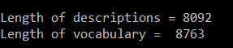
Model training on larger dataset
Fig 16: Descriptions of 6000 images
Fig 17: Training dataset size = 1000

Slide 26
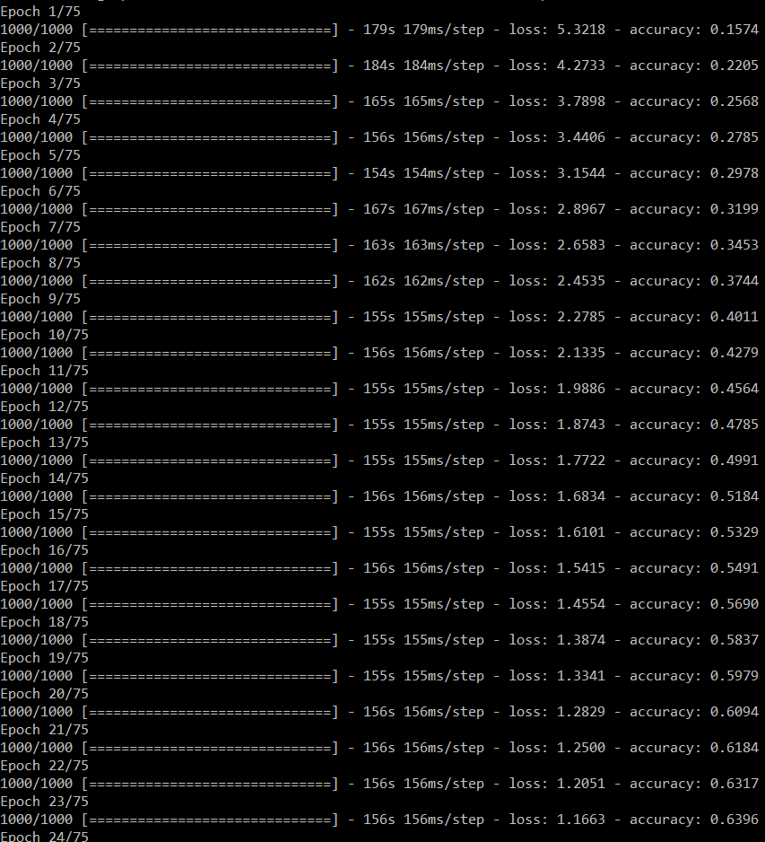
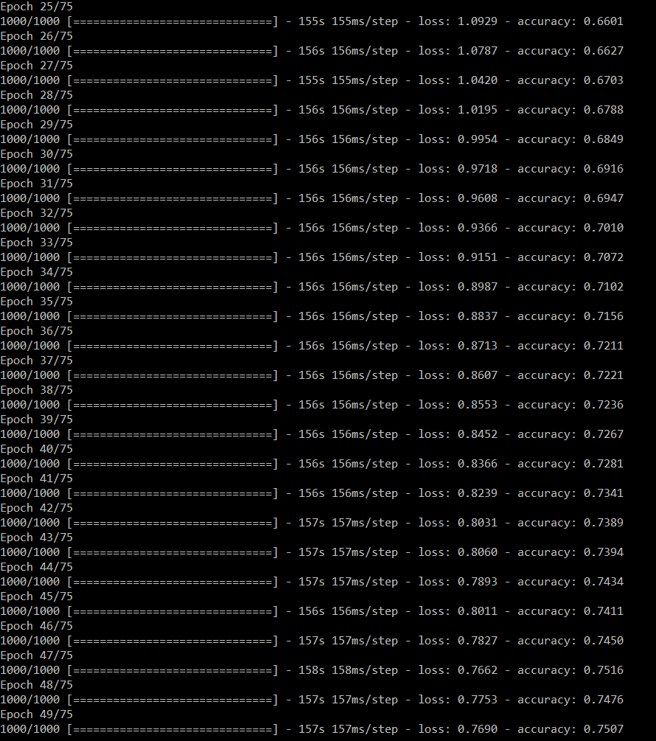
Cont. Model training on larger dataset
Fig 18: Training of model for epoch = 75 (1-24)
Fig 19: Training of model for epoch = 75 (25-49)

Slide 27
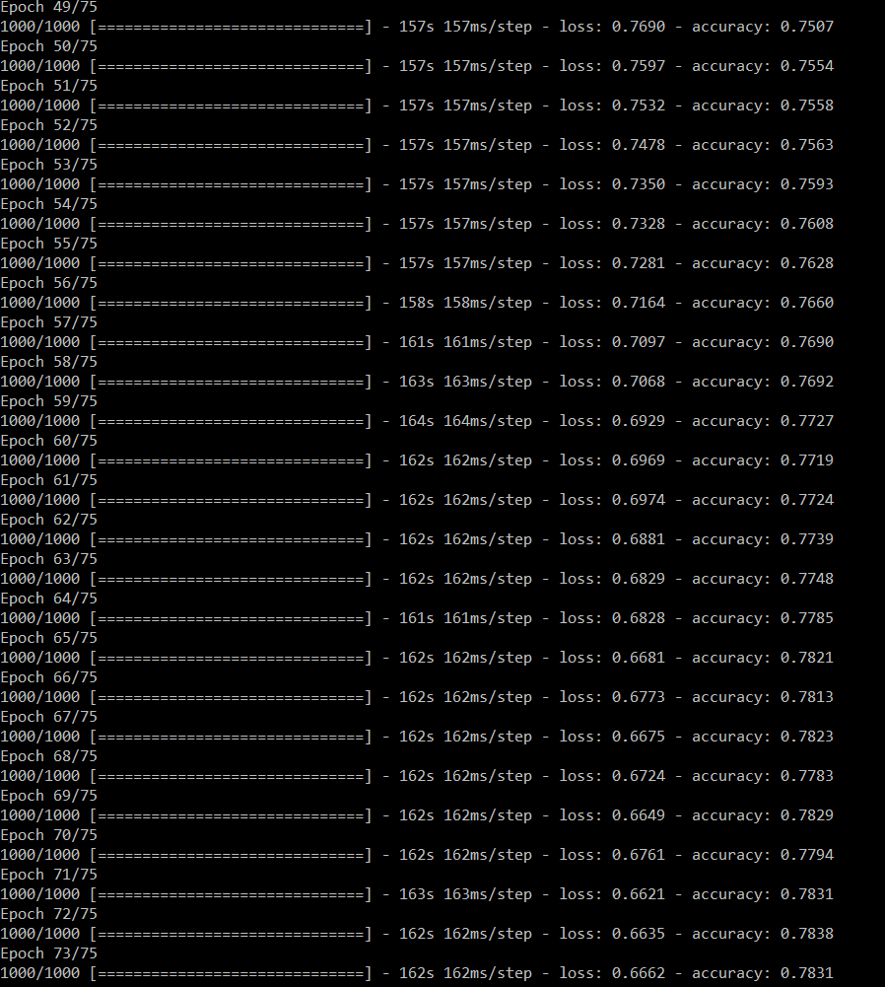
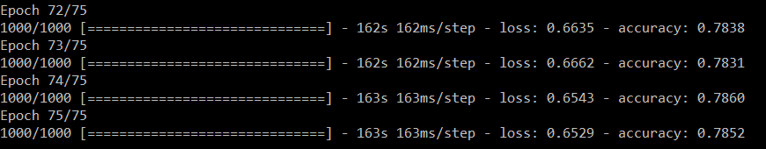
Cont. Model training on larger dataset
Fig 21: Training of model for epoch = 75 (72-75)
Fig 20: Training of model for epoch = 75 (50-71)

Slide 28
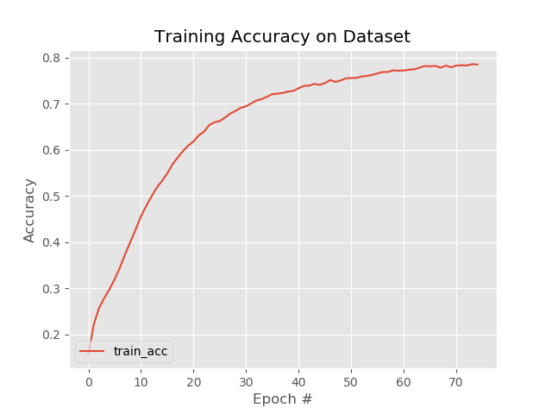
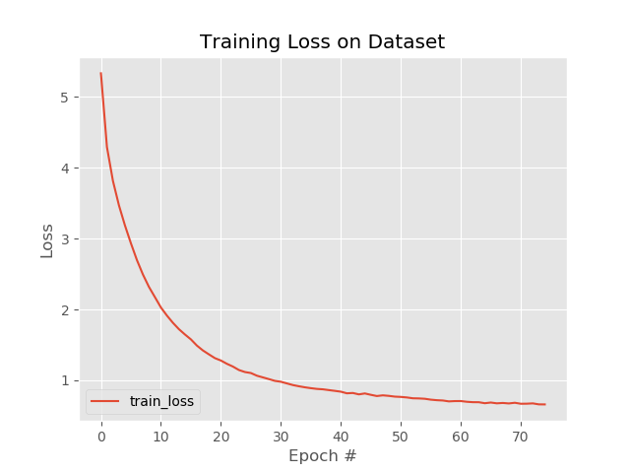
Performance metrics on larger dataset
Fig 22: Accuracy: ~78.5
Fig 23: Loss: ~0.65

Slide 29
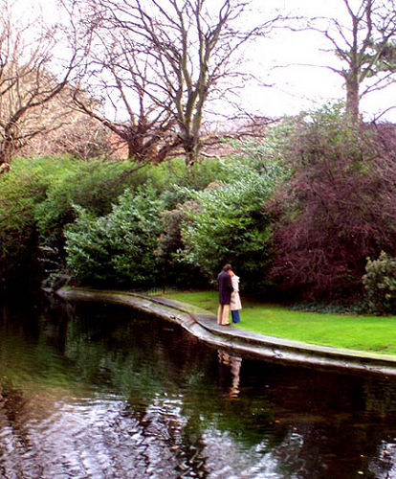
Prediction
Fig 24: Predicted sentence of the picture in Fig 19
Fig 25: A sample image used for prediction

Slide 30
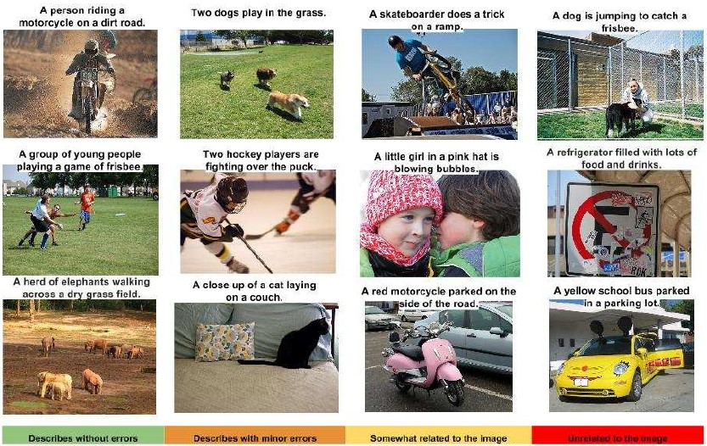
Results
Fig. 26: A selection of evaluation results, grouped by human rating

Slide 31
Conclusion
Presented an Image Caption Generator that can view an image and generate a reasonable description in English.
The model is based on a convolution neural network that extracts features from an image, followed by a recurrent neural network that generates a corresponding sentence.
Decided to go with Xception CNN model instead of InceptionV3 because of it’s better classification performance.
Designed an LSTM model which is well suited for text sequence prediction problems as per the paper.

Slide 32
Thank you

