Slide 1



Shoestring
The consumer dashboard for a peer to peer payment app.

Slide 2
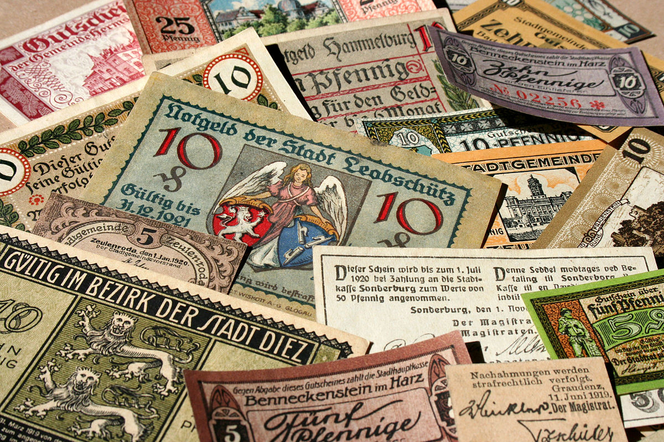

Expensive – international remittance is the lively hood of millions of families worldwide; transaction fees can take large fees from much needed money.
Long Wait Times – long transaction wait times mean that families must wait for necessary remittance payments for what can sometimes be an indeterminate amount of time.
Accessibility – banks and money cashiers maintain a hold on the international remittance industry.
Problem

Slide 3
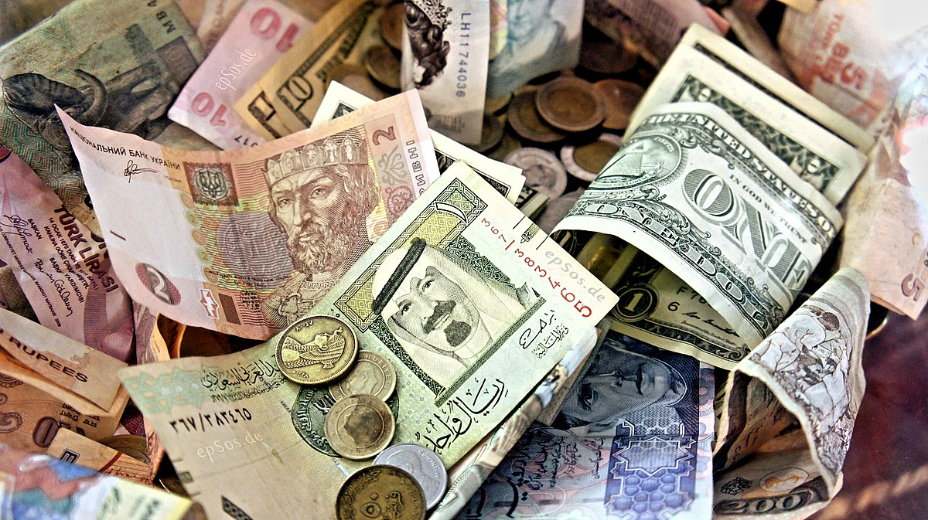





Solution
A mobile application with a web-based dashboard, where users can send money securely and quickly to anywhere.
Currency converter
Ensure you send money using
current exchange rates.
Social Component
Find friends, send or
request money, and send
thank you notes
Use Blockchain Tech
Use blockchain technology
to send payments anywhere
to anyone

Slide 4
Elevator Pitch
Shoestring is a multifunctional web-based application, which allows users to sign up, find friends, upload profile-photos, connect their bank account, utilize a currency converter and, although it is still under development, transfer money between account users. We utilize a MERN Stack to build out the user dashboard.
User’s must Sign up or log in.
Once authenticated the user can connect their bank account, up-load a user photos, search for friends, and utilize a built-in currency converter
We are developing a mobile payment application to connect with our user dashboard.

Slide 5
Concept
Description & Motivation
We realized there is a gap in the market for a peer to peer payment system that integrates currency conversion to send payments instantly both locally and internationally to anyone, anywhere. Although we are still in development, this is a presentation of our user dashboard.
User Story
As a person who frequently sends money abroad, finding a cheap, secure, and fast way to send payments is difficult
I want to easily send payments, securely to anyone, anywhere,
So that I can find a cheap alternative to send money abroad.
Given I send remittance payments to my family abroad
When I send money
I should be able to, send money cheaply, securely and instantly.

Slide 6
Process
Technologies Used
Bulma.io – Design Framework
API’s
Cloudinary
Plaid
Exchange Rate
NPM Packages
JWT
Express
Mongoose
Breakdown of Tasks
Great collaboration across all tasks
Challenges
API’s
Working with the Database
Successes
Populating Modals
Database construction and pushing

Slide 7
Contributions
Cory
Main UI Design
Front end routes
JT
Cloudinary
Front end design
Sile
ALL THINGS MONGO
DeVante
Third party API’s; Plaid, Exchange Rate

Slide 8
Demo

Slide 9
Future Development
Additional Information
Perpetually Updated Database
Display username on page with uploaded photo
Additional Functionality
React Native App to connect peer to peer payment system to mobile application
Continue Dashboard functionality
Have an editable profile information

Slide 10
Links
GitHub Repo URL
https://dry-woodland-58016.herokuapp.com/
Deployed URL
https://github.com/cmarshman/shoestring

Slide 11
Questions?

