Slide 1
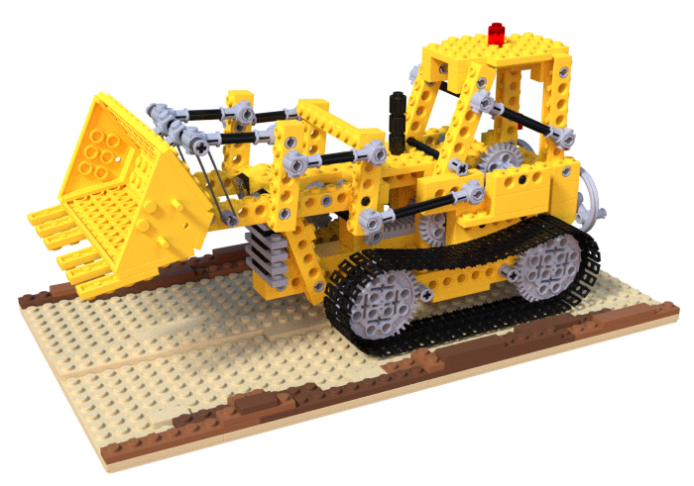














Eulerian Volume $V_{E}$
Eulerian Motion Modeling
Canonical Volume $V_{c}$
$$ℰ_{E}$$
$$f_{Em}$$
$$𝒟_{E}$$
$$x$$
A Specific Location
$$R_{E},t_{E}$$
$$x_{c}$$
$$t$$
Cycle
Consistency
$$t$$
$$x$$
$$R_{L}^{−1},−t_{L}$$
$$𝒢$$
A Specific Particle
$$σ$$
$$x_{c}$$
$$𝒟_{L}$$
$$f_{Lm}$$
$$ℰ_{L}$$
$$c$$
d
Lagrangian Motion Modeling
Lagrangian Volume $V_{L}$

