Slide 1
Paper
GraphFPN: Graph Feature Pyramid Network for Object Detection, ICCV 2021
Gangming Zhao^{1,2,3}, Weifeng Ge ^{∗1,2}, and Yizhou Yu ^{∗3}
¹Nebula AI Group, School of Computer Science, Fudan University
²Shanghai Key Lab of Intelligent Information Processing
³Department of Computer Science, The University of Hong Kong

Slide 2
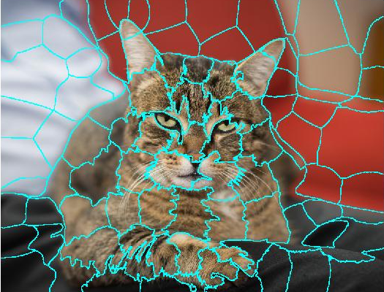
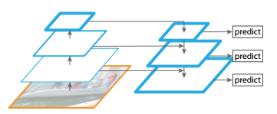
Problem
Multi-scale feature learning of general object detection
Exsiting methods overlook the intrinsic structures of images
Only features from adjacent scales interact directly, how to support feature interactions across all scales

Slide 3
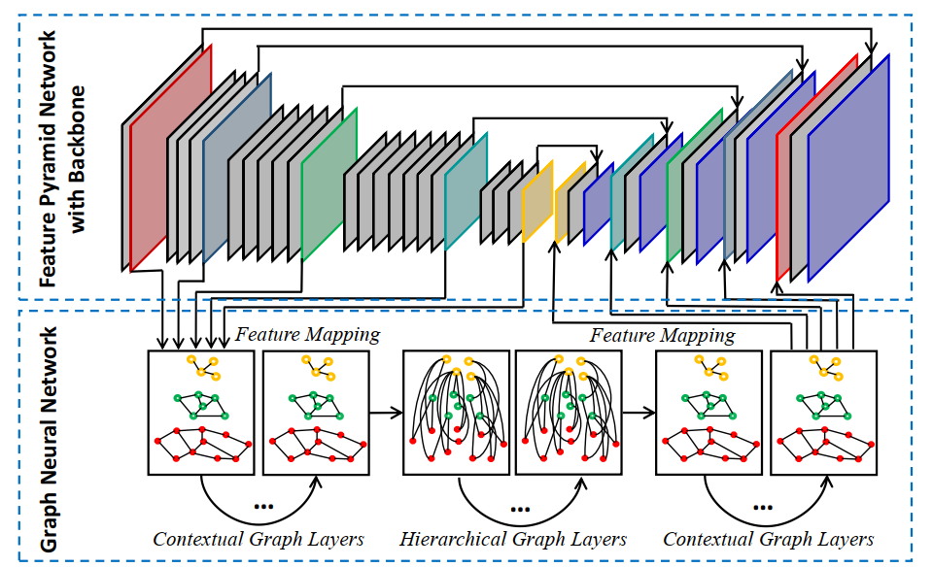
Contribution
We propose a novel graph feature pyramid network to exploit intrinsic image structures and support simultaneous feature interactions across all scales.
We further introduce two types of local channel attention mechanisms for graph neural networks by generalizing existing global channel attention mechanisms for convolutional neural networks

Slide 4
Idea
Use superpixel hierarchy to build graph, represent the intrinsic image structures.
Use graph networks to exploit intrinsic image structures and support simultaneous feature interactions across all scales.

Slide 5
Method:How to build the graph
Get superpixel hierarchy{S⁰; S¹; :::; S^{L} }. through COB^{[1]} algorithm.
S0
S0
S0
S1
S2
S1
S0
[1] Convolutional Oriented Boundaries: From Image Segmentation to High-Level Tasks, TPAMI 2017
Notes:
one of the superpixels in S(l) is a union of two superpixels in S(l-1)

Slide 6
Method:How to build the graph
Node: each superpixel
Edge
Contextual edges: connect two adjacent nodes at the same level.
Hierarchical edges: connect two nodes with ancestor-descendant relationship at different levels, prune 50% according to cosine similarity between node features.

Slide 7
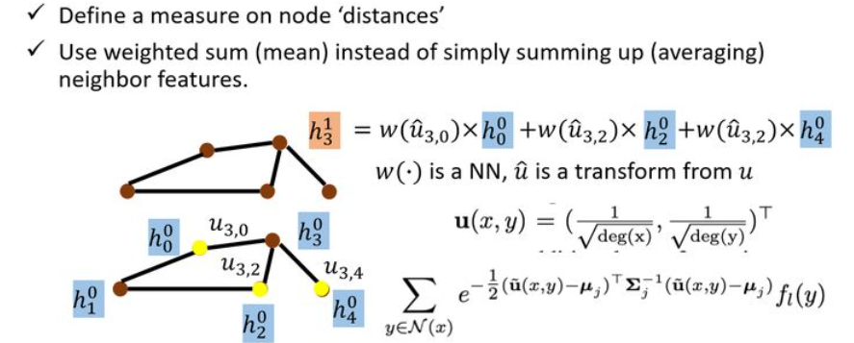
Method:Attention
Spatial attention
Channel attention
Average pooling
Local channel self attention
Notes:
Channel attention部分直接看论文

Slide 8
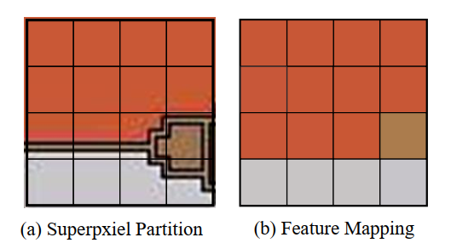
Method:Feature Mapping between GNN and CNN
CNN to GNN: Assign the grid cell to the superpixel with the largest overlap. If multiple cells are assigned to the same superpixel, maxpooling and minpooling—fcn
GNN to CNN: Simply copy each superpixel feature to each cell which is assigned to it

Slide 9
Method: architecture

Slide 10
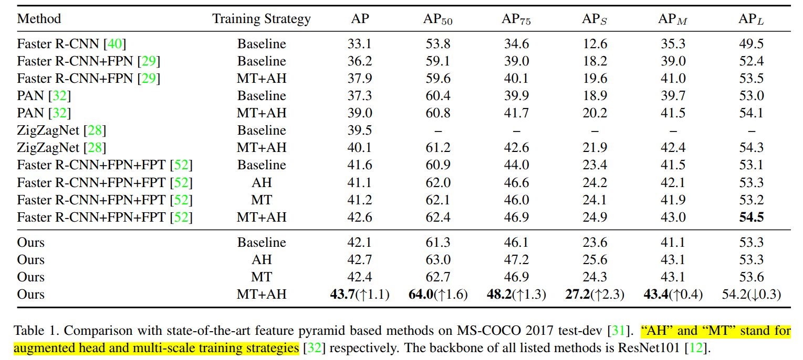
Experiment

Slide 11
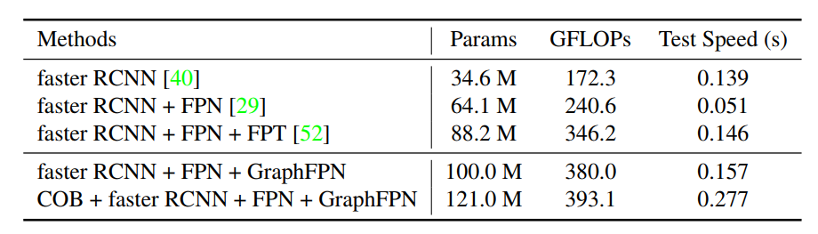
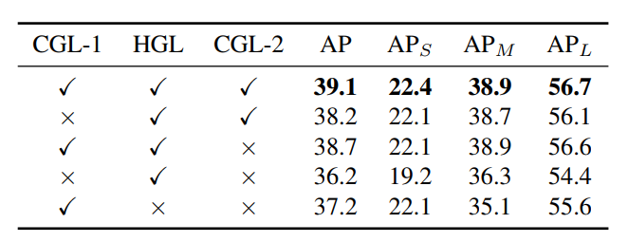
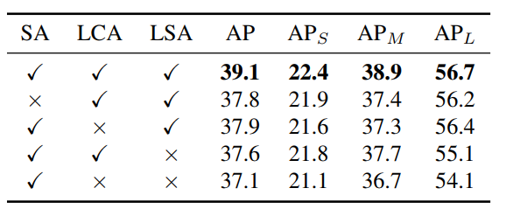
Experiment

