Slide 1
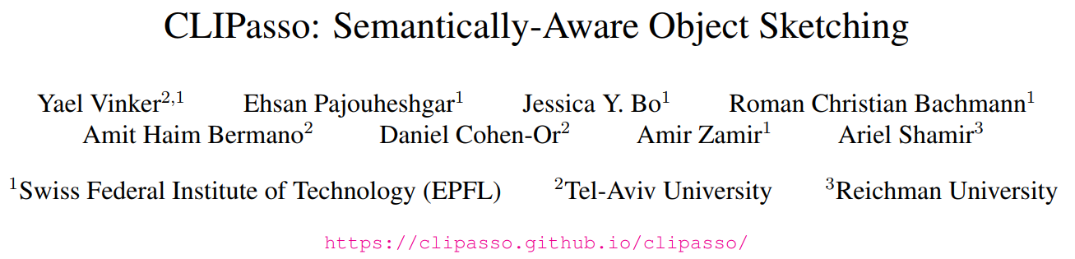
2022/4/12

Slide 2
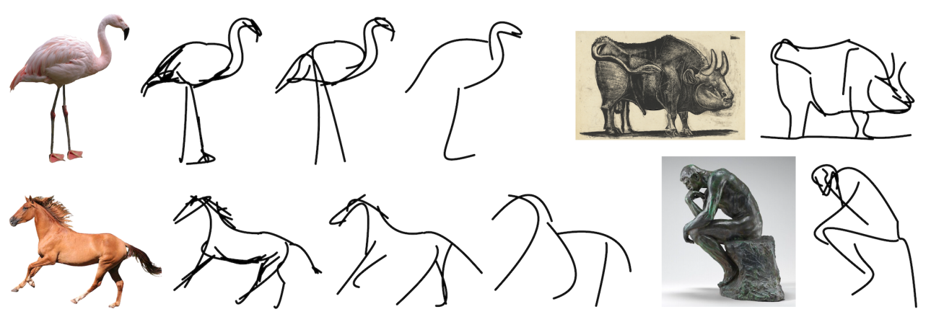
Task: abstraction
  Input: image of an object
  Output: sketch
  Requirement: preserving its key visual features (semantic understanding)

Slide 3
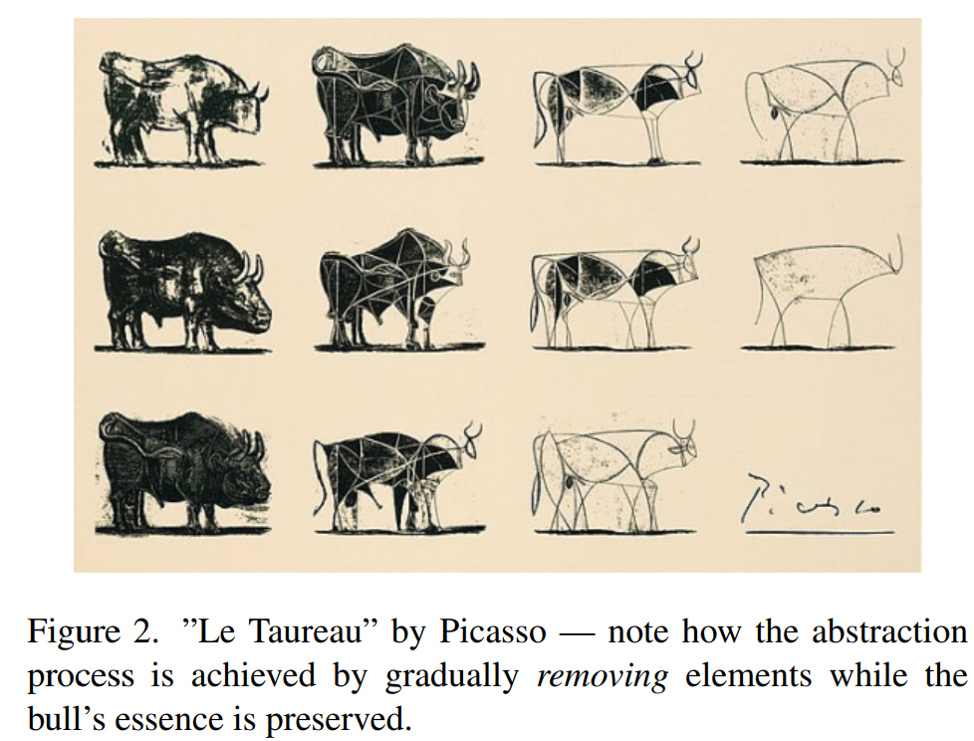

Slide 4
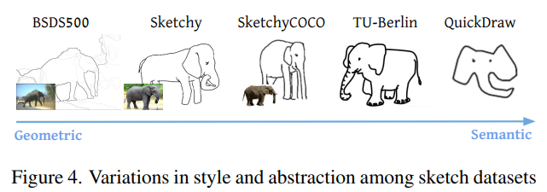
Previous works:
  Use sketch datasets to guide
  Requires the existence and availability of relevant datasets &
  Restrict the output style
This work uses CLIP:
  trained on various styles of images paired with text.
  exceptional at encoding the semantic meaning of visual depictions, regardless of their style

Slide 5
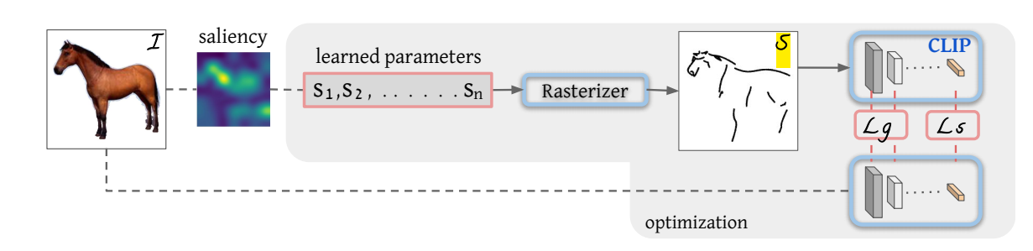
CLIPasso
an optimization-based photo-to-sketch generation technique
  achieve different levels of abstraction
  maintain both geometric and semantic attributes
  without requiring an explicit sketch dataset

Slide 6


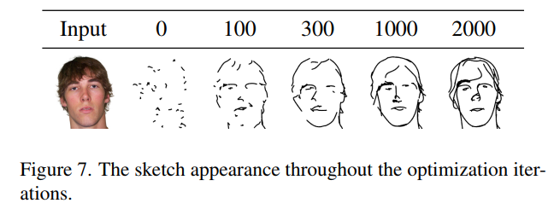


Slide 7
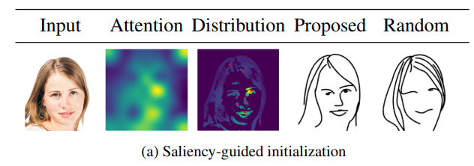
Strokes Initialization
Image → saliency map → multiplied by edge map → softmax

Slide 8
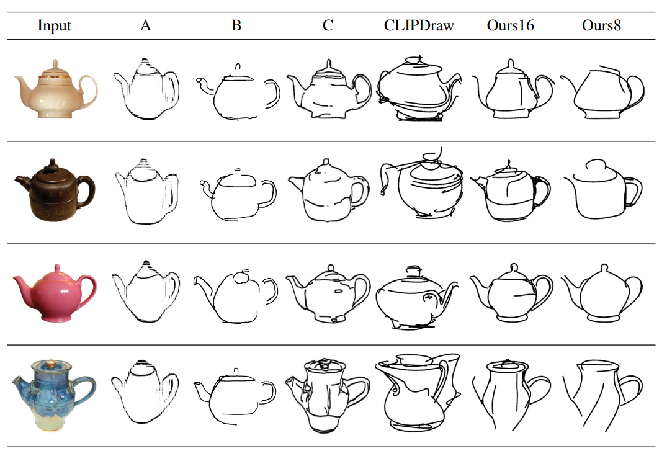

Slide 9
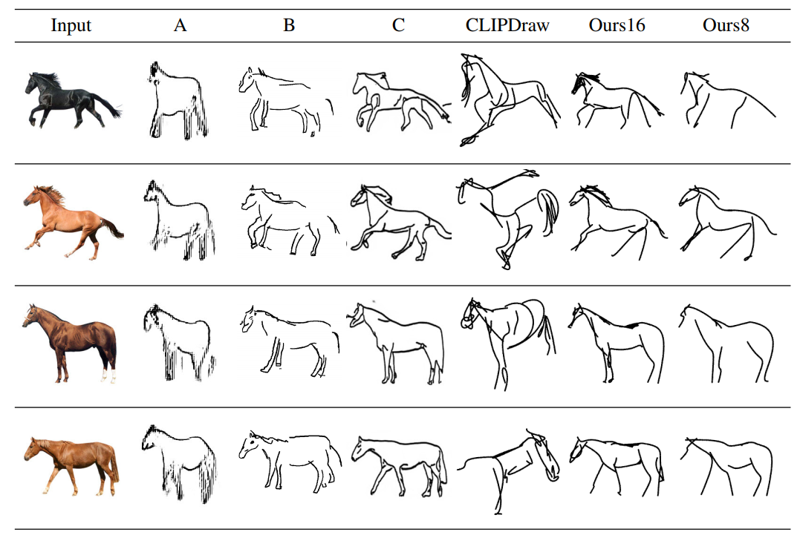

Slide 10
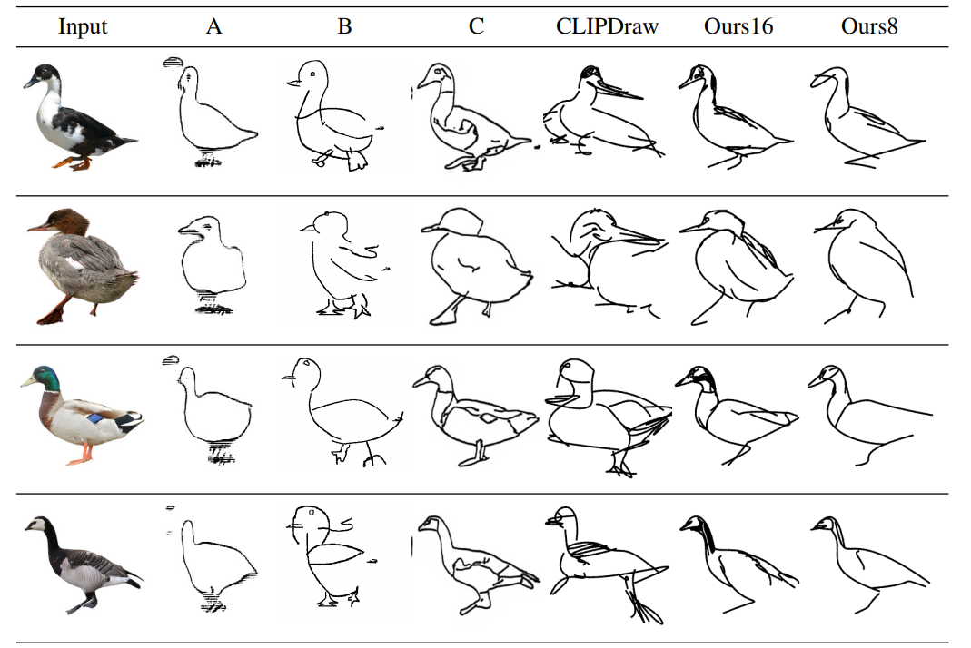

Slide 11
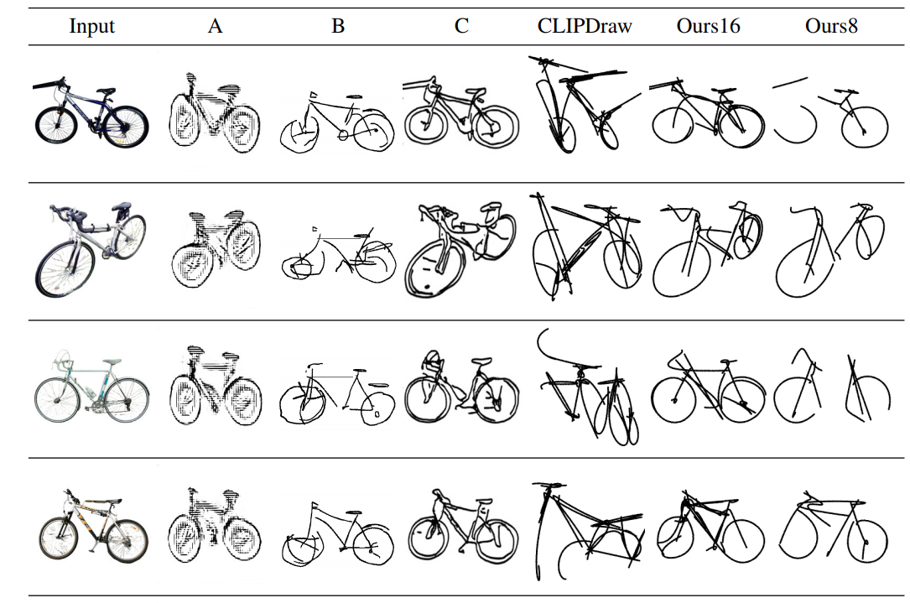

Slide 12
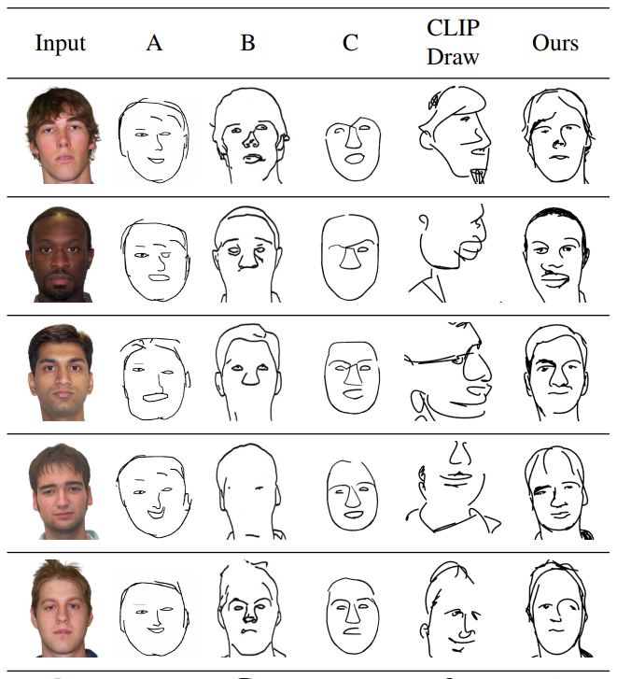

Slide 13
