Slide 1
DELTAS: Depth Estimation by
Learning Triangulation And densication of Sparse points
ECCV 2020 Magic leap

Slide 2
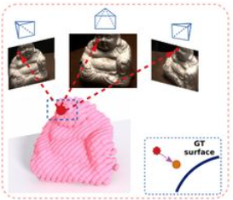
Introduction
Problem setting: multi-view stereo
Input: Images/Videos; Camera intrinsic & extrinsic
Output: the depth map of every image / 3D points cloud

Slide 3
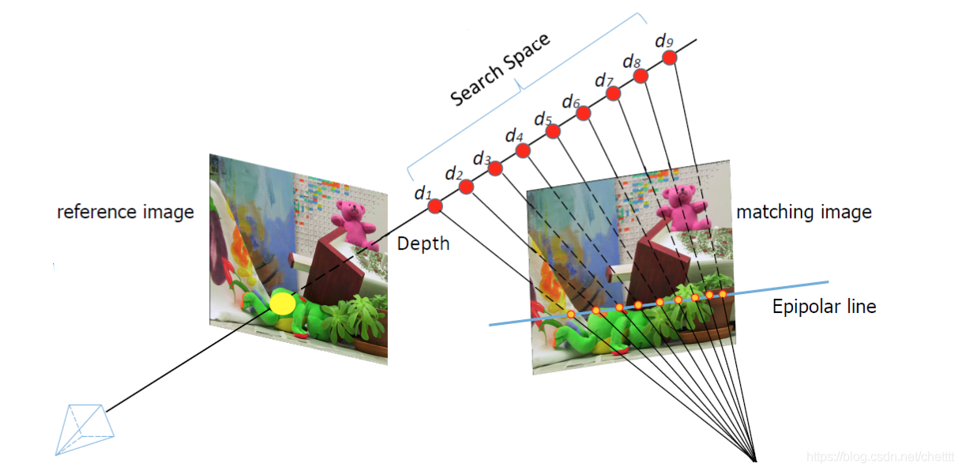
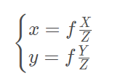
Prerequisite: Epipolar Search for MVS

Slide 4
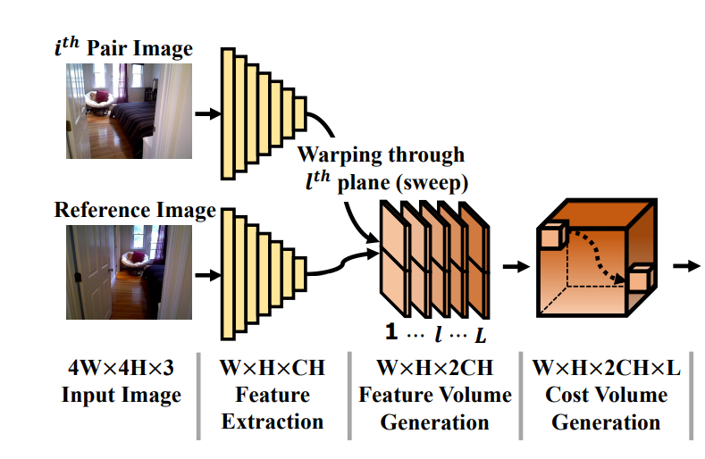
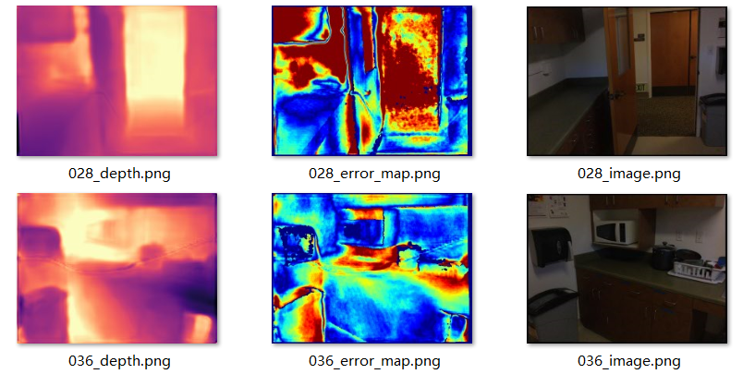
Motivation
Deep MVS Method highly rely on 3D cost volume, which is time & memory consuming.
Revisited the traditional geometry method!

Slide 5
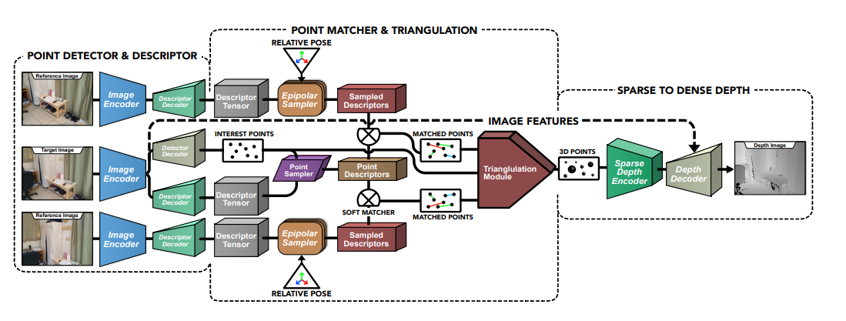
Method: Pipeline

Slide 6
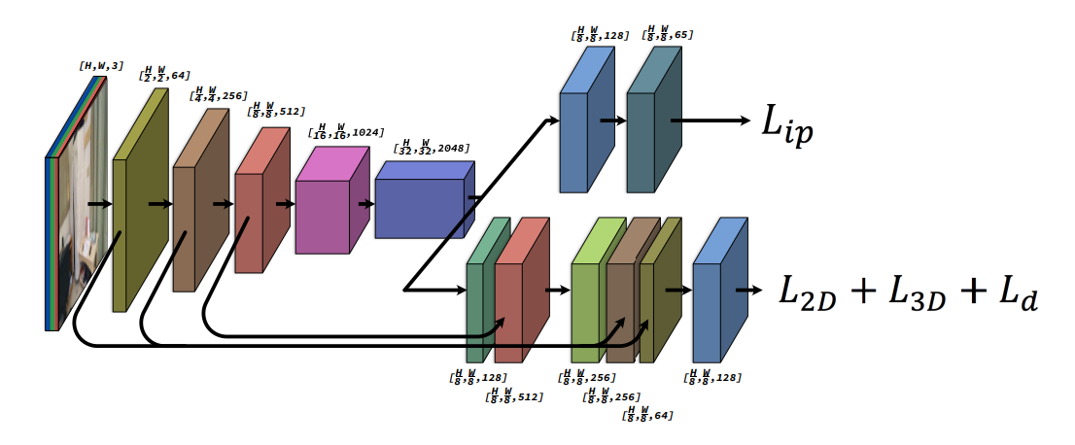
Method: Interest point detector and descriptor
Train the interest point detector network by distilling the output of the original SuperPoint network and the descriptors are trained by the matching formulation.

Slide 7
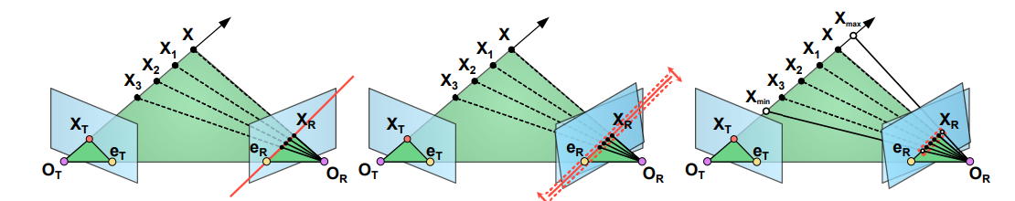
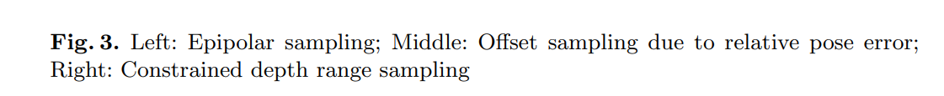
Method: Matching and Triangulation
1. Matching is from argmax operation which is differentiable
2. Triangulation: Key idea is to minimize the reprojection error

Slide 8
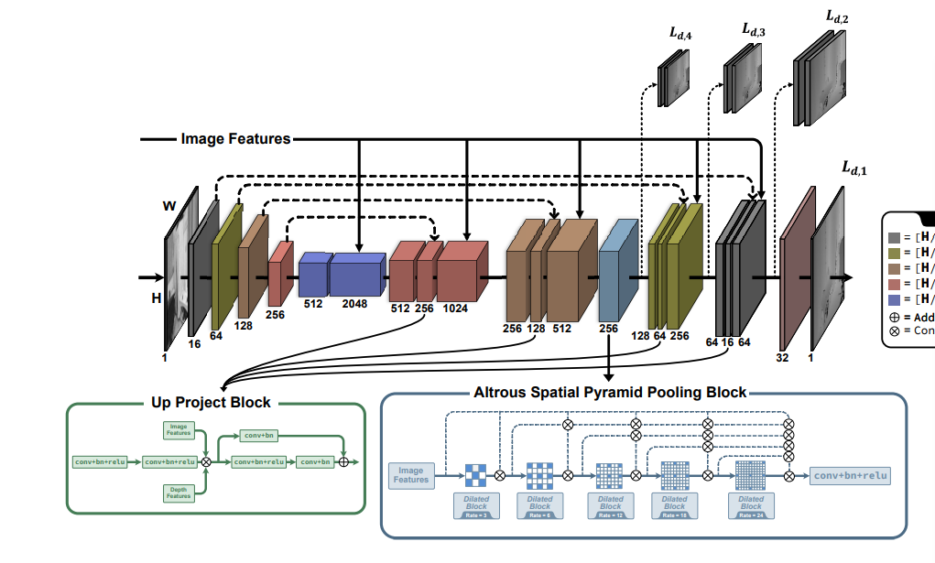
Method: Densification of sparse point

Slide 9
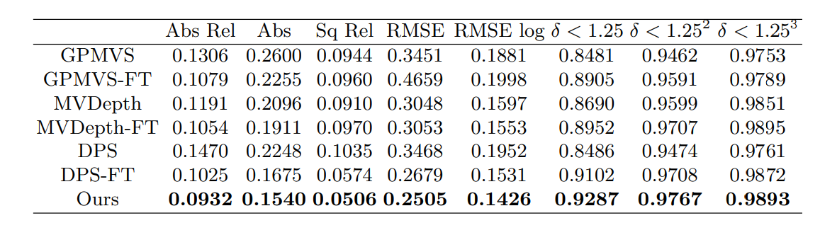
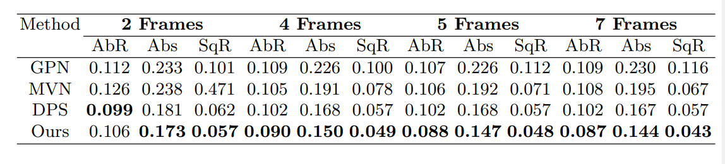
Experiments
ScanNet
ScanNet for different views

Slide 10
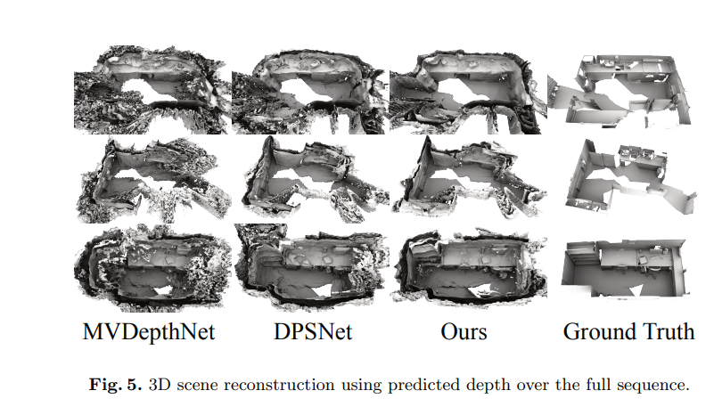
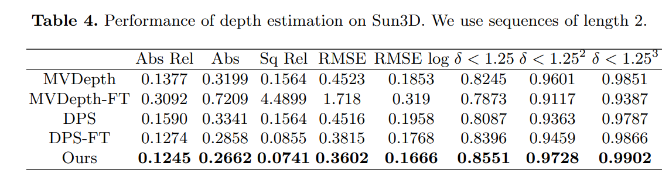
Experiments

