Slide 1
LoFTR: Detector-Free Local Feature Matching with Transformers
CVPR 2021 Zhejiang University CG&CAD

Slide 2
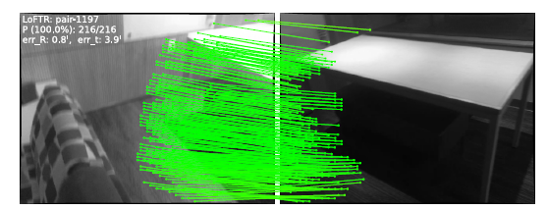
Introduction
Problem setting: Point matching between images
Input: A pair of image
Output: Sparse points correspondence between images
Application: SfM, SLAM, etc.

Slide 3
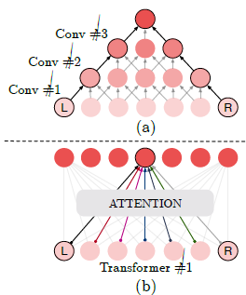
Motivation
Hand-crafted point descriptor fail to extract enough interest points due to various factors:
e.g. poor texture, repetitive patterns, illumination variation
→ pixel-wise dense matches by CNNs and selected by high confidence scores
2. CNNs suffer from limited receptive field, which may fail in large indistinctive regions
→ human can find correspondences with a larger global receptive field -> transformer

Slide 4
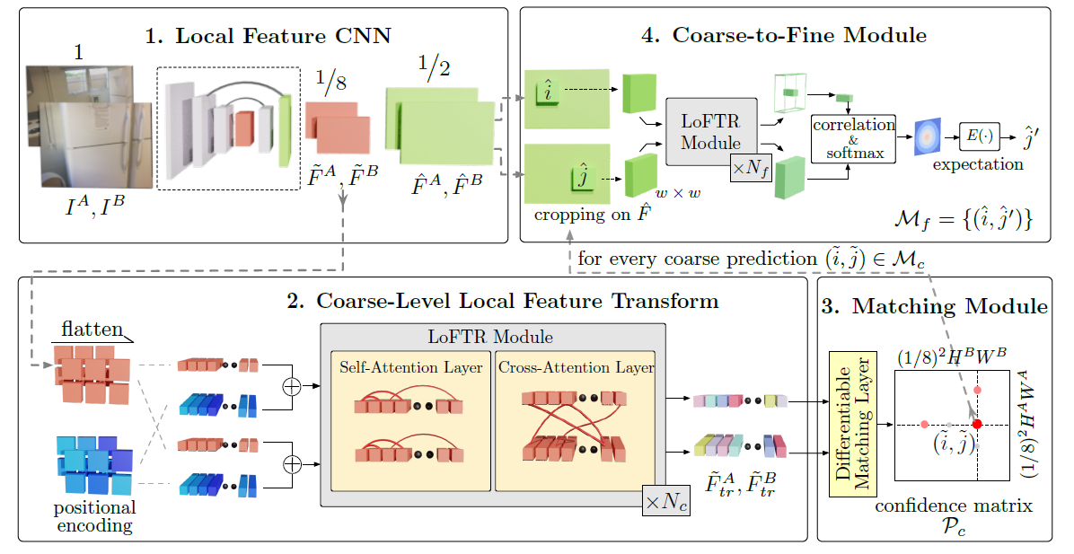
Method: Pipeline

Slide 5
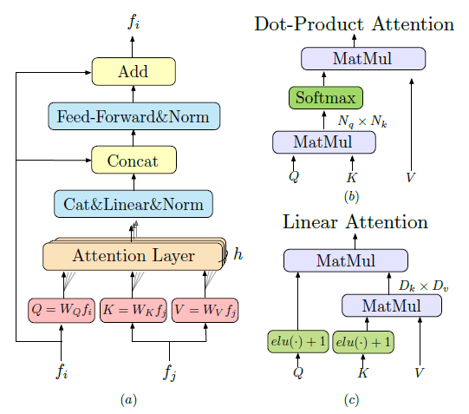
Method: Local Feature Transformer(LoFTR) Module
(a) Transformer encoder layer; (b) Vanilla dot-product attention with O(N*N) complexity;
(c) Linear attention layer with O(N) complexity;

Slide 6

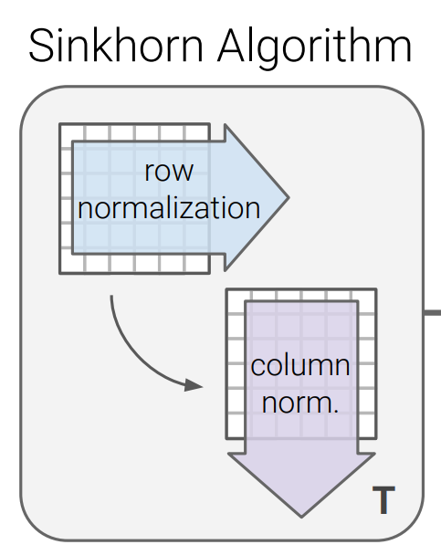

Method: Establishing Coarse-level Matches
Differentiable matching layers
Dual-softmax
Sinkhorn
Match Selection
Simply saying,
iteratively normalize the matrix row and col,
finally will converge.

Slide 7
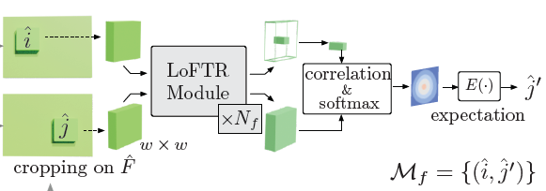
Method: Coarse-to-Fine Module
By computing expectation over the probability distribution,
we get the final position with sub-pixel accuracy.

Slide 8
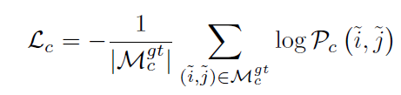
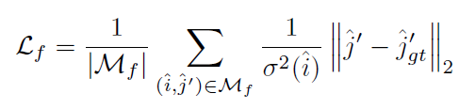
Method: Supervision
Coarse-level Supervision
Fine-level Supervision
Focusing on low uncertainty points

Slide 9
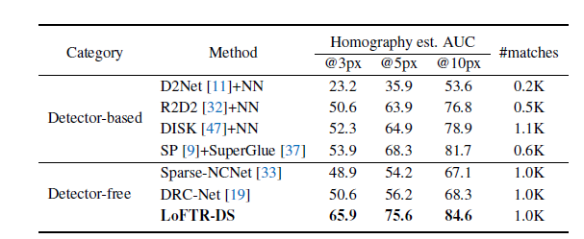
Experiments: Homography Estimation
Corner error

Slide 10
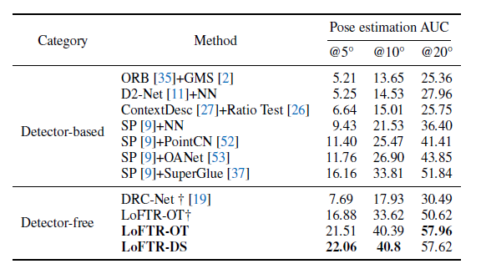
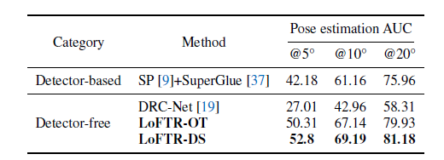
Experiments: Pose Estimation
ScanNet (Indoor)
MegaDepth (Outdoor)

Slide 11
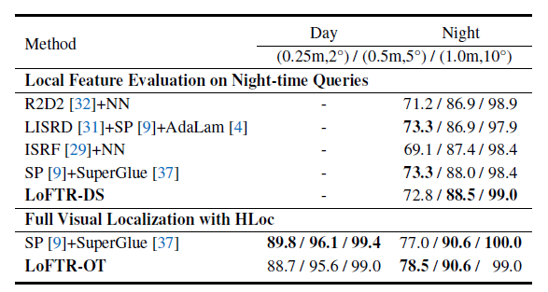
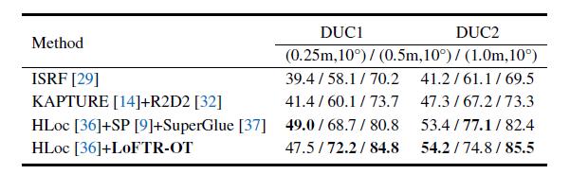
Experiments: Visual Localization
Aachen Day-Night (outdoor)
InLoc benchmark

Slide 12
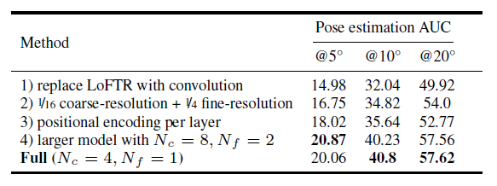
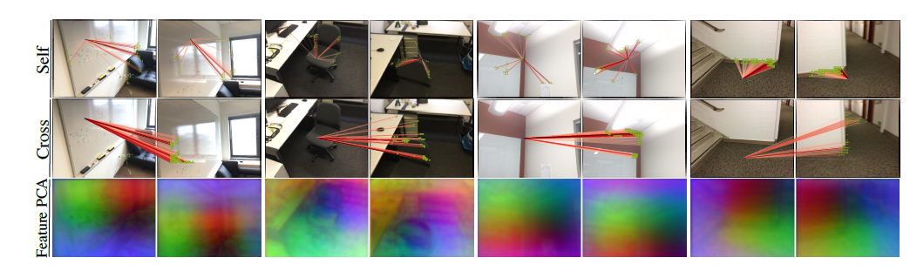
Experiments
Using DETR-style [3] Transformer architecture which has
positional encoding at each layer, leads to a noticeably declined result.

