Slide 1
Accessibility Testing
(UX Method)
User Experience (UX) Design and Management
November 12, 2025

Slide 2
Content
Methodological approach and objective
Example
Categorization of UX method
Pros & Cons
How does AI augment/change/challenge accessibility testing?
Tools or providers
Sources

Slide 3

Objective
Identify accessibility barriers
Accessibility testing “ensures that […] digital content [is] usable by everyone, including individuals with disabilities.”
It makes digital products perceivable, operable and understandable by everyone.

Slide 4

Methodological approach
Accessibility testing typically combines automated and manual tests
Automated testing
  Conducted using software tools
  Checks for compliance with WCAG
  Fast, repeatable, consistent
  Finds the most common violations
Manual Testing
  Conducted by human evaluators
  Uses assistive technology
  Real user experience
  Context-aware

Slide 5

Example
Emma (visually impaired) tries to book a flight
Automated Testing
  Selection buttons lack labels
  Color contrast fails guidelines
Expert review
  Keyboard navigation focus jumps around the page without order skipping some sections
  Dynamic price updates not announced
User observation (Emma)
  Cannot differentiate color coding in seat map
  Cannot select a seat using keyboard

Slide 6
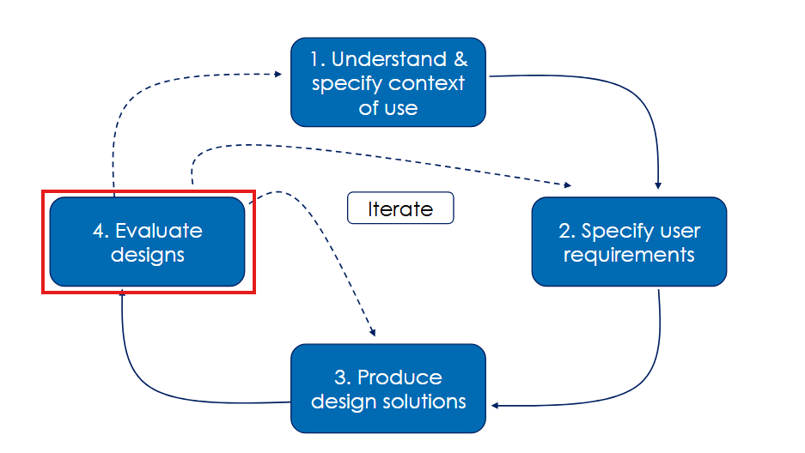
Categorization of UX method
Stage of the UCD process

Slide 7
Categorization of UX method
Dimension | Accessibility Testing Classification
Stage of the UCD process | Evaluation stage (or during iteration)
Study goal | Formative & Summative – identify & verify accessibility barriers
Measurement focus | Usability
Participants | Accessibility experts, users with disabilities
Required number of participants | Experts: 2–3 | Users: 5–10 per disability group
User behavior / attitude focus | Behavioral (observe what users do & say)
Data type | Mixed: Qualitative + Quantitative
Place of evaluation | Mostly remote (lab and field also possible)
Timeline | During & after usage
Period of experience | Snapshot during interaction
Context of use | Scripted use (or de-contextualized use)

Slide 8
Pros & Cons
Pros Cons
Ensures inclusive design
Benefits all users
Ethical responsibility
Business and market benefits
Legal compliance
Resource-intensive
Inconsistent results
Difficult to simulate and test thoroughly
Late testing results in costly fixes
May become compliance-focused, not user-focused

Slide 9

How does AI change accessibility testing?
Expands on the automated testing
Faster, scalable audits
Auto-generated suggestions
Non-Deterministic results
Human validation remains essential

Slide 10

Tools or providers
axe DevTools (by Deque Systems)
WAVE (by WebAIM)
Lighthouse (by Google)
ANDI (open-source)
Color Oracle / Stark (simulate color blindness)
NVDA & JAWS (Screen Readers)
Microsoft Accessibility Insights (for Windows applications)
…

Slide 11

Sources
Lazar, J., Feng, J. H., & Hochheiser, H. (2017). Research methods in human-computer interaction. Morgan Kaufmann, Cambridge, USA
https://www.w3.org/WAI/standards-guidelines/wcag/
https://www.nngroup.com/reports/how-to-conduct-usability-studies-accessibility/
https://arxiv.org/abs/2510.13914

Slide 12
Thank you for your attention!

