Slide 1

UX Design Challenge (Interim)
with a focus on user participation
by Silas Kraume, Léon Lehnen, Anh-Thu Dinh and Alejandro Soto

Slide 2

Table Of Contents
About Rhekiss
03
UX Design Callenge
07
UX Methods
08
Preliminary Results
11
Current Challenges
14
Conclusion
15

Slide 3



About Rhekiss
Nationwide pregnancy registry for rheumatism patients
Focus on family planning, pregnancy and postpartum outcomes
Patients are included by their treating rheumatologist
Both physicians and patients enter data via the web-application (surveys)
Investigates, inter alia, the safety of medications
Icons from www.flaticon.com

Slide 4
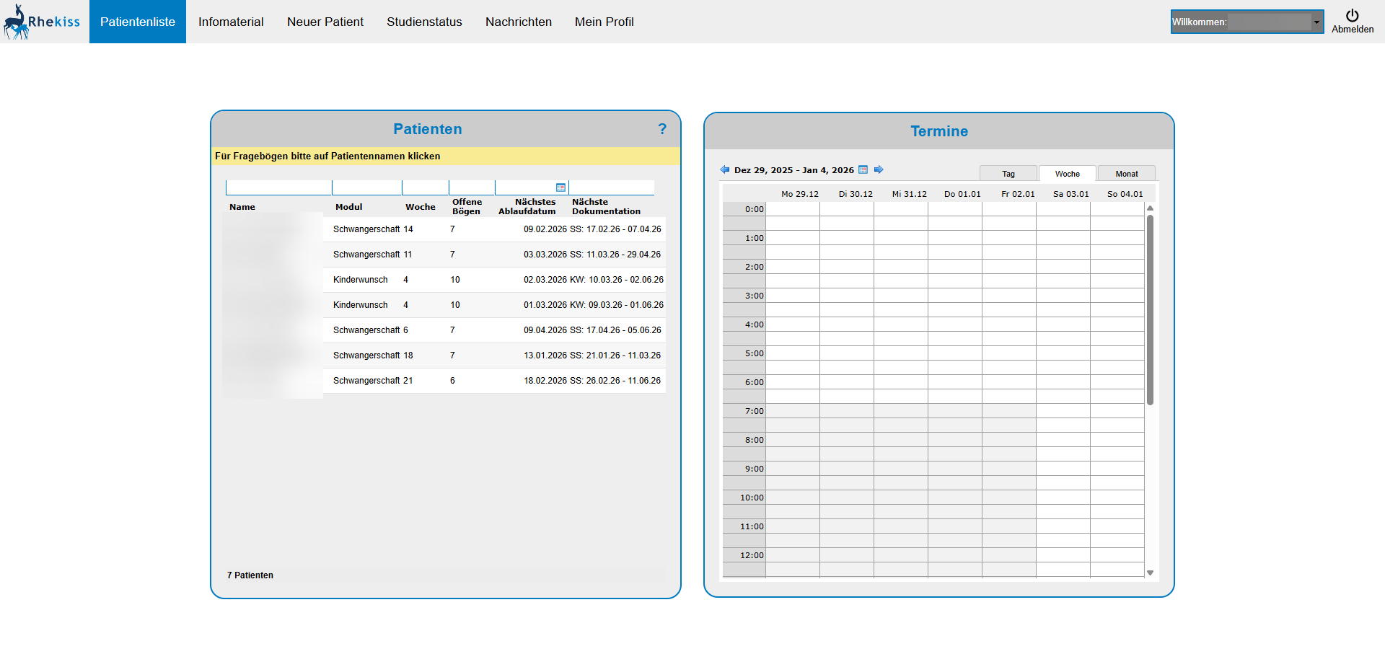
Current UI

Slide 5
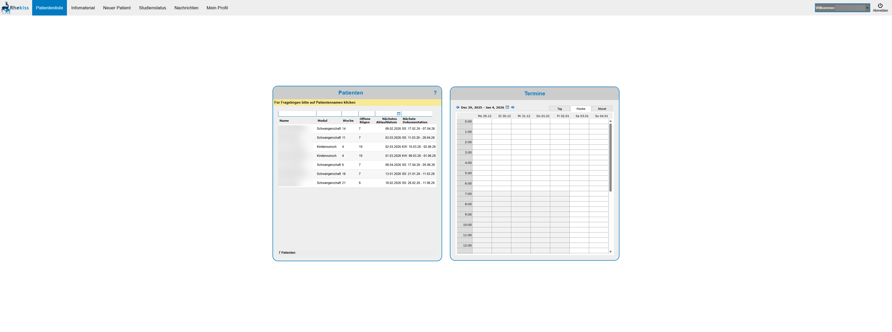
Current UI (Wide Screens)

Slide 6
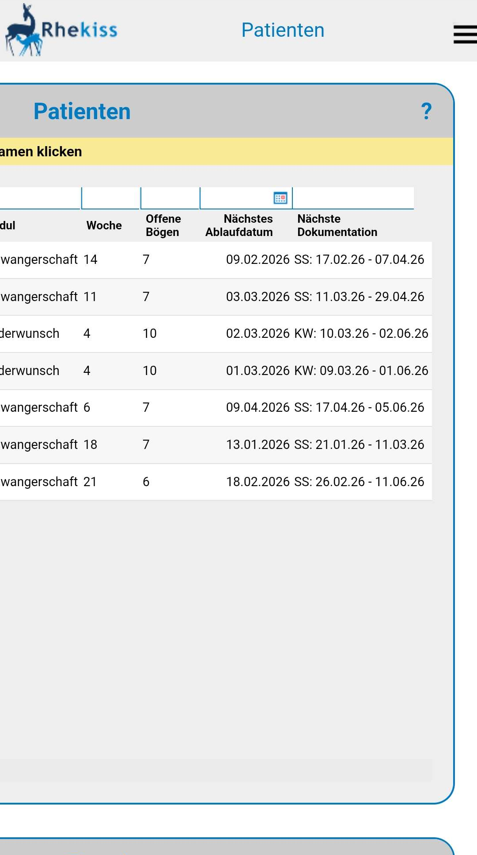
Current UI (Mobile)
Limited mobile device friendlyness despite ever increasing use of mobile devices

Slide 7
UX Design Challenge
User experience and performance improvements for Physicians and Patients
Work should not be hindered by bad UX
  Identify pain points and suggest improvements
Physicians workflow enhancements
  efficient, fast and simple design
Patient participation is especially important
  UI needs to be clear, self-explanatory, low barrier
→ Identify culprits and make the website more convenient and usable for patients and physicians!

Slide 8




UX Methods (Constraints)
Relatively small amount of users
  No large scale behaviour analysis
Budget and developer constraints
  No A/B testing
Time limitations
  No long term evaluations
Lack of web metrics due to anonymity
  No metric analysis
Icons from www.flaticon.com

Slide 9



UX Methods
Clickstream analysis
  Analyze which parts of the website are difficult to use or are overly complex
User interviews with patients and physicians
  Gather direct experiences
Accessibility testing
  Find out potential culprits for users with impairments
Icons from www.flaticon.com

Slide 10
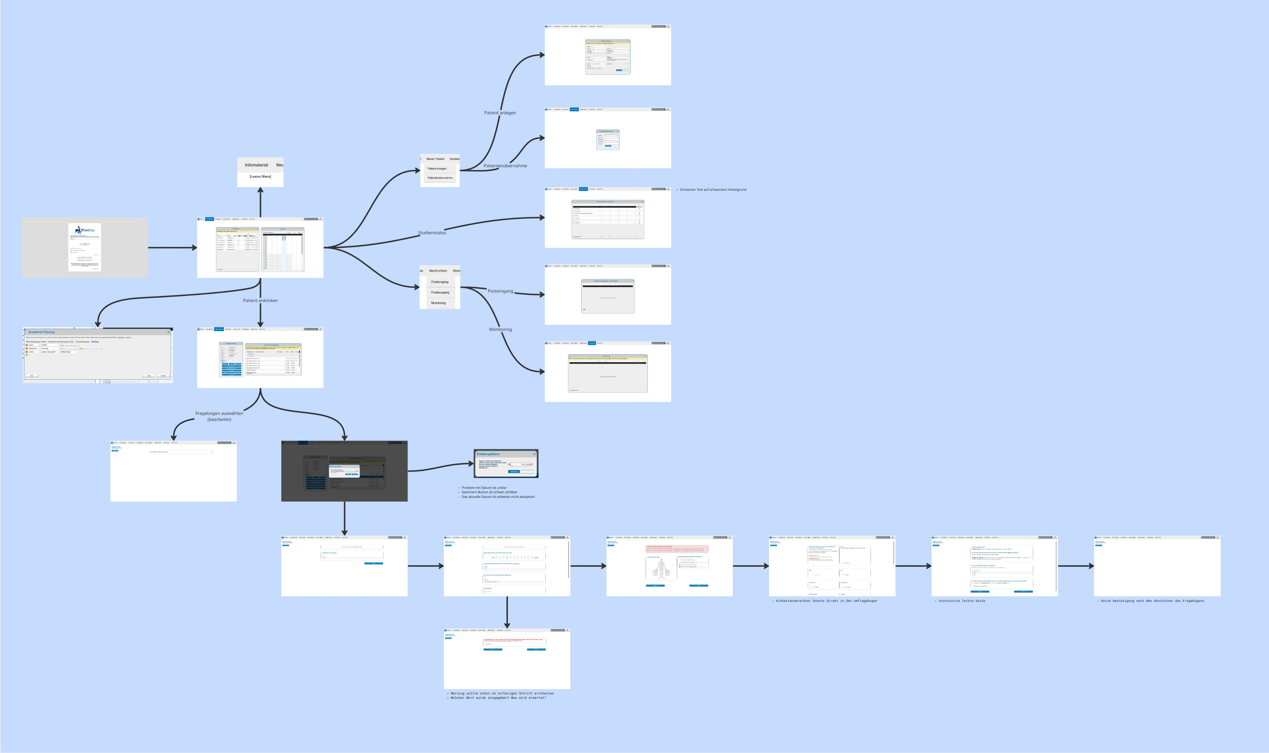
Clickstream Analysis

Slide 11
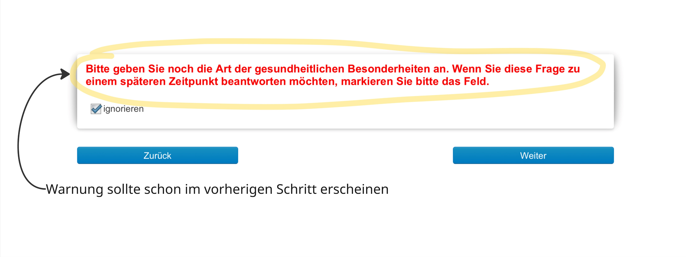
Preliminary Results

Slide 12
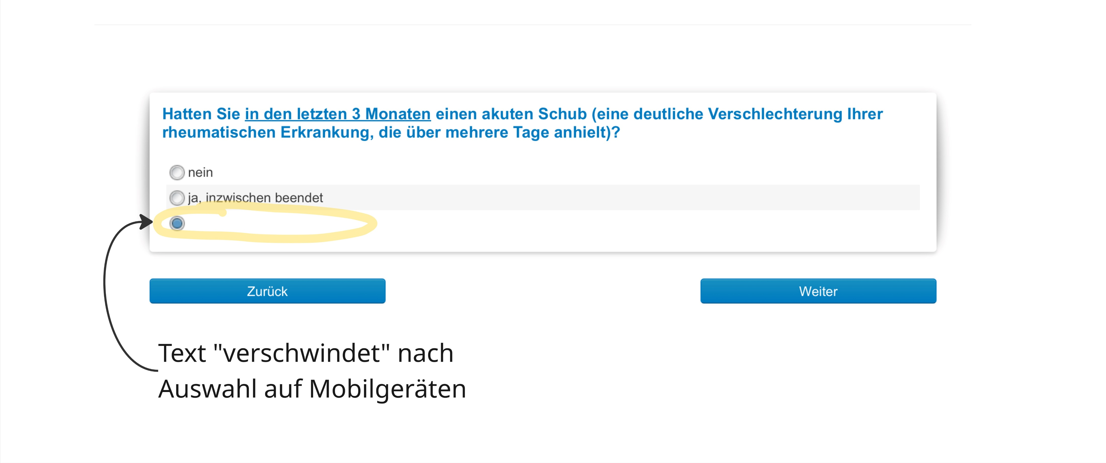
Preliminary Results

Slide 13
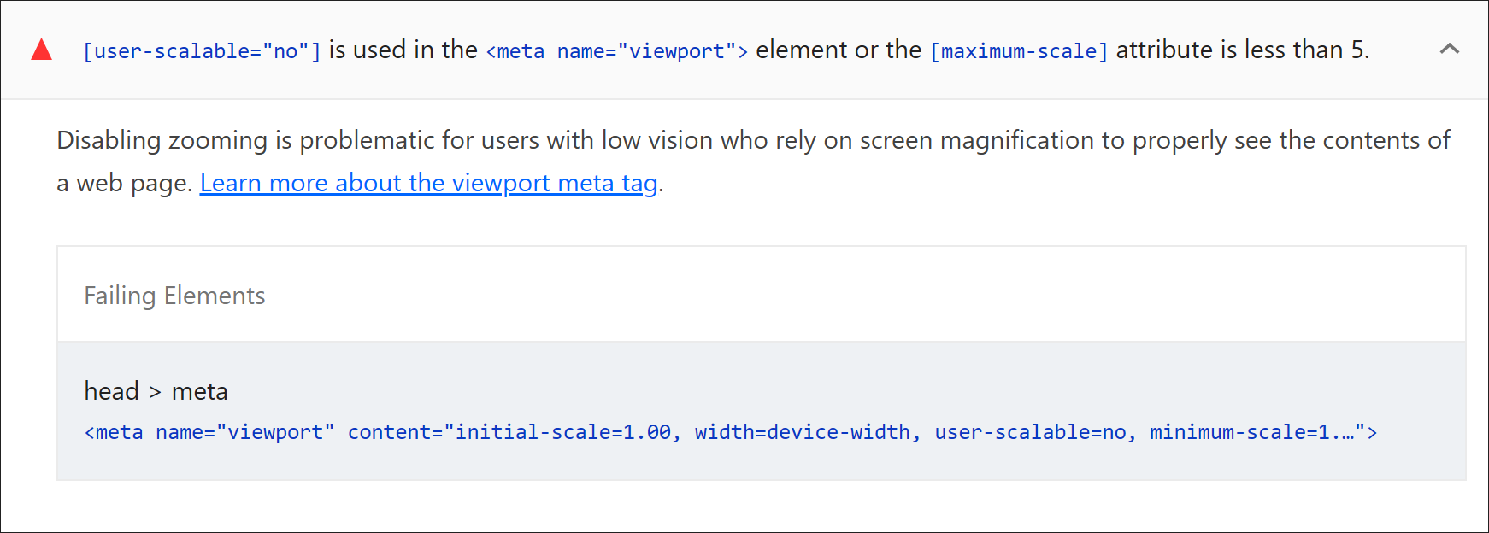
Preliminary Results

Slide 14



Current Challenges
Scheduling interview appointments with patients proves difficult
Technical problems make certain analyses more complex than anticipated (e.g. user gets logged out after site refresh)
  Accessibility testing relies on page-reloading
Solutions/Improvements need to be security conforment and viable given the limited budget
  Implementation needs to be considered

Slide 15
Conclusion
Goal has been determined
UX methods chosen to achieve this goal
Future work
  Perform user interviews for further analysis
  Investigate alternative tech solutions
  Create improved design prototypes

