Slide 1

UX Design Challenge (Final)
with a focus on user participation
by Silas Kraume, Léon Lehnen, Anh-Thu Dinh and Alejandro Soto

Slide 2

Table Of Contents
Challenge & Goal
03
Applied UX Research Methods
04
Data Analysis Overview
05
Patient Perspective
06
Physician Perspective
14
Security
21
Technological Implications
22
Conclusion
23

Slide 3


Challenge & Goal
Current State
  Functional but visually outdated & user-unfriendly
  Lacks critical feedback & guidance
  Risk of unintentional errors and imcomplete tasks
  Affects both patients and physicians
Desired State
  Improve clarity, usability & reliability
  Low-burden experience
  Ensure high-quality data collection
  Adhere to non-profit budget constraints

Slide 4
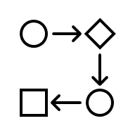



Applied UX Research Methods
Workflow Review
  Accessed both patients and physicians platform
  Reviewed all relevant processes
Interviews & Testing
  Conducted interviews with patients and physicians
  Usability Testing
Technical Audit
  Collected technical and quality data (Google Lighthouse)
  Accessibility testing
  Device compatibility
Data Collection
  Gained click and usage data

Slide 5



Data Analysis Overview
Quantitative
  Conducted clickstream analysis to map navigation paths
  Identified redundant steps in workflow
Qualitative
  Analyzed feedback from 5 patients and 2 physicians
  Identified emotional frustrations and confusions
Developer Input
  Validated findings and possibilities with software firm
  Analyzed technical metadata
Notes:
3:20

Slide 6
Patient Perspective

Slide 7
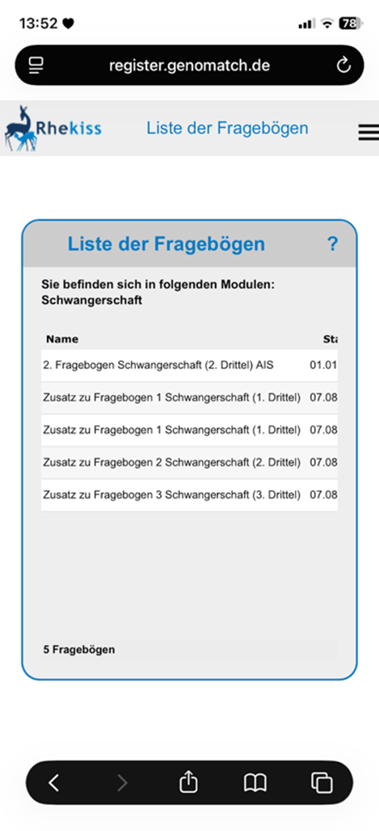
Patient Perspective
Mobile Failure
  Interface does not adapt to mobile screens
  Questionaires and buttons are cut off

Slide 8
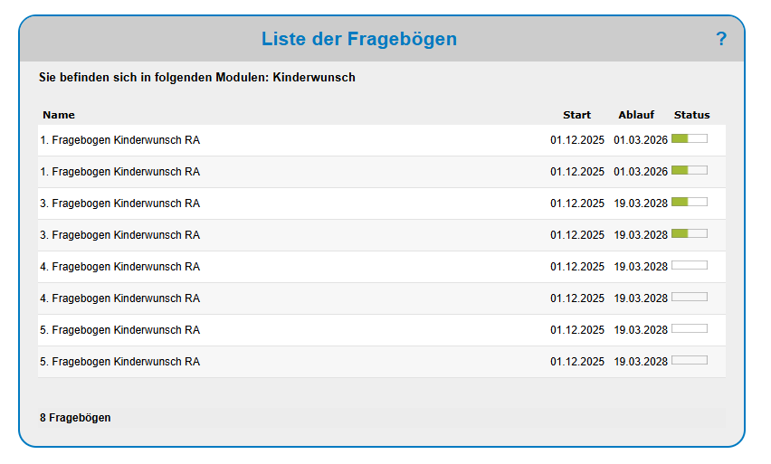
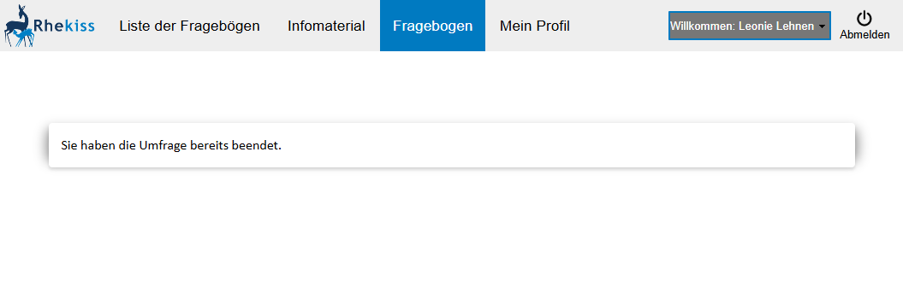
Patient Perspective
Mobile Failure
  Interface does not adapt to mobile screens
  Questionaires and buttons are cut off
Status Confusion
  Completed questionaires aren‘t clearly marked
  Users reoped them unnecessarily

Slide 9
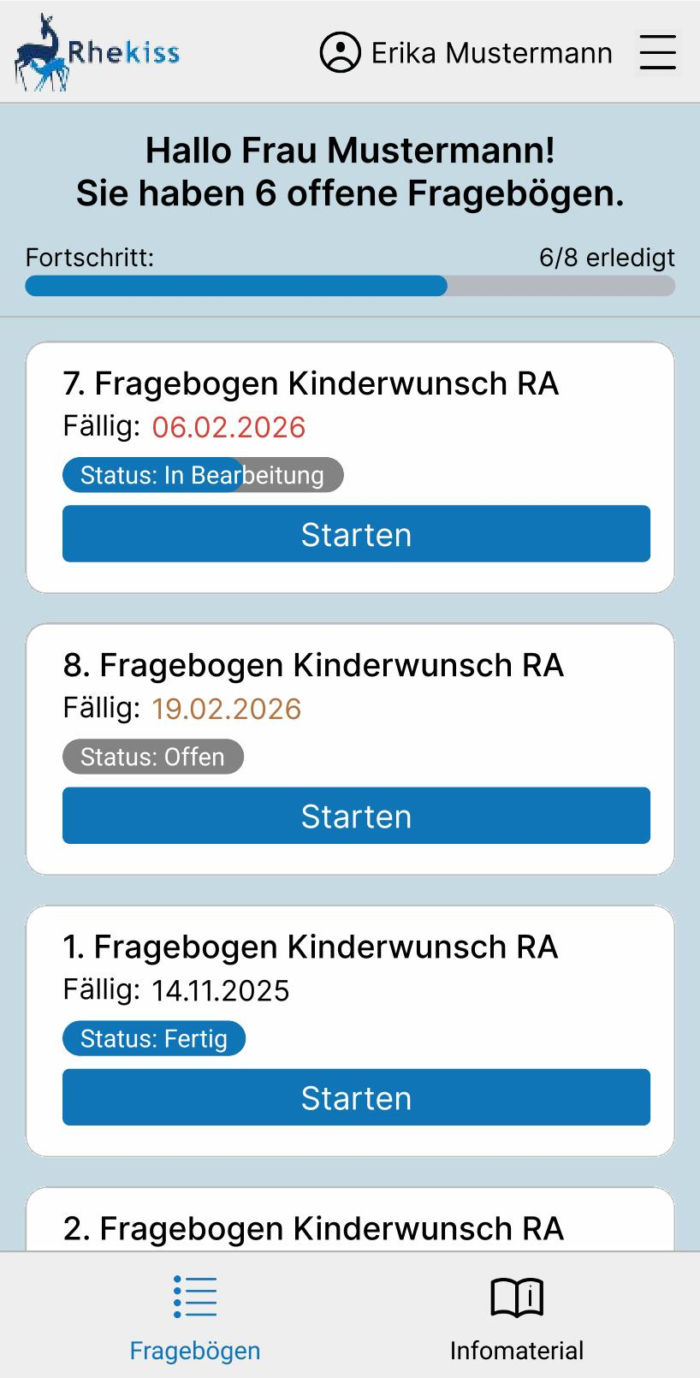
Patient Perspective
Mobile Failure
  Interface does not adapt to mobile screens
  Questionaires and buttons are cut off
Status Confusion
  Completed questionaires aren‘t clearly marked
  Users reoped them unnecessarily
Solution
  Mobile-optimized layout with large touch targets
  Clear status indication using badges and progress bars
  Noticeable colors for due date
Notes:
5:50

Slide 10
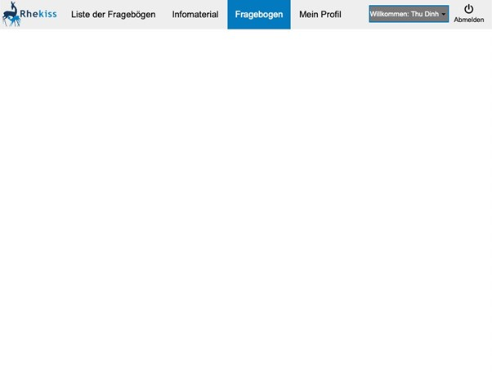
Patient Perspective
Lack of Feedback
  Patients are unsure if they completed a task
  Submission of questionaire leads to blank page
Notes:
6:45

Slide 11
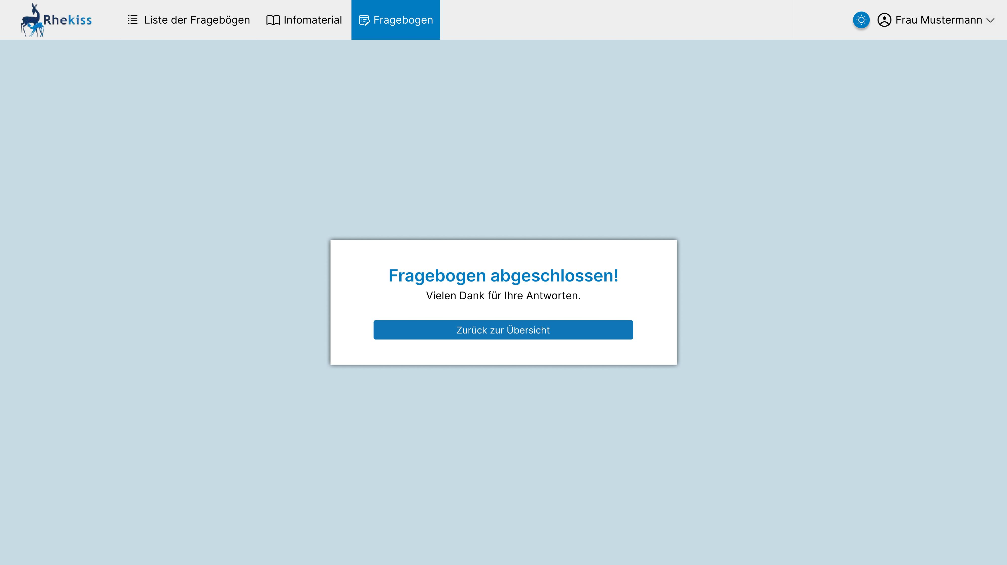
Patient Perspective
Lack of Feedback
  Patients are unsure if they completed a task
  Submission of questionaire leads to blank page
Solution
  Confirmation at the end of the
  questionaire
  Button to navigate back to the
  overview

Slide 12
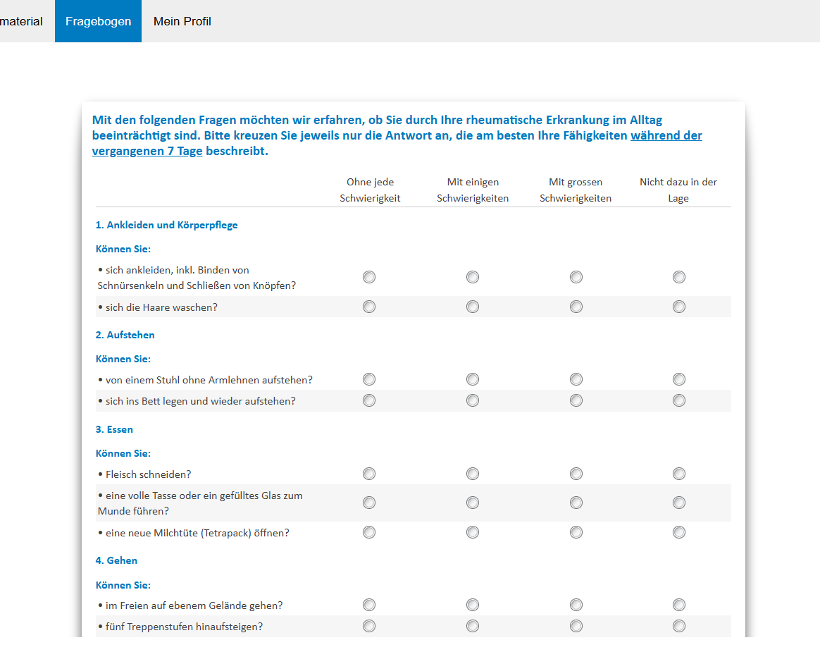
Patient Perspective
Tedious Questionaire
  Medication names needs to be typed manually
  No indication of progress inside questionaires
  Navigation to specific sections cumbersome
Notes:
7:30

Slide 13
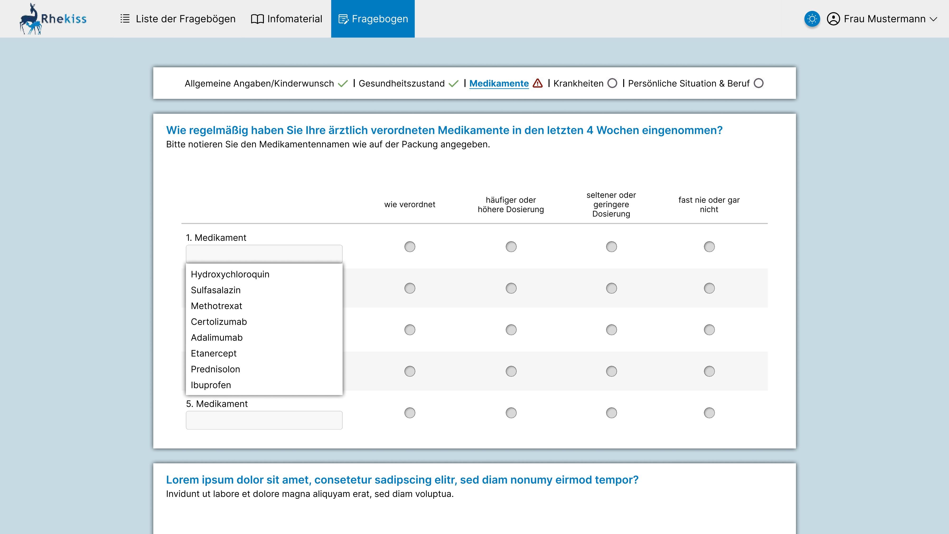
Patient Perspective
Tedious Questionaire
  Medication names needs to be typed manually
  No indication of progress inside questionaires
  Navigation to specific sections cumbersome
Solution
  Autocompletion for common medication names
  Clickable navigation bar with completion status

Slide 14
Physician Perspective
Icons from www.flaticon.com

Slide 15
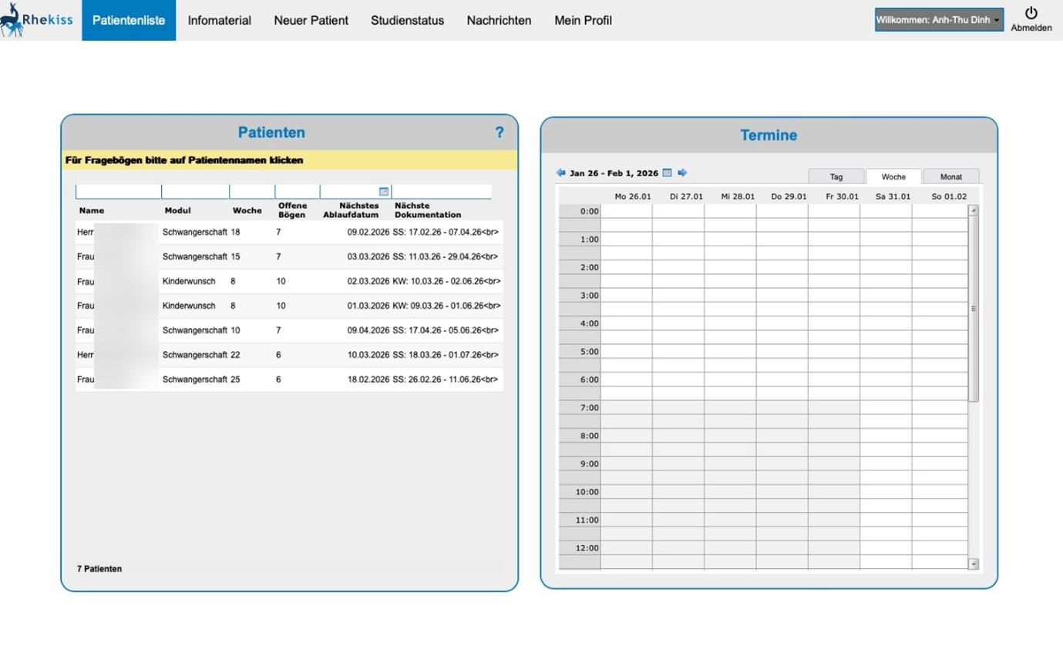
Physician Perspective
Complex Navigation
  Features are hidden in seperate categories
  „New Patient“ button at unexpected location

Slide 16
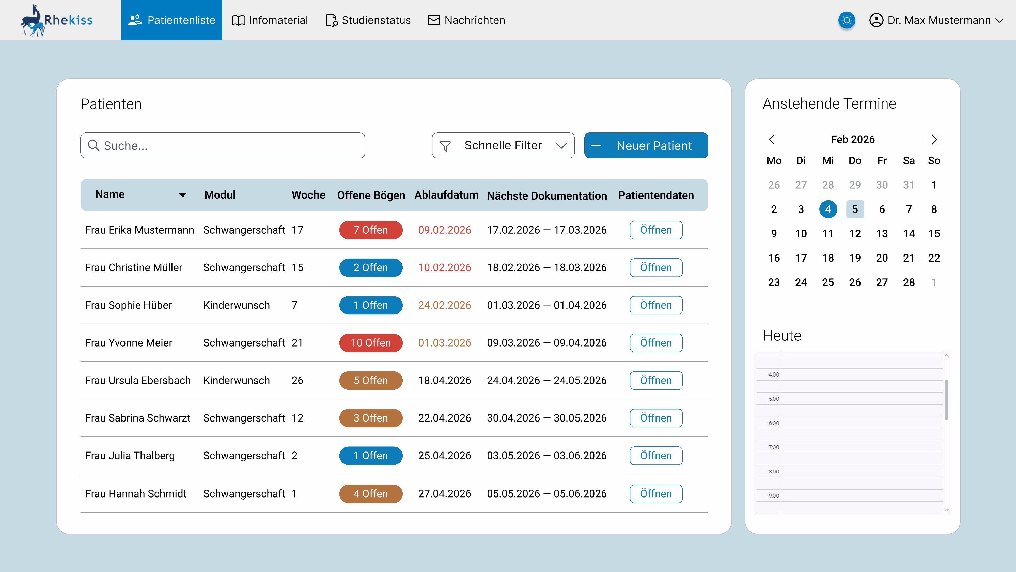
Physician Perspective
Complex Navigation
  Features are hidden in seperate categories
  „New Patient“ button at unexpected location
Solution
  Moved „New Patient“ button from navigation bar to patient list

Slide 17
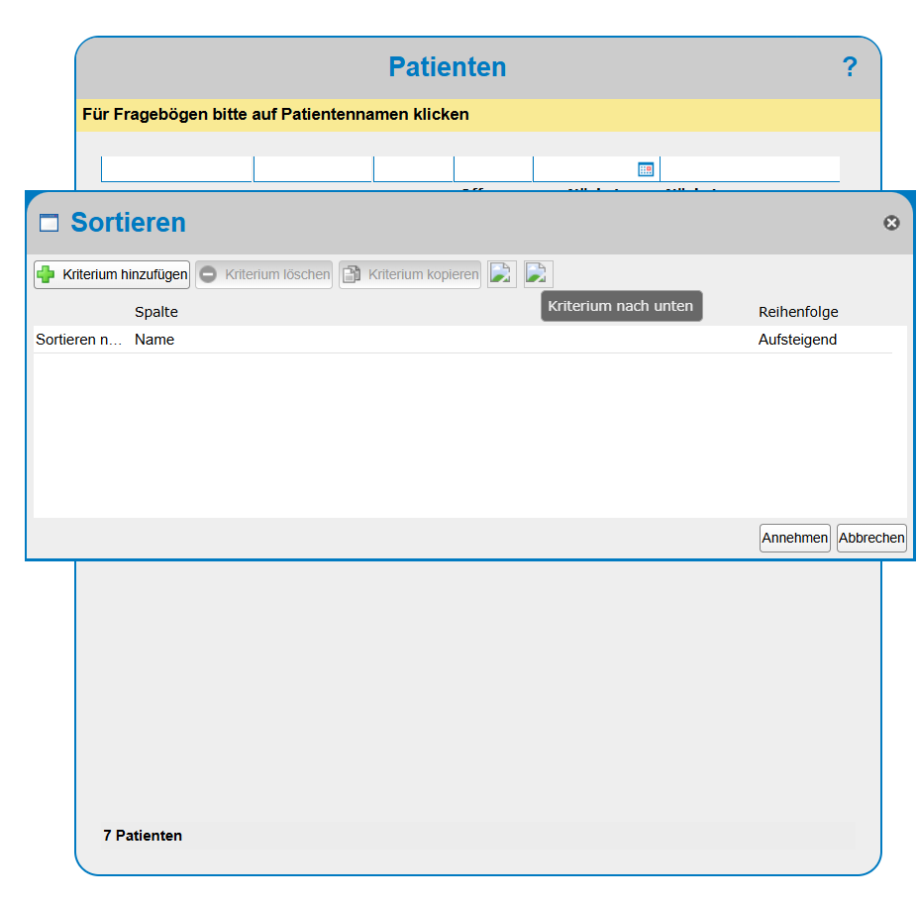
Physician Perspective
Hidden & Complicated Tools
  Advanced filtering options are buried in submenus
  Filtering usage is very technical

Slide 18
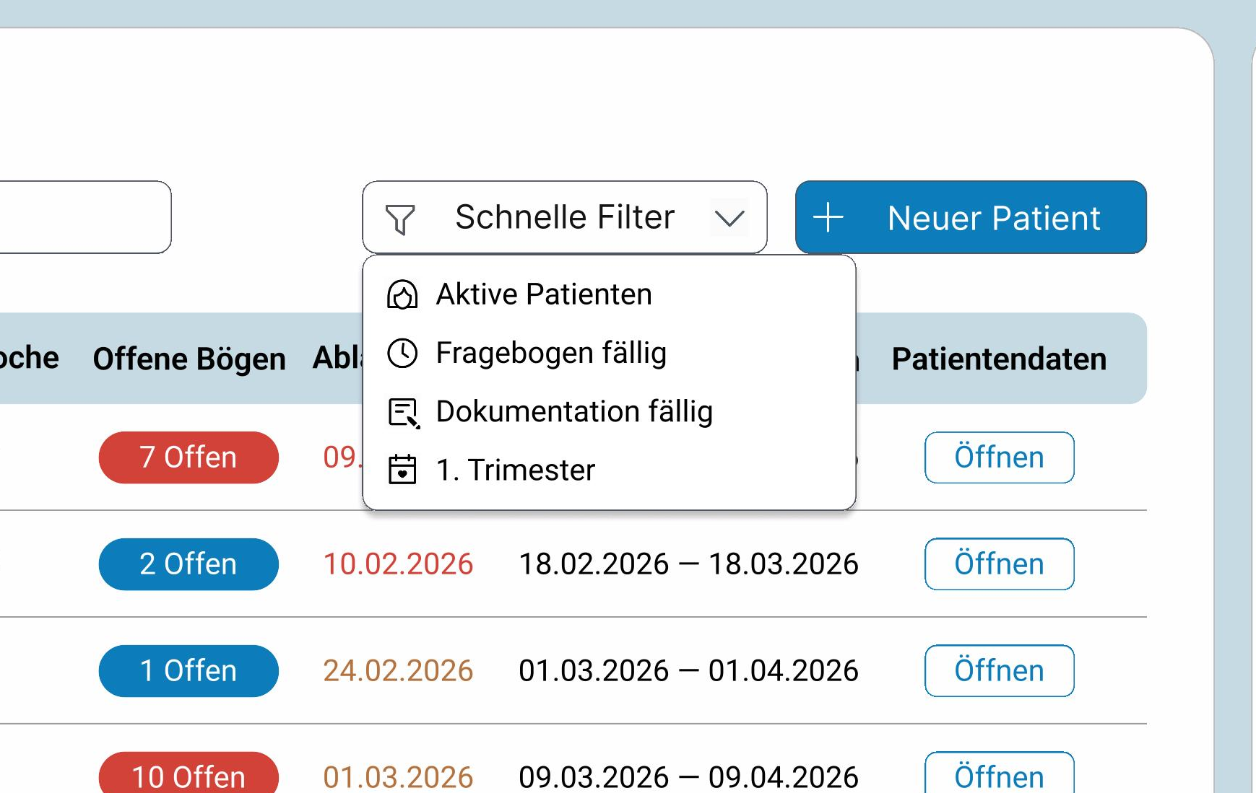
Physician Perspective
Hidden & Complicated Tools
  Advanced filtering options are buried in submenus
  Filtering usage is very technical
Solution
  Quick filters allow for fast sorting of most important categories
  Advanced filters are still available by rightclicking the patient table

Slide 19
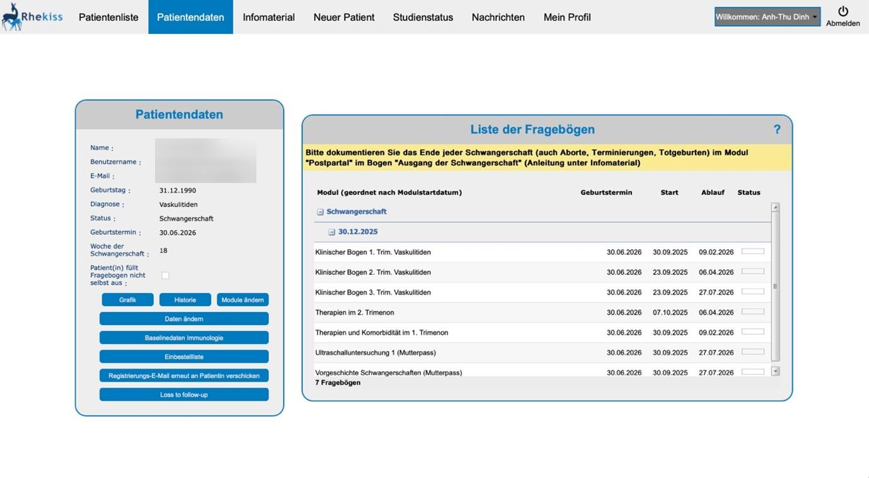
Physician Perspective
Information Clutter
  No logical grouping of UI elements
  Overwhelming options of interactable features
  No visual clarity
Notes:
10:50

Slide 20
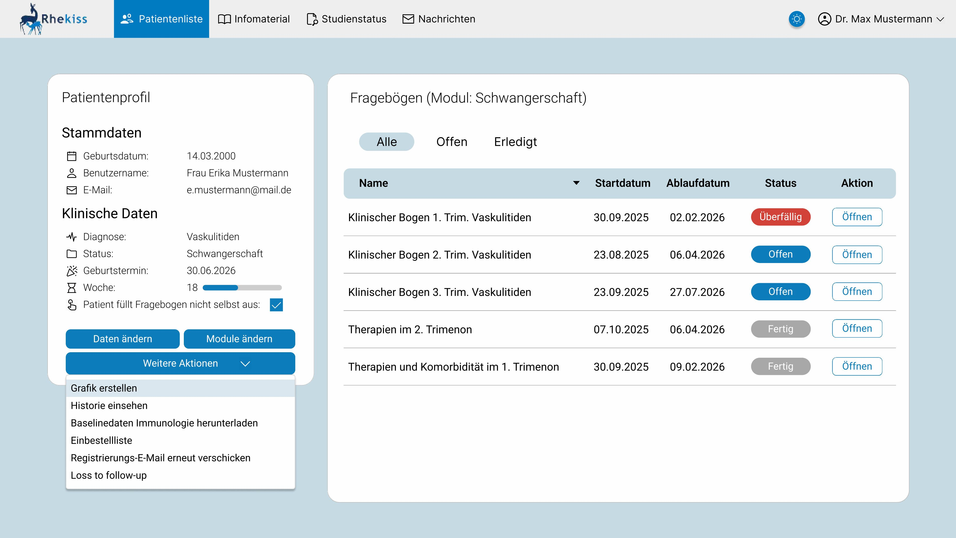
Physician Perspective
Information Clutter
  No logical grouping of UI elements
  Overwhelming options of interactable features
  No visual clarity
Solution
  Less important actions grouped to reduce visual clutter
  Improved color contrast

Slide 21

Security
A critical security vulnerability was found during analysis
Resolved quickly in cooperation with the software developers

Slide 22
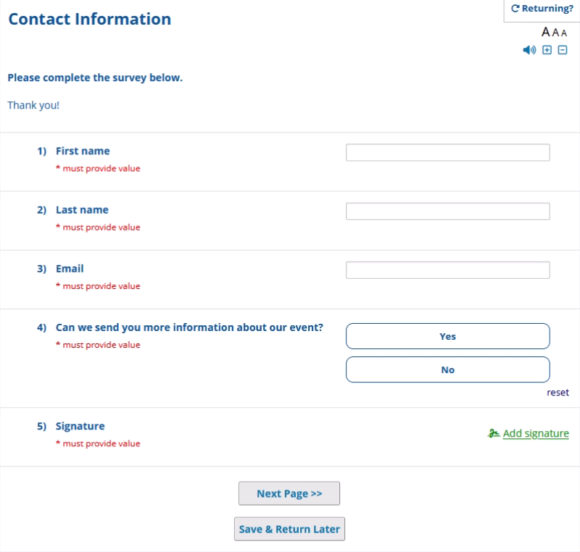
Technological Implications
Future switch to Tivian and REDCap
  Free for non-profit use
  Focused on medical applications
  Improved accessiblity features built-in
  (text-to-speech, font size)
Notes:
12:30

Slide 23
Conclusion
Main weakness: lack of predictability and feedback
Path from „functional but outdated“ to user-friendly and reliable
Prioritize mobile compatibility to enable a modern workflow
Cost-effective changes with high return in user satisfaction
Notes:
13:50

