Slide 1
SAPUI5
Silence
2018.1

Slide 2
Outline
Overall Introduction
Get Started

Slide 3
Overall Introduction

Slide 4
What is SAPUI5
SAPUI5 is SAP’s latest, HTML5-based UI technology that allows you to build rich, interactive Web applications.
SAPUI5 is a client UI technology based on JavaScript, CSS and HTML5.

Slide 5
SAPUI5 VS OpenUI5
SAPUI5 | OPENUI5
Integrated license | Apache 2.0 license
All controls | Limited Controls
No Public Contribution | available on GitHub
Notes:
https://sapui5.netweaver.ondemand.com/#/topic/5982a9734748474aa8d4af9c3d8f31c0
1、The main difference is the license.
OpenUI5 is Open Source, free to use, released under the Apache 2.0 license. Since we also use many Open Source libraries, SAPUI5 is not a separate SAP product with a separate license. It‘s integrated, for example, SAP HANA，SAP Cloud Platform
2、OpenUI5和SAPUI5相比主要是少了一些控件。
Most importantly, the core containing all central functionality and the most commonly used control libraries is identical in both deliveries. (For example, sap.m, sap.ui.layout, sap.ui.unified.)

Slide 6
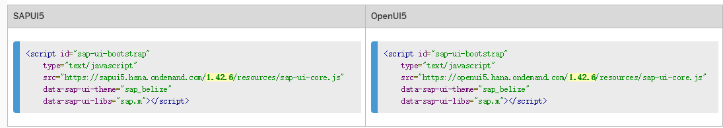
Compatibility of OpenUI5 and SAPUI5
Technically, you can switch between OpenUI5 and SAPUI5 (providing you have the respective license).
Notes:
The default version of our libraries has the generic URL https://sapui5.hana.ondemand.com/resources/sap-ui-core.js (SAPUI5) and https://openui5.hana.ondemand.com/resources/sap-ui-core.js (OpenUI5).

Slide 7
As an app developer, never do the following:
Never manipulate HTML/CSS via JavaScript (domRef.className = "someCSSClass";) or directly via CSS, for example. Always follow our recommendations under CSS Styling Issues.
Never use or override "private" functions that are not part of the API Reference. Private functions are typically (but not always) prefixed with a preceding "_".

Slide 8
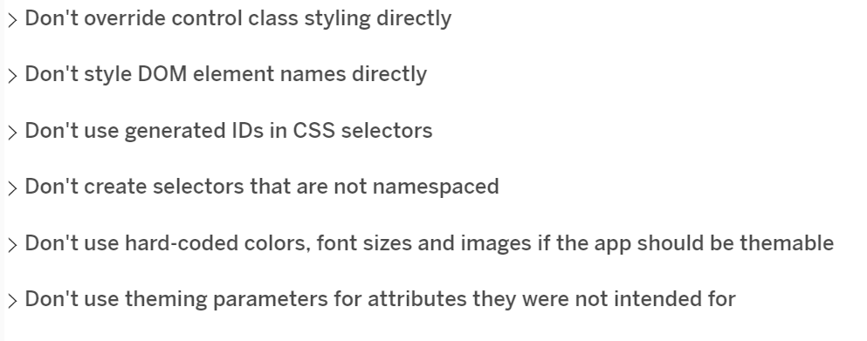
CSS Styling Issues
Notes:
https://sapui5.netweaver.ondemand.com/#/topic/9d87f925dfbb4e99b9e2963693aa00ef.html
This section lists some of the most important rules relating to CSS styling in SAPUI5 .

Slide 9
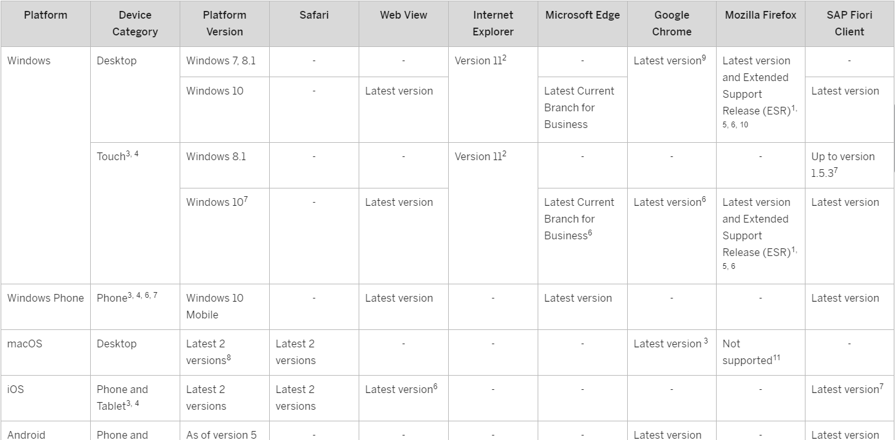
Browser and Platform Support
Browser and Platform Support
As SAPUI5 is based on CSS3, HTML5, and the ECMAScript 5 (ES5) JavaScript API, only browsers with HTML5 capabilities are supported.
Apps developed with SAPUI5 run in a browser on any device (mobile, tablet or desktop PC).

Slide 10
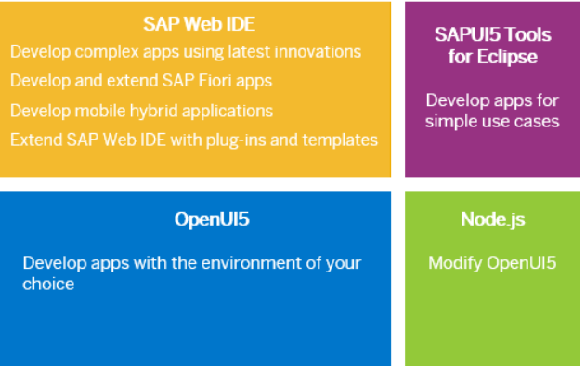
Development Environment

Slide 11
App Development Using OpenUI5
Download OpenUI5
<script src="resources/sap-ui-core.js" id="sap-ui-bootstrap"
data-sap-ui-libs="sap.m,sap.ui.layout,sap.ui.commons" data-sap-ui-theme="base">
</script>
Using OpenUI5 Sources from a Content Delivery Network
<script id="sap-ui-bootstrap"
type="text/javascript"
src="https://sapui5.hana.ondemand.com/resources/sap-ui-core.js"
data-sap-ui-theme="sap_belize"
data-sap-ui-libs="sap.m"></script>
Consume OpenUI5 Using Bower
Notes:
Develop apps using OpenUI5 and the development environment (editor and Web server) of your choice. You can either download all of the sources or refer to the online version of OpenUI5 .
1、 referring to the resources/sap-ui-core.js file that was contained in the ZIP file.
2、The default version of our libraries has the generic URL https://sapui5.hana.ondemand.com/resources/sap-ui-core.js (SAPUI5) and https://openui5.hana.ondemand.com/resources/sap-ui-core.js (OpenUI5).
The src attribute of the first <script> tag tells the browser where to find the SAPUI5 core library – it initializes the SAPUI5 runtime and loads additional resources, such as the libraries specified in the data-sap-ui-libs attribute.
The SAPUI5 controls support different themes, we choose sap_belize as our default theme.
We specify the required UI library sap.m containing the UI controls we need for this tutorial.

Slide 12
Get Started

Slide 13
Control
Property Aggregation Event
new sap.m.InputListItem({
title: "{Name}",
label: "{Name}",
selected: "{done}",
type: sap.m.ListType.Active,
content: new sap.m.Button({
text: 'Delete'
},
press:function() {
oController.clearTodo(this.getBindingContext());
}
)

Slide 14
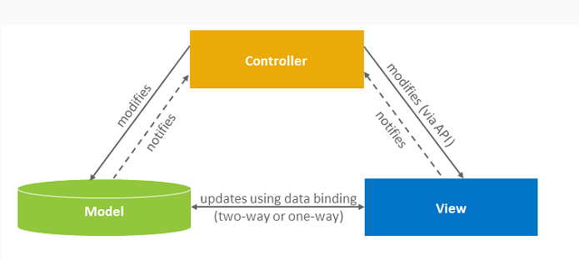
Model View Controller (MVC)
Notes:
The view is responsible for defining and rendering the UI.
The model manages the application data.
The controller reacts to view events and user interaction by modifying the view and model.
The purpose of data binding in the UI is to separate the definition of the user interface (view), the data visualized by the application (model), and the code for the business logic for processing the data (controller).
It allows you to change the view without touching the underlying business logic and to define several views of the same data.
MVC的一般流程是这样的：View（界面）触发事件–》Controller（业务）处理了业务，然后触发了数据更新–》不知道谁更新了Model的数据–》Model（带着数据）回到了View–》View更新数据

Slide 15
Model
A model in the Model View Controller concept holds the data and provides methods to retrieve the data from the database and to set and update data.
The JSON model, XML model, and the resource model are client-side models, meaning that the model data is loaded completely and is available on the client.
The OData model is a server-side model and only loads the data requested by the user interface from the server.
Notes:
retrieve (检索）

Slide 16
JSON MODEL
var oModel = new sap.ui.model.json.JSONModel();
oModel.setData({
time: new Date().toISOString()，
});
var text = new sap.m.Text({
text: '{/time}'
});
text.setModel(m)

Slide 17
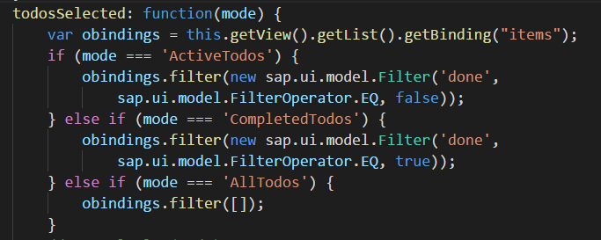
JSON MODEL
var oFilter = new sap.ui.model.Filter("property", function(value) {
return (value > 100);
});

Slide 18
Views
The view in the Model View Controller concept is responsible for defining and rendering the UI. SAPUI5 supports predefined view types.
The following predefined view types are available:
XML view (file or string in XML format); the XMLView type supports a mix of XML and plain HTML.
JSON view (file or string in JSON format)
JS view, constructed in a traditional manner
HTML view (file or string in HTML format)

Slide 19
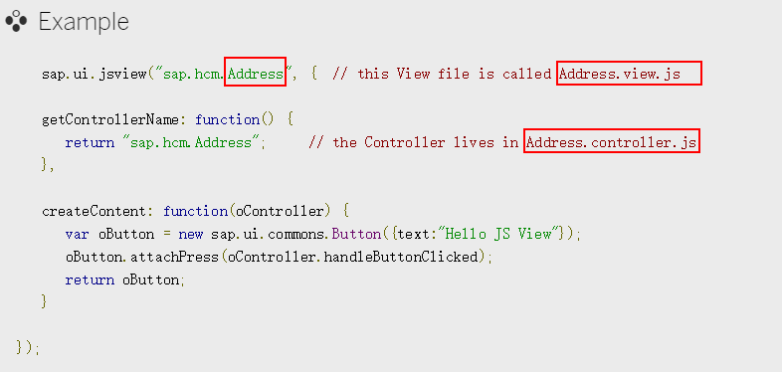
JS View
In event handlers for controls "this" usually denotes the control itself.

Slide 20

JS View Cautions
In event handlers for controls "this" usually denotes the control itself.
You can not give hardcoded IDs to JS View.
You can use the View.createId(...) method to give the view the opportunity to add its own instance ID as a prefix.

Slide 21
Controller
A controller contains methods that define how model and view interact.
sap.ui.controller("todo.Todo", {
onInit: function(){},
// controller logic goes here
});

Slide 22
Controller’s Lifecycle hooks
onInit() | This method is called upon initialization of the View. It is only called once per View instance.
onBeforeRendering() | This method is called every time the View is rendered, before the Renderer is called and the HTML is placed in the DOM-Tree.
onAfterRendering() | This method is called every time the View is rendered, after the HTML is placed in the DOM-Tree.
onExit() | Called when the view is destroyed; used to free resources and finalize activities

