Slide 1


Slide 2
Introduction
This project focuses on genome sequencing which is a crucial method in bioinformatics in which short DNA sequences are obtained from sequencing technologies then combined to construct a complete genome.
We use a powerful algorithm known as DeBruijn Graph to implement this sequencing more efficiently and accurately.

Slide 3
Objectives
Efficient Genome Assembly – Implement De Bruijn Graphs for reconstructing genome sequences.
Error Handling & Repeat Resolution – Apply computational techniques to correct sequencing errors and resolve genome repeats.
Performance Optimization – Utilize algorithmic improvements to enhance efficiency.
Comparative Analysis – Evaluate assembly quality across different datasets and k-mer sizes.

Slide 4
Challenges
Handling Sequencing Errors
Choosing the Right k-mer Size
Constructing the graph
Simplifying & Finding Paths
Addressing long reads
Graph Visualization

Slide 5
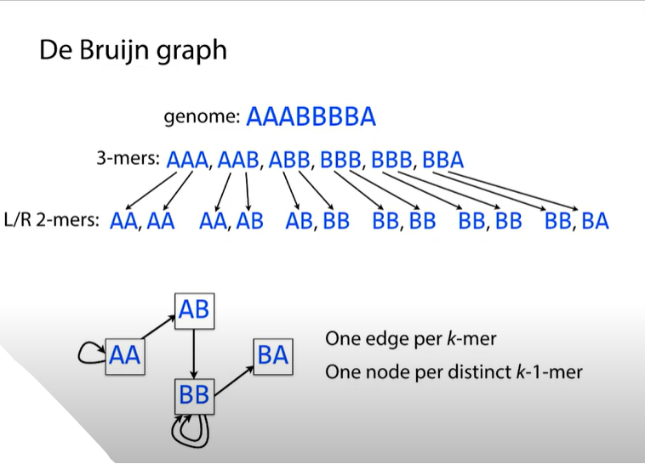
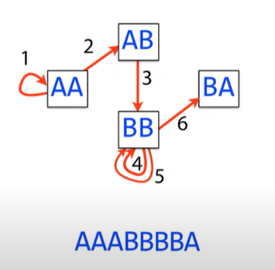

Slide 6
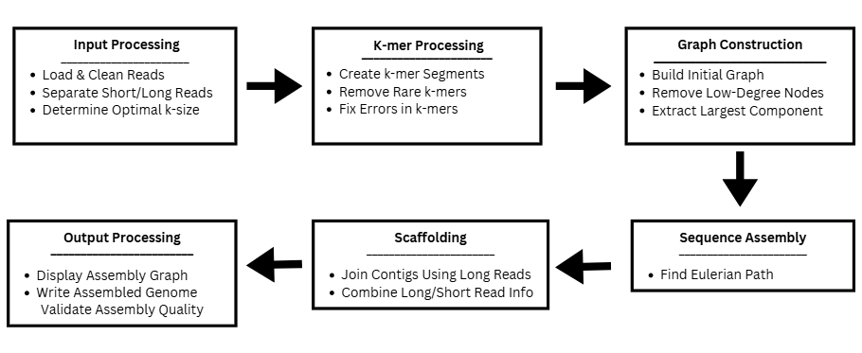
IMPLEMENTATION

Slide 7
Constructing the De Bruijn Graph
Node Creation:
For every k-mer, the function splits it into two parts:
r1: The prefix (first k-1 characters).
r2: The suffix (last k-1 characters).
Both r1 and r2 are added to a set of nodes.
Edge Creation: A directed edge is added from r1 to r2 for each k-mer.
Start Node Identification: It tracks nodes that appear as a destination (suffix) in any k-mer. Finally, it computes nodes - not_starts to identify nodes that never appear as a destination (potential starting nodes for the Eulerian trail).
def debruijnize(kmers):
nodes = set()
not_starts = set()
edges = []
for kmer in kmers:
r1 = kmer[:-1]
r2 = kmer[1:]
nodes.add(r1)
nodes.add(r2)
edges.append((r1, r2))
not_starts.add(r2)
return (nodes, edges, list(nodes -
not_starts))

Slide 8
Mapping Nodes to Edges
Converts the list of edges into a dictionary that maps each node to its list of outgoing neighbors.
Iterates over each edge tuple (source, destination).
If the source node is already in the dictionary, the destination is appended to its list.
Otherwise, a new key is created with the source node and its value initialized as a list containing the destination.
def make_node_edge_map(edges):
node_edge_map = {}
for e in edges:
n = e[0]
if n in node_edge_map:
node_edge_map[n].append(e[1])
else:
node_edge_map[n] = [e[1]]
return node_edge_map
Outcome: Provides an easy-to-use mapping of each node to its outgoing edges. This mapping is critical for traversing the graph when finding the Eulerian trail.

Slide 9
Finding the Eulerian Path
def eulerian_trail(m, v):
nemap = m
result_trail = []
start = v
result_trail.append(start)
while True:
trail = []
previous = start
while True:
if previous not in nemap:
break
next = nemap[previous].pop()
if len(nemap[previous]) == 0:
nemap.pop(previous, None)
trail.append(next)
if next == start:
break
previous = next
print(trail)
This part of the function starts by initializing the graph representation (nemap), the result trail (result_trail), and setting the starting node (start). It then enters a loop to construct the Eulerian trail iteratively.
Inside the main loop, it initializes a temporary trail list and sets previous as the current start node. It then begins another loop to traverse the graph:
It checks if previous exists in nemap. If not, the traversal stops.
Otherwise, it retrieves and removes an outgoing edge (a neighboring node) from nemap.
If previous has no more outgoing edges left, it is removed from nemap entirely.
The newly visited node is added to trail.
If this new node is the same as start, the loop breaks, indicating a completed cycle in the path.
Otherwise, previous is updated to continue the traversal.
The trail constructed in this iteration is printed.

Slide 10
Continued
After constructing a partial trail in each iteration, the function integrates it into the overall result_trail.
If all edges are used (nemap is empty), the function exits.
Otherwise, it looks for a new starting point within result_trail—a node that still has outgoing edges in nemap.
If such a node is found, the process repeats from this new start node.
If no valid starting node exists but edges remain, an error is reported, indicating an issue with the Eulerian path construction.
Finally, result_trail is returned, representing the reconstructed Eulerian path through the De Bruijn graph.
It finds where start appears in result_trail and inserts the new trail at that position.
index = result_trail.index(start)
result_trail = result_trail[:index + 1]
+ trail + result_trail[index + 1:]
if len(nemap) == 0:
break
found_new_start = False
for n in result_trail:
if n in nemap:
start = n
found_new_start = True
break
if not found_new_start:
print("Error: Eulerian path issue")
print("Result Trail:", result_trail)
print("Remaining Edges:", nemap)
break
return result_trail

Slide 11
Visualizing the Graph
Generates a DOT language string that represents the De Bruijn graph, which can be visualized using Graphviz.
Receives the graph G as a tuple containing nodes, edges, and starting nodes.
Creates a string with the beginning of a Graphviz directed graph (digraph).
For each node, it adds a line that labels the node.
For each edge, it adds a line that defines a directed connection between nodes.
Closes the graph definition with a closing brace.
def visualize_debruijn(G):
nodes = G[0]
edges = G[1]
dot_str = 'digraph "DeBruijn graph" {\n'
for node in nodes:
dot_str += f' {node} [label="{node}"] ;\n'
for src, dst in edges:
dot_str += f' {src} -> {dst} ;\n'
return dot_str + '}\n'
Assembling the final sequence
def assemble_trail(trail):
if len(trail) == 0:
return ""
result = trail[0][:-1]
for node in trail:
result += node[-1]
return result
Starts with the first node in the trail, taking all but its last character.
This is because every node overlaps the next by k-1 characters.
Iterates through each node in the Eulerian trail and appends only the last character of that node to the result.
If the trail is empty, returns an empty string.

Slide 12
Running the entire assembly
K-mer Generation:
Calls generate_kmers to
Graph Construction:
Uses debruijnize to construct the
Mapping for Traversal:
Creates the node-edge map via
Determine Start Node:
Chooses a starting node from the
Eulerian Trail:
Computes the Eulerian trail
Visualization:
Generates a DOT string for the
Sequence Assembly:
Assembles the final sequence using
obtain k-mers from the
input reads.
De Bruijn graph from the k-mers.
make_node_edge_map.
using the eulerian_trail
function.
list of nodes with no incoming
edges or defaults to an arbitrary
graph with visualize_debruijn and
renders it as a PNG file using
Graphviz.
assemble_trail and prints the result.
node.

Slide 13
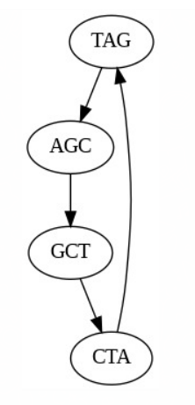


Base Code Results
Input File
Outputs

Slide 14
Conclusion
Understanding De Bruijn Graphs:
The project constructs a De Bruijn graph from k-mers (substrings of length k) derived from DNA reads.
Eulerian path for sequence assembly:
Since every k-mer overlaps with another, the assembled sequence follows an Eulerian path (a trail that visits every edge exactly once).
DNA sequence reconstruction:
By following the Eulerian trail, the original DNA sequence is reconstructed from k-mers.
The result is a contiguous sequence, useful for genome assembly.
Notes:
Document.docx
fresh5.ipynb - Colab
Current_code.ipynb - Colab

