Slide 1

Design and Analysis of Algorithms [22AIE212] & Intelligence of Biological Systems 2 ​[22BIO211]
Project Review-1
Group No : 12
Team Members:
Neha.R.Menon-CB.SC.U4AIE23324
P. Srikrishna Karthikey-CB.SC.U4AIE23350
Nandu Manoj-CB.SC.U4AIE23321
Dhruv A.P-CB.SC.U4AIE23302

Slide 2

Genome Assembly Using De Bruijn Graph
Introduction
Genome assembly is a crucial task in bioinformatics, where short DNA sequences obtained from sequencing technologies are combined to reconstruct the complete genome.
This project explores the use of De Bruijn Graphs, a powerful algorithmic approach, to enhance the efficiency and accuracy of genome assembly.

Slide 3
Problem Statement
Genome assembly presents several challenges, including handling sequencing errors, resolving repetitive DNA regions, and ensuring computational efficiency in large datasets. Traditional approaches, such as overlap graphs, are computationally expensive for large genomes. This project addresses these issues by leveraging De Bruijn Graphs, which provide a more efficient representation of sequencing data by breaking DNA sequences into smaller overlapping fragments (k-mers) and constructing a graph for genome reconstruction.
Brief Description
This project focuses on:
Processing sequencing reads from short-read and long-read sequencing technologies.
Building a De Bruijn Graph for genome reconstruction.
Applying error-handling techniques to improve accuracy.
Optimizing graph traversal algorithms for performance enhancement.
Comparative evaluation of genome assembly quality using different k-mer sizes and datasets.

Slide 4
Objectives
Efficient Genome Assembly – Implement De Bruijn Graphs for reconstructing genome sequences.
Error Handling & Repeat Resolution – Apply computational techniques to correct sequencing errors and resolve genome repeats.
Performance Optimization – Utilize algorithmic improvements to enhance efficiency.
Comparative Analysis – Evaluate assembly quality across different datasets and k-mer sizes.
Real-world Applications – Apply results to biomedical research, synthetic biology, and agricultural genomics.
Importance of Genome Assembly
Biomedical Research: Identifying genetic mutations
Agricultural Genomics: Improving crop resistance and yield
Synthetic Biology: Constructing artificial genomes for bioengineering
Key Challenges & Focus Areas​
Handling Sequencing Errors ​
Resolving Repeats in DNA Sequences ​
Efficient Graph Construction & Traversal

Slide 5
LITERATURE REVIEW
S.NO | Paper Title | Objective | Advantage | Limitations
1 | An Eulerian path approach to DNA fragment assembly | To propose a new DNA fragment assembly approach based on Eulerian paths. | Introduces a novel method for DNA fragment assembly. Effective for reconstructing genomes from short reads | The Eulerian path approach may be computationally intensive Requires well-defined fragment overlaps for optimal results
2 | Graph analysis of fragmented long-read bacterial genome assemblies | To explore graph-based methods for the analysis of fragmented long-read bacterial genome assemblies. | Utilizes graph-based approaches to handle complex genome assemblies. Particularly effective for bacterial genomes with long reads | Limited to bacterial genomes, not applicable to eukaryotic genomes. Potential challenges in scaling for larger, more complex genomes

Slide 6
LITERATURE REVIEW
S.NO | Paper Title | Objective | Advantage | Limitations
3. | A survey of mapping algorithms in the long-reads era | To survey and review various mapping algorithms developed for long-read sequencing. | Focus on long-read sequencing, which is crucial for complex genome assemblies. Highlights the evolving algorithms for more accurate mapping. | Long-read sequencing is still evolving, and the algorithms may not be fully optimized. Could become outdated as new algorithms emerge
4. | Genome sequence assembly algorithms and misassembly identification methods | To review various genome sequence assembly algorithms and methods for identifying misassemblies in genomes. | Provides a comprehensive analysis of multiple algorithms. Focus on identifying misassemblies, enhancing assembly quality. | Focuses mainly on algorithmic techniques, lacks in-depth biological context. May not cover the most recent techniques.

Slide 7
LITERATURE REVIEW
S.NO | Paper Title | Objective | Advantage | Limitations
5. | Computational complexity of algorithms for sequence comparison, short-read assembly, and genome alignment | To analyze the computational complexity of various algorithms used in sequence comparison, short-read assembly, and genome alignment. | Offers in-depth analysis of algorithmic efficiency. Provides insights into the computational trade-offs for genomic studies. | Focuses heavily on theoretical aspects, which may limit practical applicability. May not address newer, more efficient algorithms.
6 | GAGE: A critical evaluation of genome assemblies and assembly algorithms | To critically evaluate various genome assembly algorithms and their performance using a benchmark suite. | Provides an extensive benchmark for genome assembly algorithms. Offers a evaluation framework for comparing different approaches. | May not cover all emerging algorithms. The benchmark suite may be limited in scope for very specific genomic datasets.

Slide 8
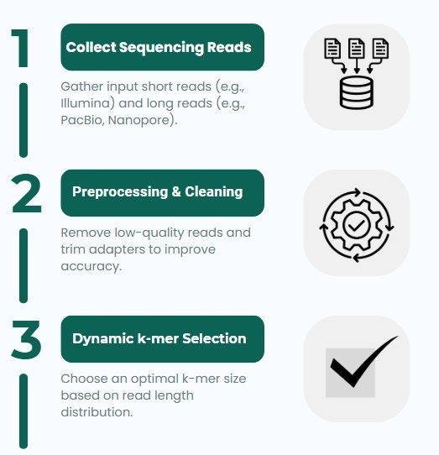
Methodology

Slide 9
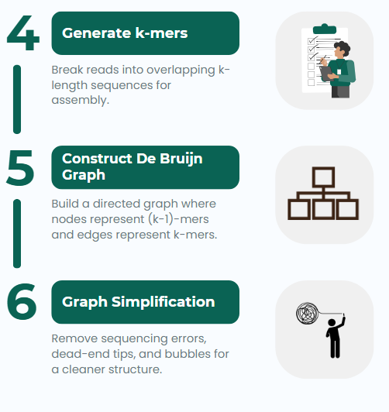
Methodology

Slide 10
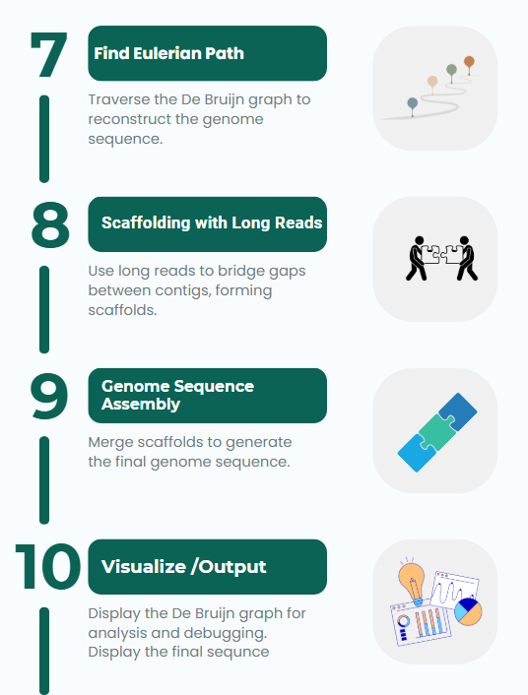
Methodology

Slide 11
Genome Sequencing
Genome sequencing
Genome sequencing is the process of reading the DNA sequence of an organism.
Current sequencing technologies do not read entire genomes in one go; instead, they produce short fragments called reads.
These reads must be assembled into a complete genome.
Why is it important?
Used in biomedical research, agriculture, and synthetic biology.
K-mer
A k-mer is a contiguous substring of length k from a biological sequence.
Eg: Consider the DNA sequence-"AGCTGA"
If we choose k = 4 (4-mers), we extract the following overlapping substrings:
"AGCT"
"GCTG"
"CTGA"

Slide 12
Genome Sequencing
Reads
A read in DNA sequencing is a short fragment of DNA sequence that is output by a sequencing machine. Reads are obtained by breaking DNA into smaller fragments
There are two types of reads
Short Reads (Illumina) → High accuracy, used for constructing the genome graph.
Long Reads (PacBio, Nanopore) → Used for scaffolding (connecting genome fragments).
Type | Read Length | Error Rate | Cost | Usage in Project
Short-Read Sequencing (Illumina) | 50-300 bp | Low (0.1-1%) | Cheap | Main method for De Bruijn graph
Long-Read Sequencing (PacBio, Nanopore) | 10,000+ bp | High (10-15%) | Expensive | Used for scaffolding to improve assembly

Slide 13
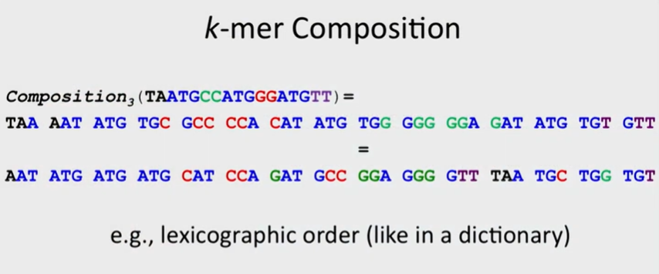
Genome Assembly
k-mer composition refers to the set of all possible k-length substrings (k-mers) that can be extracted from a given DNA sequence. It provides a structured way to analyze genomic data, particularly in genome assembly and sequence comparison.
What is Lexicographic Order?
A method of sorting DNA sequences alphabetically (A < C < G < T).
Application in Genome Assembly:
Helps in ordering k-mers efficiently.
Used in sorting reads before building a De Bruijn graph.

Slide 14
Genome Assembly
1) Overlap (Finding Similar Reads)
Overlap is the process of identifying where sequencing reads share a common sequence at their ends. It is essential for connecting reads into a continuous sequence by forming edges in an overlap graph.
2) Layout (Arranging Reads in Order)
Layout involves arranging the sequencing reads in the correct order based on their overlaps. This step ensures a coherent path through the graph, avoiding errors and resolving ambiguities in genome assembly.
3) Consensus (Finalizing the Genome Sequence)
Consensus is the process of determining the most accurate genome sequence from multiple overlapping reads. It corrects sequencing errors by selecting the most frequent and reliable nucleotide at each position.

Slide 15
Genome Sequencing
Error Correction Methods:
Low-Frequency k-mer Filtering: Remove k-mers that appear very rarely, as they are likely caused by sequencing errors rather than real biological sequences. Sequencing errors introduce random mutations, creating k-mers that don’t actually exist in the genome. Count the occurrences of each k-mer in the sequencing reads. Set a threshold (e.g., k-mers appearing fewer than 3 times may be removed). Remove rare k-mers from the graph to eliminate erroneous paths.
Tip Removal: Remove short dead-end branches that do not contribute to the main genome sequence, often caused by sequencing errors or low coverage. If a sequencing error occurs near the end of a read, it creates a short "orphan" path in the graph that does not connect to the main structure. Identify short paths (tips) in the De Bruijn graph that do not extend to other paths. Check if they are likely caused by errors (i.e., low coverage or low frequency). Prune these dead-end paths to keep the graph clean.

Slide 16
Genome Sequencing
Bubble Merging (Resolving Small Alternative Paths): Merge small alternative paths ("bubbles") that arise due to sequencing errors, polymorphisms, or small mutations. Sequencing errors create alternative paths with one or a few base differences. Identify two parallel paths that start from a common node and rejoin later. Check their frequency in reads (more frequent = more reliable). Merge the bubble by choosing the most frequent or reliable path.

Slide 17
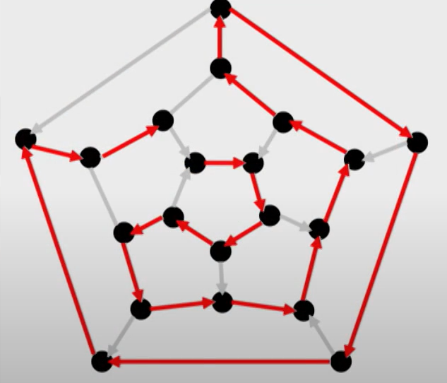
DeBruijn Graph
What is a Hamiltonian Graph?
A graph where a path visits each node exactly once.
Alternative to De Bruijn graphs but computationally expensive.
Genome Sequencing

Slide 18
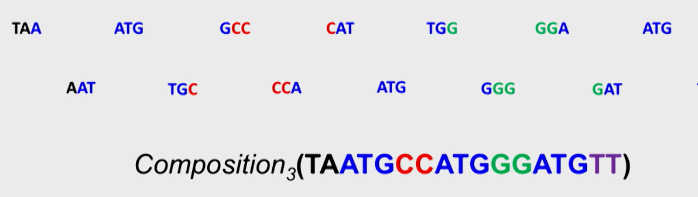
DeBruijn Graph
DeBruijn Graph follows the Eulerian Path principle.
An Eulerian path is a path that visits each nodes exactly while traversing.
DeBruijn graph is created from a genomic path created by arranging the genomic compositions.
Here the compositions will be arranged directed path where each edge is a k-mer and the nodes are represented by the prefix(k-1)-mer and suffix(k-1)-mer of the k-mer edge.

Slide 19
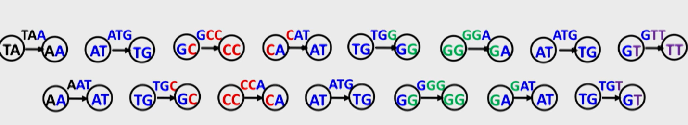
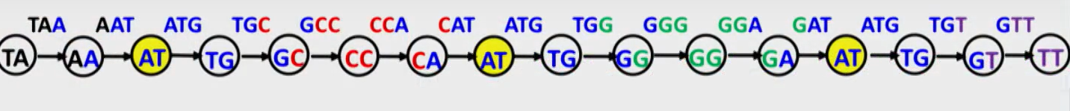
DeBruijn Graph
For each k-mer in k-mers
connect its prefix node with a suffix node by an edge
Then we combine the overlapping sequences to create a long continuous directed path.

Slide 20
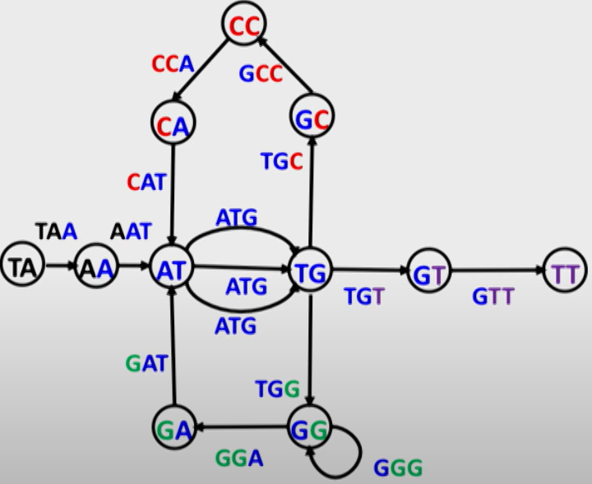
DeBruijn Graph
After combining the overlapping sequences, the identical labels or nodes present in the created path will be glued together into one, this process ultimately leads to the formation of DeBruijn Graph.

Slide 21
DeBruijn Graph
Furthermore, time complexity analysis of DeBruijn graph and various methods being used in the project will done to understand their efficiency.

Slide 22
Expected Results
Accurate Genome Reconstruction – Minimization of sequencing errors and resolution of repetitive regions.
Efficient Error Handling – Filtering low-frequency k- mers, tip removal, and resolving alternative paths.
Optimized Algorithmic Performance – Efficient De Bruijn Graph construction and Eulerian path traversal.
Improved Computational Efficiency – Adaptive k- mer selection and scaffolding using long reads.
Performance Evaluation – Higher N50 scores, better genome coverage, and reduced time complexity.
Real-World Impact – Applications in biomedical research, synthetic biology, and agricultural genomics.
Future Enhancements
Hybrid Assembly: Combining graph-based and alignment-based methods
Machine Learning Integration: AI-based error correction in sequencing
Cloud Computing for Large-Scale Genome Assembly

Slide 23
Timeline
Phase | Task | Duration | Week
Phase 1 | Literature Review & Understanding Genome Assembly | 1-2 weeks | Jan 3rd and 4th weeks
Phase 2 | Data Collection & Preprocessing | 1 week | Feb 1st week
Phase 3 | De Bruijn Graph Construction & Error Correction | 1-2 weeks | Feb 2nd and 3rd weeks
Phase 4 | Genome Reconstruction Using Eulerian Path | 1-2 weeks | Feb 4th week and March 1st week
Phase 5 | Performance Analysis & Optimization | 1 week | March 2nd week
Phase 6 | Final Report Writing & Presentation | 1 week | March 3rd week to final review week

Slide 24
References
P. A. Pevzner, H. Tang, and M. S. Waterman, "An Eulerian path approach to DNA fragment assembly," Proceeding of the National Academy of Sciences, vol. 98, no. 17, pp. 9748–9753, Aug. 2001.
P. Marijon, R. Chikhi, and J. S. Varré, "Graph analysis of fragmented long-read bacterial gene assemblies," BMC Bioinformatics, vol. 21, no. 1, p. 249, May 2020.
K. Sahlin, T. Baudeau, B. Cazaux, and C. Marchet, "A survey of mapping algorithms ," Bioinformatics, vol. 38, no. 14, pp. 3378–3390, Jul. 2022.
Meng et al., "Genome sequence assembly algorithms and misassembly identification methods," Molecular Biology Reports, vol. 49, no. 9, pp. 11133–11148, Sep. 2022.
M. S. Waterman, "Computational complexity of sequence alignment and genome assembly," Bullet of Mathematical Biology, vol. 46, no. 4, pp. 515–527, Jul. 1984.
S. L. Salzberg et al., "GAGE: A critical evaluation of genome assemblies and assembly algorithms," Genome Research, vol. 22, no. 3, pp. 557–567, Mar. 2012.

