Slide 1
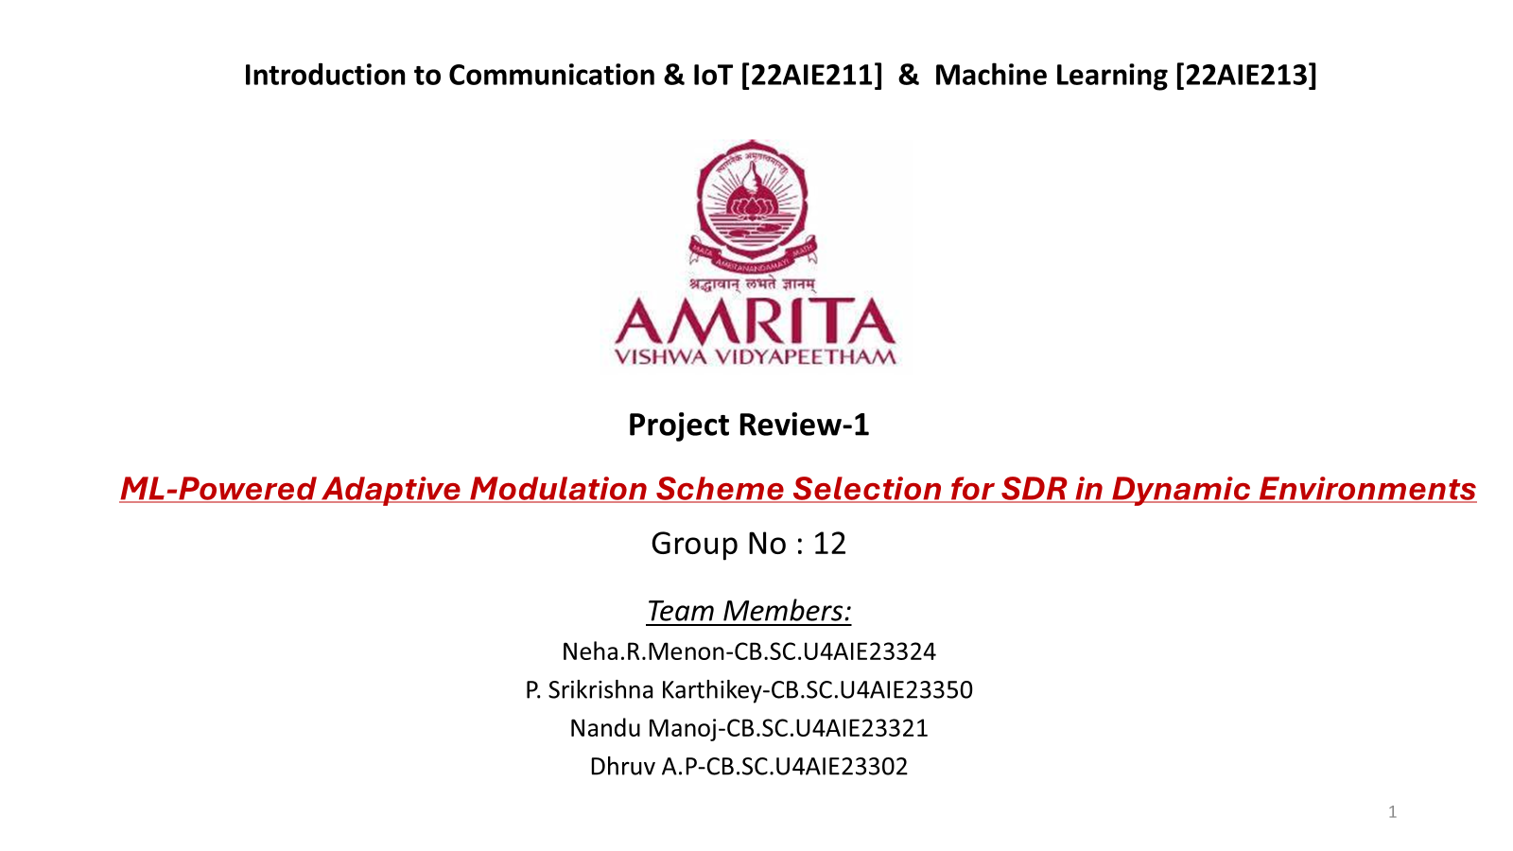

Slide 2
Introduction
Research Problem:
Significance:
Motivation:
Fixed modulation schemes fail to adapt to noise, interference, and bandwidth changes, reducing transmission efficiency.
Dynamic modulation improves data transmission, enhancing system reliability and performance.
ML-driven adaptive modulation in SDRs overcomes static limitations by analyzing real-time signal characteristics.

Slide 3
General Objectives ​
Develop a robust framework for signal generation and classification to dynamically select BPSK, QPSK, or 16-QAM under varying noise conditions.​
Enhance classification accuracy using feature extraction and machine learning techniques to improve modulation scheme identification.​
Ensure scalability and reproducibility by providing a structured methodology for signal preprocessing, feature extraction, and model evaluation.​
Validate model performance through visualization, statistical analysis, and high classification accuracy on unseen data for real-world deployment.​

Slide 4
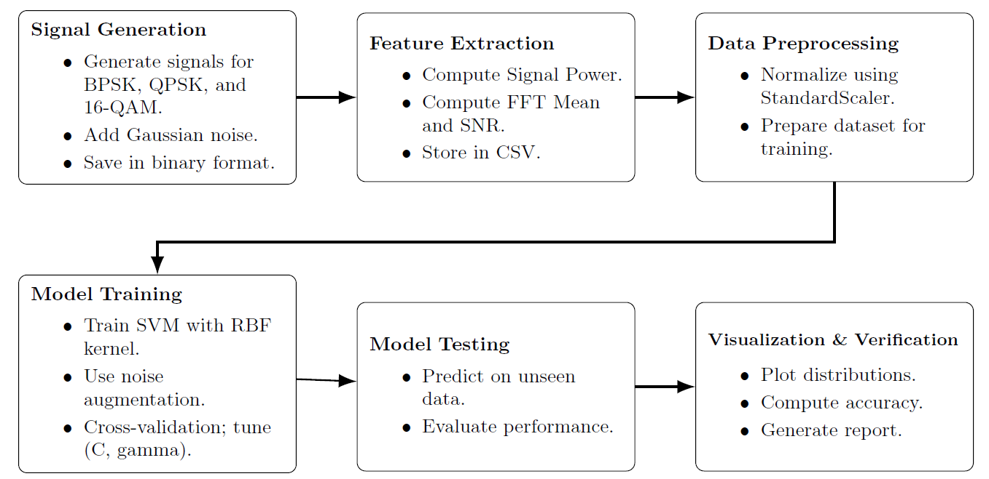
Methodology

Slide 5

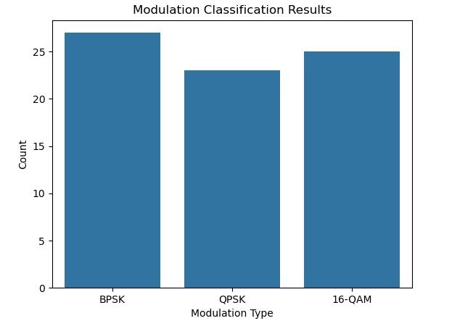
Preliminary Results
The predicted results are saved into a CSV file named classified_result.
Here we can see the comparison between the counts of different Modulation schemes.

Slide 6
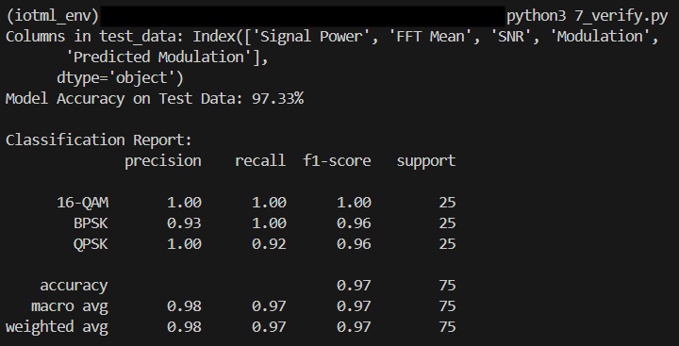
Preliminary Results
The overall model performance classification report.

Slide 7
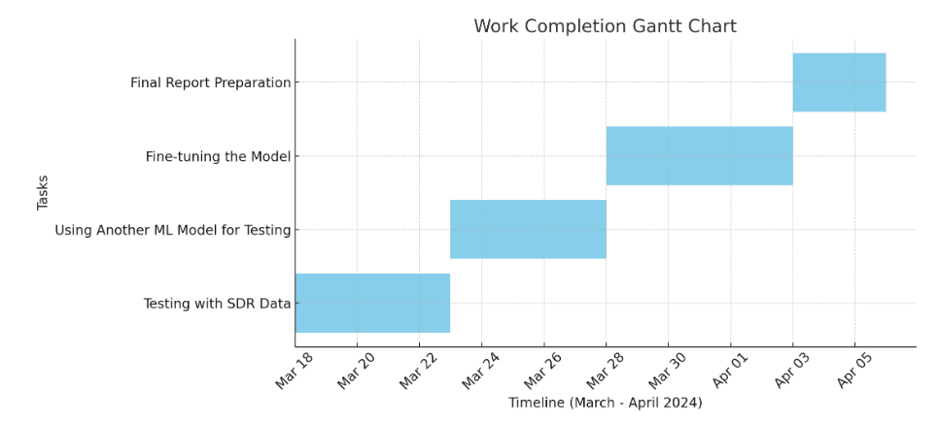
Work Plan Timeline

Slide 8
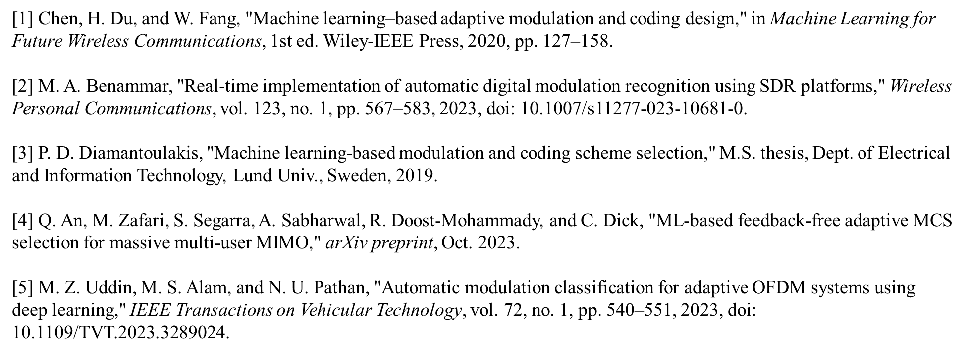
References

Slide 9

Expected Outcome
Development of a robust ML-based adaptive modulation system that can autonomously select the most appropriate modulation scheme.
The outcome contributes significantly by integrating AI-driven decision-making for better adaptability and resilience in wireless communications.
The study encourage integrating ML techniques for networking and communication purposes. This can save the computational and overhead costs.

Slide 10
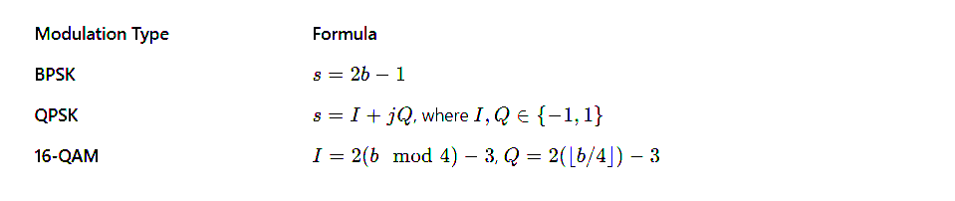
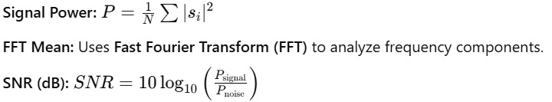
Formula Used
Signal Generation
Features

