Slide 1

Mathematics for Computing [22MAT230] & Introduction to AI & Robotics ​[22AIE214]
Project Review-1
Group No : 12
Team Members:
Neha.R.Menon-CB.SC.U4AIE23324
Dhruv A.P-CB.SC.U4AIE23302
Nandu Manoj-CB.SC.U4AIE23321
P. Srikrishna Karthikey-CB.SC.U4AIE23350

Slide 2
Problem Statement
Autonomous pothole detection and avoidance robot
implemented using robotics and mathematical concepts

Slide 3
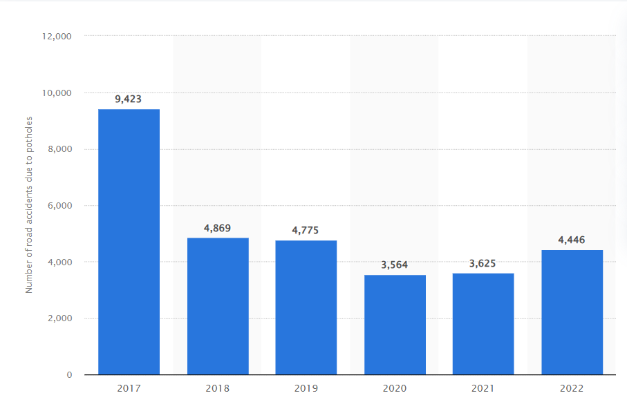



Motivation
Potholes contribute to approximately 33% of all road accidents in some regions, leading to injuries and fatalities.
In the U.S., drivers spend around $3 billion annually on vehicle repairs caused by pothole damage
Vehicles slowing down or swerving to avoid potholes disrupt traffic flow, causing delays and increasing commute times.
Number of road accidents due to potholes in India from 2017 to 2022

Slide 4
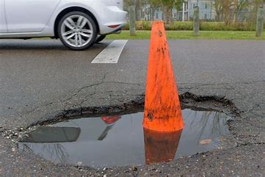
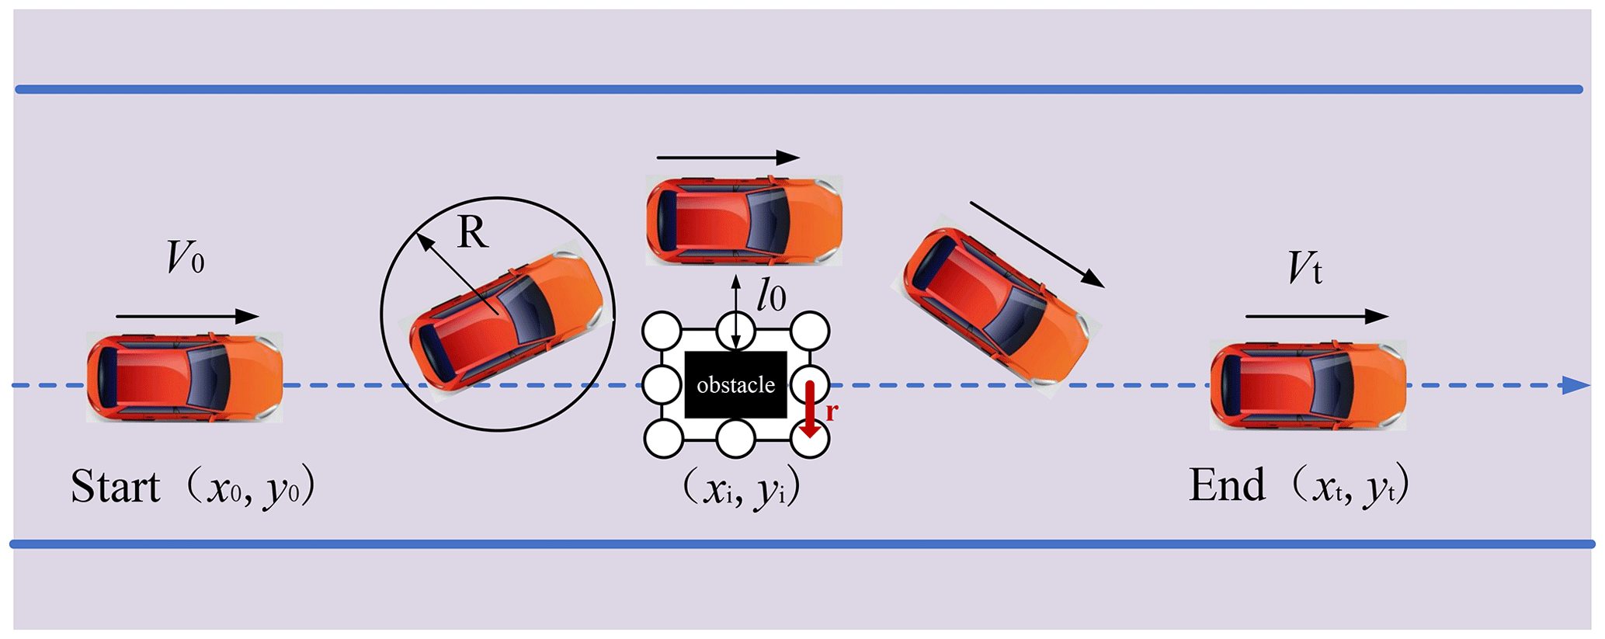
General Objectives
Pothole Avoidance ​
​
To design a robot that can autonomously navigate around pothole, ensuring smooth movement and preventing damage.
Pothole Detection ​
Develop a system that can detect potholes on the road using a combination of sensors

Slide 5
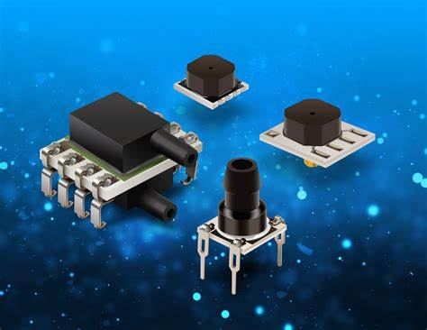


Specific Objectives
Sensor Integration: To integrate various sensors for data collection to analyze the environment.
Real-time Processing: To process sensor data using algorithms (image processing, distance measurement)​
Efficiency and Optimization : Develop an optimized path-planning algorithm that minimizes the time and energy.

Slide 6
Sl.No | Title | Methodology | Limitations
1. | Neural Network-Based Obstacle and Pothole Avoiding Robot[1] | Developed a mobile robot with Arduino Uno for pothole avoidance. Used Sharp distance measurement and ultrasonic sensors for detection. Implemented a feedforward backpropagation neural network for real-time path adjustment. | Sensor limitations affect depth estimation accuracy. Simple neural network model limits performance compared to deep learning methods. Tested in controlled environments, making real-world deployment uncertain.
2. | RoadScan: A Novel and Robust Transfer Learning Framework for Autonomous Pothole Detection in Roads[2] | Feature Extraction: Employed the VGG16 model to extract pertinent features from road images. Siamese Network: Implemented a custom Siamese network with triplet loss to distinguish between pothole and non-pothole images. | The proposed model achieved a 96.12% accuracy, a 3.89% Equal Error Rate (EER), and an Area Under the Receiver Operating Characteristic curve (AUROC) value of 0.988, indicating high effectiveness in pothole detection. The study primarily focuses on detection and does not delve into real-time avoidance strategies or integration with navigation systems.

Slide 7
Sl.No | Title | Methodology | Limitations
3. | Improved Pothole Detection Using YOLOv7 and SRGAN [3] | Super Resolution: Applied SRGANs to upscale low-resolution images, enhancing detail and clarity. Object Detection: Utilized the YOLOv7 network to detect potholes in both the original and upscaled images. | The integration of SRGANs with YOLOv7 demonstrated improved detection performance on low-quality images, highlighting the effectiveness of the approach. The study focuses on image enhancement and detection but does not explore real-time processing capabilities or avoidance mechanisms.
4. | Pothole Detection and Avoidance via Deep Learning on Edge Devices [4] | Deep Learning Model: Utilized a convolutional neural network (CNN) for pothole detection. Edge Implementation: Deployed the model on the Xilinx ZCU104 evaluation board to meet vehicle deployment constraints, such as power consumption. Simulation Environment: Created a virtual road environment using CARLA, introducing random potholes for testing. | The system successfully detected potholes and executed avoidance maneuvers in the simulated environment, demonstrating the feasibility of deploying deep learning-based pothole detection and avoidance systems on edge devices. The evaluation was conducted in a simulated environment, which may not capture all real-world variables. Further testing in real-world scenarios is necessary to validate the system's effectiveness.

Slide 8
Sl.No | Title | Methodology | Limitations
5. | SPAS: Smart Pothole- Avoidance Strategy for Autonomous Vehicles [5] | Uses advanced reinforcement learning model to address pothole avoidance more effectively. It utilizes the Deep Deterministic Policy Gradient (DDPG) algorithm. It integrates traveler feedback using a Hybrid Recognition Model with Speech and Gesture (HRM-SG) | The limitation of the SPAS is that it neglects pedestrians, including visually challenged people.
6. | Autonomous Vehicle System for Pothole Detection and Avoidance[6] | Uses 'Turtlebot3 Burger' model robot for simulating autonomous vehicle on the road. Used a custom-trained convolutional neural network model consisting of 5 layers. For the robot's point of view, they used YOLOv4-Tiny model as it provided better results on Raspberry Pi . For lane detection, Gaussian blurring, Canny edge detection are used. | In real-time hardware implementations, there still exists a considerable amount of drift within the robot's motors, thus causing deviation from the ideal results obtained in simulation. The current model for pothole detection uses a simple RGB camera which can’t estimate the depth.

Slide 9
Sl.No | Title | Methodology | Limitations
7. | Computer vision for road imaging and pothole detection: a state-of-the-art review of systems and algorithms [7] | The paper employs a multi-method approach for pothole detection, integrating image processing, 3D point cloud modeling, and deep learning. 3D point cloud modeling reconstructs road surfaces using stereo vision and disparity transformation to detect potholes. SVM for image classification, CNNs, YOLO, and Faster R-CNN are used for object detection and semantic segmentation. | Classical 2D image processing-based methods are highly sensitive to environmental factors like illumination and weather conditions. Irregular Pothole Shapes, Imaging not able to provide volume or depth of the hole. Lack of large dataset for deep learning methods.
8. | Detecting Potholes using simple image processing techniques and real-world footage [8] | It proposes a computer vision-based pothole detection method that does not rely on machine learning. Uses color-based model and convex hull processing to extract the road surface. Canny edge detection and contour detection are applied to identify dark edges corresponding to potholes. | The system is highly dependent on lighting conditions, and shadows, poor visibility, and environmental factors can affect detection accuracy. It cannot detect potholes without visible dark edges, detection range is limited (2m to 20m) dilation process may absorb potholes into the road boundary.

Slide 10
Sl.No | Title | Methodology | Limitations
9. | Design and Implementation of a Robot for Road Pothole Detection Using GPS[9] | Integrated a GPS module to record geographical coordinates of detected potholes. Utilized a GSM module to transmit pothole location data to a centralized database or relevant authorities for maintenance. Programmed a microcontroller to process real-time sensor data, identifying potholes based on predefined depth thresholds. | Sensor Accuracy: Ultrasonic sensors may produce inaccuracies due to environmental factors such as temperature, reflectivity, and sensor angle. Data Transmission Challenges: GSM-based transmission may suffer from delays or data loss in areas with weak network coverage.
10. | Real-Time Pothole Detection Using Deep Learning[10] | Collected 1,087 images for dataset creation. Trained YOLOv3, YOLOv4, SSD-TensorFlow models for real-time pothole detection. YOLOv4 achieved 85.39% mAP and detected potholes up to 100 meters away. | Small dataset size limits generalization to different road conditions. Performance degrades in poor lighting, rain, or snow. High GPU requirements make real-time deployment on Raspberry Pi challenging.

Slide 11
Research Gap
Methodological Gap – Limitations in existing techniques used for pothole detection and avoidance.
Theoretical Gap – Lack of a strong mathematical model integrating multiple aspects like depth sensing, optimization, and real-time navigation.
Data Gap – Inadequate datasets for real-world pothole detection, especially in varying road conditions.
Application Gap – Existing solutions focus on detection but lack avoidance strategies and real-time correction mechanisms.
Technology Gap – Inefficient sensor fusion in previous works, leading to inaccurate detection and false positives

Slide 12
Research Gap
Gap | Solution
Enhancing Pothole Detection Accuracy
Many pothole detection systems rely only on RGB images, leading to misclassifications in low light and wet conditions. | Use an Intel depth-sensing camera to differentiate actual potholes from water, cracks, and shadows.
Improving Path Planning for Real-Time Avoidance
Existing projects detect potholes but don’t actively navigate around them. | Use linear programming (LP) for path optimization, ensuring efficient deviation while minimizing extra movement.
Increasing Reliability with Sensor Fusion
Previous works often use only one type of sensor, making them unreliable in diverse conditions. | Combine multiple sensors (Intel depth camera, IMU, ultrasonic sensors) using matrix-based fusion techniques to improve accuracy.

Slide 13
Research Gap
Reducing Sensor Noise for More Accurate Pothole Detection
Sensor noise affects detection accuracy in real-world environments. | Use Least Squares Regression for sensor calibration, filtering out noise and improving consistency.
Logging Pothole Locations for Road Maintenance
Most detection systems do not store pothole data, making long-term road repairs difficult. | Store GPS coordinates of detected potholes in a cloud database, creating a real-time pothole mapping system for city planners.

Slide 14
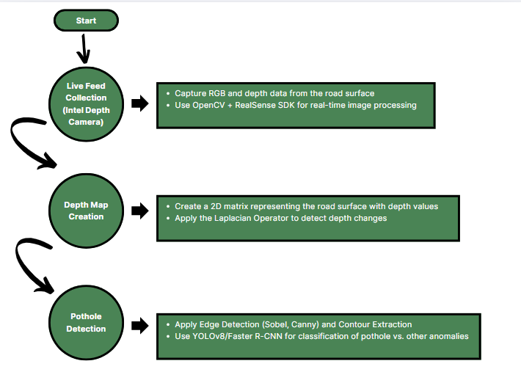
Proposed Methodology

Slide 15
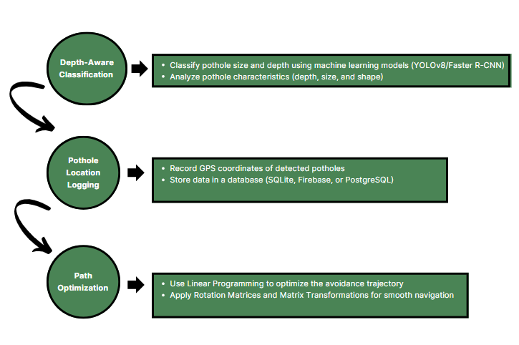
Proposed Methodology

Slide 16
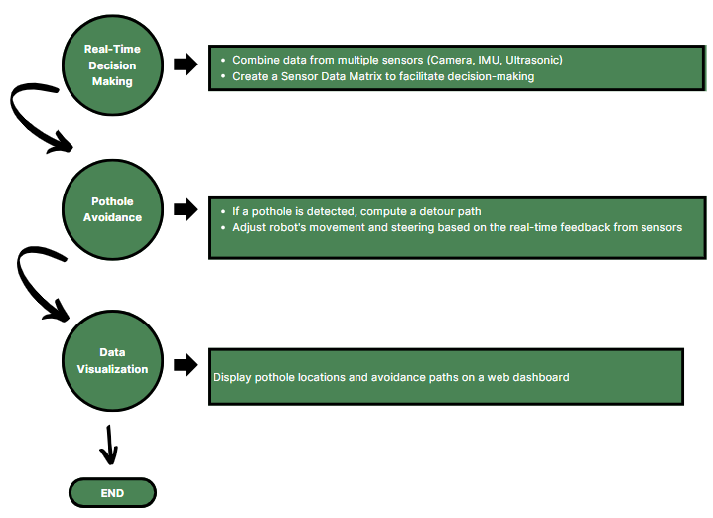
Proposed Methodology

Slide 17
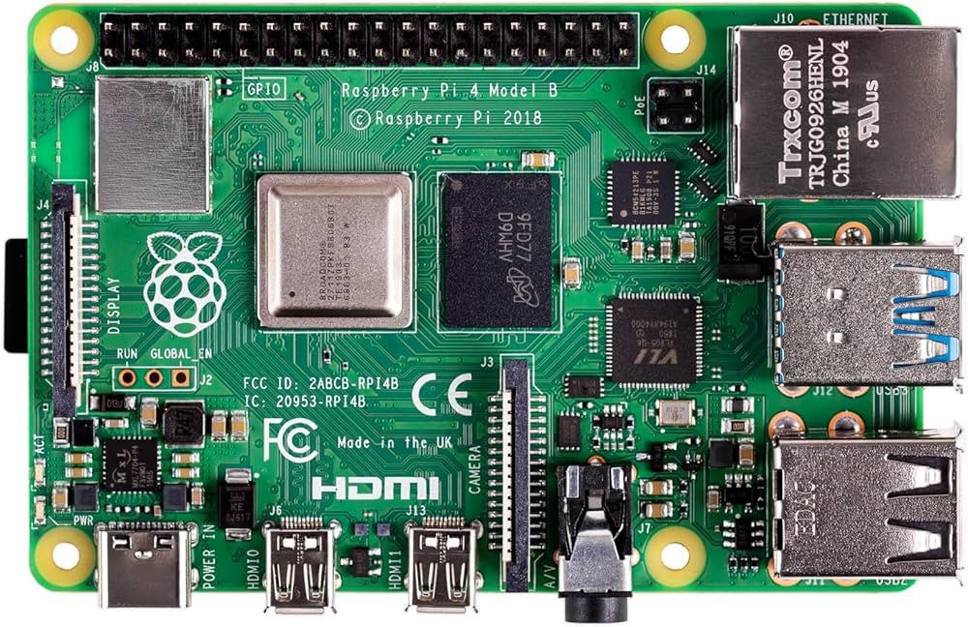
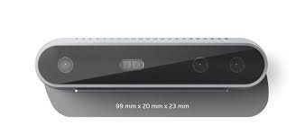
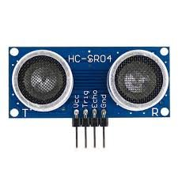
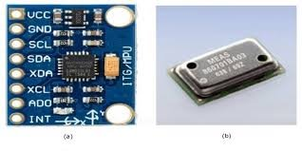
Hardware Requirements
a. Core Processing Unit
Raspberry Pi 4 (4GB/8GB RAM) – Handles
image processing and decision-making.
Raspberry Pi 4
b. Camera Module
Intel RealSense Depth Camera – Captures
RGB and depth data for pothole detection.
c. Sensors for Navigation & Obstacle Avoidance
Ultrasonic Sensors (HC-SR04) – Detects nearby
obstacles to avoid collisions.
IMU (Inertial Measurement Unit, MPU6050
or BNO055) – Stabilizes movement and helps
with trajectory correction.
Raspberry Pi 4
Intel RealSense Depth Camera
Ultrasonic Sensors (HC-SR04)
IMU

Slide 18
d. Motion & Mobility
Chassis (4WD/Tracked) – For navigating different terrains.
High-Torque DC Motors (With Motor Driver L298N) – Powers the
bot’s movement.
Servo Motors (MG995) – Controls steering and minor adjustments.
e. Power Supply & Connectivity
Lithium-Ion Battery Pack (7.4V/12V, 5000mAh or higher) – Powers Raspberry Pi and motors.
Power Management Board (Buck Converter, 5V 3A) – Regulates voltage for different components.
Wi-Fi/Bluetooth Module (Raspberry Pi Built-in or External Adapter) – For wireless communication.
Hardware Requirements​

Slide 19
a. Operating System & Core Software
Raspberry Pi OS (64-bit Lite Recommended) – Lightweight OS for Raspberry Pi.
Python 3.x – Programming language for the project.
b. Computer Vision & Machine Learning Libraries
OpenCV – For image processing (edge detection, contour detection, filtering).
PyTorch/TensorFlow – For deep learning-based pothole detection.
YOLOv8 or Faster R-CNN – For real-time object detection.
c. Depth Processing & Sensor Libraries
Intel RealSense SDK – Interfaces with the Intel depth camera.
Scikit-Image – For processing and enhancing depth data.
NumPy & SciPy – For matrix operations and sensor fusion calculations.
Software Requirements
​

Slide 20
d. Navigation & Robotics Libraries
RPi.GPIO – Controls GPIO pins on Raspberry Pi.
Adafruit_MotorHAT – Manages motor control for movement.
RTKLIB (Optional) – GPS data processing for logging pothole locations.
e. Data Storage & Communication
SQLite/PostgreSQL (Optional) – Stores detected pothole coordinates for later retrieval.
Flask/Django (Optional, for IoT Dashboard) – Web framework for remote monitoring.
Software Requirements
​

Slide 21

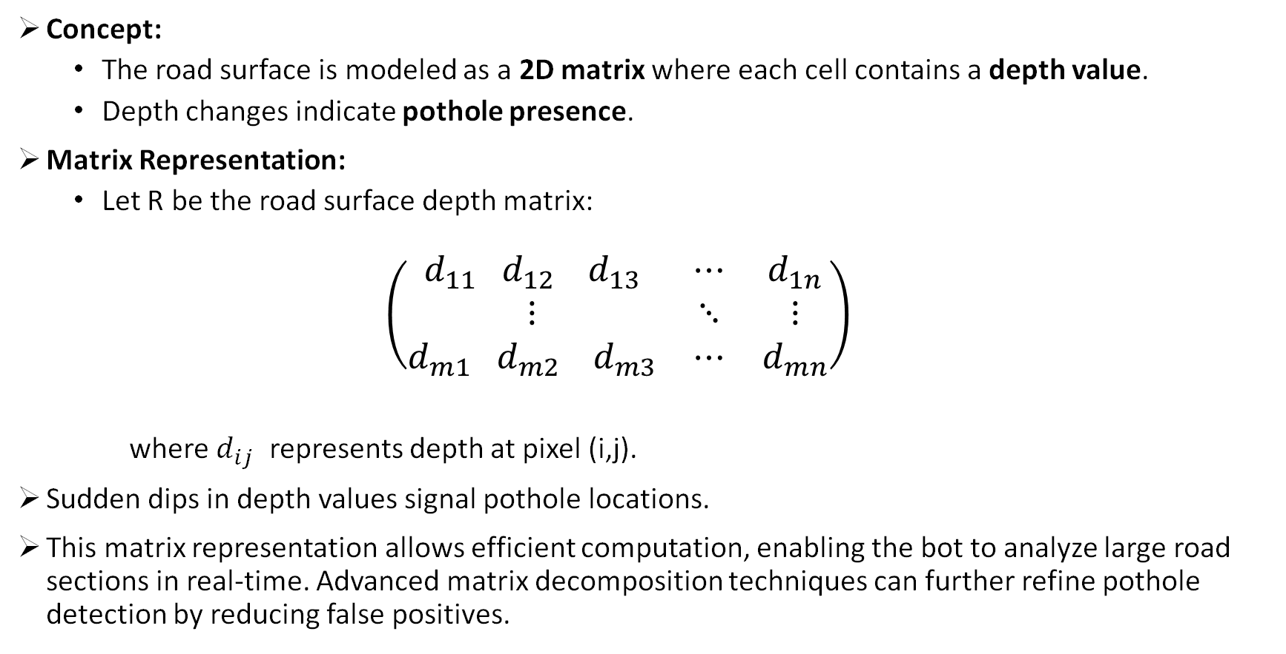
Mathematical Concepts
Concept:
The road surface is modeled as a 2D matrix where each cell contains a depth value.
Depth changes indicate pothole presence.
Matrix Representation:
Let R be the road surface depth matrix:
$$\left(\begin{matrix}d_{11} d_{12} d_{13} & ⋯ & d_{1n} \\ ⋮ & ⋱ & ⋮ \\ d_{m1} d_{m2} d_{m3} & ⋯ & d_{mn}\end{matrix}\right)$$
where $d_{ij}$ ​ represents depth at pixel (i,j).
Sudden dips in depth values signal pothole locations.
This matrix representation allows efficient computation, enabling the bot to analyze large road sections in real-time. Advanced matrix decomposition techniques can further refine pothole detection by reducing false positives.

Slide 22
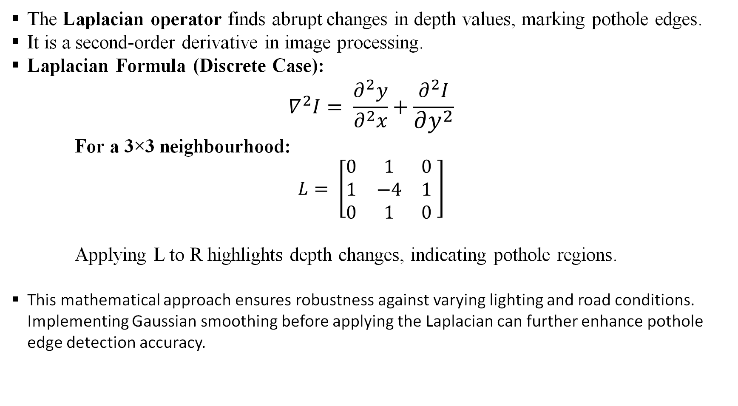
Pothole Detection Using Laplacian Operator
The Laplacian operator finds abrupt changes in depth values, marking pothole edges.
It is a second-order derivative in image processing.
Laplacian Formula (Discrete Case):
$$∇^{2}I= \frac{∂^{2}y}{∂^{2}x}+\frac{∂^{2}I}{∂y^{2}}$$
For a 3×3 neighbourhood:
$$L= \left[\begin{matrix}0 & 1 & 0 \\ 1 & −4 & 1 \\ 0 & 1 & 0\end{matrix} \right]$$
Applying L to R highlights depth changes, indicating pothole regions.
This mathematical approach ensures robustness against varying lighting and road conditions. Implementing Gaussian smoothing before applying the Laplacian can further enhance pothole edge detection accuracy.

Slide 23
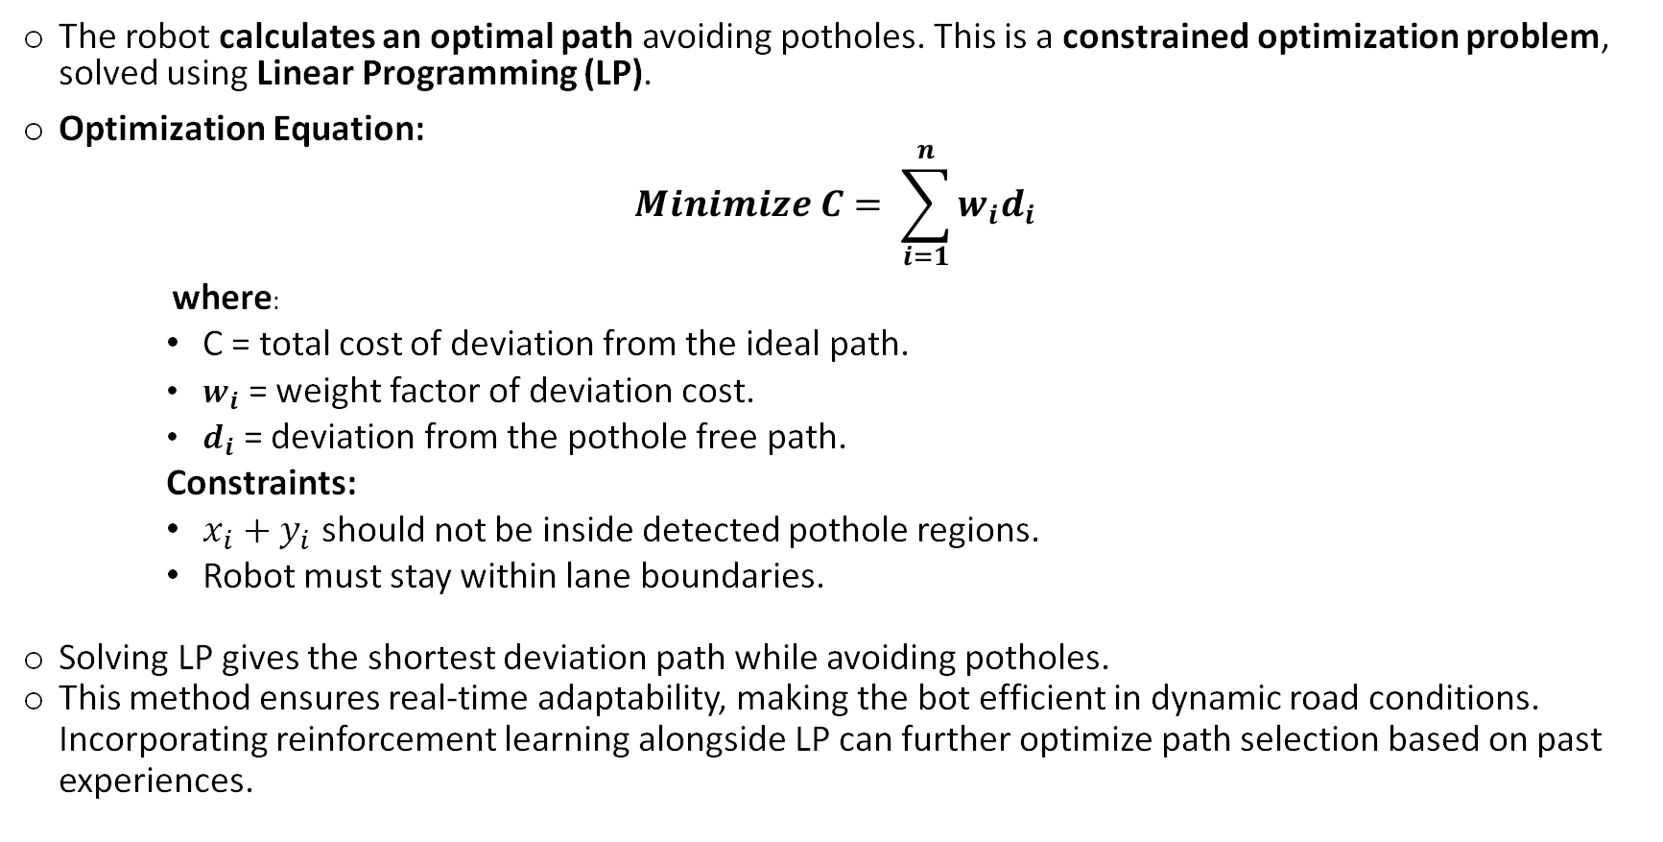
Path Planning and Avoidance Using Linear Programming
The robot calculates an optimal path avoiding potholes. This is a constrained optimization problem, solved using Linear Programming (LP).
Optimization Equation:
$$Minimize C= \sum_{i=1}^{n}{w_{i}d_{i}}$$
where:
C = total cost of deviation from the ideal path.
$w_{i}$ = weight factor of deviation cost.
$d_{i}$ = deviation from the pothole free path.
Constraints:
$x_{i}+y_{i}$ should not be inside detected pothole regions.
Robot must stay within lane boundaries.
Solving LP gives the shortest deviation path while avoiding potholes.
This method ensures real-time adaptability, making the bot efficient in dynamic road conditions. Incorporating reinforcement learning alongside LP can further optimize path selection based on past experiences.

Slide 24
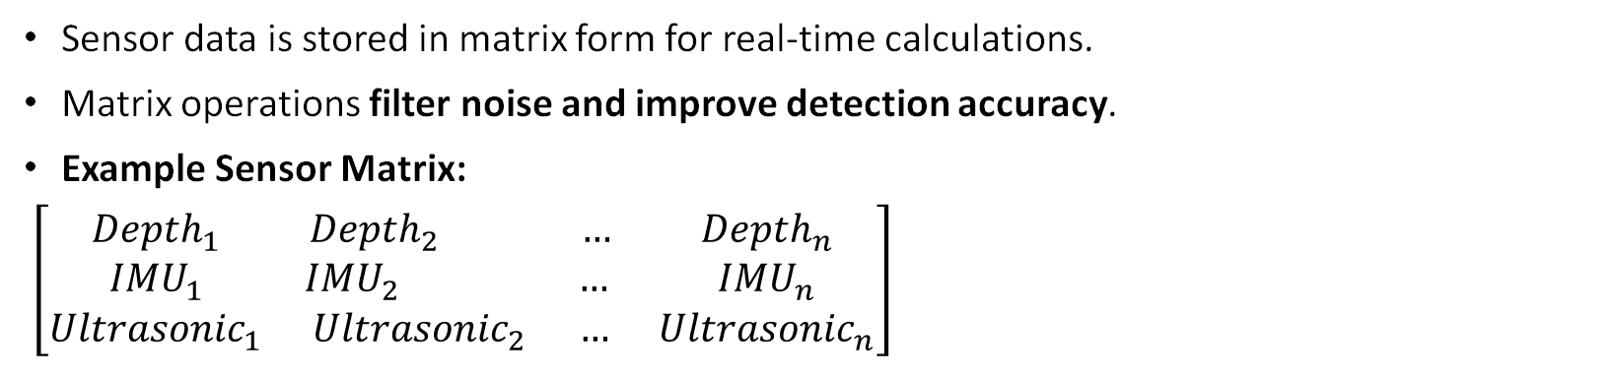
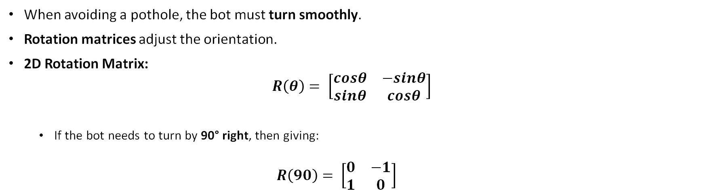
Sensor Data Representation as Matrices
Combining multiple sensor inputs improves reliability and accuracy.
Using sensor fusion techniques, such as Kalman filtering, can further refine data accuracy and minimize false detections. Properly weighted sensor contributions help in decision-making when conflicting signals arise.
Sensor data is stored in matrix form for real-time calculations.
Matrix operations filter noise and improve detection accuracy.
Example Sensor Matrix:
$\left[\begin{matrix}{Depth}_{1} & {Depth}_{2} … & {Depth}_{n} \\ {IMU}_{1} & {IMU}_{2} … & {IMU}_{n} \\ {Ultrasonic}_{1} & {Ultrasonic}_{2} … & {Ultrasonic}_{n}\end{matrix}\right]$
Rotation Matrices for Navigation Adjustments
When avoiding a pothole, the bot must turn smoothly.
Rotation matrices adjust the orientation.
2D Rotation Matrix:
$$R\left(θ\right)= \left[\begin{matrix}cosθ & −sinθ \\ sinθ & cosθ\end{matrix}\right]$$
If the bot needs to turn by 90° right, then giving:
$$R\left(90\right)= \left[\begin{matrix}0 & −1 \\ 1 & 0\end{matrix}\right]$$
Ensures precise realignment after avoidance manoeuvre.
This transformation allows smooth and controlled turns, reducing energy wastage. Advanced motion planning algorithms can refine trajectory correction using higher-order polynomials.

Slide 25
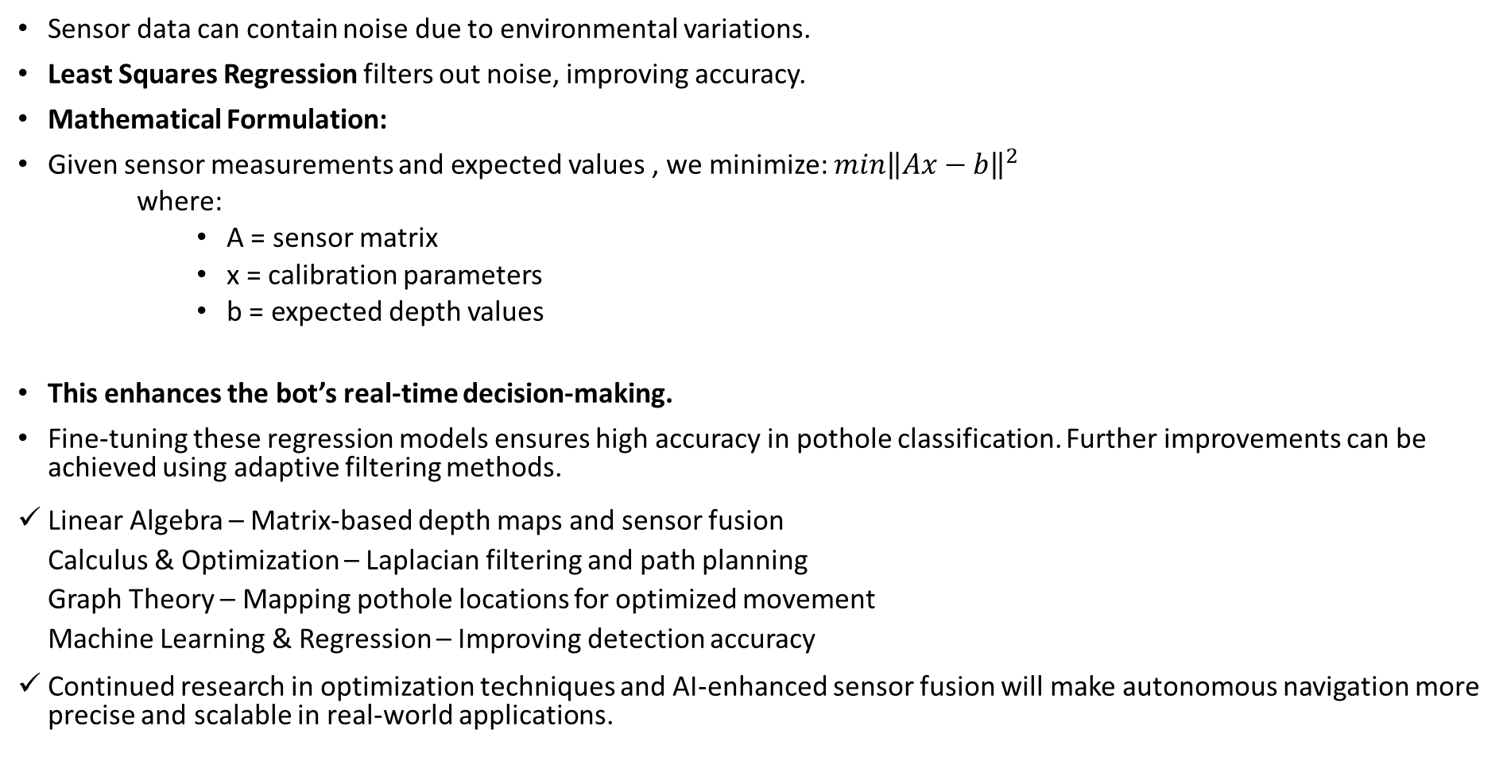
Sensor Calibration Using Least Squares Regression
Sensor data can contain noise due to environmental variations.
Least Squares Regression filters out noise, improving accuracy.
Mathematical Formulation:
Given sensor measurements and expected values , we minimize: $min{\left\|Ax−b\right\|}^{2}$
where:
A = sensor matrix
x = calibration parameters
b = expected depth values
This enhances the bot’s real-time decision-making.
Fine-tuning these regression models ensures high accuracy in pothole classification. Further improvements can be achieved using adaptive filtering methods.
Linear Algebra – Matrix-based depth maps and sensor fusion Calculus & Optimization – Laplacian filtering and path planning Graph Theory – Mapping pothole locations for optimized movement Machine Learning & Regression – Improving detection accuracy
Continued research in optimization techniques and AI-enhanced sensor fusion will make autonomous navigation more precise and scalable in real-world applications.

Slide 26
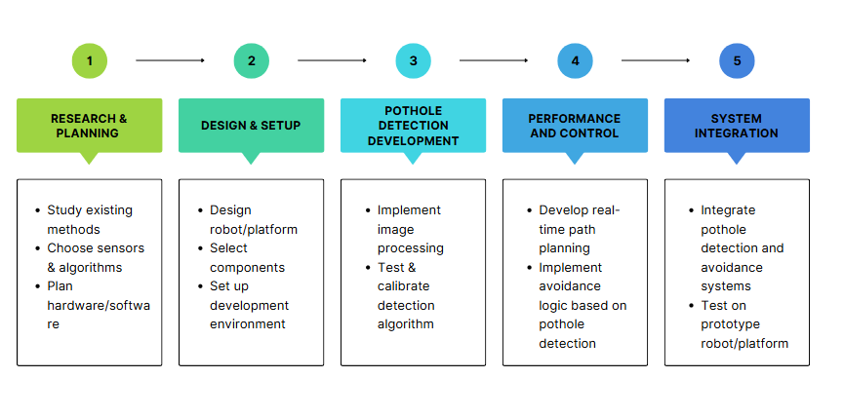
Timeline
Review 1
Review 2​
Jan – Feb 1st week
Feb 2nd and March 1st week

Slide 27
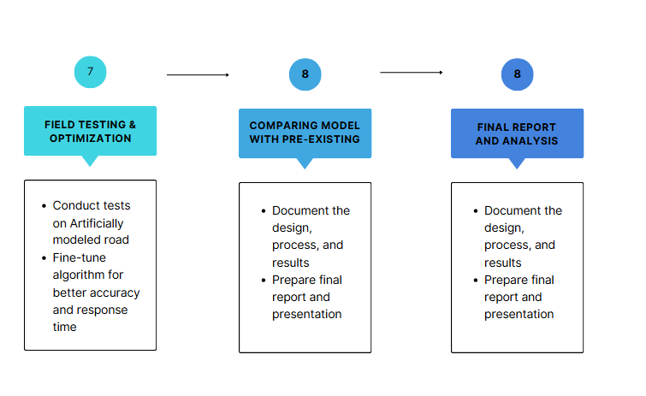
Timeline
Final Review
March 2nd week

Slide 28

[1]Al Arafat, Md Mahedi, Mohammad Shahadat Hossain, Delowar Hossain, and Karl Andersson. "Neural network-based obstacle and pothole avoiding robot." In Proceedings of the Fourth International Conference on Trends in Computational and Cognitive Engineering: TCCE 2022, pp. 173-184. Singapore: Springer Nature Singapore, 2023
[2] Parasnis, G., Chokshi, A., Jain, V., & Devadkar, K. (2023). RoadScan: A Novel and Robust Transfer Learning Framework for Autonomous Pothole Detection in Roads. arXiv preprint arXiv:2308.03467.
[3] Rout, N.K., Dutta, G., Sinha, V., Dey, A., Mukherjee, S., & Gupta, G. (2023). Improved Pothole Detection Using YOLOv7 and ESRGAN. arXiv preprint arXiv:2401.08588.
[4] M. H. Asad, S. Khaliq, M. H. Yousaf, M. O. Ullah, and A. Ahmad, "Pothole Detection Using Deep Learning: A Real-Time and AI-on-the-Edge Perspective," Advances in Civil Engineering, vol. 2022, no. 16, pp. 1-13, 2022. doi: 10.1155/2022/9221211.
[5]G. Raja, S. Anbalagan, S. Senthilkumar, K. Dev and N. M. F. Qureshi, "SPAS: Smart Pothole-Avoidance Strategy for Autonomous Vehicles," in IEEE Transactions on Intelligent Transportation Systems, vol. 23, no. 10, pp. 19827-19836, Oct. 2022, doi: 10.1109/TITS.2022.3161589.
keywords: {Roads;Speech recognition;Computational modeling;Convolutional neural networks;Autonomous vehicles;Gesture recognition;Deep learning;Autonomous vehicles;pothole-avoidance;reinforcement learning;deep deterministic policy gradient;speech and gesture recognition},

Slide 29
[6] S. Bhadraray, S. Dey, T. S. Amith and S. Ramaiah, "Autonomous Vehicle System for Pothole Detection and Avoidance," 2023 IEEE 8th International Conference for Convergence in Technology (I2CT), Lonavla, India, 2023, pp. 1-6, doi: 10.1109/I2CT57861.2023.10126120. keywords: {Roads;Urban areas;Road vehicles;Machine learning;Companies;Safety;Reliability;Machine Learning;ROS;Gazebo;Pothole Detection;On Board Computer;Actuator Interface},
[7] Nachuan Ma, Jiahe Fan, Wenshuo Wang, Jin Wu, Yu Jiang, Lihua Xie, Rui Fan, Computer vision for road imaging and pothole detection: a state-of-the-art review of systems and algorithms, Transportation Safety and Environment, Volume 4, Issue 4, December 2022, tdac026,
[8] Nienaber, S., Marthinus J. Booysen, and R. S. Kroon. "Detecting potholes using simple image processing techniques and real-world footage." (2015).
[9]Hsu, Ya-Wen, Jau-Woei Perng, and Zong-Han Wu. "Design and implementation of an intelligent road detection system with multisensor integration." 2016 International Conference on Machine Learning and Cybernetics (ICMLC). Vol. 1. IEEE, 2016.
[10]Shaghouri, Anas Al, Rami Alkhatib, and Samir Berjaoui. "Real-time pothole detection using deep learning." arXiv preprint arXiv:2107.06356 (2021).

