Slide 1
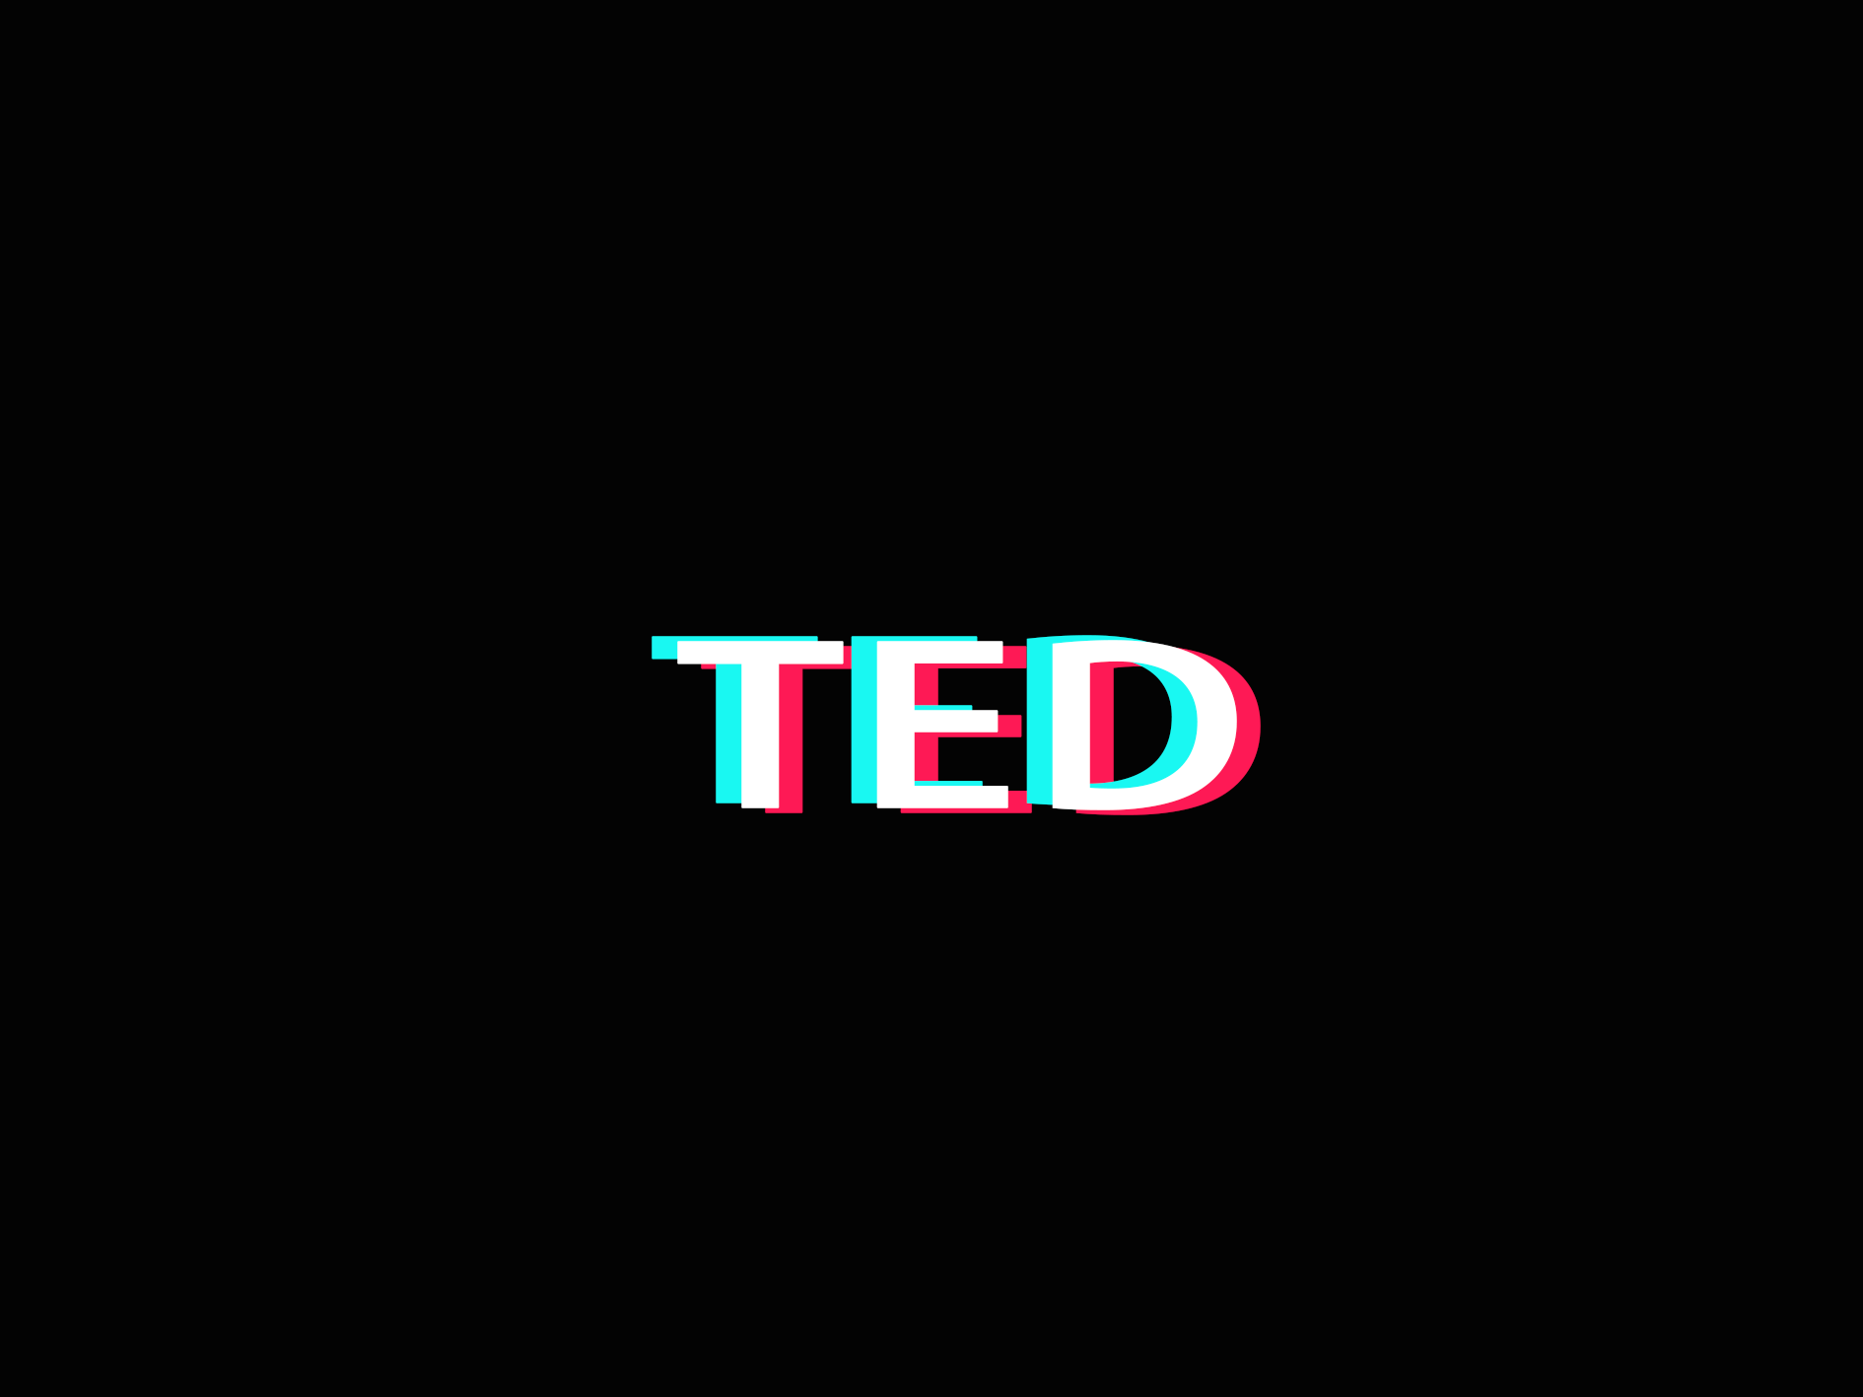
TED Talks Data Mining
—— Elabration Step

Slide 2
Subtitles
Detailed Architecture of the Project
Prototype of the GUI
Data Clearing and Transformation
Analysis of the Dataset
& Analysis Diagram

Slide 3
1
Detailed Architecture

Slide 4
1. Detailed Architecture
General function
After logging in, users can select the videos he likes according to some tags and the user's own homepage will be generated.
Predict the amount of attention to the TED video based on the duration, tag and author information.

Slide 5
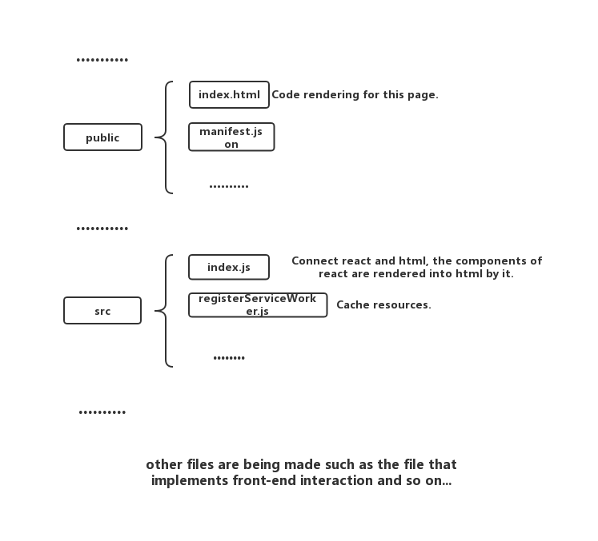
1. Detailed Architecture
Front end
Our front end is designed with React.
Here are the brief structure of the front end.

Slide 6
1. Detailed Architecture
Back end
Recommend.
Based on K-means algorithm, we set 10 or 15 topics as the kernel, separating videos into several parts, and we will recommend the best suitable videos to different audience with different interested topics. In our K-means algorithm, we use TF-IDF to calculate differences between videos.
2. Prediction.
Based on Regression algorithm, we use duration, speakers‘ occupation and main topic of the video as the input value, and set ‘views’ as the target value, then we may get an model to predict number of views of an given information video.

Slide 7
2
Prototype of the GUI

Slide 8
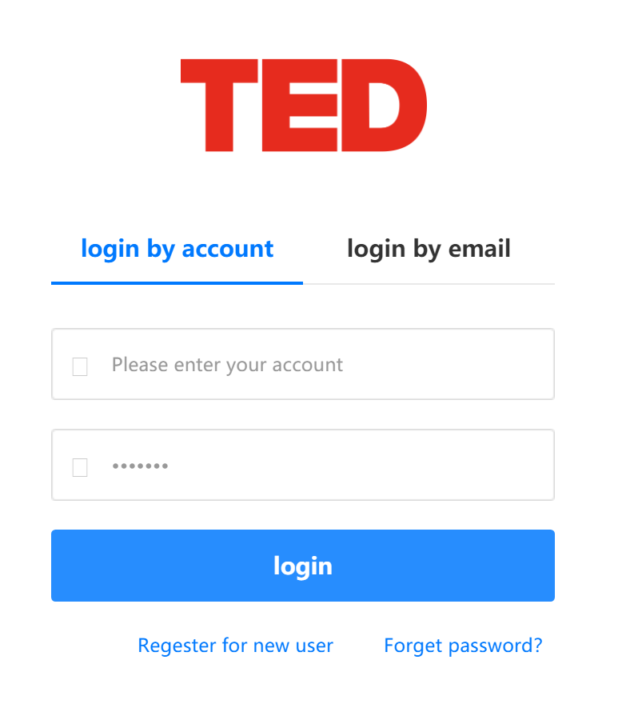
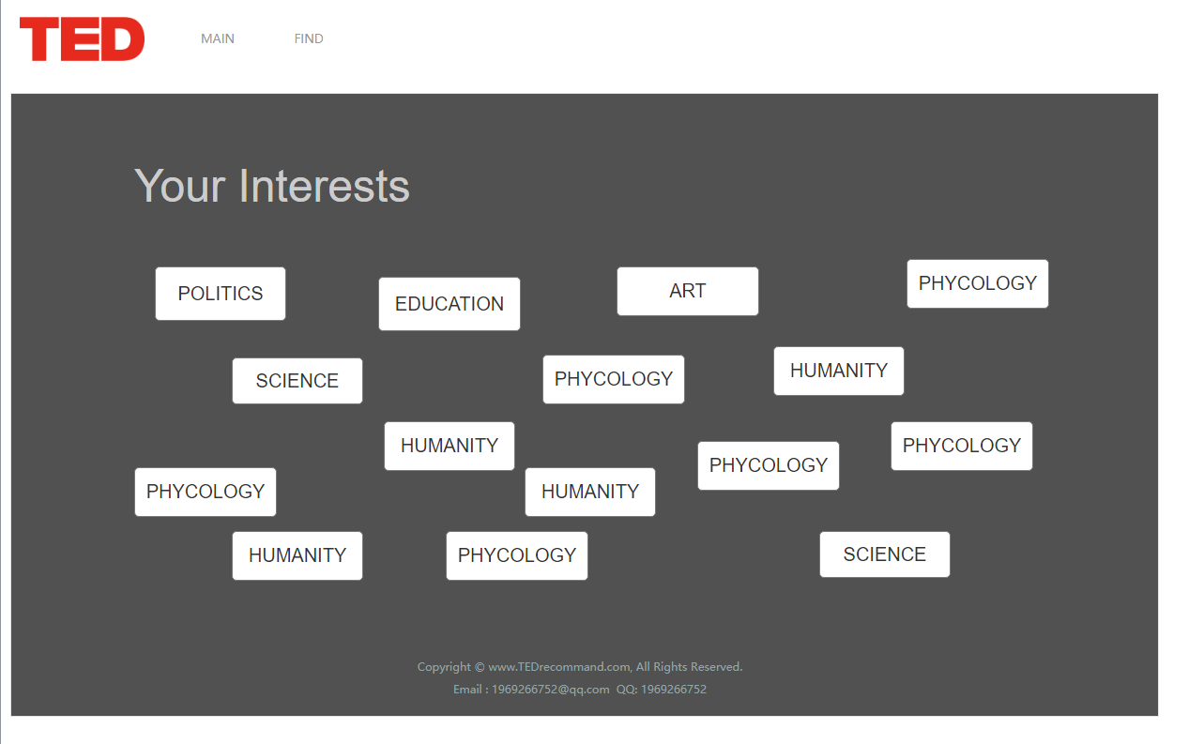
2. Prototype of the GUI
Log-In
Choose interested labels

Slide 9
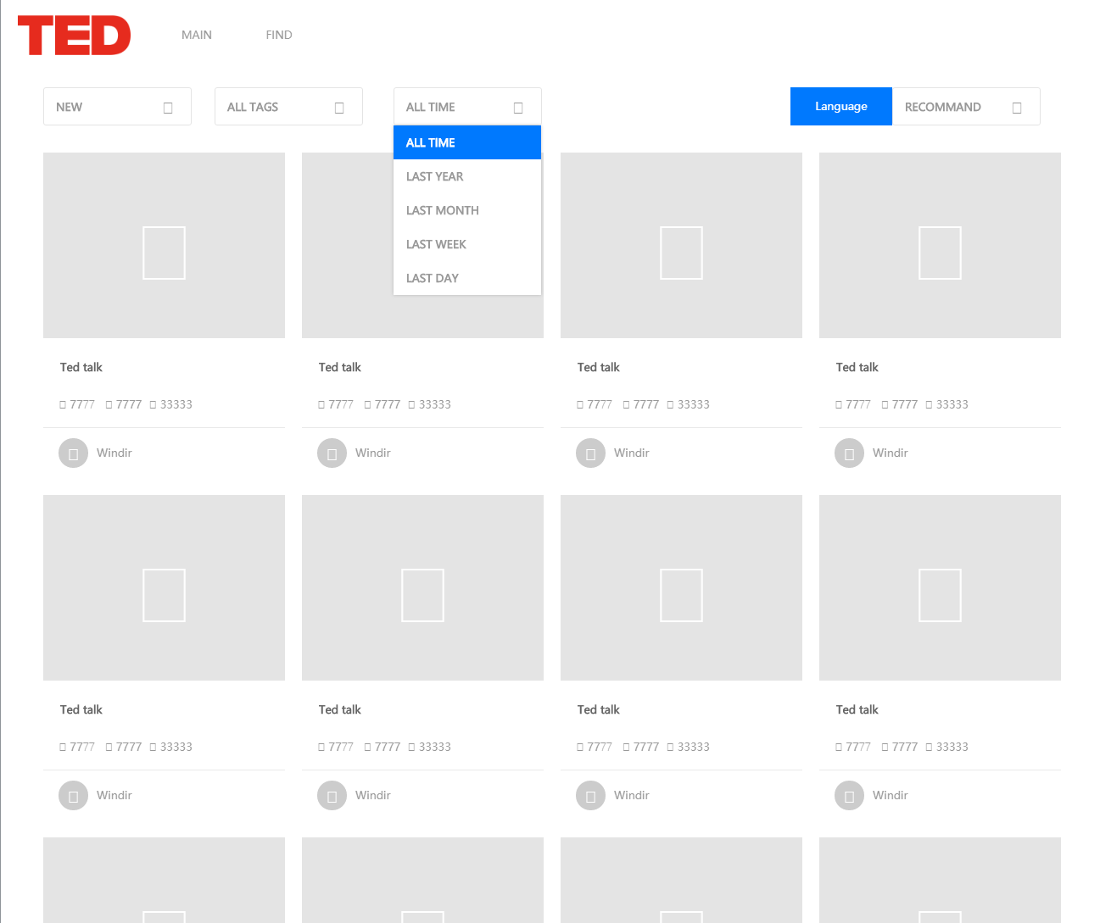
2. Prototype of the GUI
Homepage
After the initial selection of tags, users will have their personalized homepage to recommend TED videos of interest to them.
In the homepage, they can filter videos by theme and time.

Slide 10
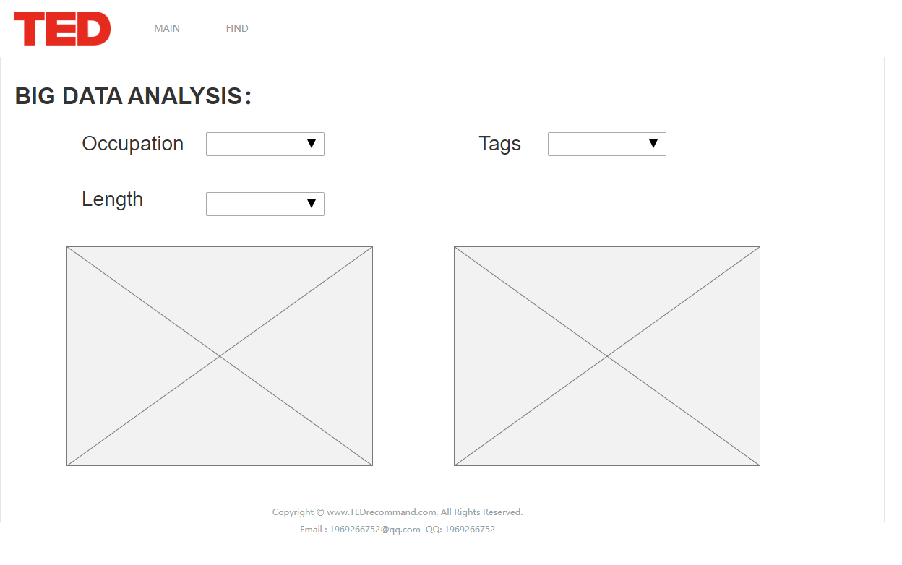
2. Prototype of the GUI
Prediction
Through predictive capabilities, speakers can predict their audience by their occupation, themes, and presentation time.

Slide 11
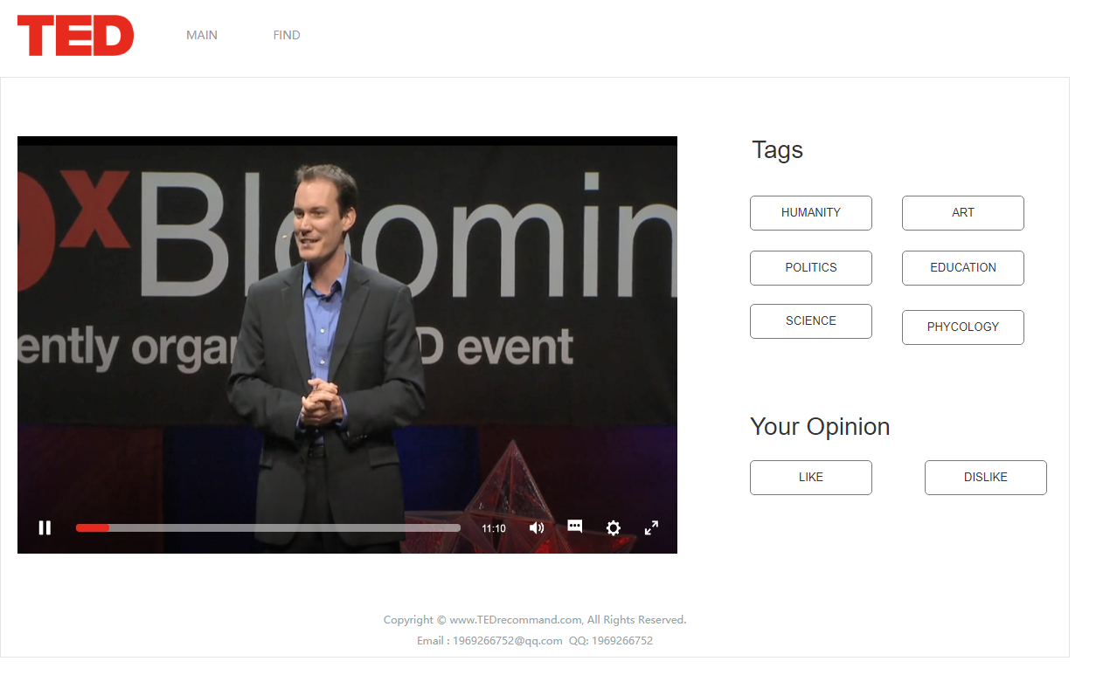
2. Prototype of the GUI
Watch Video
Users may choose like or dislike after watching the video. If they choose dislike, they will be asked to choose one or more more suitable tags.

Slide 12
3
Data Clearing and Transformation

Slide 13
3. Data Clearing and Transformation
What we have done:
Import .csv file into .py file as Dataframe using Panda.
pd.read_csv( )
Clean data-missed record & Drop useless column.
df.dropna & df.drop & df.rename
Change data format :
from ‘str’ to ‘float64’ & from ‘str’ to ‘dictionary’
pd.to_numeric & .apply(lambda x: ast.literal_eval(x))

Slide 14
3. Data Clearing and Transformation
What we have done:
In order to analyze the relationship between theme and views, we need to separate each individual theme from the tag array.
raw
processed

Slide 15
3. Data Clearing and Transformation
Difficulties:
‘ratings’ was transformed from ‘str’ to an array of ‘dictionary’. However, because the order of the elements in the array is confusing, extracting the same theme, such as ‘funny’ will be somewhat difficult.

Slide 16
4
Analysis of the Dataset

Slide 17
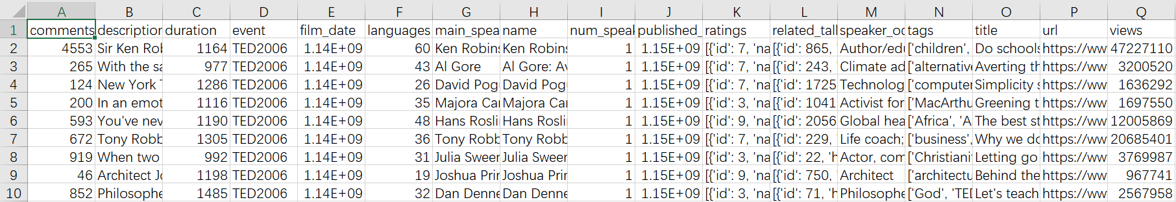
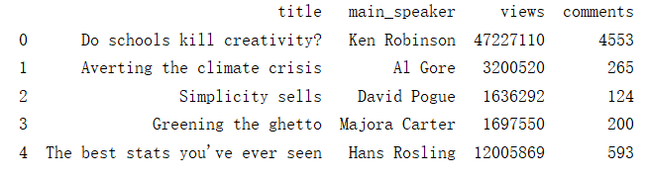
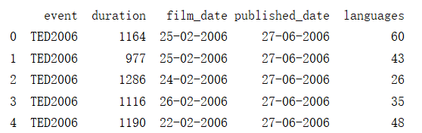
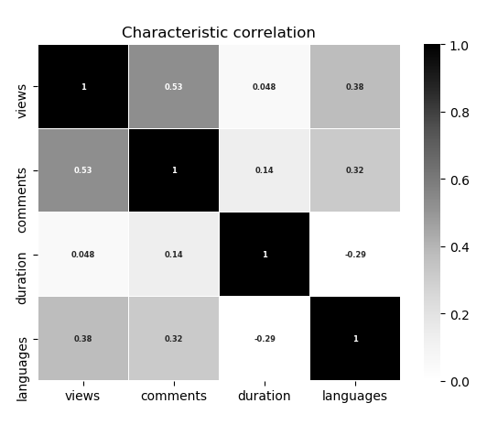
4. Analysis of the Dataset
5500*17
01 Data collection
02 Data cleaning
03 Analysis
04 Visualization

Slide 18
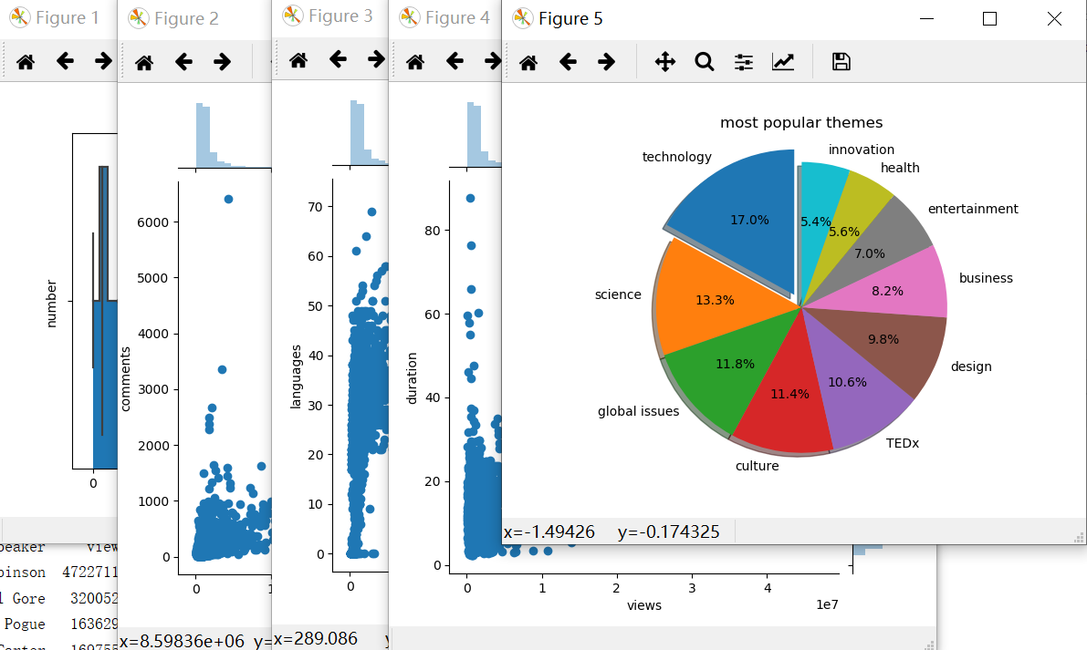
4. Analysis of the Dataset
What I have analyzed
1. The overall situation of the ted video includes statistics on the number of views, comments, etc(mean,average,max and so on).
2. Analysed the comments and views of all talks and find the correlation between them, find out the most viewed and most commented talks
3. A ted talk can be changed into different languages, so I analyzed the situation of the language and its relationship with views
4. Statistical characteristics of the duration and find out the longest and shortest talk
5. The relationship with different events of ted talks
6. Analysed the tags of every talks find out the most popular tag
7. The published time of talks and find out the trend of ted talks

Slide 19

Plan&
Risk
past-now
Data analysis with python(finished)
5/13-5/17
visualization&display as a report
5/17-5/19
ML&prediction
5/20-5/25
Backgroud construction
5/26-5/28
Integrate the project

Slide 20
Plan&
Risk
past-now
Data analysis with python(finished)
5/13-5/17
visualization&display as a report
5/17-5/19
ML&prediction
5/20-5/25
Backgroud construction
5/26-5/28
Integrate the project
1. Our project is divided into two parts, the back end design needs to be behind the front end, so the successful integration of the front and rear ends is also a challenge.
2. Our dataset has too much data and I should spend a lot of time on learning how to use python to visualize it.

Slide 21
Thank you

