Slide 1

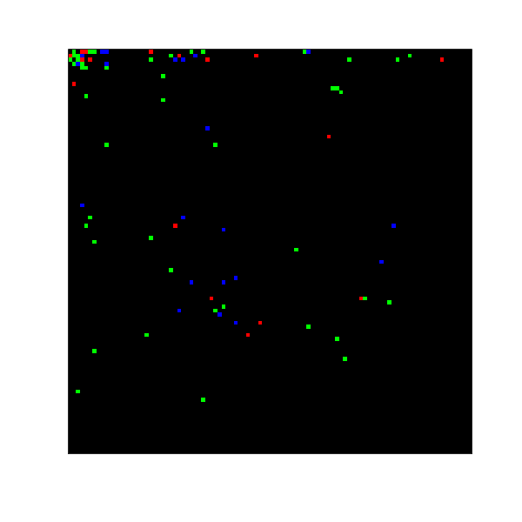
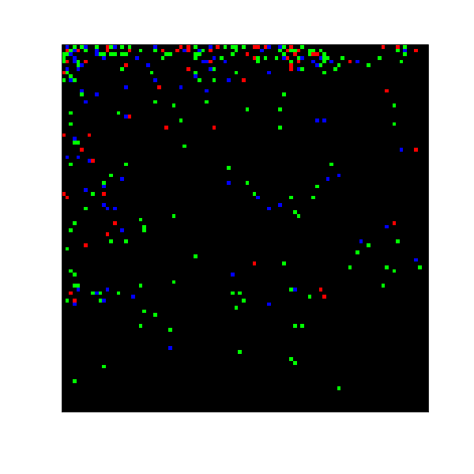

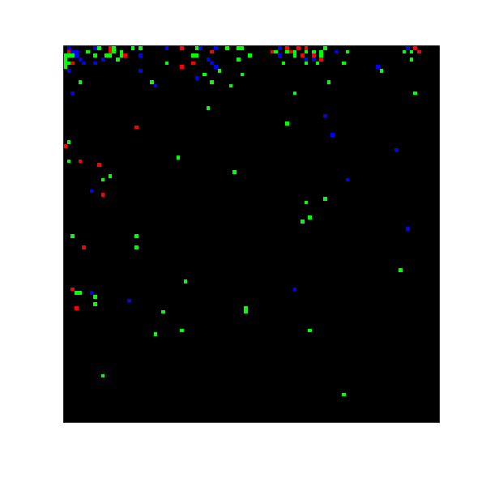
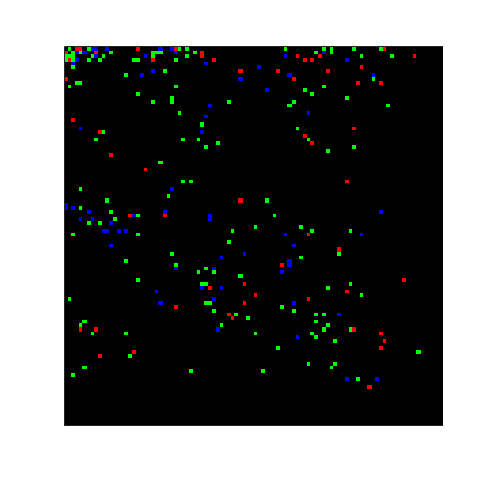
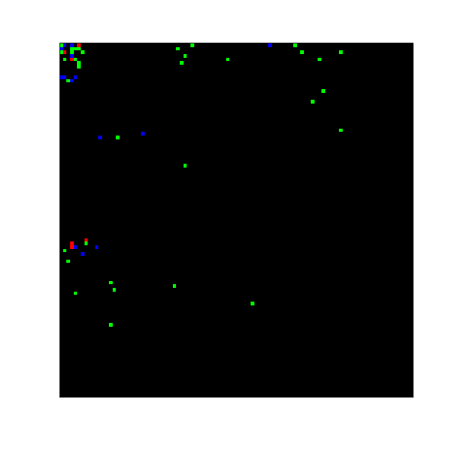
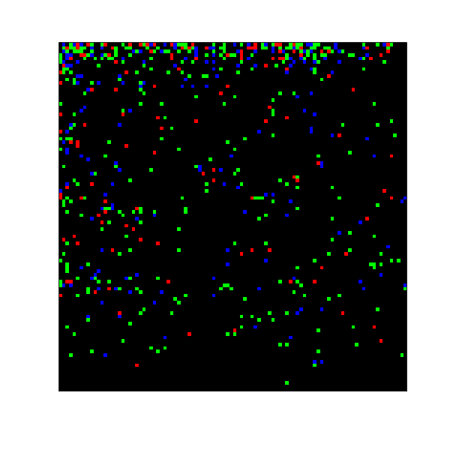
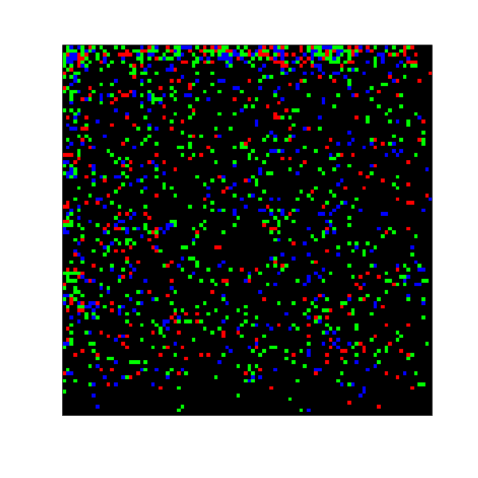
Male
Female
parasitized larvae
parasitized female
parasitized male
70%
100 days
100 days
30%
Grow
Sex
Probability
50%
50%
100 days
100 days
70%
30%
100 days
100 days

Slide 2
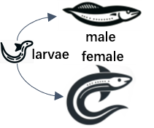
Part I :Question analysis
Part II :Model Construction
Literature search
Population dynamics model
Population Stability Test Model
Ecosystem Stability Evaluation Model
Cellular Automata Model
Reproductive and developmental characteristics of lampreys
Lamprey relationships in ecosystems
Optimized differential equation
Environment Simulation
population stability
sex-resource relationship
(Base on Logistic Model)
Simulate trends :
(1) spread rate
(2) extent of parasites
(1) Logistic Model
(1) CRITIC Method
(2) Lotka-Volterra Model
(2) Entropy Weight Method
Predator
Prey
Competitor
parasite
Analyze the effect of sex ratio on Population
Explore the advantages and disadvantages of Sex Differences
Explore the advantages and disadvantages of Sex Differences
Observing whether sex ratios change benefit parasite
…
Part III :Result and Analysis
Analysis and Conclusion
Sensitivity Analysis of F
Advantages and Disadvantages

