Slide 1
Social Media Database Management System
Kinetic Social — Relational DBMS Project
Database Management Systems Presentation
Submitted by: Vansh Chadha | Roll Number: 25U021036 | Branch: Computer Science & Engineering (AI)
Submitted by: Abhinav Sonker| Roll Number: 25U021037 | Branch: Computer Science & Engineering (AI)
Submitted by: Akshat Argal | Roll Number: 25U021038 | Branch: Computer Science & Engineering (AI)
Submitted by: Wasif Ansari | Roll Number: 25U021040 | Branch: Computer Science & Engineering (AI)
Submitted by: Shristi Jaiswal | Roll Number: 25U021039 | Branch: Computer Science & Engineering (AI)
Course Instructor: Priyankar Choudary Sir | Academic Session: 2026–2027 (3rd Semester)
Tech Stack: React 18 • Node.js Express REST API • MySQL

Slide 2
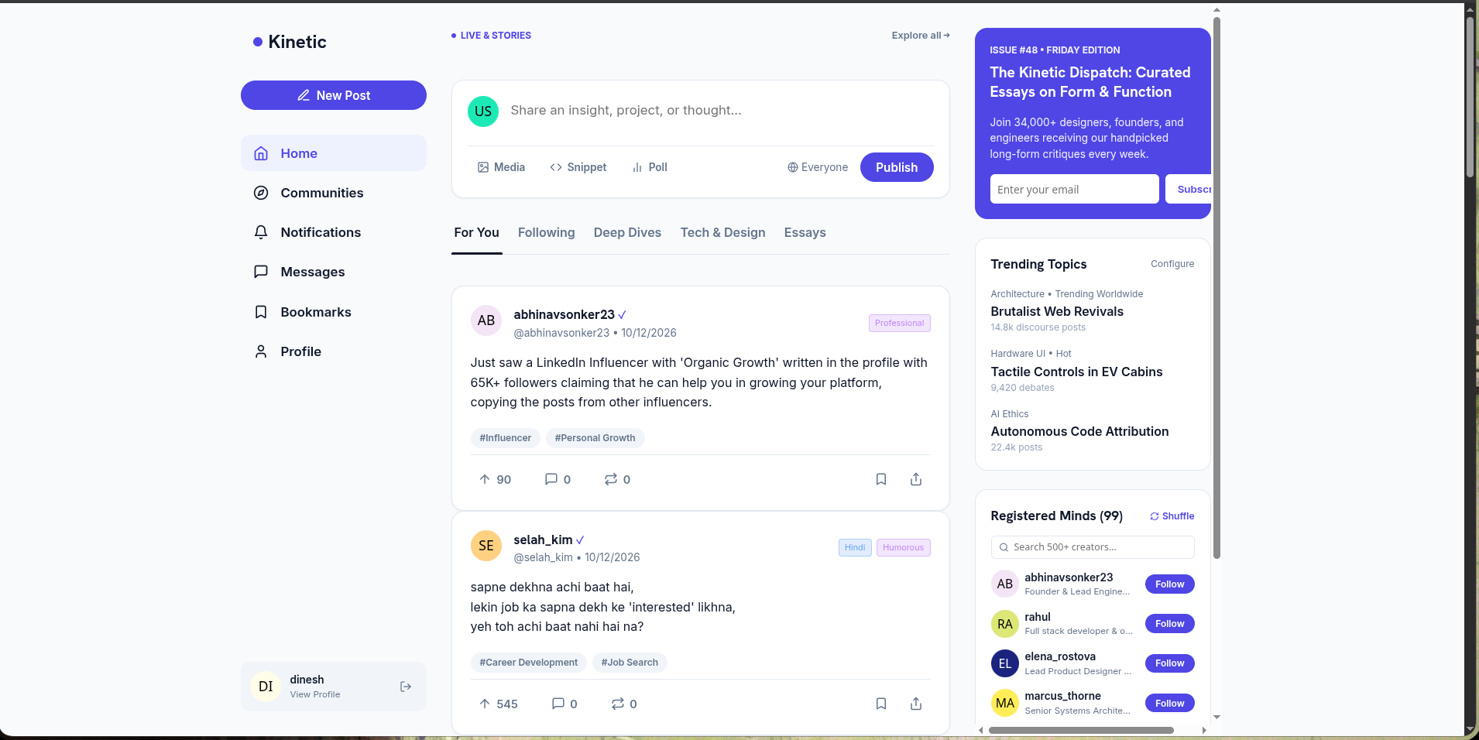
1. Project Overview & Architectural Scope
High-concurrency social media platform with normalized 3NF schema and trigger-based aggregate caching
Problem Statement
Application Dashboard & Home Feed
• Naive social graphs suffer from severe unindexed filesort latency on follower feeds.
• Calculating like counts via dynamic COUNT(*) causes table lock contention and high read latency.
• Storing author metadata inside post rows creates cascading update anomalies when users update bios or usernames.
• Lack of strict referential cascading causes orphaned comments and reactions.
Core System Objectives
• Formulate a fully normalized 3NF & BCNF relational schema on MySQL 8.
• Implement ACID database triggers to maintain aggregate like_count automatically.
• Formulate a stored procedure (get_mutual_followers) for common follower intersection.
• Implement composite B-Tree indexes reducing timeline query latency to <10 ms.
• Connect schema to Node.js/Express API and interactive React 18 client.

Slide 3
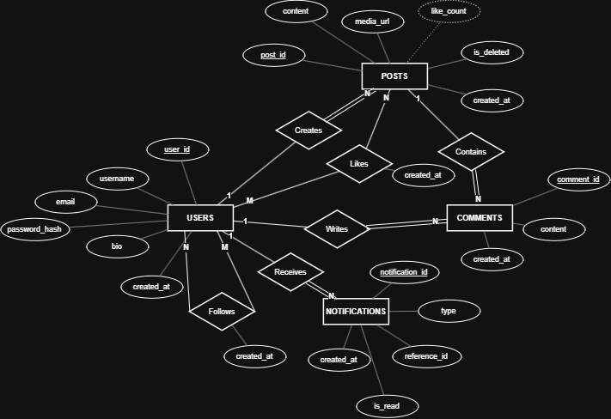
2. Entity–Relationship (ER) Modeling (Chen Notation)
Rigorous conceptual design capturing 6 primary entities, associative junction tables, and cardinality ratios
Cardinalities & Decisions
Entities & Cardinalities:
• Users → Posts (1:N): Total on Posts
• Users → Comments (1:N): Total on Comments
• Posts → Comments (1:N): Total on Comments
• Users ↔ Posts (Likes, M:N): Junction table
• Users ↔ Users (Follows, M:N): Self-referencing recursive graph
• Posts ↔ Tags (M:N): PostTags bridge table
Key Design Decisions:
• Surrogate AUTO_INCREMENT PKs prevent multi-column join explosion.
• ON DELETE CASCADE guarantees zero orphaned comments or dangling likes.

Slide 4
3. Relational Schema, Functional Dependencies & Normalization
Proof of 1NF, 2NF, 3NF, and BCNF compliance with deliberate trigger-maintained denormalization
Final Relational Schema
Step-by-Step Normalization Proof
• USERS (user_id [PK], username [UQ], email [UQ], password_hash, bio)
• POSTS (post_id [PK], user_id [FK], content, like_count, is_deleted)
• COMMENTS (comment_id [PK], post_id [FK], user_id [FK], content)
• LIKES (user_id [PK,FK], post_id [PK,FK], created_at)
• FOLLOWS (follower_id [PK,FK], following_id [PK,FK], created_at)
• NOTIFICATIONS (notification_id [PK], user_id [FK], type, ref_id)
• TAGS (tag_id [PK], name [UQ])
• POST_TAGS (post_id [PK,FK], tag_id [PK,FK])
1NF (Atomic Attributes):
• Eliminated repeating tag lists and author metadata from posts into dedicated atomic tables (PostTags, Tags).
2NF (No Partial Key Dependencies):
• In Likes and Follows with composite PKs, created_at strictly depends on the full pair; single-PK tables satisfy 2NF trivially.
3NF (No Transitive Dependencies):
• Author attributes (username, email) live strictly in Users, eliminating: post_id → user_id → username.
BCNF (Determinants are Superkeys):
• For all non-trivial X → Y, X is a candidate key. Fully satisfies BCNF.
Functional Dependencies (FDs)
• user_id → username, email, password_hash, bio, created_at
• post_id → user_id, content, media_url, like_count, created_at
• comment_id → post_id, user_id, content, created_at
• {user_id, post_id} → created_at
• {follower_id, following_id} → created_at
Reasoning: Keys uniquely determine entire tuples by domain rules.

Slide 5
4. MySQL Implementation: Triggers, Procedures & Queries
Advanced DBMS mechanisms maintaining transactional consistency and high-speed retrieval
ACID Triggers: like_count & Notifications
Multi-Table Timeline Join Query
CREATE TRIGGER trg_like_insert AFTER INSERT ON Likes
FOR EACH ROW BEGIN
UPDATE Posts SET like_count = like_count + 1
WHERE post_id = NEW.post_id;
-- Auto-generate notification for author
INSERT INTO Notifications (user_id, type, reference_id)
SELECT p.user_id, 'like', NEW.post_id FROM Posts p
WHERE p.post_id = NEW.post_id AND p.user_id <> NEW.user_id;
END;
SELECT p.post_id, u.username AS author, p.content,
p.like_count, GROUP_CONCAT(DISTINCT t.name) AS tags
FROM Follows f
JOIN Posts p ON p.user_id = f.following_id
JOIN Users u ON u.user_id = p.user_id
LEFT JOIN PostTags pt ON pt.post_id = p.post_id
LEFT JOIN Tags t ON t.tag_id = pt.tag_id
WHERE f.follower_id = ? AND p.is_deleted = FALSE
GROUP BY p.post_id ORDER BY p.created_at DESC LIMIT 50;
Stored Procedure: Mutual Followers
DROP PROCEDURE IF EXISTS get_mutual_followers;
DELIMITER $$
CREATE PROCEDURE get_mutual_followers(IN u_a INT, IN u_b INT)
BEGIN
SELECT DISTINCT u.user_id, u.username
FROM Follows f1
JOIN Follows f2
ON f1.follower_id = f2.follower_id
JOIN Users u
ON u.user_id = f1.follower_id
WHERE f1.following_id = u_a
AND f2.following_id = u_b;
END$$
DELIMITER ;
Database Architecture Highlights
• Zero Counter Drift: Triggers guarantee count matches rows.
• View Encapsulation: user_feed view simplifies timeline reads.
• B-Tree Composite Indexing: idx_posts_user_created, idx_follows_following eliminate temporary filesorts.

Slide 6
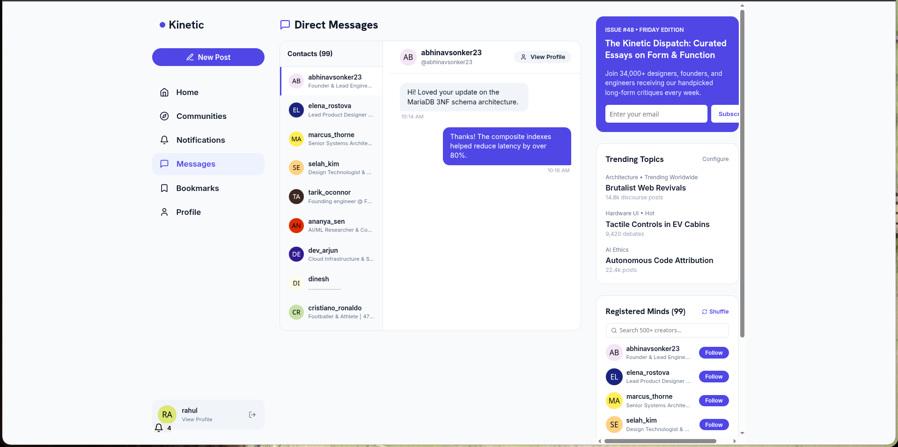
5. Application Demonstration: Live Feed & Trigger Reactions
End-to-end full-stack interaction showcasing atomic database triggers and real-time updates
End-to-End Social Interaction Workflow
1. Post Creation & Categorization:
User submits publication with tags → API initiates parameterized INSERT INTO Posts and PostTags inside MySQL.
2. Real-Time Interaction (Like Reaction):
Follower clicks like button on feed → Client sends POST /posts/:id/like with authentication header.
3. Atomic Trigger Execution:
• MySQL trg_like_insert executes synchronously.
• Posts.like_count atomically increments by 1.
• System inserts notification row for author without notifying self.
4. Zero SQL Injection:
All queries executed via mysql2 connection pool using strictly parameterized prepared statements.

Slide 7
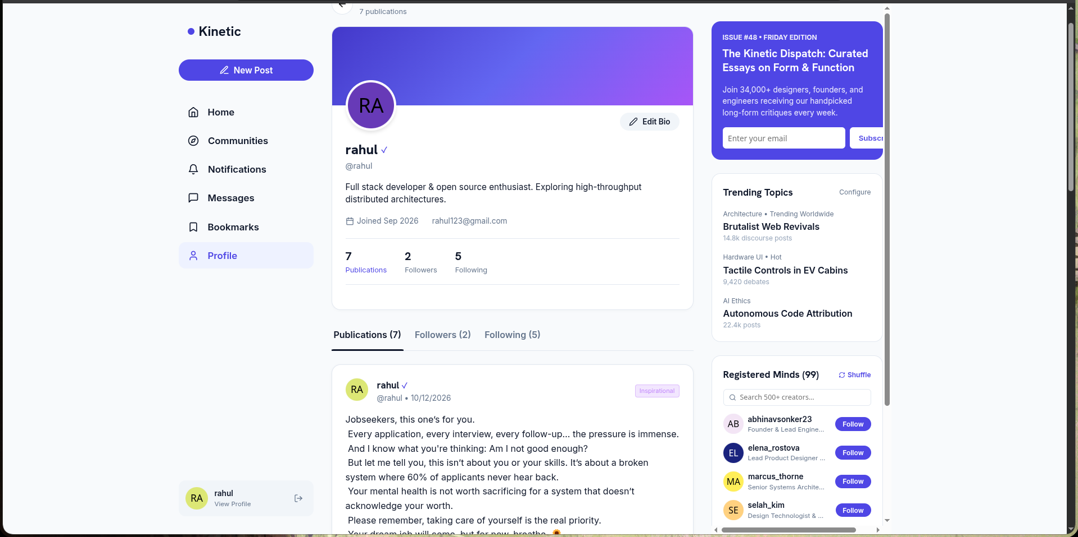
6. Application Demonstration: Profile & Stored Procedure
Mutual connection discovery via get_mutual_followers and profile constraint inspection
Stored Procedure Execution & Security
Stored Procedure Workflow:
1. User navigates to a creator profile (e.g., /users/3).
2. Backend executes:
CALL get_mutual_followers(viewer_id, target_id)
3. MariaDB performs self-join on Follows table and returns common accounts.
4. React UI renders clickable mutual connection pills.
Application Architecture:
• React 18 client handles optimistic UI updates.
• Express.js connection pool manages persistent socket connections to MySQL .

Slide 8
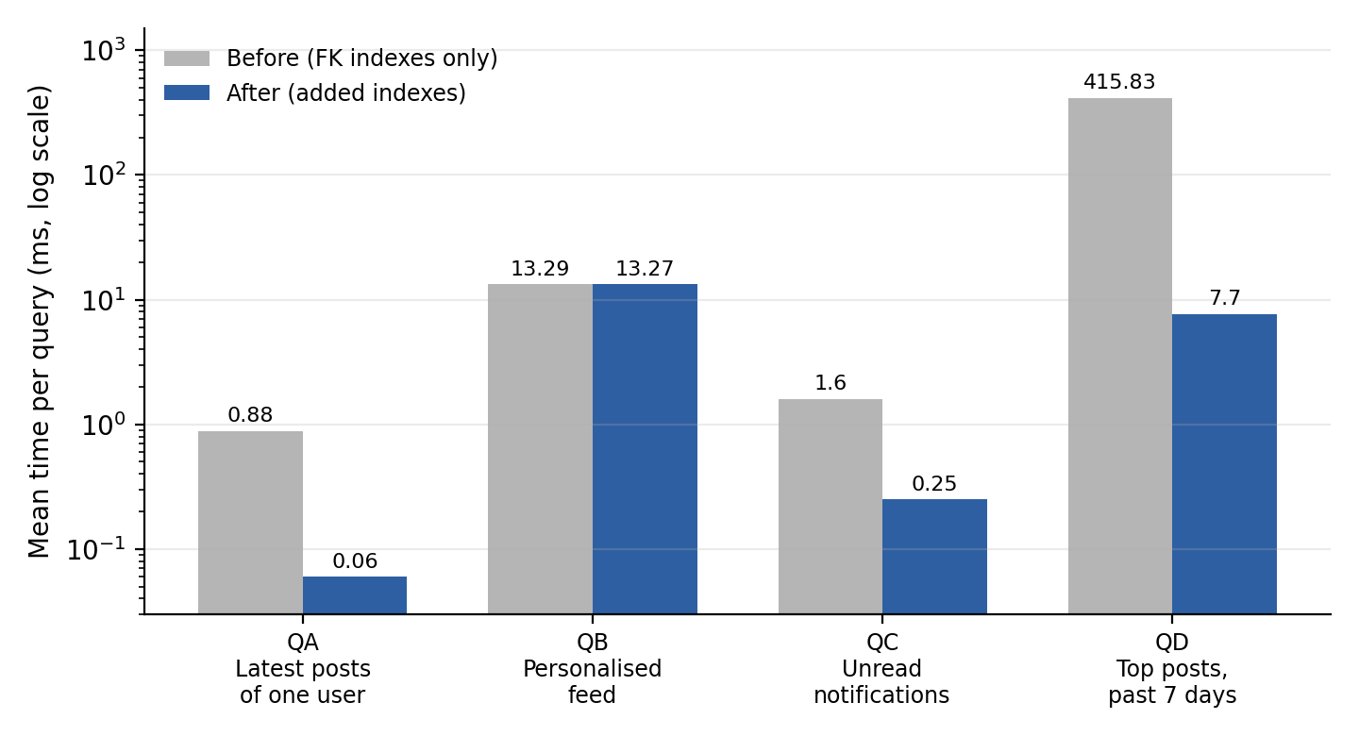
7. Testing, Performance Benchmarks & Conclusion
Constraint verification, 54x indexing performance acceleration, and project summary
Constraint & Operation Test Cases
Indexing Benchmark (300K Tuples)
Operation Input / Constraint Status
--------------------------------------------------------------
User Registration Unique username & email PASS
Duplicate Handle Rejected by UNIQUE constraint PASS
Self-Following CHECK (follower_id <> following) PASS
Duplicate Reactions Composite PK (user_id, post_id) PASS
Foreign Key Cascade Delete user cascades to posts PASS
Trigger Consistency Atomically syncs like_count PASS
Mutual Followers SP Self-join returns common users PASS
Conclusion & Future Scope
• Successfully built an enterprise-grade 3NF/BCNF relational social architecture.
• Demonstrated triggers, views, stored procedures, and B-Tree indexes.
• Future: Redis caching layer for read-heavy feeds and horizontal range sharding.
Query latency reduced from 418 ms down to 7.7 ms (54x faster) using composite B-Tree index on (user_id, created_at).

