Slide 1
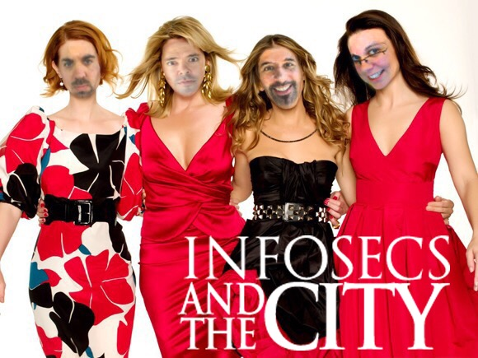
@Mr_FMunson
@ChrisCarlis
@VajKat
@j0hnnyXm4s

Slide 2
Who are you, and why do I care?
Johnny Xmas - @J0hnnyXm4s – Pentester for RedLegg International
Chris Carlis - @ChrisCarlis – Pentester for Dell SecureWorks
Kate Vajda – Pentester & IR “for A Utility Company”
Fletcher Munson – “Uh. . .just put ’sysadmin’”
Notes:
“Why do I care” = We run some pretty mean meetups in the Midwest. Here are some pics:

Slide 3
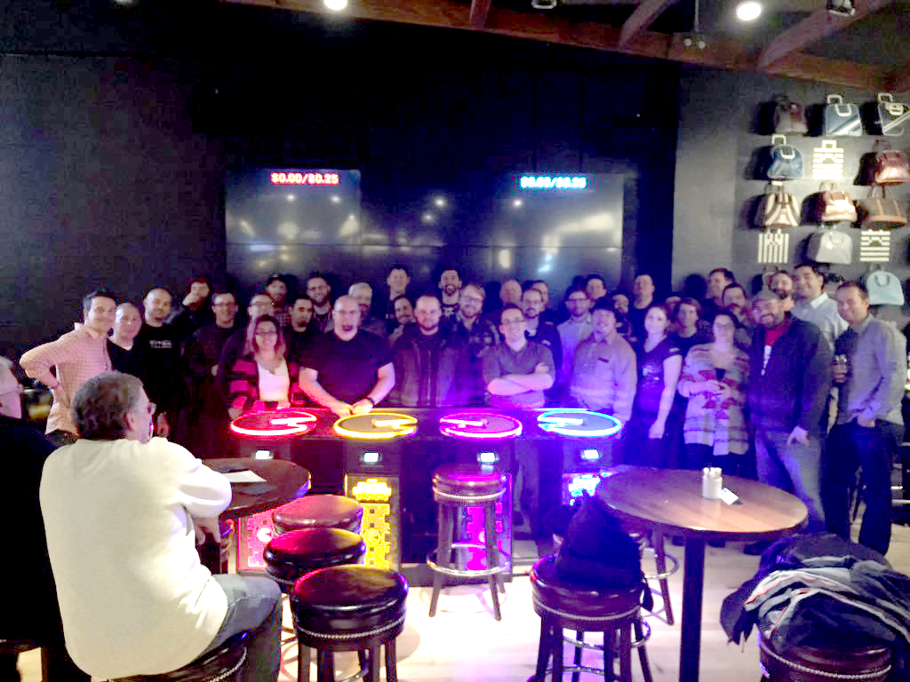
Average night @ burbsec prime

Slide 4
INNAUGURAL burbsec east

Slide 5
The BurbSec Framework: Core
NO DUES
No hacks \ sploits \ 0Days
No Presentations
No sales pitches
Refreshment Sponsors are OK (just not pushy ones)!

Slide 6
The BurbSec Framework: Location
High general population density
High IT Pro population density (Look for tech stores)
CENTRAL (Not what’s convenient for you)
Corporate centers are often great spots
Near mass transit or highway exits

Slide 7
The BurbSec Framework: Interior
Beer, Food, Bourbon
Quiet enough for casual conversation
Not TOO Quiet
Reserved Seating
Cool with randos coming and going all night
SEPARATE CHECKS

Slide 8
The BurbSec Framework: ADVERTISING
Twitter
Twitter
Twitter
Twitter
Meetup.com – Surprisingly effective
Your company’s customers \ Clients (and employees)
Happy attendees

Slide 9

Experiences, Objections & Contradictions

Slide 10
INTERNETS!
@J0hnnyXm4s @ChrisCarlis @VajKat @Mr_FMunson
@BurbSecPrime | @BurbSecNorth | @BurbSecEast | @BurbSecWest
@MiSec | @MilSec
Burbsec.com | Milsec.org | MichSec.org
Github: J0hnnyXm4s/TALKS
Notes:
“Why do I care” = We run some pretty mean meetups in the Midwest. Here are some pics:

