Slide 1
Attack Paths
How to get people to have infosecs with you when you have never had infosecs before
Eve adams (@hackerhuntress)
J0hnny Xm4s (@j0hnnyxm4s)

Slide 2
BEST PRACTICES FOR GETTING SOME INFOSECS
Do it yourself
Do it with other people
Know who you’re doing it with

Slide 3
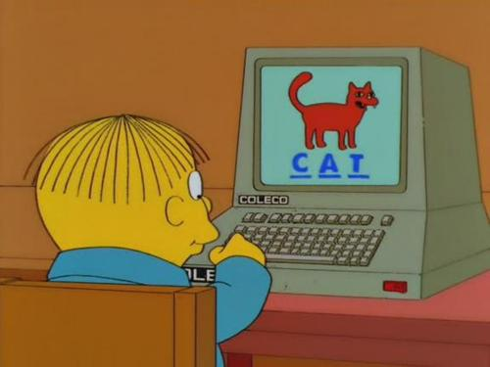
SELF-EJUCATE!

Slide 4
Struckchured Lernding
FREE or cheap workshops at cons
Joseph McCray, Marcus J. Carey, Georgia Weidman, etc, etc, etc.
LEARN TO CODE!!!!!
Exercism.io (http://exercism.io)
Code Academy ( http://codeacademy.com)
Treehouse (http://teamtreehouse.com/)
PYTHON ALL THE THINGS (All of the above)
Mozilla One and Done (https://oneanddone.mozilla.org/en-US/)

Slide 5
Struckchured Lernding
Hacker Training Sites
Hackthissite (https://www.hackthissite.org/)
Vulnhub (http://vulnhub.com) (By our friends g0tm1lk & L0pi)
WebGoat \ OWASP (https://www.owasp.org/index.php/Category:OWASP_WebGoat_Project)
Mozilla (Look for security projects)
One and Done (https://oneanddone.mozilla.org/en-US/)
P2PU (https://p2pu.org/en/schools/school-of-webcraft/)

Slide 6
OMG CTF
SANS quarterly CTFs (PRIZES!)
Posted to (http://pen-testing.sans.org/blog)
CCDCs
CTF365.com
Basically every CTF at every con ever
Most have write-ups afterwards
Many provide downloads of the CTF puzzles for offline use
Example: https://www.defcon.org/html/links/dc-ctf.html

Slide 7
OMG CTF
You probably will NOT win a CTF for a very long time.
Think like amateur marathon runners: You don’t run to win; you run to finish, regardless of how long it takes.
You WILL be able to solve AT LEAST one puzzle.
Failure is EXCELLENT.
You don’t learn from success, you learn from failure.
When we succeed, we don’t learn, because we already know.
Failure is when we review, troubleshoot, and try a better approach next time.
SO GET OUT THERE AND FAIL!

Slide 8
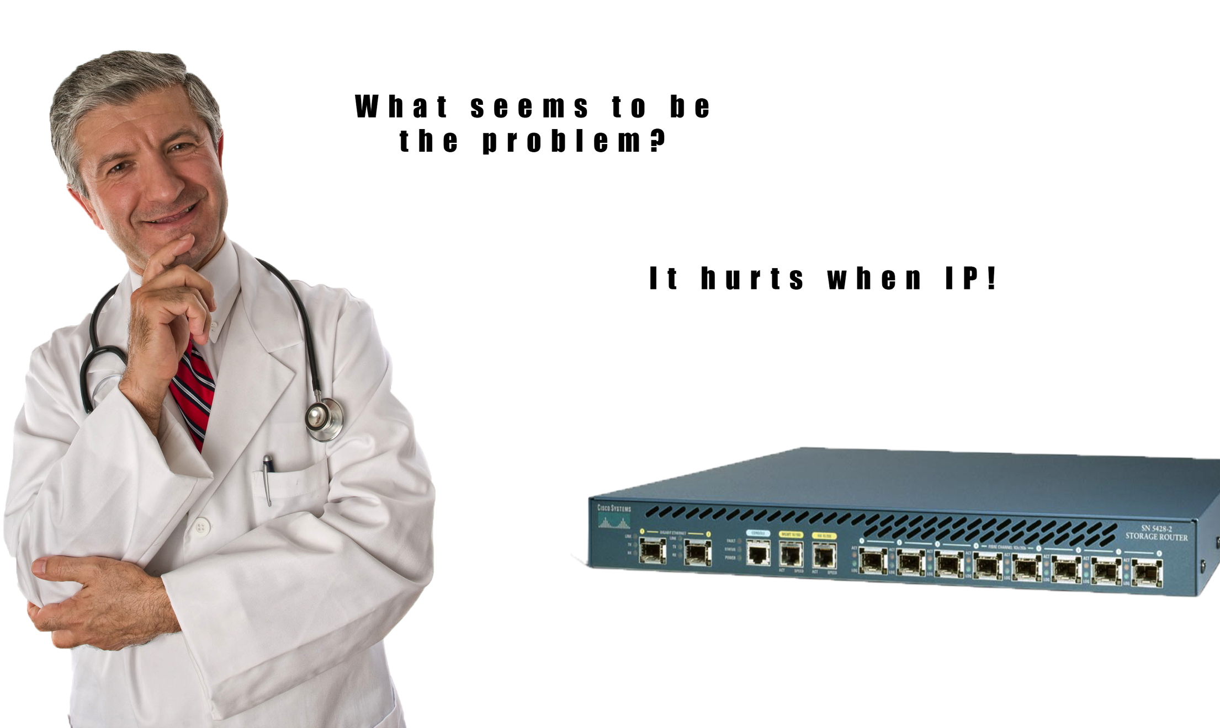

Slide 9
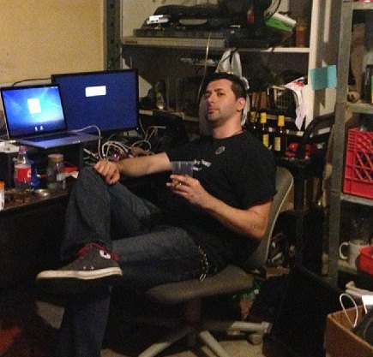
The best Lab, not THE best Lab.
Hardwares
Cisco or Juniper managed switch & router.
Grab an AP off the OSWP list
Cheap network tap (if you want)
Check out eBay & “IT Asset Recovery Firms”
ESXi Server
Powerful desktop is fine
Disk I/O & RAM is a concern
Multi-port LAN adapter (RJ-45 is fine)
Load it with VM for each application
Tweak Linux kernels, IPTables, SELinux

Slide 10
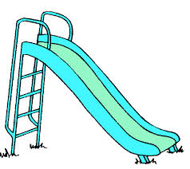

Slide 11
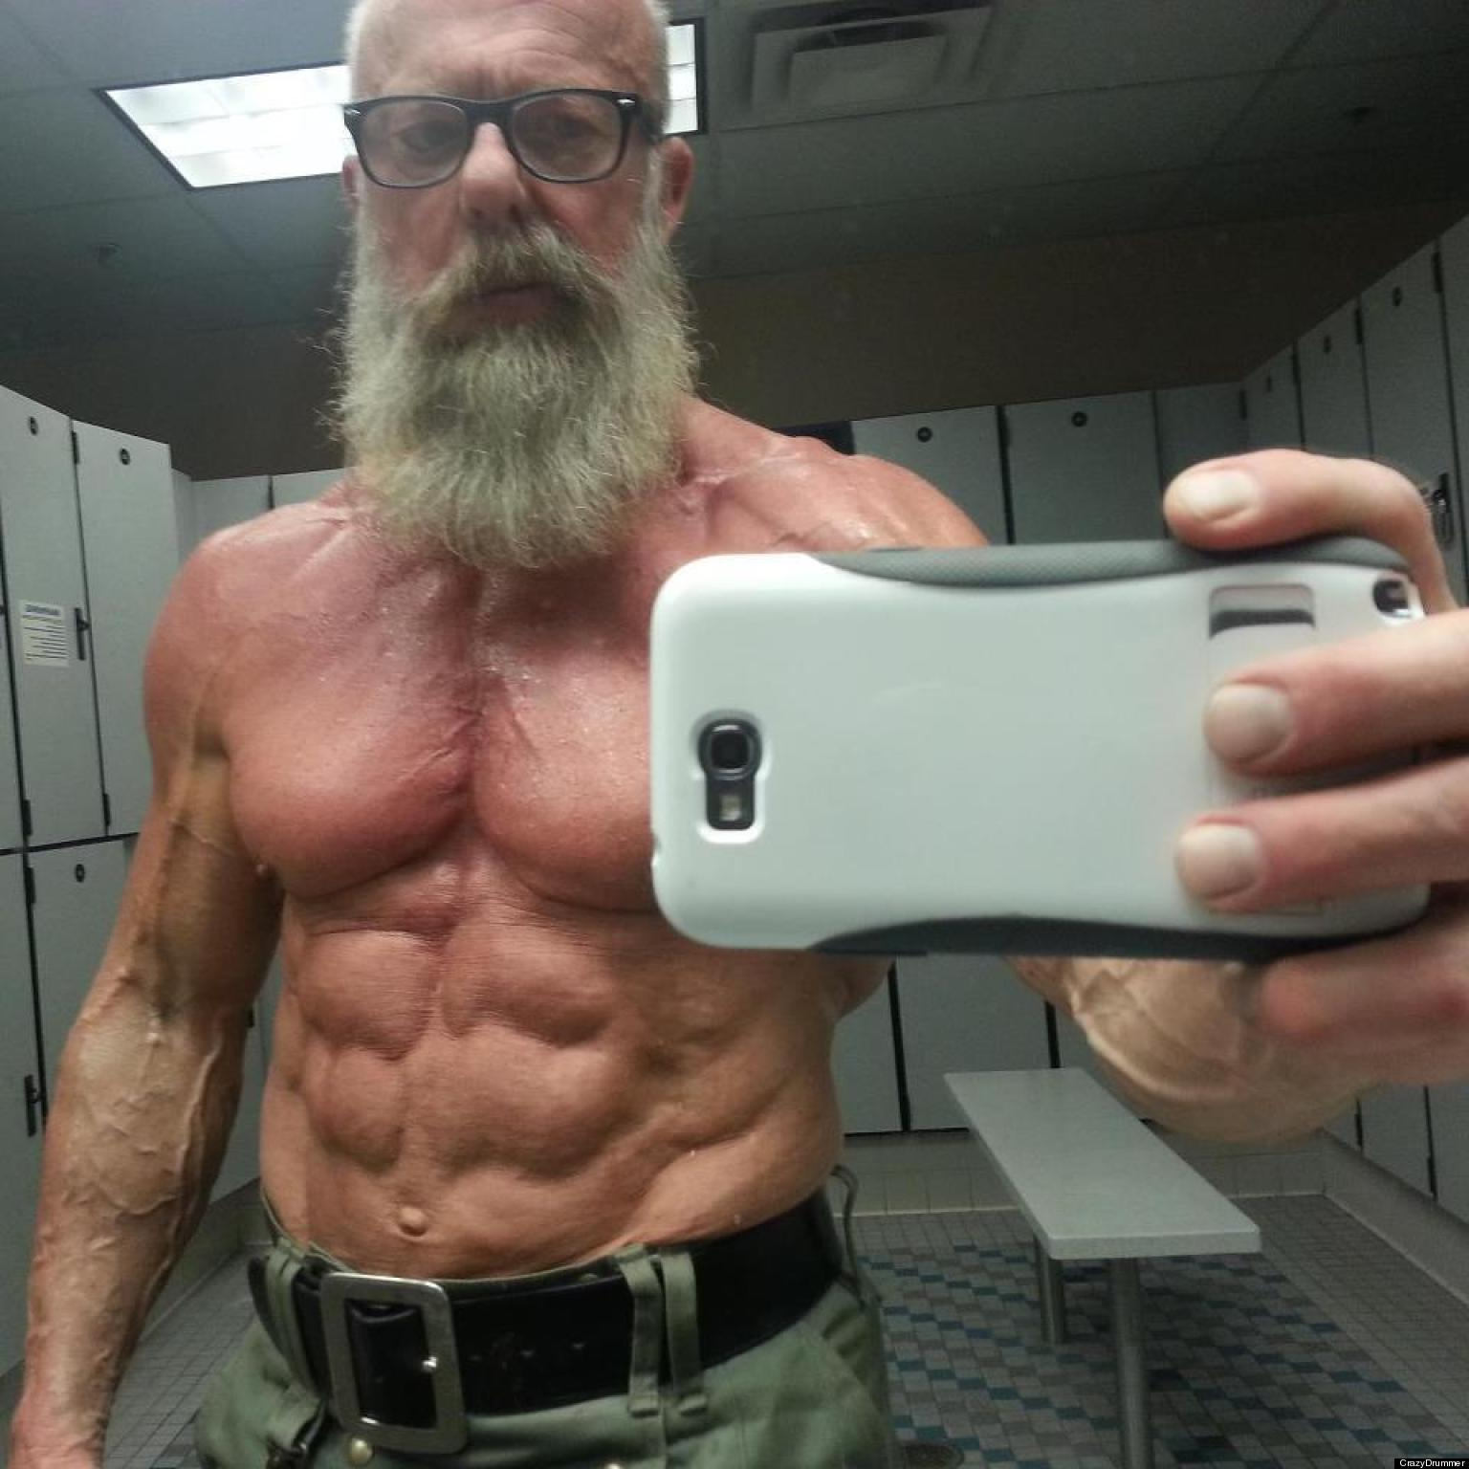
Bro, Do You Even Vegetable?
SECURITY ONION
Do NOT run in a VM.
Bro IDS + ElasticSearch or Splunk
PFSense
Kali
Windows Server
AD Domain, Forests, etc.
Hack All the (common) Distros
CentOS
RHEL
Solaris
Windows, Windows, Windows

Slide 12
OK, I Set Everything Up. Am I 1337 yet?
Moderate to advanced knowledge of IP & TCP
Ermahgerd Wireshark
Packet forging \ crafting
SIEM Analysis \ Hunting
Rule \ Sig \ Alert creation
Analyzing alerts (ID false-positives, tweak rules for them)
Solid Linux Skillset
Administration (Permissions, NFS/SMB, Cron, Maintenance)
Bash scripting
PYTHON or PHP

Slide 13


Slide 14
You’re Not Playing Scrabble
Don’t spend all your time racking up letters, but being functionally useless.
Certs are overrated; not useless, but not silver bullets.
Don’t get a cert in order to learn, get a cert because you already have learned. THAT’S WHAT THEY’RE FOR.
Educational Exceptions (CCNA, RHCE, OSCP, GIAC, etc)
Most cert req’s are not reeeeaaalllly requirements.
Certs that have a lot of HR filter “pull:”
CISSP
GIAC
CCNA\P

Slide 15
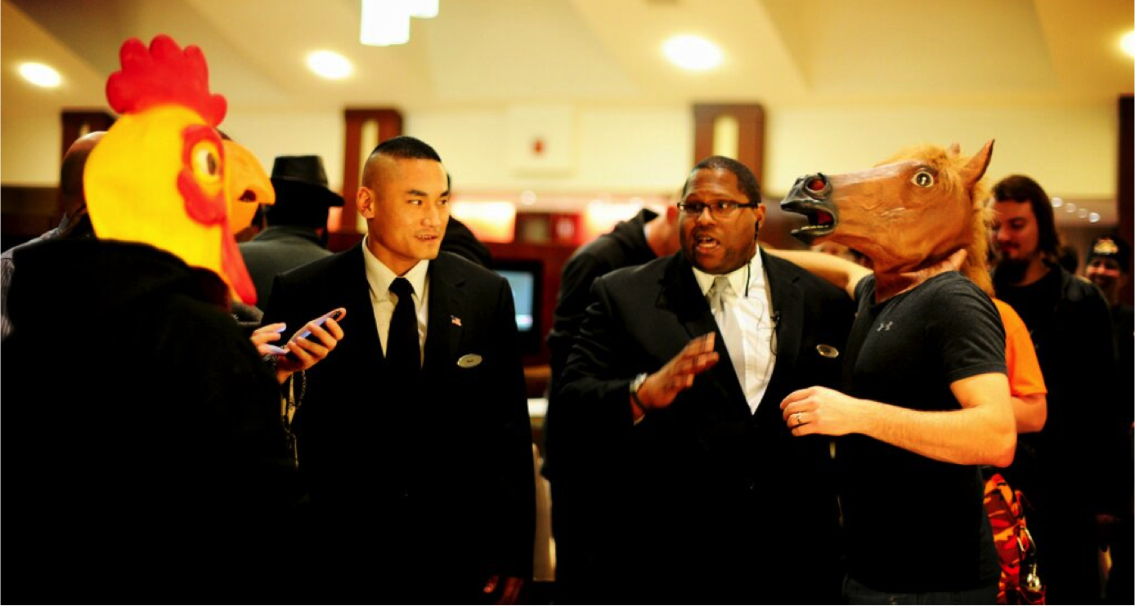
NETWERK INTELAGENTLY

Slide 16

UNIFIED CREEPINESS THEORY
(For all possible human values)

Slide 17
IRL Social Networking Like Grandpa Used to Do Before You Kids Showed Up with Your Fancy Smartphones and Your Facebutts and Your iPhablets
What we’re doing here:
Making people like us
73% of people got their current job via someone they know
Showing up and working hard are no longer all it takes to get ahead
LISTEN, and provoke conversation. Studies show people will like you more when you let them talk about themselves.
Forging long-term contacts
Keep connections fresh via post-con interactions (LinkedIn, Twitter)
Find local meetups, attend regularly (Don’t have one? START ONE!)
Shameless plug (I mean GREAT EXAMPLE): http://burbsec.com

Slide 18
IRL Social Networking Like Grandpa Used to Do Before You Kids Showed Up with Your Fancy Smartphones and Your Facebutts and Your iPhablets
What we’re NOT doing here:
Proving ourselves
Nobody really cares about your skill level. We care about who you are.
Bragging \ strong vocal reinforcement of achievements is very annoying
Tends to show you have no self-soncfidence
Putting People to Sleep
We’re already on 4 hours of sleep and don’t want to hear some stranger’s life story
We know you’re excited to be surrounded by people who like what you like. So are we. Take it down a notch (about 30%).
If the other person isn’t interracting, you’re talking too much.
Bad signs: folded arms,no eye contact, no relative questions, no words of agreement, attempts to change subject or find a reason to leave
Make THEM talk. Ask THEM questions. Learn THEIR interests.

Slide 19
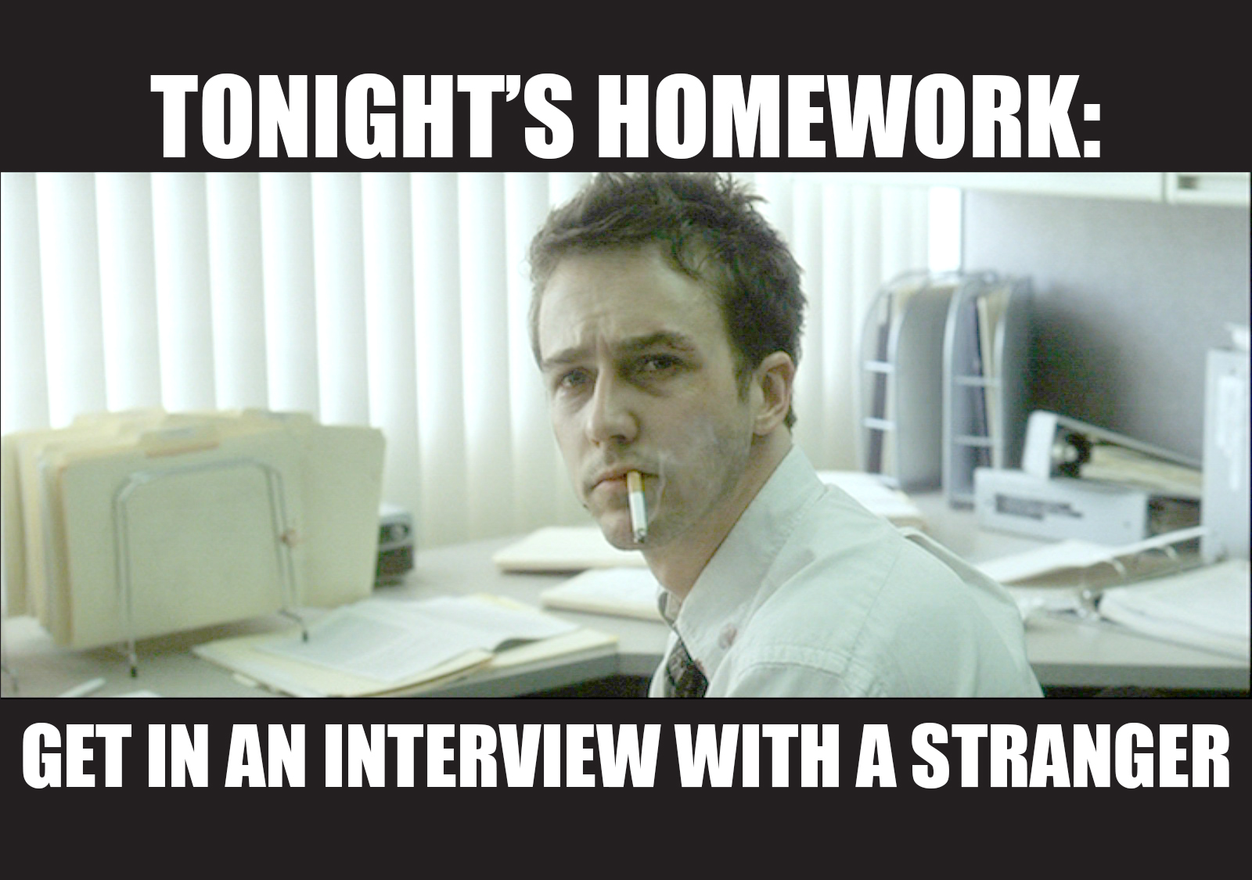

Slide 20
“Soft Skills” Books
How to Win Friends and Influence People by Dale Carnegie
Everyone Loves You when You’re Dead by Neil Strauss
The Game by Neil Strauss
The Prince by Niccolò Machiavelli

Slide 21
Security \ Hacker Mentality Books
The Art of War by Sun Tzu (Maybe)
The Prince by Niccolò Machiavelli
Snow Crash by Neal Stephenson
Neuromancer by William Gibson
1984 by George Orwell

Slide 22
