Slide 1
Permissions & Privacy
Only Give Apps the Permissions that they Need

Slide 2
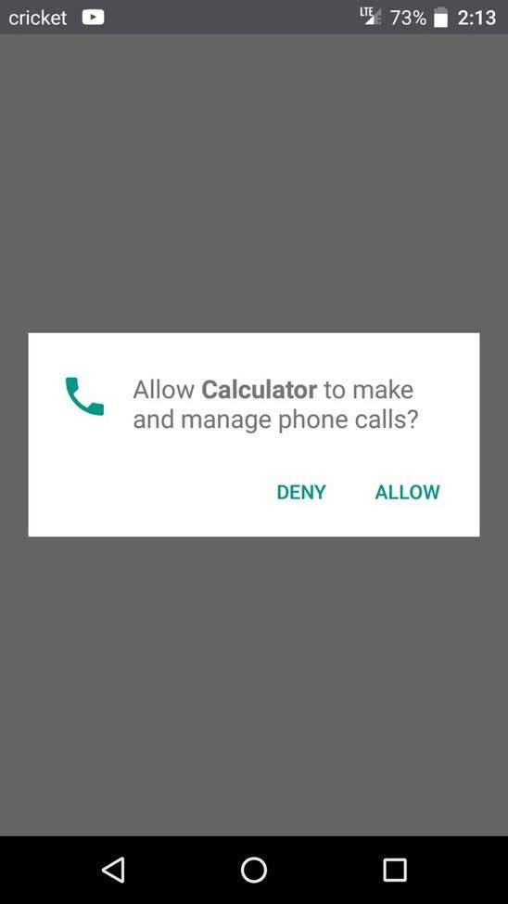
What’s wrong with this?

Slide 3
Think About Your Favorite App
What is it?
What permissions does it use?
What permissions have you enabled?
Are you comfortable with these permissions?

Slide 4
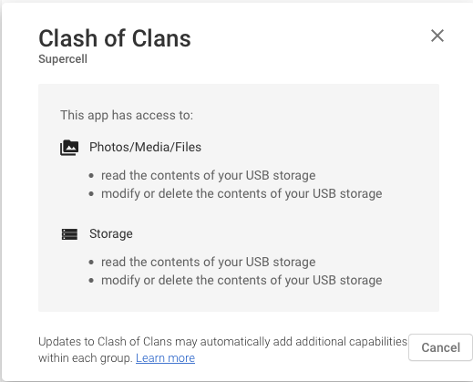



Finding an App’s Permissions
Let’s find out <-check them out

Slide 5
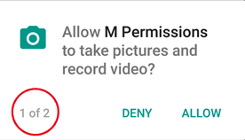
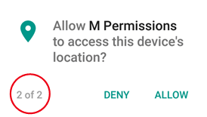
Be Careful About What You Grant
You can review the permissions the app will request before you install it
You can deny an app’s requested permissions while you are using it

Slide 6
Apps should only request the permissions they need to operate
By granting too many permissions, you are violating the principle of least privilege
You may be violating your privacy & security as well!

Slide 7
Principle of Least Privilege
Give the least amount of privilege that something needs to properly function
Examples:
Adult privilege to drive a car = Generally Ok
Child drive a car? = Bad
Your classmates know you’re in the class = Ok
Your classmates can know your grades = Bad
What bad things can happen from improperly using privileges?

Slide 8
Principle of Least Privilege
Software operates under the same reasoning

Slide 9
Security Benefits of Least Privilege
If a resource is comprised, the effects will be limited
Abuse
Misuse
Limit impact of vulnerabilities
Only the resources that need to know will know……

Slide 10
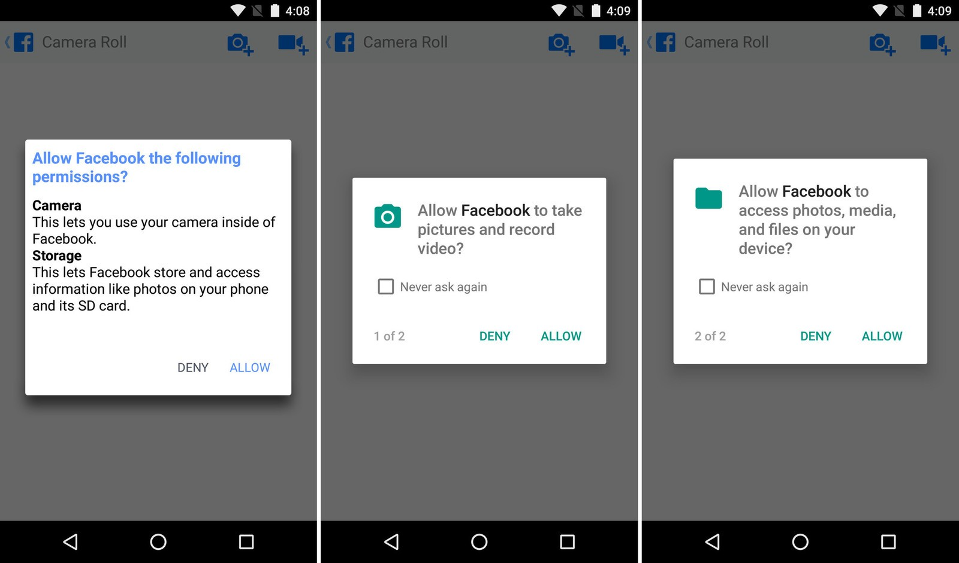
Apps Need Permissions to Function

Slide 11

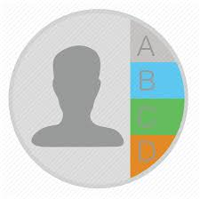
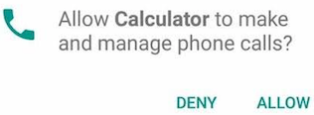
Apps Should Only Ask for Permissions They Need
Calculator App
Contacts
Why?

Slide 12
Permissions Activity
Application should only ask for the least amount of privileges to properly function
https://teachingmobilesecurity.github.io/index.html?page=permissions

Slide 13
Discussion
Be careful about what you allow the applications you create to do
As a user, be careful about what you enable

Slide 14

Questions?

