Slide 1
Proper Encryption Usage
All Encryption is not Created Equally

Slide 2
What is Encryption
Methods of masking messages from unintended parties

Slide 3
Your Thoughts on Each?
Which would you use and when?
What are the strengths and weaknesses of each?

Slide 4
Some Forms of Cryptography
Caesar Cipher
XXXX
XXXX

Slide 5
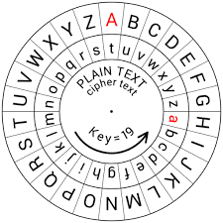
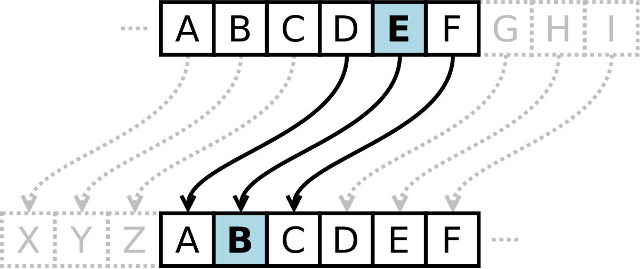
Caesar Cipher
Each letter “shifts”

Slide 6
Cryptanalysis
Art of breaking codes and ciphers

Slide 7
Breaking Caesar Cipher
Why is it easy to break?

Slide 8
Breaking Caesar Cipher
Brute Force
Frequency of words and letters
Others?

Slide 9
XXXX
XXXX

Slide 10
Stronger Methods
XXXX

Slide 11
Two Common Forms
Symmetric
Asymmetric

Slide 12
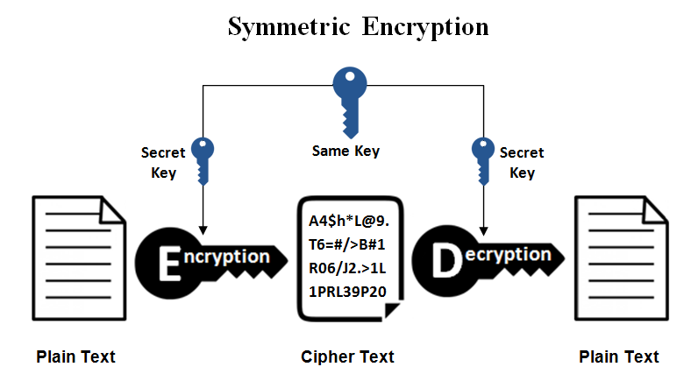

Slide 13
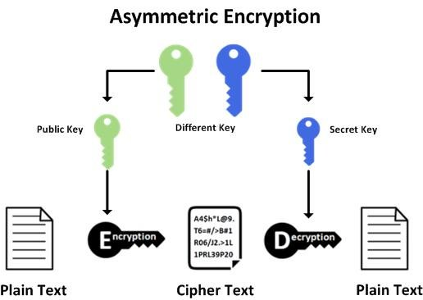

Slide 14
XXXX
XXXX

Slide 15
XXXX
XXXX

Slide 16
XXXX
XXXX

Slide 17
XXXX
XXXX

Slide 18
Recap
Which form of encryption uses the same key?
Which form of encryption uses a different key?
What are some forms of “defeating” cryptography?

Slide 19
Recap
Which form of encryption uses the same key? Symmetric
Which form of encryption uses a different key? Asymmetric
What are some forms of “defeating” cryptography? Brute force, common word

Slide 20
Activity
Implement several forms of cryptography
See why cryptography is necessary
Break the forms of cryptography

Slide 21

Questions?

