Slide 1
Introduction to Android Development
Preparing You for Mobile CyberSecurity Activities

Slide 2
Introductory Note
This is not a comprehensive Android development guide
The camp is focused on cyber security, not Android development
Learning to develop is still very cool/useful!

Slide 3
Android IDE – Android Studio
Contains code development tools and emulators
Free for Windows and Mac
1,000 of good tutorials
www.google.com

Slide 4
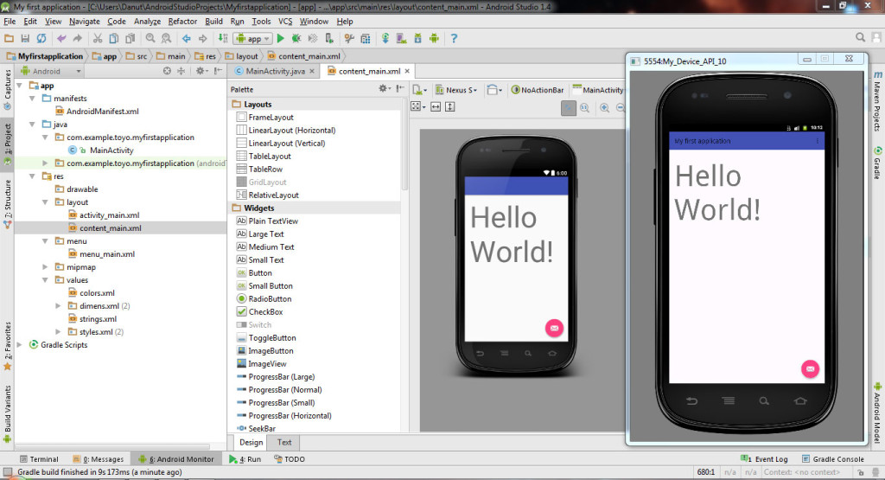
Android IDE – Android Studio

Slide 5
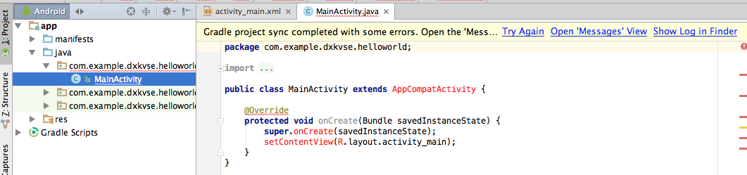
Android IDE – Android Studio

Slide 6
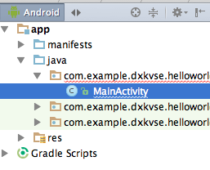
Android Studio: File Structure
Files will appear on the left
Many files are created by default

Slide 7
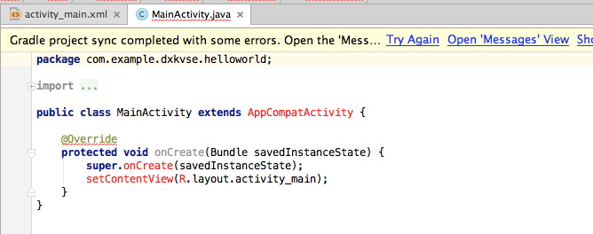
Android Studio: Code Structure
Code is “Java like”
Uses functions, objects just like many programs

Slide 8
Components of an App
UI: What the user sees
“Code-Behind”: What drives the app
Data: Where the information is stored

Slide 9
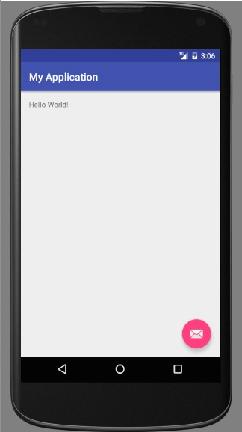
Hello World: Let’s Create an App
Notes:
- Instructor should create a hello world app with the students

Slide 10
Recap
Android apps are developed by: Android Studio
What platforms are they available for: Windows, Mac
Many files are created by default

Slide 11

Questions?

