Slide 1
Data Privacy
Ensuring that You Keep Your Data Safe on the Web

Slide 2
Many Apps Ask for Data
Many applications ask your data
Think about the data that your apps have access to
Location
Phone Number
Friends

Slide 3
How Could This Data Be Used Against You?
Know your location
Know your friends
Spam you
Spoof you
Steal your identify
…..

Slide 4
Data Stored on Your Phone
May be accessed by that app
May be accessed by other apps (if not properly stored)
Could be intercepted by other parties on the web

Slide 5
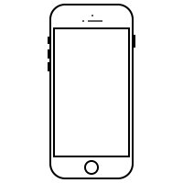




“Accessing” Your Data
Can observe data from other apps
Steal data during transmission
Steal data from server

Slide 6
How You Can Stay Safe
Be careful about what you share
Think about what data you’d want others to know
Know that your data can be accessed by others

Slide 7
Data Privacy Activity
Data Privacy Activity

Slide 8
Results
Third parties could know your information
People snooping could know your information
How could this be used against you?

Slide 9

Questions?

