Slide 1
Proper Encryption Usage
All Encryption is not Created Equally

Slide 2
What is Encryption
Methods of masking messages from unintended parties

Slide 3
Two Common Forms
Symmetric
Asymmetric

Slide 4
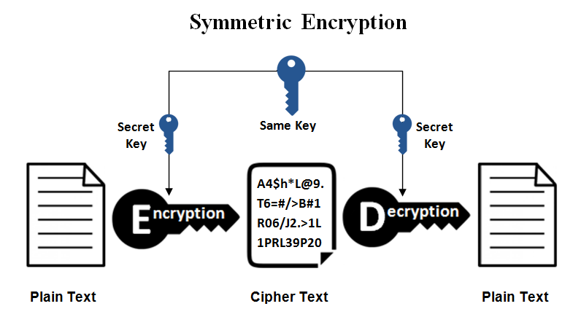

Slide 5
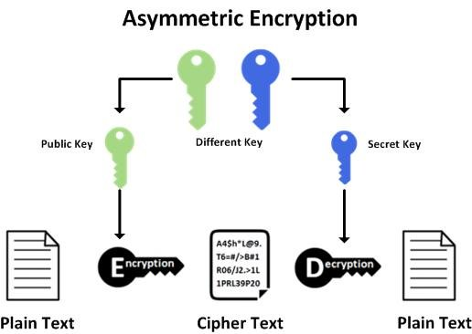

Slide 6
Your Thoughts on Each?
Which would you use and when?
What are the strengths and weaknesses of each?

Slide 7
Some Forms of Cryptography
Caesar Cipher
Playfair Cipher
AES

Slide 8
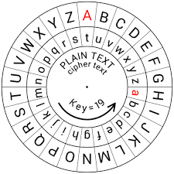
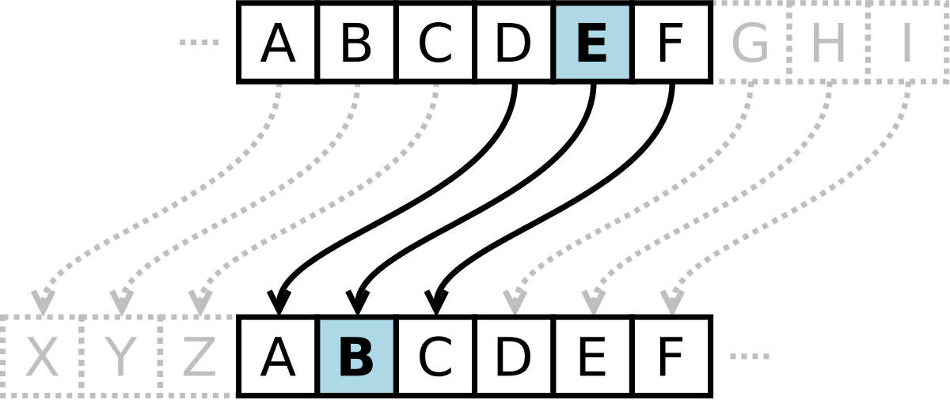
Caesar Cipher
Each letter “shifts”

Slide 9
Cryptanalysis
Art of breaking codes and ciphers

Slide 10
Breaking Caesar Cipher
Why is it easy to break?

Slide 11
Breaking Caesar Cipher
Brute Force
Frequency of words and letters
Others?

Slide 12
Stronger Methods
Playfair
Stronger but very breakable
AES
Largely the standard

Slide 13
Recap
Which form of encryption uses the same key? Symmetric
Which form of encryption uses a different key? Asymmetric
What are some forms of “defeating” cryptography? Brute force, common word

Slide 14
Activity
Implement several forms of cryptography
See why cryptography is necessary
Break the forms of cryptography

Slide 15

Questions?

