Slide 1
PLASMA Labs
Activity Introduction

Slide 2
Starting Android Studio
Because Android Studio takes a while to start, let’s do it now…..

Slide 3
Lab Purpose
Inform and motivate students about:
The importance of adhering to proper security procedures
Fundamental security concepts

Slide 4
Lab Structure/Components
Structure
Problematic App
Fix for the app
Demonstrate that the app has been repaired
Components
Activity
Videos
Lecture Slides
“Howto” Guide
Can do the activities on your own, or in a classroom

Slide 5
Lab Levels
Beginner
Just learning about security/programming
Medium
Some experience with security/programming
Advanced
Have been developing Android apps ~6+ months
Designed to challenge all levels of developers

Slide 6
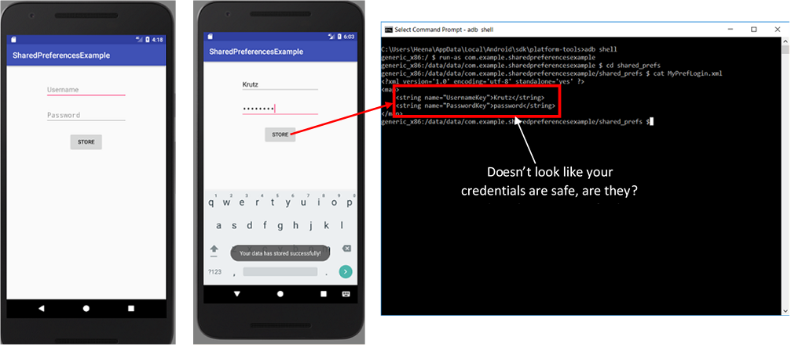
Enable Hands-On Learning

Slide 7
Publicly Available
www.TeachingMobileSecurity.com

Slide 8
Starting Android Studio
https://developer.android.com/training/basics/firstapp/running-app

