Slide 1
Security Training and Awareness
Presentation by Mr. Nicholas Lemonias
M.Sc. Information Security
Presented at The University of Derby,
07/03/2013

Slide 2
Information Assets
Information is an important business asset that similarly to other business assets, it needs to be protected and secured from exposure.
(BS ISO 27002:2005)

Slide 3
Introduction: Defintion of Risk
The potential for an unwanted event to have a negative impact upon a case, by exploiting an exposure".
ISO 31000 (2009), ISO Guide 73, The definition of risk: is the effect of uncertainty on objectives. Therefore in this definition uncertainties may include events (which may or may not happen), and uncertainties caused by a lack of information, or ambiguity. The definition also includes both negative and positive impacts on objectives.
Question: How do we measure exposure? Aswer: Risk Analysis Evaluation.
Risk Assesement is the reduction of the exposures identified by risk analysis, to a level acceptable by an organisation."

Slide 4
ISO/IEC 27001:2005 Standard.
The ISO 27001 standard has been written for the purpose of raising awareness in the security of information, and systems in a business processing environment.
ISO 27001 was the first international security standard for commerce.
It provides a framework, that organisations can use to assess and demonstrate the relevance and suitability of information protection controls.

Slide 5
What is an information security policy?
A management document providing direction, and commitment to information security and stating the organisation's approach to infosec management.
Signed by a MD or CEO.
Available to all information security employees.
Should be readily accessible on demand.
Should set the scope of responsibility for employees.

Slide 6
OECD Guidelines
Nine Principles
Stressing the need for management, by illustrating the different aspects of security management.
Emphasise the multi-disciplinary nature of security.

Slide 7
A corporate security manual
A single Hierarchical Document set which:
Describes and mandates the use of approved controls
Is globally pertinent across:
the organisational structure
the hierarchical structure
Is also a compliance document, that enables participation and creates and maintains awareness.

Slide 8
A typical corporate security policy and manual framework.
Security Policies
45%
Policies
Corporate Tasks
Procedures
& Standards
45%
Guidelines
Project Planning
Projects and Plans

Slide 9
Nine Principles of Information Security Managment.
Accountability
Awareness
Ethics
Multidisciplinary
Proportionality
Integration
Timeliness in response.
Reassesement
Democracy.

Slide 10
Definition of Security Awareness
" Security Awareness is the precise dissemination of knowlege pertaining the acquisition of new skills, technologies and characteristics of a mental attitude, which best defines, how members within an organisation would make informed decisions, and how they would respond to security related incidents."

Slide 11
Awareness, Training, Education
A successful IT Security program is consistent of :
Development of IT security policy.
Informing users of business code of ethics, along with their security responsibilities.
The establishment of business functions for monitoring and policy review for improvements.

Slide 12
Awareness, Training, Education
"Training provides essential knowledge, and produces essential skills and competencies."
The difference between training and awareness, is that training seeks to disseminate new knowledge for the purpose of acquisition of new skills, whilst awareness concentrates on an individuals effort and attention on descriptive knowledge of a single issue, or a set of issues.

Slide 13
Training Provision
Third Party Training
Online Training
Virtual CD
Seminars
One to One training
Classroom based training

Slide 14
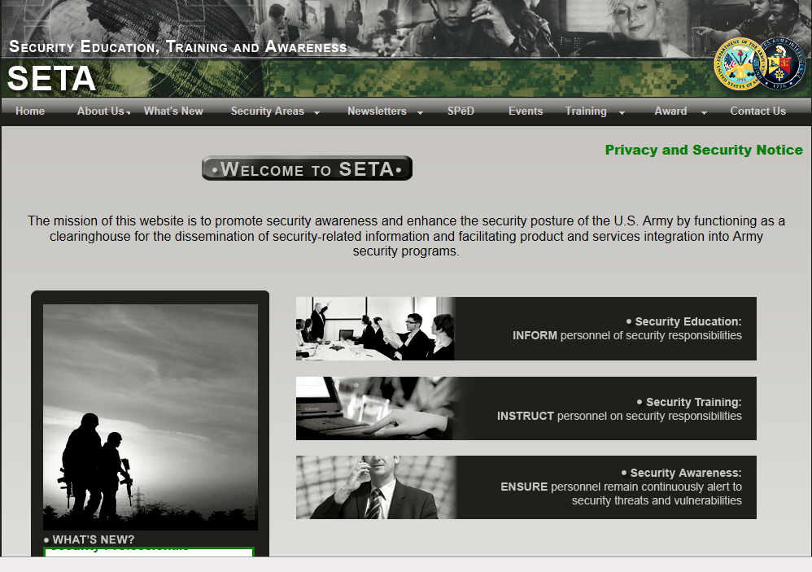

Slide 15
Ethical and Compliance Issues
Engaging, interactive instructional design that engages employees and helps the message stick.
Relevant, scenario-based content to aid knowledge retention.
Courses tailored to territory, language and job role.
Media options where you choose what is most appropriate to your online audience - text & graphics or video that has the built-in option to deploy in text & graphics where bandiwidth is a concern.
Industry leading client services to ensure your curriculum is well-planned, communicated throughout your organization and flawlessly executed
Methods to engage remote learners with DVD, mobile applications and classroom-based learning.
Accurate, current content provided by high calibre subject matter and legal experts .

Slide 16


Thank You
Questions ?
FEEL FREE TO ASK!

