Slide 1
Intrusion Detection Systems
Presented by Mr. Nicholas Lemonias
MSc. in Information Security
University of Derby
2012-2013.
Duration: 15' minutes.
Presentation by Nicholas Lemonias.

Slide 2
Part I Objectives
To comprehend concepts of Intrusion Detection Systems, and demonstrate how different detection technologies are used to construct an efficient detection system.
To Identify the key factors and key concepts from existing literature pertaining the accumulation of Intrusion Detection systems.
To demonstrate how the information flow, could be protected in cases of ‘real-time’ network intrusions, in view of statistical analysis methodologies.

Slide 3
1. Introduction
1.1 Motivation for Intrusion Detection in Enterprise Management
1.2 Classification of Intrusion Detection Systems.
1.3 Conceptual view of enterprise assets

Slide 4
Introduction: ISO 27001 - CIA
Information security is an emerging field that incorporates the efforts of people, policies, training, certification, awareness and a variety of technologies to improve:
The Confidentiality of data transmission.
The Integrity of data in transmission and storage.
And the Availability of Data in transit.
(ISO 27001)

Slide 5
Overview
Existing security mechanisms protect information systems from unauthorised access with access control mechanisms. However if access controls are compromised, an abuser may gain unauthorised access, and cause great damage or disruption to our enterprise assets. [5], [1]

Slide 6
Introduction
" Therefore, the definition of an Intrusion Detection system is the accurate identification of any set of actions that attempt to compromise the Confidentiality, Integrity and Availability of resources. " [3]

Slide 7
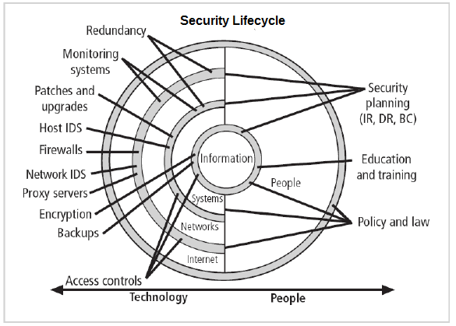
Information Security Lifecycle

Slide 8
1.1 Academic research - IDS field
The development of intrusion detection systems dates back to the early1980s. [1]
Academic research evidents research findings by J Anderson et. al, 1980 with the publication "Computer Security Threat Monitoring and Surveillance on the various architectures of IDS systems". [1]

Slide 9
Introduction
Intrusion Detection Systems are an integral element of an enterprise's defence line guarding computer systems and networks from abuse. [1]
Although Intrusion Detection technologies should not be considered a complete defence against threats. [1]
Intrusion Detection can play a significant role in the overall security architecture of our Enterprise. [1]

Slide 10
1.2 Classification of IDS systems
There are two types of Intrusion Detection systems:
Network-based Intrusion Detection Systems with their main characteristic being real-time, intrusion detection.
Host-based Detection systems and their main characteristic being static analysis of log entries.

Slide 11
Why do we need an IDS system
IDS are an integral element of a corporation's defence-line guarding computer systems and networks from abuse. Thus IDS systems are a dedicated assistant to the security monitoring of a security infrastructure. [1]
Although firewalls, policies, identification systems, access controls might not be adequate to offer total security, since all these security technologies are prone to a variety of system errors, zero day vulnerabilities, but also human errors. [1] [ 2]

Slide 12
Intrusion Detection Systems: Types
Application based IDS Systems. [8]
Host based. (Also called an agent). [8]
Target-based (Integrity Checker). [8]
Network-based. [8]
Hybrid or Integrated (Combination of the above). [8 ]
Honeypot/HoneyNet and Sticky Honeypot. [8]
Gateway IDS. [8]

Slide 13
IDS Detection techniques
Two prominent Intrusion Detection techniques utilized in the architecture of Intrusion Detection Systems: [2]
Misuse detection sequence. (Kumar & Spafford et al., 1995)
Anomaly detection sequence. (Legn et al., 1995)

Slide 14
IDS Detection Techniques
Misuse detection key factors:
Popular systems accumulating misuse detection techniques (STAT) as described in existing literature by Kumar et al. 1995. [2]
They use patters of well-known attacks, or well-known vulnerabilities to recognise and match intrusion patterns [2].
Citing a Pattern matching example
" A Signature rule for a password guessing attack." [2]

Slide 15
IDS Detection Techniques: Disadvantages of Misuse technique
Therefore the disadvantage in the utilisation of ‘Misuse detection’ is thus, it’s limited efficacy in the detection of:
Novel attacks, zero-day attacks that do not equilibrate to any previously known attack patterns or signatures [2].

Slide 16
IDS Detection Techniques: Anomaly Detection
Anomaly Detection is another technique accumulated in the architecture of Intrusion Detection Systems.
An Anomaly Detector example.
Real Life Example: IDES Project.
(Clunt et al. 1992) – The consideration of observed activities which are significantly deviated from established norms, and known user-profile anomalies. [2]

Slide 17
IDS Detection Techniques: Anomaly Detection
If for a session that we monitor the frequencies are significantly lower in latency, or equally significantly higher, then an anomaly alarm is raised. [2]
Therefore, the advantage in the accumulation of an anomaly detection method, is therefore it’s efficacy against novel attacks, that we have no prior knowledge about.) [2]

Slide 18
IDS Detection Techniques: Anomaly Detection
Thus the disadvantage in the accumulation of an anomaly detection method in the context of Intrusion Detection, is therefore a higher false positive rate, and that due to the fact that ‘new behaviours’ could be misinterpreted by the IDS systems, and thus perceived as a network indifference, or a network anomaly. [2]

Slide 19
Other Types of Analysis and Comparison
Signature-based analysis methodology. [2] [8]
Statistical analysis methodology. [2] [8]
Based on time, frequency of attacks (how noisy an attacker is), and the length of time. For example: Employee A logged into the system late at night, although he frequently logs in during working hours, that would trigger an alarm). [8]
Integrity-Checker methodology. [8]
Anomaly Detection / A behaviour based methodology. [2] [8]

Slide 20
Intrusion Detection Systems: IDES and NIDES
Although some Intrusion Detection Systems accumulate both methodologies.
Examples cited in current subject literature [2] :
IDES (According to Anderson et al. 1995) [2]
NIDES (According to Anderson et al. 1995) [2]

Slide 21
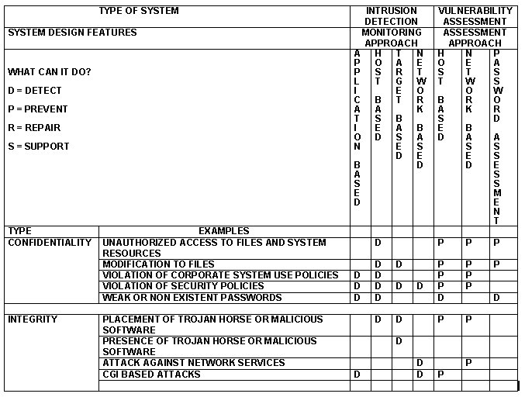
Notes:
C.Dupuis et al. [8]

Slide 22
Victim's Perspective
"Therefore an intrusion is considered as the result of an ‘Overt act’, by a malicious attacker; and a manifestation observed by the victim." [10, page 6]
However some attacks produce no manifestations, and whilst some manifestations are caused by system, or network malfunction. [9]

Slide 23
Attacker's viewpoints and key characteristics
A definition of what constitutes an attack
An attacker’s viewpoints is therefore: [9]
" Characterised by intent, and risk of exposure !" [9]
A victim's perspective: [9]
Intrusions are characterised by their manifestation! In which case may, or may not include the causal effect of damage.

Slide 24
Challenges to Intrusion Detection Systems
Deployment. [8]
Using IDS in fully switched networks. [8]
Interpreting all the data being presented. [8]
Encryption, VPN's and Tunnels. [8]
On-going support. [8]
Cost. [8]
Performance. [8]

Slide 25
Concluding Remarks:
Research the disadvantages of Intrusion Detection Systems
The main disadvantage in the context of Intrusion Detection Systems is the high-rate of false positives, but also the loss of trust, loss of revenue and even the loss of trusted clients. Furthermore other disadvantages include:
Defiance of contractual agreement - due to improper policies in the response of a false intrusion detection alarm.
Another disadvantage is the learning difficulty and the creation of response teams within an IT department.

Slide 26
Questions?
Any questions, please feel free to ask.
Thank you for watching.

Slide 27
References
[1] J.McHugh, A. Christie, Julia Allen, J.M,A.C,J.A, 2000. Defending Yourself: The Role of Intrusion Detection Systems. of Intrusion Detection Systems, [Online]. 1, 10. Available at: http://www.cert.org/archive/pdf/IEEE_IDS.pdf [Accessed 02 May 2013].[2] Next Generation Intrusion Detection Expert System (NIDES).
[2] W.Lee, J.Stolfo Salvatore, W.L,S. J. S, 2001. A Framework for constructing features and models for Intrusion Detection systems.. A Framework for constructing features and models for Intrusion Detection systems., [Online]. 3, 261. Available at: http://www.cert.org/archive/pdf/IEEE_IDS.pdf [Accessed 25 May 2013].
[3] Heady, R. and Luge, G., et al. (1990) The Architecture of a Network Level Intrusion.. The Architecture of a Network Level Intrusion., p.18. Available at: https://www.cs.unm.edu/~treport/tr/90/tr.pdf [Accessed: 25/04/2013].
[4] Denning Dorothy, An Intrusion-Detection Model. IEEE Proceedings on Software Engineering, Vol. SE-13, No. 2, February, 1987.
[5] D. Anderson, T. Frivold, A. Valdes. SRI-CSL-95-07, Department of the Navy, Space and Naval Warfare Systems Command, Next Generation Intrusion Detection Expert System (NIDES), May 1995.
[6] Kumar, S, (1995). Classification and detection of computer intrusions. Unpublished doctoral dissertation, Purdue University, West Lafayette, Indianapolis.
[7] Kumar, S., & Spafford, E.H. (1994). A pattern-matching model for misuse intrusion detection. In NIST (Ed.), Proceedings of the 17th national computer security conference (pp. 11--21), National Institute of Standards and Technology (NIST), Baltimore, MD.
[8] C. Dupuis, Intrusion Detection Systems (IDS) Introduction and Overview, 2003.
[9] L. Berland, Prof Yan Chen, Advances, Problems, and all the politics that lie between. Available at: www.cs.northwestern.edu/~ychen/classes/cs495-s04/.../IDS_survey.ppt[Accessed: 25/04/2013].
[10] Faizal, H.Y, Robbie. Y, Feature Selection For Detecting Fast Attack In Network Intrusion Detection. Available at:http://eprints2.utem.edu.my/186/1/02_02_4%5B1%5D-JAMT_vol_2_no_2.pdf [Accessed: 25/04/2013].

