Slide 1

Intrusion Auditing Under Windows NT
Catching Greg Hoglund - Part II
By JD Glaser
jdglaser@ntobjectives.com
Copyright, 1999 © NT OBJECTives, Inc.

Slide 2
Overview
NT Behavior
Tools I use
New tools I have written
Useful techniques
Copyright, 1999 © NT OBJECTives, Inc.

Slide 3
My Morning E-Mail Message
From my good friend, Greg Hoglund
JD,
You’re hosed
Greg
A side note on the title to answer everyone’s questions
  - Greg is a very good friend and we spend
  a great deal of time eating Thai and talking shop
Copyright, 1999 © NT OBJECTives, Inc.

Slide 4
Race is on
Change passwords
Assemble a toolkit from burned CD of known good tools
Begin looking for damage
How do we find out who was on the system and when?
Copyright, 1999 © NT OBJECTives, Inc.

Slide 5
Initial Assertions
Start reading my logs
Lots of log activity. Can't verify for certain a time/date/logon range
No odd server names - COULD BE FORGED THOUGH
I'm not running IIS on this box - Cross that off
Must have sniffed a password.
Common Problem - Strong PDC, Weak local admin passwords
  Undermines the whole game
Copyright, 1999 © NT OBJECTives, Inc.

Slide 6
My Initial Process
Read the logs
Examine the task list
Examine the loaded dll's list
Read the logs
Look through the registry
Read the logs
Copyright, 1999 © NT OBJECTives, Inc.

Slide 7
My Second E-Mail Message
JD
LOL, Your new password is “keepgregout”
Greg
Hmmm…?
Copyright, 1999 © NT OBJECTives, Inc.

Slide 8
Trojan Possibility
I know he did not sniff this time, nothing went out over the wire because I haven't yet accessed any domain resources.
Must be a Trojan

Slide 9
NetMon Tip
Hook up MS NetMon to watch all outgoing traffic of a suspected breached host
Be aware that the generated traffic can have forged source address info

Slide 10
Check Files
Break out the file integrity checker
  You can use a home-made solution here
  Use your own baseline records
  Perl can be used here to great effect
Results = Nothing. All files match to originals
No new files are detected

Slide 11
.EXE Side Note
Run file as ~ in temp directory can confuse a tripwire report
Why? because you probably aren't going to take time to look at these
Or you have scripted TW to avoid looking there because of ‘NOISE’ factor

Slide 12
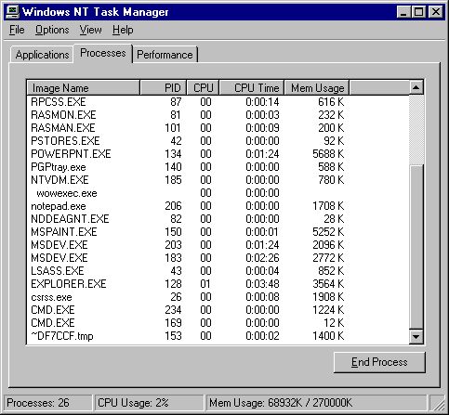
TaskMan Showing ~EXE

Slide 13
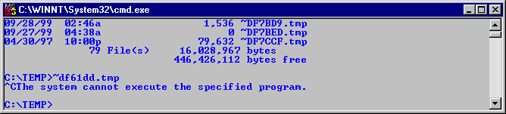
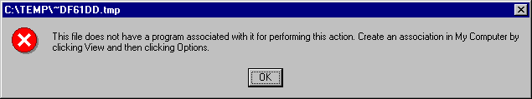
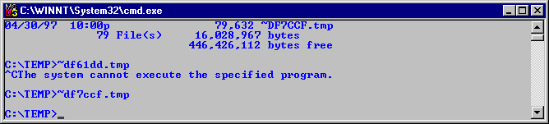
Executing ~.tmp Files
Attempting to execute garbage
Bottom box launched a perfectly good working copy of Calculator.exe

Slide 14
~ Points
File Integrity checkers can alter file access times
  Can Leave wide time stamp trial showing what to avoid
This is one method to sidestep automated sweeps

Slide 15
Examine RID’s
Look at latest RID, none have been added (NT uses them sequentially and never reuses them)
You see accounts have been created/deleted

Slide 16
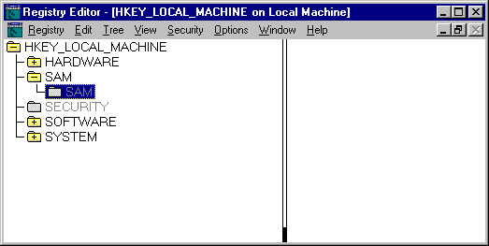
Getting to RID Registry Key

Slide 17
Proceed Right Past
Some Admins get stuck here
  The ‘grey’ gives impression that it’s not accessible
From the menu,
  give yourself the rights to subkeys
Proceed right past the ‘grey’

Slide 18
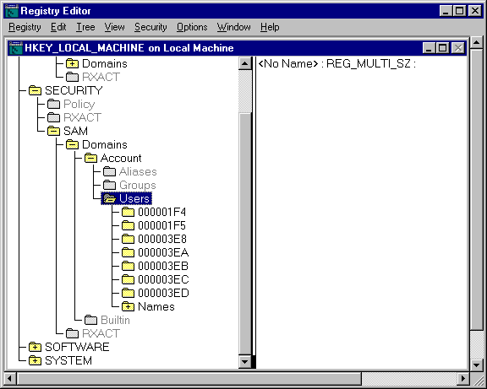
RID Registry Key Screen Shot

Slide 19
Key RID Points
Examine key, see the admin (500 dec = 1F4 hex)
Notice 3E8 this is 1000 the first user account, always starts this way on NT 4.
Notice 3E9 is missing - need to account for this, could have been used in attack
500 is the last sequence numbers in a SID that ID’s the builtin admin account
If no auditing has been turned on, these numbers might be your only clue

Slide 20
Why do I need an Audit Tool?
Speed
  Cuts down research time considerably
  A few hours manually vs. minutes
Automates searching
  Without it, looking at entries in the event log is on an individual basis and must be hand matched
Eliminates Hassle
  Need to hand match logs hexadecimal ID’s.

Slide 21
NTLast
Freeware command line audit tool that analyzes the NT event log
Matches logon times with logoff times
  Establishes user time frames for further forensic work
  It quickly displays who logged on and when
  How long they were logged on
  Logon Failures - no way to plainly see this in
  MAIN CLUE: Where did they come from?
NOTE - ALWAYS REFERENCE AGAINST THE EVENT LOG
Copyright, 1999 © NT OBJECTives, Inc.

Slide 22
Setting Up the Audit - Errors
Very common error
  Following slide explains the mistake of setting auditing for only one file, when you think auditing has been set for several files - NT GUI is a bit misleading here. Unless you go back and check, you can’t be sure your files are being audited.
  Notice on first slide that ACE’s are added for the first group, But second slide shows the following groups have no ACE’s assigned.
        Result = No Effect
Copyright, 1999 © NT OBJECTives, Inc.

Slide 23
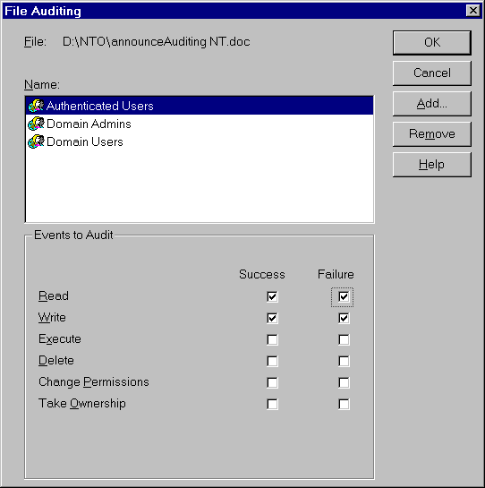
Setup Error #1
Copyright, 1999 © NT OBJECTives, Inc.

Slide 24
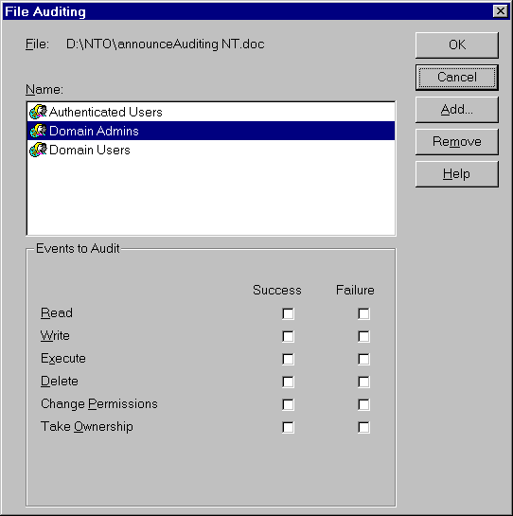
Setup Error #2
Work is lost, even though gui made it look like work was done - no way to check your work
Copyright, 1999 © NT OBJECTives, Inc.

Slide 25
Running NTLast
Important Notes
  Auditing must have already been turned on and events have been recorded.
    It doesn't do any good to run NTLast against an empty log. NT has security auditing turned off by default, so this must be specifically done beforehand
Copyright, 1999 © NT OBJECTives, Inc.

Slide 26
Combining Switches
ntlast /f /i =
ntlast -f -r -n 25 =
ntlast /i /not Administrator =
ntlast -m \\machinename -f -r =
Gets the last 10 failed interactive logon attempts
Gets the last 25 failed remote logon attempts
Gets the last 10 interactive logons by other accounts besides "Administrator"
Gets the last 10 failed remote attempts against machine name
Copyright, 1999 © NT OBJECTives, Inc.

Slide 27
Watching for Logon Failures
Failures are indicated by a single value of 528 in the NT Event Log. This is not easy to spot, nor count. At first glance, determining which account failed the logon is not obvious either.
See the following slide of how to use the -F switch with NTLast to view all the failed logon attempts against you box quickly
TIP - I keep ntlast in my path and I place a shortcut to it from explorer so I can get to it quickly - See appendix for details on setting this up
TIP - I also keep a shortcut placed on my desk to the event viewer, and have the sec log as the default log to look at. See appendix for details of how to do this.**
Copyright, 1999 © NT OBJECTives, Inc.

Slide 28
Routine Password Guessing
NTLast -f -r -n 100 >> results.txt
susans \\LIONESS BDC2 Sun Jun 20 09:04:13pm 1999
susans \\LIONESS BDC2 Sun Jun 20 09:04:13pm 1999
susans \\LIONESS BDC2 Sun Jun 20 09:04:14pm 1999
mrogers \\LIONESS BDC2 Sun Jun 20 09:04:14pm 1999
mrogers \\LIONESS BDC2 Sun Jun 20 09:04:15pm 1999
mrogers \\LIONESS BDC2 Sun Jun 20 09:04:15pm 1999
erindfeld \\LIONESS BDC2 Sun Jun 20 09:04:16pm 1999
erindfeld \\LIONESS BDC2 Sun Jun 20 09:04:16pm 1999
Notice as well the close times synchs - indicates automated guessing
Probably attempting 3 common guesses as to not trigger a lockout
**Note - Using -f switch for failure lookups
**Note - Redirecting ntlast output to file to save results
Copyright, 1999 © NT OBJECTives, Inc.

Slide 29
Remote Usage Results
NTLast -r >> results.txt
erindfeld \\RIND BDC2 Mon Jun 21 10:10:00am 1999
erindfeld \\RIND BDC2 Sun Jun 20 04:41:15pm 1999
erindfeld \\SUSANS BDC2 Sat Jun 19 12:47:14am 1999 <--Oddball
mrogers \\MROGERS BDC2 Tue Jun 15 12:38:32pm 1999
susans \\SUSANS BDC2 Wed Jun 09 04:47:52pm 1999
mrogers \\MROGERS BDC2 Wed Jun 09 06:40:52pm 1999
erindfeld \\RIND BDC2 Wed Jun 09 09:31:21am 1999
  Notice the oddball here, erindfeld logging on from someone else’s box late at night
  **Note - Redirecting ntlast output to file to save results
Copyright, 1999 © NT OBJECTives, Inc.

Slide 30
Evidence of a Sniffed Password
NTLast -r -n 200 >> results.txt
brianm \\LION ACCT Wed Apr 21 02:07:30am 1999 <--ALERT
brianm \\LION ACCT Sat Apr 17 12:57:22am 1999 <--ALERT
gallager \\DOCSERV ACCT Thu Apr 08 05:45:14pm 1999 <--Normal remote
gallager \\DOCSERV ACCT Wed Apr 07 05:18:03pm 1999 <--Normal remote
thomasl \\DOCSERV ACCT Tue Apr 06 05:58:34pm 1999 <--Normal remote
brianm \\BRIANM ACCT Mon Apr 02 02:09:29pm 1999 <--Normal remote
thomasl \\THOMASL ACCT Mon Apr 02 11:01:19am 1999 <--Normal remote
Notice time lag between brianm logging on from his machine and
and logging on from unknown remote box
Indicates time needed to crack sniffed password. Notice no failures - Fairly significant - strong evidence of a sniffed password
Copyright, 1999 © NT OBJECTives, Inc.

Slide 31
Remote User Activity
NTLast -r -u brianm -n 3 >> results.txt
brianm \\LION BDC2 Mon Jun 07 09:10:00pm 1999
brianm \\LION BDC2 Sun Jun 06 03:41:15am 1999
brianm \\LION BDC2 Sat Jun 05 04:47:14am 1999
Tells us the last 3 time this guy logged on remotely
Now drill down on one of these times
Copyright, 1999 © NT OBJECTives, Inc.

Slide 32
Verbose Mode - Time Frame Usage
NTLast -v -r -u brianm >> results.txt
35 minute remote logon from brianm
Record Number: 704
ComputerName: ACCT
EventID: 528 - Successful Logon
Logon: Wed Apr 21 02:07:30am 1999
Logoff: Wed Apr 21 02:42:30am 1999
Details -
ClientName: brianm
ClientID: (0x0,0x20F9E8A)
ClientMachine: \\LION
ClientDomain: ACCT
LogonType: Remote
  This gives us a 35 minute window during first crack to look for file activity
  **Note - Saving verbose mode output to a file
Copyright, 1999 © NT OBJECTives, Inc.

Slide 33
Regarding Searching
Two things to try
  You will want to look at very first access times to see first possible activity
  Next look at recent activity
Be prepared, you may find nothing
TIP - Try to run as few apps as possible while performing an exam. Command line tools leave a smaller footprint - less chance of altering evidence
Copyright, 1999 © NT OBJECTives, Inc.

Slide 34
Matching File Access
Searching for files
  Rule out normal system files - I use HandleEx.exe from SysInternals for learning about system files
At a command prompt, use
  dir /t:c to find file creation times
  dir /t:w to find last file write times
  dir /t:a to find last file access times
Tip - run “dir /t:a > search.txt” and load that file into an editor with a search feature
Copyright, 1999 © NT OBJECTives, Inc.

Slide 35
Searching
With luck,
  you will find a file created during that first suspected logon
  you will find that same file accessed during the last logon
WARNING
    **Note - Don't use Explorer to check file access times. This destroys the real file access time by setting it to the current time you look at it. That isn't what you want and will kill your clues.
Copyright, 1999 © NT OBJECTives, Inc.

Slide 36
File Search Results
With luck, A file shows creation for that time
dir /t:c c:\winnt\system32 >> results.txt
06/13/96 06:38p 152,848 winmsd.exe
06/13/96 06:38p 13,046 winnt.hlp
04/21/99 02:38a 32,768 winoldapp.exe <--VERY SUSPECT
06/13/96 06:38p 2,880 winsock.dll
04/30/97 11:00p 92,944 WINSPOOL.DRV
04/30/97 11:00p 15,120 WINSRPC.DLL
04/30/97 11:00p 166,672 WINSRV.DLL
06/03/96 06:38p 19,728 winstrm.dll
**There is no legit file called winoldapp.exe - but it does not look out of place
**There IS a legit file called winoldap.mod - very similar
**Compare - winoldapp.exe == 32k winoldap.mod = 2k
Copyright, 1999 © NT OBJECTives, Inc.

Slide 37
File Examination Using GNU Strings
./strings winoldapp.exe >> results.txt
NetUseDel -These are the API’s used to make netBIOS connects
NetShareEnum
NetUseAdd
NetUserEnum
GetSidSubAuthority
LookupAccountNameA
  **Strings reveals very suspicious api calls
  **Looks like a backdoor
*note - a hacker can hide his machine from browsers - See App D
Hackers machine is now basically invisible so it's likely you won't notice it
Then connect calls are made to this hidden machine from this dll
Copyright, 1999 © NT OBJECTives, Inc.

Slide 38
Real Life Results Problematic
You may find that the main file you are interested in was modified AFTER the suspected user time frame.
Or the access time fits, but the modified time is wrong This is probably not enough evidence and means you will have to keep digging.
Or things are just totally overwritten.
Copyright, 1999 © NT OBJECTives, Inc.

Slide 39
Remote WinWord Launch
Partial list of file accesses during a user time frame
06/22/99 12:17a 3,772,176 MSO97.DLL
06/22/99 12:17a 5,324,560 WINWORD.EXE
06/22/99 12:17a 1,158,416 WWINTL32.DLL
Missing from list is msidl.dll - MS GUI Hook
This means a DCOM launch
WinWord is operating in the background /w no visible interface - Can only view this from Task Manager
Copyright, 1999 © NT OBJECTives, Inc.

Slide 40
Trouble Finding DCOM Permissions
Look, WinWord is not listed in DCOMCNFG
It is listed in OleView, Very few admins know about OleView
Or under Classes Key
User Manager perms/users are not altered, looking there not helpful
Copyright, 1999 © NT OBJECTives, Inc.

Slide 41
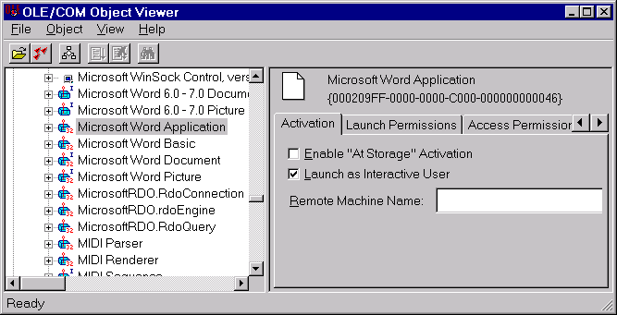
OleView.exe #1
Copyright, 1999 © NT OBJECTives, Inc.

Slide 42
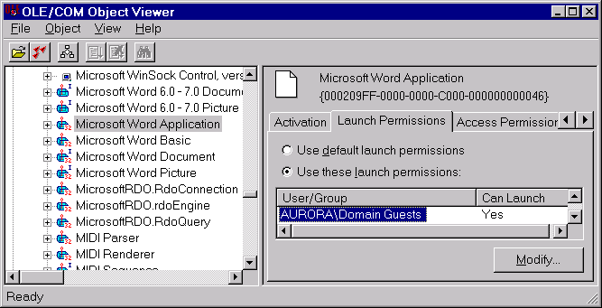
OleView.exe #2
Copyright, 1999 © NT OBJECTives, Inc.

Slide 43
OleView Permissions
Look, runs under perms of current GUI user
Use “nbtstat -a” to probe when Admin is logged on
Launch WinWord with full Admin privs
= Guest backdoor w/ Admin privs
WinWord has large install base
Don’t install Word/Office on a secure file server
Copyright, 1999 © NT OBJECTives, Inc.

Slide 44
App_Dll Key
HKLM/Software/microsoft/windows nt/currentversion/windows/appinit_dlls
Loads the dll listed here into every GUI process
Empty by Default
Never seen this used by a legit app
**The kicker is that this value is saved in kernel mode, and requested by user32 whenever a gui is launched. This means that the value can be erased while running to help hide it, but it's effect stays in place.
IMPORTANT - this is *NOT* in MS sec guidelines, nor in any NT sec book guidelines I have seen.
Copyright, 1999 © NT OBJECTives, Inc.

Slide 45
How to use it for a Compromise?
Create a dll that can capture keystrokes.
Enter dlls name in AppInit_DLLs key
Dll will now capture keystrokes and write to a file and/or send mail
Notes:
So, to recap a bit, If someone were to compromise your system, or a rogue admin, all they would need to do is pop the name of the dll into this key and reboot the box.
Or wait for a reboot.
Upon reboot, the dll can start intercepting whatever data it is interested in.
Unless you look for this, you’ll miss it as a backdoor possibility.

Slide 46
Signature of an Attack
Any unknown name of a dll listed in this key is sign of bad news
Any unknown dlls being listed in your running process spaces could have been injected from this key
Notes:
The signature of an attack is either the name of an unkown dll placed in key,
or unknown dll’s showing up in your process listings.
Result is bad news. Requiring the manual investigation.

Slide 47
How to protect against it?
Be aware of the keys existence
Know that’s its default value is empty
Know that the value can be erased, but it’s effect remains in place until a reboot
Audit the key value and perform checks
Use File Integrity Checkers
Reboot with empty key value to remove it’s effect!
Notes:
There are several things to do to protect against this attack and others like it.
First be aware of it.
Second, know it’s default properties, that it is empty by default, no mainstream apps use it. That it can be erased but still used while system is running
Third, audit the value for changes with Regedt32 and the security/auditing menu.
Fourth, use a file integrity checker like Pedestal Software’s Intact or Tripwire’s NT version for Tripwire.
And finally, erase the value and reboot the system will at lest get rid of that problem. There may be others to worry about.

Slide 48
NT Repair Directory
Watch this guy
Accessed very rarely by backup or manually by repair kit
An access might very well mean it was read by L0pht Crack
Set some kind of trigger to watch for access time changes here
**Key here is that crackers don’t want alter it, they just want to read it - you most likely are not looking for a Trojan or altered binary here
Copyright, 1999 © NT OBJECTives, Inc.

Slide 49
Signatures of L0phtcrack
A successful logon without failures appearing
A more recent file access time on c:\winnt\repair\sam._
Active, long running process on a machine

Slide 50
How to protect against it
Set auditing on directory
Make notes of when you access this registry
Use File Integrity Checkers in a ‘lite’ mode
Think, Don’t go numb

Slide 51
Actively Hunt L0phtCrack
Create scripts to read this access time
Create scripts to read remote drives as well
Create scripts to search remote processes

Slide 52
Listing Remote Processes
Use lservers, npList and Grep
lservers | nplist | grep l0phtcrack > alert.txt
List of use and time running - very valuable
New tools from NTO, check our site next week

Slide 53
NPList Dump
Process information for \\KRASH:
Name Pid Mem User Time Kernel Time Elapsed Time
Idle 0 16 0:00:00.000 69:52:39.745 0:00:00.000
System 2 200 0:00:00.000 0:06:08.519 0:00:00.000
WINLOGON 34 28 0:00:00.330 0:00:01.992 71:19:38.767
SERVICES 40 1472 0:00:01.111 0:00:03.915 71:19:37.586
LSASS 43 880 0:00:02.824 0:00:06.058 71:19:36.344
SPOOLSS 68 200 0 :00:00.781 0:00:01.091 71:19:27.651
l0phtcrack 3134 2544 0:04:28.486 0:00:01.912 0:06:04.454
regedt32 230 620 0:00:01.762 0:00:04.125 2:54:35.192
MSPAINT 206 604 0:00:02.713 0:00:10.404 2:53:06.865
OUTLOOK 154 5460 0:00:05.948 0:00:08.402 1:31:17.836
MAPISP32 181 3184 0:00:00.460 0:00:00.941 1:31:17.646
CMD 179 1236 0:00:00.010 0:00:00.040 0:02:58.316

Slide 54
Time to Run is a Clue
L0phtCrack usually takes a least a few hrs
This is total CPU time, not idle time
This value is much higher than normal activity
Most applications have high idle time, low actual CPU time

Slide 55
NT Process Times
D:\Work\eattime\Debug>nplist l0phtcrack
Name Pid Pri Thd Hnd Mem User Time Kernel Time Elapsed Time
l0phtcrack 3134 8 2 32 2544 0:04:28.486 0:00:01.912 0:06:04.454
l0phtcrack 3134 8 2 32 2588 0:07:55.503 0:00:02.223 0:09:35.427
D:\Work\eattime\Debug>nplist msdev
Name Pid Pri Thd Hnd Mem User Time Kernel Time Elapsed Time
MSDEV 11772 8 5 68 1308 0:00:01.862 0:00:03.324 4:28:11.848
MSDEV 3589 8 8 255 5476 0:02:51.656 0:01:00.016 2:59:41.442
Very Important to notice kernel/User time relationship

Slide 56
Advanced Remote Listing
Use nplist /csv and/or grep
nplist \\hostx > process.txt
Import into Excel spreadsheet
Calculate and report all process running longer than X hrs

Slide 57
Why Full Scale Integrity Checking Can Fail
Can be too intrusive
In making it’s hash, it kills what you need to see - access times
Lesson - You can’t blindly apply security

Slide 58
Gina Replacement Key
HKEY_LOCAL_MACHINE\Software\Microsoft\Windows NT\CurrentVersion\Winlogon
Be aware that a new value here allows a dll to intercept your logons
Basic technique is called DLL Pass-Through
  Calls are simply intercepted then forwarded to the real calls
Copyright, 1999 © NT OBJECTives, Inc.

Slide 59
Gina API Calls
int WINAPI WlxLoggedOutSAS (PVOID pWlxContext, DWORD dwSasType,
      PLUID pAuthenticationId, PSID pLogonSid, PDWORD pdwOptions,
PHANDLE phToken, PWLX_MPR_NOTIFY_INFO pMprNotifyInfo,
PVOID *pProfile)
{
//call real gina api
iRet = GWlxLoggedOutSAS (pWlxContext, dwSasType, pAuthenticationId, pLogonSid,
pdwOptions, phToken, pMprNotifyInfo, pProfile);
pMprNotifyInfo->pszUserName, <-Grab this
pMprNotifyInfo->pszPassword, <-Grab this
< insert code here to do whatever>
hFile = CreateFile (); <-Store it or send it
WriteFile ();
CloseHandle (hFile);
}
}
return iRet;

Slide 60
Hooks - In General
Hooks allow the loading of dll's into 'every' GUI process.
This means a keyboard/clipboard interceptor.
Example - pgp puts pgp60hk.dll into every process space. You can see this with handleex.exe
Copyright, 1999 © NT OBJECTives, Inc.

Slide 61
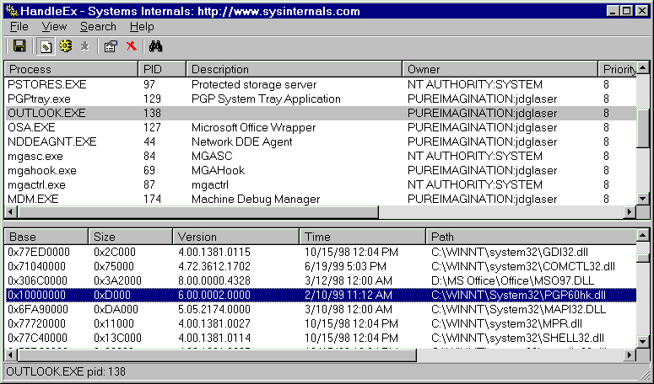
Hooks - Outlook Process Space
  PGP hook injected into MS Outlook
Copyright, 1999 © NT OBJECTives, Inc.

Slide 62
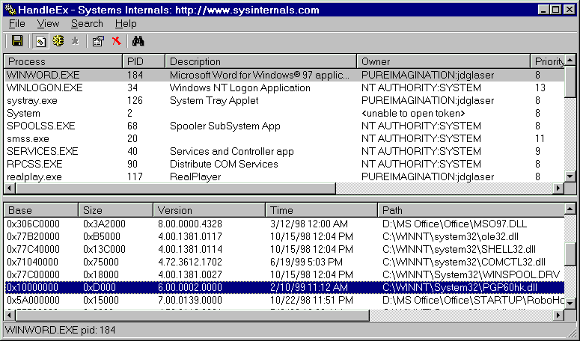
Hooks - WinWord Process Space
  PGP Hook Injected into MS WinWord process space
Copyright, 1999 © NT OBJECTives, Inc.

Slide 63
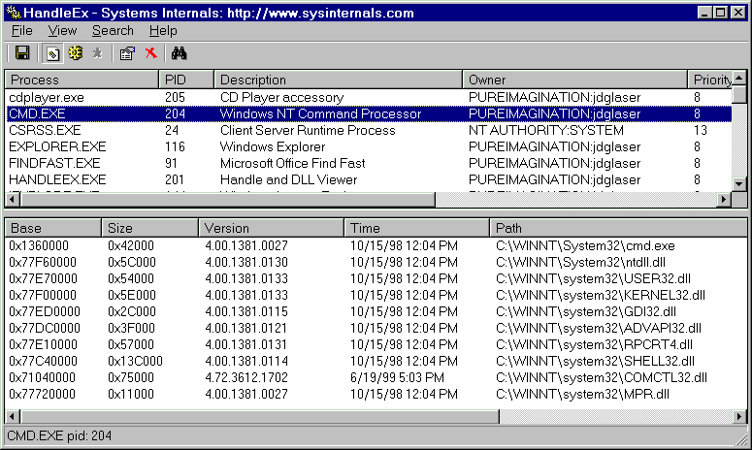
Hooks - Cmd Process Space
  Notice - No injection, cmd has no msg pump for hook to attach
  Fewer system dll’s loaded - can be useful when needed
Copyright, 1999 © NT OBJECTives, Inc.

Slide 64
Finally - WinObj
This tool allows viewing of driver space
List all the known, registered drivers
Important to baseline and know your drivers

Slide 65
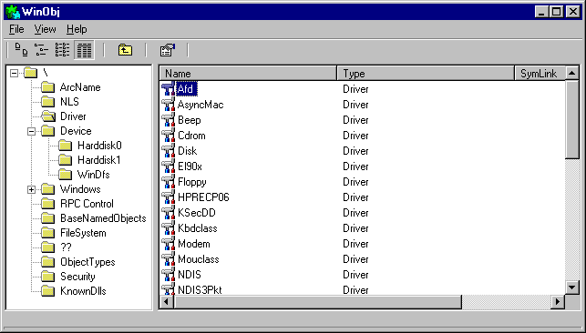
WinObj Base Shot

Slide 66
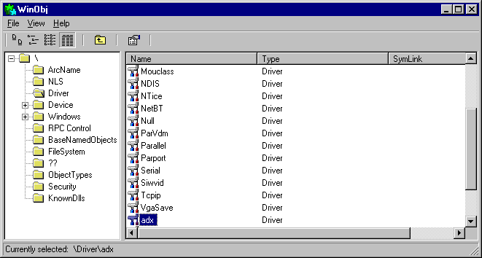
Unknown Driver Shot
*Driver adx does not belong here*

Slide 67
Rogue Driver Conclusion
This driver is able to sniff memory and place an smtp frame to the wire
This driver eludes file checkers
This driver eludes casual system checking
Greg is caught
  Why?

Slide 68
Removing Executing Files
Load device driver dynamically
  No rebooting necessary
Verify it is loaded
Delete driver’s file
AMAZING
  No file locked msg

Slide 69
Myth #4,650
Files are locked and can't be deleted because NT is using them
FALSE
Drivers live in non-paged memory - Exe’s don’t
They can have there backing file deleted because most drivers are not swapped and so do not make use of virtual memory in the same manner that normal exe’s do
Files are locked in place because NT uses it's virtual paging mechanism to back the file. Usually, only part of the exe is loaded, with a bunch of reserved, but not committed memory available to the process. NT locks the resources it needs so it can swap in and out what it want's.

Slide 70
Oh, Great Network Guru:)
Tools I use
2-3 number crunching machines
WinAT and AT - if you don't know how to use these, YOU LOSE
MKS tools, (grep, strings) powerful command tools
cacls and xcacls - put these tools in scripts and run them, run them, run them.
FileMon, RegMon, WinObj from sysinternals
I don’t own a commercial scanner

Slide 71
Tools Part II
Excel -
  security is an information war.
  will win if we can better analyze data
NT Resource kit - Learn it
ActiveState, and Perl debugger
  more valuable than many expensive tools
Baselining and auditing
  Collect and USE your data

Slide 72
Base Lining
How do I know what my baseline is
Using FileMon
  Get familiar with file activity
Using RegMon
  Watch and record accesses
Using WinObj
  Memorize basic NT drivers
Put this info into Excel

Slide 73
Advances in NT Drivers
MS now gives DDK away for free on the net
  Used to be $1,000 for MSDN subscription
Driver writers were a small, closed group before
Now available to larger audience
Copyright, 1999 © NT OBJECTives, Inc.

Slide 74
NTO Auditing Facts
Europeans download audit tools over 2 to 1 vs US
The guy response -
  Great scanner, rocks, smokes
The chick response
  You have a date calculation error at line 46, fix it
Copyright, 1999 © NT OBJECTives, Inc.

Slide 75
Summing It All Up
Shown evidence of an intrusion
Shown files accessed within a user timeframe
Given some techniques/tips to assist you
Shown how to examine different aspect of NT
Shown you that Greg is a really good guy
  See his Talk for detailed file tracking
Copyright, 1999 © NT OBJECTives, Inc.

Slide 76
Announcing New NTO Tools
lservers - netbios names dumper
nplist - network process dumper
audited - now audits the registry
PacketX - Raw packet creator for NT
ntolog /backup /clear
spscan - dumps SP level of all NT hosts
New versions of NTLast being posted

Slide 77
PacketX
Raw Native NT Packet Writer
Writes whatever you want to the wire
Forges Ethernet/TCP/IP Headers
Validates FW Rules

Slide 78
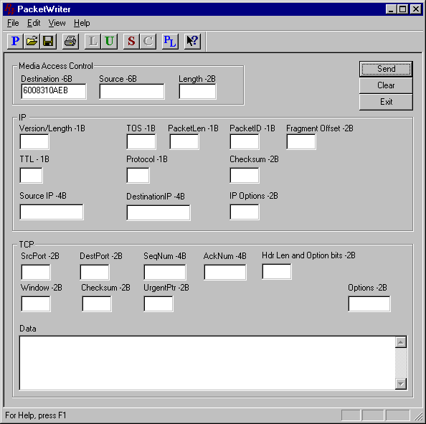
PacketX Shot

Slide 79
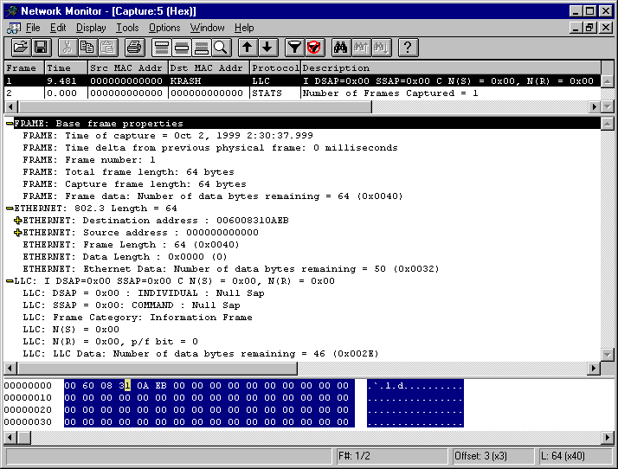
PacketX Capture Shot

Slide 80
Moment of Silence
W. Richards Stevens - RIP

Slide 81
In Closing - Possible Part III
If this talk interested you and would like to know more…....
Tell SANS and maybe they will sponsor Part III
NT Memory
NT Object Tracking
NT Hooking Mechanisms
Copyright, 1999 © NT OBJECTives, Inc.

Slide 82
Resources and Reference
Afind.exe for finding file access times without changing it
Audited.exe for generating a list of all files being audited on system
  Quick way to check your work
Both tools are freeware and can be downloaded from
  http://www.ntobjectives.com
HandleEx.exe from SysInternals, again, freeware at
  http://www.sysinternals.com
Strings from Cygnus Bash - freeware unix tools for NT *VERY USEFUL*
  http://www.cygwin.com
Copyright, 1999 © NT OBJECTives, Inc.

Slide 83
Addendum - Facts, Tip details
TIP Access times can be faked - API’s can alter all 3 time stamps
TIP Place Event Viewer shortcut on desktop - Set Event Viewer to default to security log.
TIP Don’t use Explorer to look up access times, it corrupts them
Copyright, 1999 © NT OBJECTives, Inc.

Slide 84
Appendix A - Hiding from Browsing
Using the registry editor set the key HKEY_LOCAL_MACHINE\System\CurrentControlSet\Services\LanManServer\Parameters
  Set value Hidden from 0 to 1. You should then reboot.
You can also type
  net config server /hidden:yes
You can still connect to the computer, but it is not displayed on the browser.
Copyright, 1999 © NT OBJECTives, Inc.

Slide 85
Additional Information
http://www.l0pht.com - l0phtckrack.exe
http://www.sysinternals.com - pslist.exe
http://www.tripwiresecurity.com
http://www.pedestalsoftware.com
http://www.webspan.net/~tas/pwdump2
Notes:
The following sites contain the software mentioned in this talk.
http://www.l0pht.com - l0phtckrack.exe
http://www.sysinternals.com - pslist.exe
http://www.tripwiresecurity.com
http://www.pedestalsoftware.com
http://www.webspan.net/~tas/pwdump2

