Slide 1
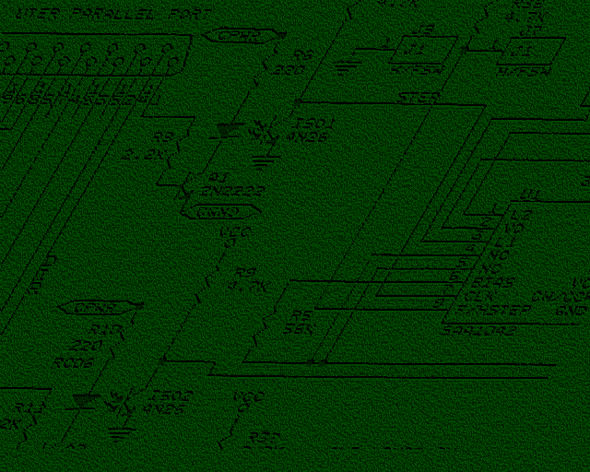
Slipping in the Window:
TCP Reset Attacks
Paul (Tony) Watson CISSP, CISM, CCSP, CCSE, MCSE+Security, etc, etc…
paw@paw.org
www.terrorist.net
CanSecWest

Slide 2
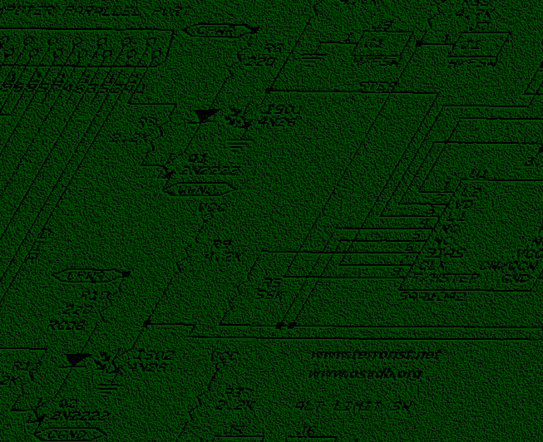
A Quick Show of Hands
How Many BGP Jockeys Are Here?
How Many of You Implement RFC-2385 BGP TCP MD5 Signatures?

Slide 3
Agenda
Background
“Separating Fact from Fud”
Facts & Fundamentals
  RFC-793, Window size defaults, ISN Prediction
Targets
Practical Attack Requirements & Estimates
Live Testing Results
Protecting From Attack / Solutions & Fixes
The Disclosure Process
Thanks and Credits

Slide 4
Background
Sequence number research
  Blind spoofing, packet injection, session hijacking
Growth in available bandwidth
Growth of business dependence on Internet
  VPN’s, Mail, Web, Database, B2B, etc.
DDoS attacks (what a waste of resources)
  Mass-rooting, drone deployments, poor ATO* (on/off)
Homeland Security / Critical Infrastructure
  Threats of Information Warfare
*ATO: Attack (Air) Tasking Orders

Slide 5
TCP Reset Attack Time Requirements
Slide from Convery & Franz’s presentation:
“BGP Vulnerability Testing: Separating Fact from FUD”
■ A theoretical blind attack @ 1 million pps ~ 30 minutes to just get the seq. number (assuming a correct guess after iterating through 50% of the space).
(2³²/2)/1,000,000 = # of seconds
 Our tool was able to generate 62,500pps* ~ 9 hours
 Since the attacker won’t know which side is 179 vs. a high port multiply these numbers by 2.
 With source port randomization, this goes to 4 years in the first example (1 mil. pps to guess 1 48 bit number and 142 years assuming 62,500pps and needing to guess both sides):
((2⁴⁸/2)/62,500)x2 = # of seconds
*What sort of event is 62.5kpps on your router?

Slide 6
Facts: TCP Features & Options
Sequencing of TCP packets
  Sequence and acknowledgement numbers
    32 bit field (over 4 billion possibilities)
    Ensures ordering of received packets
  Window size
    16 bit field (over 65,000 possibilities)
    Sender and receiver have independent window sizes

Slide 7
Facts: RFC-793 ( TCP )
receive window
This represents the sequence numbers the local (receiving) TCP is willing to receive. Thus, the local TCP considers that segments overlapping the range RCV.NXT to RCV.NXT + RCV.WND - 1 carry acceptable data or control.
Segments containing sequence numbers entirely outside of this range are considered duplicates and discarded.
RST
A control bit (reset), occupying no sequence space, indicating that the receiver should delete the connection without further interaction. The receiver can determine, based on the sequence number and acknowledgment fields of the incoming segment, whether it should honor the reset command or ignore it. In no case does receipt of a segment containing RST give rise to a RST in response.

Slide 8
Facts: RFC-793 Requirements
receive window
This represents the sequence numbers the local (receiving) TCP is willing to receive. Thus, the local TCP considers that segments overlapping the range RCV.NXT to RCV.NXT + RCV.WND - 1 carry acceptable data or control.
Segments containing sequence numbers entirely outside of this range are considered duplicates and discarded.
** So a TCP packet with a sequence number within “range” is accepted.

Slide 9
Facts: RFC-793 Options
For a RST, a receiver CAN use sequence and acknowledgement to verify the packet. Unfortunately, not a single TCP stack I have tested verified the acknowledgement number. As a result, Reset attacks are easy to successfully execute….
RST
A control bit (reset), occupying no sequence space, indicating that the receiver should delete the connection without further interaction. The receiver can determine, based on the sequence number and acknowledgment fields of the incoming segment, whether it should honor the reset command or ignore it. In no case does receipt of a segment containing RST give rise to a RST in response.

Slide 10
But it gets even worse……

Slide 11
Facts: TCP Features & Options
Window Scaling: RFC-1323
  Primarily used for Long Fat Networks (LFN)
  Windows up to 30 bits (scale factor of 14)
    1 gigabyte windows!!!
  Dramatically simplifies TCP Reset attacks
    Only 4 packets required in a “best (worst?) case” scenario

Slide 12
Facts: Window Size Observations
A larger window provides greater transmission efficiency but expands the opportunity TCP Reset attacks
Windows sizes can vary by application
  Cisco TELNET has a window of 4,192
  Cisco BGP has a window of 16,384
The window sizes on the next slide do not use RFC-1323 (window scaling)

Slide 13
Facts: Window size observations
Operating System | Initial Window Size | Packets Required
Efficient Networks 5861 (DSL Router) v5.3.20 | 4,096 | 1,048,575
Linux 2.4.18 | 5,840 | 735,439
Nokia IPSO 3.6-FCS6 | 16,384 | 262,143
Cisco 12.2(8) | 16,384 | 262,143
Cisco 12.1(5) | 16,384 | 262,143
Cisco 12.0(7) | 16,384 | 262,143
Cisco 12.0(8) | 16,384 | 262,143
Windows 2000 5.00.2195 SP1 | 16,384 | 262,143
Windows 2000 5.00.2195 SP3 | 16,384 | 262,143
HP-UX 11 | 32,768 | 131,071
Windows 2000 5.00.2195 SP4 | 64,512 | 66,576
Windows XP Home Edition SP1 | 64,240 | 66,858

Slide 14
Facts: Revised “FUD” Equation
At 1 million packets per second:
((( 4,294,967,295 / 1,000,000 ) / 16,384 ) / 60 ) /2 = .00218 (1/10 second)
  .00218 minutes ( 1/10th second )
At 62,500 packets per second:
((( 4,294,967,295 / 62,500 ) / 16,384 ) / 60 ) / 2 = .0291 (approx. 1.7 seconds)
  .0291 minutes ( 1.7 seconds )
With TCP windows, we can reduce time requirements from 9 hours to 1.7 seconds (for 50% success rate)
What kind of event is 60,000 packets for 1 second?
  Would you even notice?

Slide 15
Facts: TCP Sequence Prediction
Zalewski “Strange Attractors” Paper
Cisco had historical problems with ISN generation
Cisco IOS is fixed in latest IOS images
Win95, 98, NT, 2000, HP/UX, IRIX, MacOS
  Severe ISN problem, helpful against these, but
WHY BOTHER???
  The requirements are so low with this technique, that its practically unnecessary. (65k windows for Win2K)

Slide 16
TCP Source Port Considerations
A successful TCP Reset attack requires the attacker to either have knowledge of a valid 4-tuple (or make an accurate guess)
  Destination is easy
  Destination port is easy
  Source is easy
  Source port is the difficult part… Or is it?
The theory is that source ports increase the difficulty from 2³² to 2⁴⁸
  This is true only with Pseudo-random source ports
  We don’t use ports less than 1,024 (privileged ports)
  We don’t use ports greater than 49,152 (reserved ports)
Do OS’s have a predictable pattern for source port selection??

Slide 17
Source Port Observations
Operating System | Observed Initial source port | Observed next port selection method
Linux 2.4.18 | 32,770 | Increment by 1
Nokia IPSO 3.6-FCS6 | 1,038 | Increment by 1
Cisco 12.2(8) | 11,000 | Increment by 1
Cisco 12.1(5) | 48,642 | Increment by 512
Cisco 12.0(7) | 23,106 | Increment by 512
Cisco 12.0(8) | 11,778 | Increment by 512
Windows 2000 5.00.2195 SP3 | 1,060 | Increment by 1
Windows 2000 5.00.2195 SP4 | 1,038 / 1,060 | Increment by 1
Windows XP Home Edition SP1 | 1,050 | Increment by 1

Slide 18
TCP Source Port Considerations
Source ports were never intended to provide security
Cisco appears more dispersed by IOS
  But could this be used to help fingerprint the router?
    An outbound connection would need to be coaxed shortly after reboot
To guess the unknown part of the 4-tuple (BGP or other service)
  How many neighbors? (assume ½ of BGP neighbors initiate)
  Know or estimate uptime
  Know of estimate IOS or OS version
  Compile data to create a “guess range” (will vary, assume 50)
The information can be determined or accurately estimated using existing techniques and methods
Once the attacker resets the first connection, the next source port used will be easy to guess (just add 1 or 512)

Slide 19
Targets
BGP (the most obvious target)
SSL, TLS, SSH (long lived connections, such as VPN’s)
IRC Servers (Netsplit anyone?)
Domain Name System (DNS) TCP
Video Conferencing Systems
SQL / Database Connections
Remote Control (VNC, RDP, PCAnywhere)
Online Games (Half-life tcp/27015, Diablo II tcp/4000, etc…)
AOL (5190-5193)
MPLS / LDP (Thanks to Nicolas ‘Nico’ Fischbach for this)
Others?

Slide 20
Targets: BGP
Locations with limited connectivity
  Countries (China)
  E-Commerce or Business sites
  Others (Next slide will show how to find these)
Threat of massive DDoS using drones with ATO’s*
  Could reduce/eliminate the usefulness of border filtering
Outages of hours or days due to route dampening
Analysis of over 40,000 routers
  Data provided courtesy of Bill Chezwick (Lumeta)
  Sending non-spoofed SYN elicited over 3000 SYN-ACK responses (13.3%)
    The 3000+ routers included in paths to 6.6% of internet routes (346,133 of 2,262,018 traced)

Slide 21
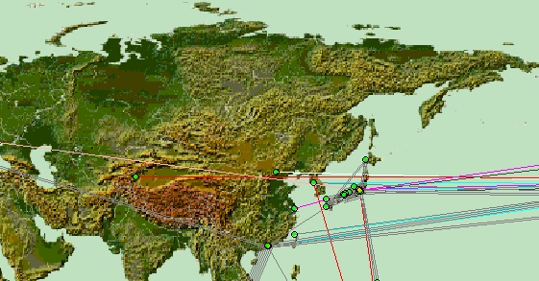
Targets: BGP
http://www.caida.org/tools/visualization/mapnet/Backbones/
An analysis of backbone routes, shows a very limited amount of connectivity to China. This would be exceptionally vulnerable.

Slide 22
Targets: SSL Based VPN’s
http://www.securityfocus.com/news/8088
“Secure Socket Layer (SSL) VPNs will be the fastest growing segment of the market. Datamonitor's report on Firewall and VPN solutions forecasts that home working and the push for mobility/anywhere-anytime access for workers will see enterprise investment in Secure Socket Layer (SSL) VPNs grow 74 per cent a year between 2003-2007. Datamonitor estimates that the SSL VPN market will rise from $120m in 2003 to just over $1bn in 2007.”
    Neoteris
    Symantec Safe Web
    Other competitors in this market space

Slide 23
Targets: Domain Name System
Name servers zone transfers
  Large zone file transfers
  Root, gTLD, ccTLD servers?

Slide 24
Targets: Internet Relay Chat (IRC)
IRC Server are well know, and easy to find
  Maps of hosts and peers are easily gathered
  Operating systems of server is easily obtained
Communications Ports are well known
Taking down the IRC network would not be too difficult

Slide 25
Practical Attack Requirements
Window size of 16,384 is used
  Window size used by BGP
Assume ideal ISN (perfectly random)
  No sequence number prediction
Packets are 320 bits
  20 byte IP header
  20 byte TCP header
The following calculation is used:
((( 4,294,967,295 / 16,384 ) * 320 ) / bandwidth in mbps ) = seconds required
Note that these numbers are complete brute-forcing… We will probably hit much sooner!

Slide 26
Practical Attack Requirements
Internet Connectivity | Packets Required | Time Requirement | 50 Source Ports Time Requirement
56kbps (dialup) | 262,144 (*50) | 1497 seconds (90 minutes) | 74,850 seconds (20.8 hours)
256kbps (DSL) | 262,144 (*50) | 327 seconds (20 minutes) | 16,350 seconds (4.5 hours)
1.54kbps (T1) | 262,144 (*50) | 54 seconds | 2,700 seconds (45 minutes)
45mbps (DS3) | 262,144 (*50) | 1.8 seconds | 90 seconds
155mbps (OC3) | 262,144 (*50) | ½ seconds | 25 seconds
Window Size | 16,384 bytes

Slide 27
Practical Attack Requirements
Window size of 65,535 is used
  Best case scenario without RFC-1323
Assume ideal ISN (perfectly random)
  No sequence number prediction
Packets are 320 bits
  20 byte IP header
  20 byte TCP header
The following calculation is used:
((( 4,294,967,295 / 65,535 ) * 320 ) / bandwidth in mbps ) = seconds required

Slide 28
Practical Attack Requirements
Internet Connectivity | Packets Required | Time Requirement | 50 Source Ports Time Requirement
56kbps (dialup) | 65,537 (*50) | 374 seconds (6 minutes) | 18,700 seconds (5.2 hours)
80kbps (DSL) | 65,537 (*50) | 262 seconds (4.3 minutes) | 13,107 seconds (3.6 hours)
256kbps (DSL) | 65,537 (*50) | 81 seconds (1 minute) | 4,050 seconds (1.1 hours)
1.54kbps (T1) | 65,537 (*50) | 13.6 seconds | 680 seconds (11 minutes)
45mbps (DS3) | 65,537 (*50) | .5 seconds | 25 seconds
155mbps (OC3) | 65,537 (*50) | .1 seconds | 5 seconds
Window Size | 65,535 bytes

Slide 29
Results of Live TCP Reset Attacks
Using methods described in this paper
TCP source port was provided to attacking system to obtain accurate results for a single port attack (then extrapolate 50 port attack)
No Sequence prediction was performed
  Brute force guessing only (starting at SEQ=0)

Slide 30
Live Testing: Hardware and Software
SYSTEM | HARDWARE | SOFTWARE
Initiating Host | Pentium 4 1.7ghz | Windows XP SP1
Target Host A | Intel Celeron 2.2ghz | Windows 2000 SP4
Target Host B | Cisco 2621 router | 12.0(7) T
Attacker System | AMD Athlon XP 2700+ | Linux 2.4.18
Network Fabric | Cisco Catalyst 2950 | 12.1(13) EA1

Slide 31
Live Testing: Tools
Reset-tcp.c
  Uses libnet-1.1.1 (Mike Schiffman)
  Tool was specifically written for this project
Program will be released for independent testing
  Code is not RFC-31337 compliant
  Read the code and comments before compiling
Modified version of Cisco TCP Test Tool
  I developed a modified version of “TCP Test Tool” (ttt)
  Modified version allowed for window-size sequence increments
  This utility achieved transmission rates over 60,000pps

Slide 32
250pps (Low-end Upstream DSL)
Packets generated at rate of 250pps
40 bytes per packet
  Approximates 80,000 bits per second
  Typical upstream available to low-end home DSL
Time required to cover entire 32-bit sequence space using 16-byte window was about 4 minutes 18 seconds

Slide 33
Live Testing: Results at 250pps
Target: Windows 2000 | Start Time | Time of Reset | Time (sec.) Required
Test 1 | 164830 | 165231 | 401
Test 2 | 164835 | 165241 | 406
Test 3 | 165503 | 165920 | 417
Test 4 | 170041 | 170044 | 3
Test 5 | 171639 | 171654 | 15
Test 6 | 222221 | 222227 | 6
Test 7 | 222347 | 222431 | 84
Test 8 | 224751 | 224820 | 69
Test 9 | 231325 | 231441 | 116
Test 10 | 161545 | 161759 | 214
Anticipated Window Size | 63,000 bytes
Packets Per Second | 250

Slide 34
4,370pps (T-1 Speed)
Packets generated at rate of 4,370pps
40 bytes per packet
  Approximates 1,389,400 bits per second
  Typical available upstream on standard T-1 circuit
Time required to cover entire 32-bit sequence space using 16-byte window was about 15 seconds

Slide 35
Live Testing: Results at 4,370pps
Target: Windows 2000 | Start Time | Time of Reset | Time (sec.) Required
Test 1 | 180038 | 180046 | 8
Test 2 | 180724 | 180728 | 4
Test 3 | 180812 | 180822 | 10
Test 4 | 180910 | 180920 | 10
Test 5 | 181210 | 181221 | 11
Test 6 | 205600 | 205607 | 7
Test 7 | 181408 | 181418 | 10
Test 8 | 181539 | 181550 | 11
Test 9 | 202329 | 202332 | 3
Test 10 | 202410 | 202414 | 4
Anticipated Window Size | 63,000 bytes
Packets Per Second | 4,370

Slide 36
Live Testing: Conclusions
Live results matched the predicted estimates
A single home DSL is more than capable of seriously impacting a single BGP talker or other TCP service
  Combined with a DDoS and ATO’s*, an attack could be devastating (intelligent drone targeting)
  Imagine RST packets at DDoS ICMP Flooding speeds
The limited number of required packets allows for more precise DDoS attacks, with limited collateral damage
TCP needs to be fixed!

Slide 37
Solutions and Fixes
Cisco has taken this issue seriously
  Implementing pseudo-random source ports
  Considering TCP Reset “ACKs” (changing RFC)
My solution
  Verify both SEQ and ACK in RST packets
  Increases difficulty on 16k BGP from 2^18 to 2^36
    Instead of 200k packets, we now need 70 billion!!!
  Maintains RFC-793, no re-write required
Filtering
  RFC-2385 BGP TCP MD5 Signatures
  RFC-2827 Filtering
Unicast reverse path forwarding
Window Size Tuning (least effective)

Slide 38
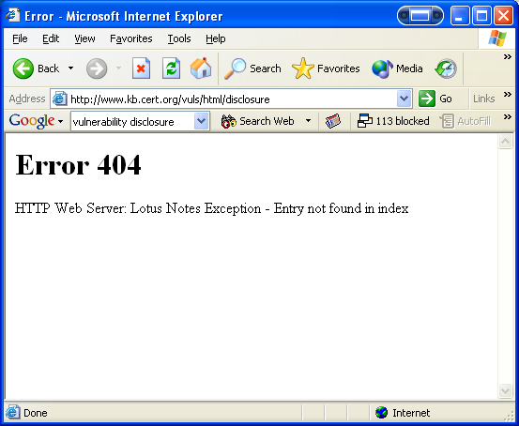
The Disclosure Process
Step 1: Visit CERT/CC for disclosure process
Notify authors of FUD paper / Cisco CIAG
Agree on communication with Vendor
“Thank you for your cooperation, and for the permission to share this with CERT/CC. I'll be forwarding on the latest copy of the paper tonight, and I will send you a copy of the email I send to them. I would be happy to copy you on future communication” –undisclosed member of Cisco CIAG
Maintain unilateral communication with Cisco
  Legal departments will destroy private disclosure
  CERT/CC took no action in 3 months of waiting
Coordinate with NISCC (UK CERT)
  Open communication, prompt action, great org!

Slide 39
Thanks and Credits
Matthew Franz & Sean Convery
  Excellent paper “Fact from FUD”
  Reviewing, proofing, and excellent input
OSVDB Staff
  Reviewing, testing, verification, support, and late night “CoD” gaming
Bill Chezwick, Lumeta
  Supplying Internet traceroute data

Slide 40
Bibliography
1. Convery, Sean and Franz, Matthew; “BGP Vulnerability Testing: Separating Fact from FUD”, 2003, http://www.nanog.org/mtg-0306/pdf/franz.pdf
2. Schiffman, Mike D.; Libnet packet library, 2003, http://www.packetfactory.net/libnet
3. CA-01-09 CERT; The sequence number CERT advisory CA-01-09, 2001, http://www.cert.org/advisories/CA-2001-09.html
4. Zalewski, Michal; Strange Attractors and TCP/IP Sequence Number Analysis - One Year Later, 2002, http://lcamtuf.coredump.cx/newtcp/
5. Bellovin, Steve; RFC 1948 "Defending against Sequence number attacks", 1996, http://www.faqs.org/rfcs/rfc1948.html
6. Jacobson V.; RFC 1323 TCP Extension for High Performance, 1992, http://www.faqs.org/rfcs/rfc1323.html
7. USC, University of Southern California; RFC 793 “Transmission Control Protocol”, 1981, http://www.faqs.org/rfcs/rfc793.html
8. PIX TCP Reset Advisory; 2000-07-11, http://www.cisco.com/warp/public/707/pixtcpreset-pub.shtml
9. Shimomura, Tsutomu; “Technical details of the attack described by Markoff in NYT”, 25 Jan1995, http://www.networkcomputing.com/unixworld/security/001.add.html
10. Watson, Paul A. aka shade@corcom.com; alt.2600 Usenet Reply Post, January 1995, http://groups.google.com/groups?as_umsgid=26OOhertz@shade.com&output=gplain
11. CA-1995-01, CERT; IP Spoofing Attacks and Hijacked Terminal Connections, 23 Jan 1995, http://www.cert.org/advisories/CA-1995-01.html
12. MacDonald, Dave and Barkley Warren; Microsoft Windows 2000 TCP/IP Implementation Details, 2000, http://www.microsoft.com/windows2000/techinfo/howitworks/communications/networkbasics/tcpip_implement.asp
13. Ferguson P. & Senie D., RFC-2827 “Network Ingress Filtering: Defeating Denial of Service Attacks which employ IP Source Address Spoofing”, 2000, http://www.faqs.org/rfcs/rfc2827.html
14. Heffernan, A., RFC-2385 “Protection of BGP Sessions via the TCP MD5 Signature Option”, 1998, http://www.faqs.org/rfcs/rfc2385.html

