Slide 1
windows nt/2000 event log management and intrusion detection
cory scott
securify, inc.
cscott@securify.com

Slide 2
topics covered
Requirements for Event Log Management and IDS systems
Issues with Windows NT/2000 Event Logging
Commercial tools
Event Log Architecture
Batch processing of Event Logs
A proposed solution
Using syslog as an Event Log management solution
Events to look for

Slide 3
What are the requirements for an event log management system?
The ability to transmit log messages in “real-time” or in batch to other monitoring systems
Analysis should be able to utilize common scripting tools with the same ease that has existed in the UNIX world for years
Alerting features should exist that are completely customizable to the administrator
Filtering of extraneous or repetitive log events prior to analysis
Storage of event log message for safekeeping in flat files or databases

Slide 4
What are the requirements for an IDS?
Analysis should be combined with a common-sense auditing policy that allows for intrusion detection by looking for suspicious events
Accountability (identify and authenticate each user and process in the system)
Real-time detection and response
Subgoals: forensic evidence, system analysis, system performance, problem identification
These goals are often in conflict

Slide 5
types of responses
Active
- Take action against intruder
- Amend the environment
- Collect more information
Passive
- Log, alert, and/or alarm
(ala Bace, pg. 125-129)

Slide 6
windows nt event logging
Distributed nature of logs with no built-in way to centralize
Inaccessible, cryptic, and superfluous entries
No real-time reaction ability
Not a lot of good information out there on what events to look for – hard to map user to action

Slide 7
commercial tools
Some only measure uptime and provide limited information
Most attempt to apply a one-size-fits-all approach to suspicious events
Most are non-heterogeneous
Many have a lot of bloat and lack of flexibility
Most are overkill
On the flip side, they are getting better and there is a direct line of support with a commercial tool.

Slide 8
event log architecture
Architecture Overview
The three types of event logs & what goes where:
- Application
- Security
- System
Also in Win2k - Active Directory, File Replication, & DNS

Slide 9
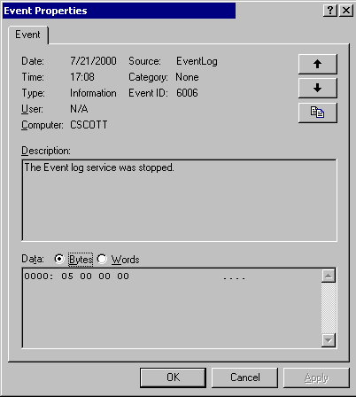
event log message internals
Timestamp
Severity
IDs & Sources
Description
Event Data

Slide 10
Batch processing of Event Logs
Task Scheduling Review
Scheduling tasks…
The AT command and the Task Scheduler:
  at 12:00 /every:Su,M,T,W,Th,F,S runme.bat
Or repeating in smaller increments…
  Script called runme5.bat contains:
  SOON 300 C:\RUNME5.BAT
  C:\RUNME.BAT

Slide 11
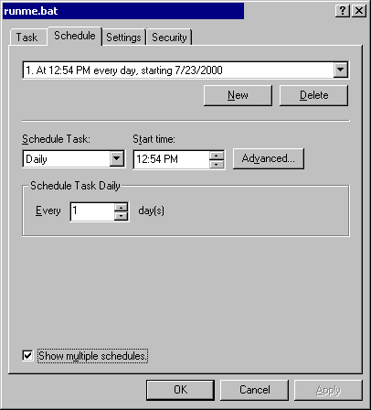
task scheduler

Slide 12
batch processing of event logs: exporting and dumping
Binary file backup
- Within the Event Viewer
- NTOLog
Viewing the binary logs
- Manual: Event Viewer
- Batch: DumpEl with –b switch
Extracting event logs into text files
- DumpEl

Slide 13
batch processing of event logs: exporting and dumping examples
NTOLog – www.ntobjectives.com
ntolog \\SERVER /b /c /sec /f secbackup.evt
DumpEl – Windows NT/2000 Resource Kit
dumpel -f secevts.txt -l Security -d 1
(live log)
dumpel -f secevts.txt –b -l secbackup.evt -d 1
(backup log)

Slide 14
dealing with windows nt & the event log service
Increase the size of the event logs
- Disk is cheap!
Think about retention policy
- Overwrite as needed
- Overwrite entries that are x days old
- Do not overwrite

Slide 15
suggested audit policy
Depends on environment; however, there are some settings that are commonplace:
Logon and Logoff (Failure)
User and Group Management (Success and Failure)
Security Policy Changes (Success and Failure)
File and Object Access (Failure)
Restart, Shutdown, and System (Success and Failure)

Slide 16
event log registry entries
CrashonAuditFail
HKLM\System\CurrentControlSet\Control\Lsa
CrashOnAuditFail=1
Only impacts on the Security log
Secure logs against remote access
HKLM\System\CurrentControlSet\Services\
EventLog\[LogName]
RestrictGuestAccess=1

Slide 17
one solution
Centralized logging of multiple hosts (including NT, UNIX, applications) using the syslog protocol
While this is nothing spectacularly new to the UNIX realm (although there aren’t a good number of strong deployments), this is gaining popularity in the NT realm.
Why intermingle logs of different NT and UNIX and firewall and router systems?
Correlation, depth of coverage (might miss it on one, but not the other), synchronization, ease of administration

Slide 18
transmitting event log messages
Syslog client for Windows NT – EventReporter (was EvntSlog)
Forwarding event log messages realtime via syslog
  Available at www.eventreporter.com
  Approximately $25 a server

Slide 19
breakdown of a syslog message
Local and remote capability – 514/udp
Facility:
Auth, Auth-Priv, Cron, Daemon, Kern, LPR, mail, mark, news, syslog, user, uucp, local0-local7
Priority:
Emergency, Alert, Critical, Error, Warning, Notice, Info, Debug

Slide 20
building a secure logging server
Common security practices
- Physical, network, host based security
- Read-once ability
- Sync time sources

Slide 21
building a secure logging server
Important tools to use
Syslog-ng
A good replacement for syslogd – www.balabit.hu
Swatch
A flat file monitoring utility – www.stanford.edu/~atkins/swatch
Sendpage
Pager gateway - sendpage.cpoint.net
Perl

Slide 22
syslog client and server communication
Configuring EventReporter
- Define a syslog server
- Define which logs are sent and at what facility
Configuring syslog-ng
- Define sources (local / remote)
- Define filters (facility, priority, program, host, grep)
- Define destinations (file, pipe, stream, tty, program, syslog)
- Define logs (combinations of sources, filters, destinations)

Slide 23
best practices for logging / watching the logfiles
Suggested configurations and audit policy for system logs
How to log your own events from Windows NT and 2000 – Logevent, a Reskit utility
logevent "Danger - core temperature critical!"
Swatch configuration
swatch -c $HOME/.swatchrc -t /var/log/critical
  In .swatchrc:
  watchfor /User account lockout/ mail=admin@acme.com,subject=Lockout

Slide 24
events to look for
Logon/Logoff
Account Policy Violations
System Events
User and group events
Policy Changes
New events to Windows 2000

Slide 25
events to look for
Logon/Logoff
Unknown Username or Bad Password –
Security Event 529 - Failure Audit
Unsuccessful Logon –
Security Event 537 – Failure Audit
Make sure you are monitoring each workstation for these events.

Slide 26
events to look for
Logon Types:
2 = Interactive
3 = Network
4 = Batch
5 = Service
6 = Proxy

Slide 27
events to look for
Violations of Account Policies – Failure Audits
Account Logon Time Restriction Violation
  Security Event 530
Account Currently Disabled - Security Event 531
Account Has Expired - Security Event 532
User Not Allowed to Log on - Security Event 533
Logon Type Restricted - Security Event 534
Password Expired - Security Event 535

Slide 28
events to look for
System Events
System Restart - System Event ID 512
Some Audit Event Records Discarded - System Event ID 516
Audit Log Cleared - System Event 517

Slide 29
events to look for
User and Group Management
User Account Created / User Account Deleted - Security Event 624 / 630
Change Password Attempt - Security Event 627
Local Group Member Added / Global Group Member Added - Security Event 636 / 632
User Account Changed - Security Event 642
Domain Policy Changed - Security Event 643

Slide 30
events to look for
Policy Change
User Right Assigned / Removed - Security Event 608/609
Audit Policy Change - Security Event 612
New Trusted Domain / Removing Trusted Domain - Security Event 610/611

Slide 31
events to look for
New to Windows 2000
Encrypted Data Recovery Policy Changed
Security Event ID 617
IPSec policy agent changed
Security Event ID 615
IPSec policy agent disabled
Security Event ID 614
IPSec policy agent encountered a potentially serious failure
Security Event ID 616

Slide 32
summing it up
Managing Event Logs can be a difficult process, but the rewards of a well-tuned logging system are worth it!
Check out my article on this topic at securityfocus.com in the Microsoft Focus area

Slide 33
end of presentation
Please remember to fill out the speaker evaluation forms.
Updated slides available at:
http://packetstorm.securify.com/papers/
NT/cscottSANS.ppt

