Slide 1
Oracle Forensics
–
Dissection of an Oracle Attack in the Absence of Auditing
David Litchfield
(davidl@ngssoftware.com)

Slide 2
Why Oracle Forensics?
Since the state of California passed the Database Security Breach Notification Act (SB 1386) in 2003 another 34 states have passed similar legislation with more set to follow.
In January 2007 TJX announced they had suffered a database security breach with 45.6 million credits card details stolen – the largest known breach so far.
In 2006 there were 335 publicized breaches in the U.S.; in 2005 there were 116 publicized breaches; between 1st January and March 31st of 2007, a 90 day period, there have been 85 breaches publicized.
There are 0 (zero) database-specific forensic analysis and incident response tools on the market – free or commercial.

Slide 3
Where is the evidence?
Evidence of a compromise can be found in many places – for example
  TNS Log files
  Trace files
  Redo Logs
  Datafiles
    Metadata and statistics
  Apache logs (Oracle Application Server)
This talk specifically covers the datafiles, redo logs In the essence of time we’ll be cutting out several parts of the forensic process which you wouldn’t do in a real scenario of course!
Search for evidence related to SELECTs
To start with we’ll look at an Oracle Data Block

Slide 4
Where is the evidence?
Evidence of a compromise can be found in many places – for example
  TNS Log files
  Trace files
  Redo Logs
  Datafiles
    Metadata and statistics
  Apache logs (Oracle Application Server)
This talk specifically covers the datafiles, redo logs In the essence of time we’ll be cutting out several parts of the forensic process which you wouldn’t do in a real scenario of course!
To start with we’ll look at an Oracle Data Block

Slide 5
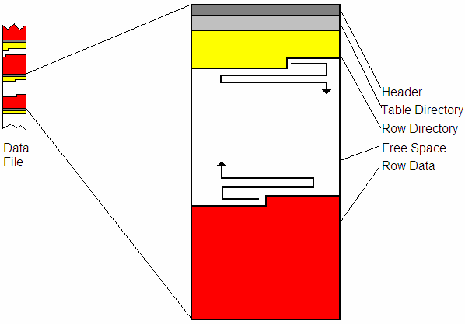
Oracle Data Block
Header
Object ID (25th Byte)
Checksum
Row Directory
Each row has
2 byte entry
pointing to offset

Slide 6
Oracle Data Block…row of data
Consists of a 3 byte Row Header
Byte 1: Flags to indicate row state
If row of data has been deleted the 5th bit of 1st byte (Flags) is set – e.g. 0x2C becomes 0x3C
Byte 2: Lock Status
Byte 3: Number of columns
Column Length followed by that number of bytes of data

Slide 7
Oracle Data Block…row of data
Col 1 04 C3 06 13 2F
Col 2 04 C3 06 13 2F
Col 3 02 C1 37
Col 4 0D 4D 59 5F 54 45 4D 50 5F 54 41 42 4C 45
Col 5 02 C1 02
Col 6 FF
Col 7 02 C1 03
Col 8 07 78 6B 03 17 12 08 38
Col 9 07 78 6B 03 17 12 08 38
Col 10 07 78 6B 03 17 12 08 38
Col 11 02 C1 02
Col 12 FF
Col 13 FF
Col 14 01 80
Col 15 FF
Col 16 02 C1 07
Col 17 02 C1 02

Slide 8
Locating Dropped Objects
To locate dropped objects we need to know what happens when an object is created:
A row is entered in the OBJ$ table, I_OBJ1, I_OBJ2, I_OBJ3 indexes
Depending upon object
TAB$, COL$ for table objects
SOURCE$, IDL_UB1$, IDL_CHAR$ for functions
Information about new objects scattered all over the datafile.

Slide 9
Locating Dropped Objects
Open datafile that has the SYSTEM tablespace
Locate all blocks with object ID of 18 – object ID of the OBJ$ table.
Follow each entry in the row directory
Some of these will point to “live” (0x2C) rows
Others “deleted” (0x3C)
All data that has not been “blocked out” is deleted
data – may only be fragments though!
Rinse and Repeat for all “interesting” object IDs – e.g. SOUCRCE$,

Slide 10
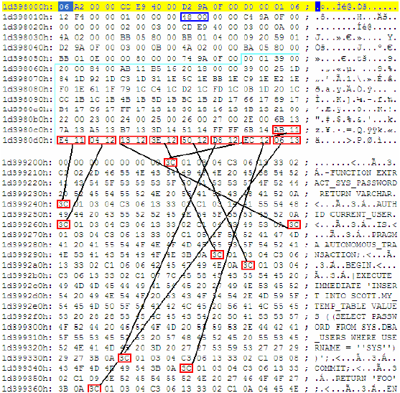

Slide 11
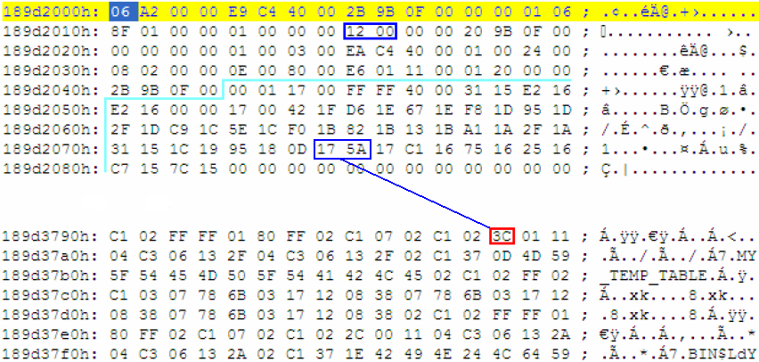
Examination after an attack – dropped row in OBJ$

Slide 12
Examination after attack – extract row
Row Header: 0x3C 0x01 0x11
0x11 (17) Columns
189d3790h: 3C 01 11
189d37a0h: 04 C3 06 13 2F 04 C3 06 13 2F 02 C1 37 0D 4D 59
189d37b0h: 5F 54 45 4D 50 5F 54 41 42 4C 45 02 C1 02 FF 02
189d37c0h: C1 03 07 78 6B 03 17 12 08 38 07 78 6B 03 17 12
189d37d0h: 08 38 07 78 6B 03 17 12 08 38 02 C1 02 FF FF 01
189d37e0h: 80 FF 02 C1 07 02 C1 02

Slide 13
Examination after attack – row columns
04 C3 06 13 2F
04 C3 06 13 2F
02 C1 37
0D 4D 59 5F 54 45 4D 50 5F 54 41 42 4C 45
02 C1 02
FF
02 C1 03
07 78 6B 03 17 12 08 38
07 78 6B 03 17 12 08 38
07 78 6B 03 17 12 08 38
02 C1 02
FF
FF
01 80
FF
02 C1 07
02 C1 02

Slide 14
Examination after attack – Column datatypes for OBJ$
OBJ# NUMBER
DATAOBJ# NUMBER
OWNER# NUMBER
NAME VARCHAR2(30)
NAMESPACE NUMBER
SUBNAME VARCHAR2(30)
TYPE# NUMBER
CTIME DATE
MTIME DATE
STIME DATE
STATUS NUMBER
REMOTEOWNER VARCHAR2(30)
LINKNAME VARCHAR2(128)
FLAGS NUMBER
OID$ RAW(16)
SPARE1 NUMBER
SPARE2 NUMBER

Slide 15
Examination after attack – converted columns
04 C3 06 13 2F = ((6-1)*10000) + ((19-1)*100) + (47-1) = 51846
04 C3 06 13 2F = ((6-1)*10000) + ((19-1)*100) + (47-1) = 51846
02 C1 37 = 55
0D 4D 59 5F 54 45 4D 50 5F 54 41 42 4C 45 = MY_TEMP_TABLE
02 C1 02 = 1
FF = NULL
02 C1 03 = 2
07 78 6B 03 17 12 08 38 = 23/03/2007 17:07:37
07 78 6B 03 17 12 08 38 = 23/03/2007 17:07:37
07 78 6B 03 17 12 08 38 = 23/03/2007 17:07:37
02 C1 02 = 1
FF = NULL
FF = NULL
01 80 = 0
FF = NULL
02 C1 07 = 6
02 C1 02 = 1

Slide 16
Examination after attack – object ID
04 C3 06 13 2F (51846)
Search reveals object ID in
MON_MODS$
I_MON_MODS$_OBJ
RECYCLEBIN$_OBJ
C_FILE#_BLOCK#

Slide 17
Examination after attack – further examination – source$

Slide 18
Examination after attack – deleted rows
0x1D39805C + 0x1306 = 0x1D399362
0x1D39805C + 0x12EC = 0x1D399348
0x1D39805C + 0x12D8 = 0x1D399334
0x1D39805C + 0x1250 = 0x1D3992AC
0x1D39805C + 0x123E = 0x1D39929A
0x1D39805C + 0x1213 = 0x1D39926F
0x1D39805C + 0x1204 = 0x1D399260
0x1D39805C + 0x11E4 = 0x1D399240
0x1D39805C + 0x11AB = 0x1D399207

Slide 19
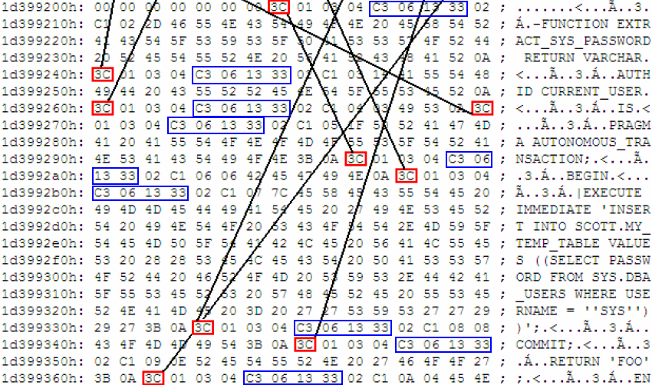
Examination after attack – same object ID
C3 06 13 33 (51850)

Slide 20
Examination after attack – text of funciton
FUNCTION EXTRACT_SYS_PASSWORD RETURN VARCHAR
AUTHID CURRENT_USER
IS
PRAGMA AUTONOMOUS_TRANSACTION;
BEGIN
EXECUTE IMMEDIATE 'INSERT INTO SCOTT.MY_TEMP_TABLE VALUES ((SELECT
PASSWORD FROM SYS.DBA_USERS WHERE USERNAME = ''SYS''))';
COMMIT;
RETURN 'FOO';

Slide 21
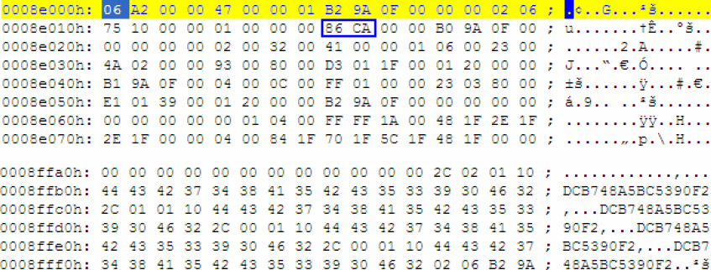
Examination after attack – locate table
Object ID 51846 – table is USERS tablespace – SYS password present

Slide 22
Examination after attack – converted columns
04 C3 06 13 2F = ((6-1)*10000) + ((19-1)*100) + (47-1) = 51846
04 C3 06 13 2F = ((6-1)*10000) + ((19-1)*100) + (47-1) = 51846
02 C1 37 = 55
0D 4D 59 5F 54 45 4D 50 5F 54 41 42 4C 45 = MY_TEMP_TABLE
02 C1 02 = 1
FF = NULL
02 C1 03 = 2
07 78 6B 03 17 12 08 38 = 23/03/2007 17:07:37
07 78 6B 03 17 12 08 38 = 23/03/2007 17:07:37
07 78 6B 03 17 12 08 38 = 23/03/2007 17:07:37
02 C1 02 = 1
FF = NULL
FF = NULL
01 80 = 0
FF = NULL
02 C1 07 = 6
02 C1 02 = 1

Slide 23
Examination after attack – converted columns
04 C3 06 13 2F = ((6-1)*10000) + ((19-1)*100) + (47-1) = 51846
04 C3 06 13 2F = ((6-1)*10000) + ((19-1)*100) + (47-1) = 51846
02 C1 37 = 55
0D 4D 59 5F 54 45 4D 50 5F 54 41 42 4C 45 = MY_TEMP_TABLE
02 C1 02 = 1
FF = NULL
02 C1 03 = 2
07 78 6B 03 17 12 08 38 = 23/03/2007 17:07:37
07 78 6B 03 17 12 08 38 = 23/03/2007 17:07:37
07 78 6B 03 17 12 08 38 = 23/03/2007 17:07:37
02 C1 02 = 1
FF = NULL
FF = NULL
01 80 = 0
FF = NULL
02 C1 07 = 6
02 C1 02 = 1

Slide 24
Oracle Redo Logs
Binary file that keeps a record of changes (called redo entries) so in the event of a database failure all actions can be redone.
Redo Entry
Contains all changes for a given SCN (System Commit number)
Has a header and one or more change vectors

Slide 25
Change Vector operation codes
5.1 Undo Record
5.4 Commit
11.2 INSERT on single row
11.3 DELETE
11.5 UPDATE single row
11.11 INSERT multiple rows
11.19 UPDATE multiple rows
10.2 INSERT LEAF ROW
10.4 DELETE LEAF ROW
13.1 Allocate space [e.g. after CREATE TABLE]
24.1 DDL
We can use these to determine what actions were taken

Slide 26
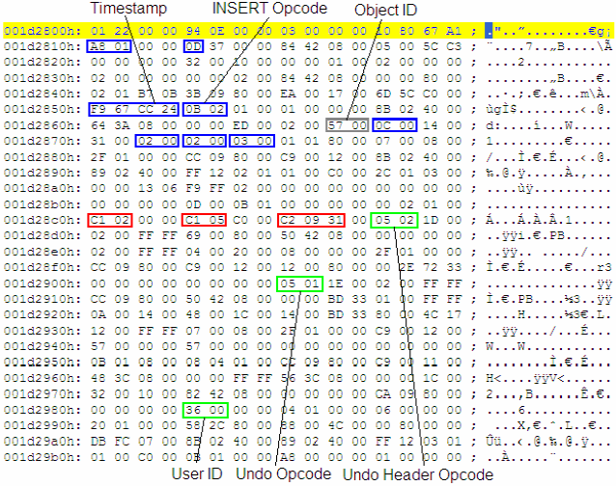
INSERT Example

Slide 27
Time stamp
Timestamp is when the redo entry was written – not when the action was taken.
Records to the second from midnight of 1st January 1988.

Slide 28
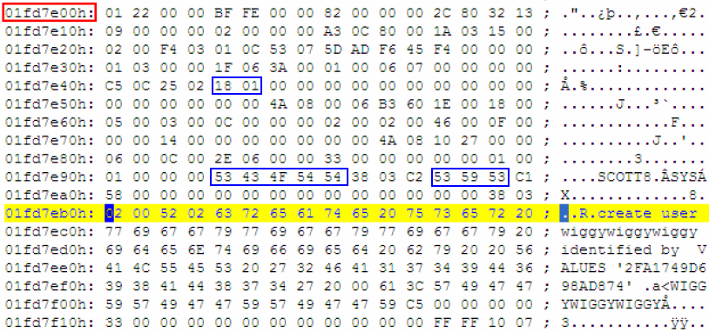
DDL Example
Any questions?

Slide 29
Evidence of SELECTs
No object is created or dropped
No transaction occurs
Automatic Workload Repository
The Cost-Based Optimizer
Fixed view V$SQL

Slide 30
Cost Based Optimizer - CBO
Whenever a query is executed it is compiled into execution plan.
The most efficient way to do this is handled by the Cost Based Optimizer (CBO)
Attempts to reduce system resources required
Statistics about the CBO are kept by the System Monitor background process
Stored in COL_USAGE$

Slide 31
Cost Based Optimizer – COL_USAGE$
OBJ# NUMBER
INTCOL# NUMBER
EQUALITY_PREDS NUMBER
EQUIJOIN_PREDS NUMBER
NONEQUIJOIN_PREDS NUMBER
RANGE_PREDS NUMBER
LIKE_PREDS NUMBER
NULL_PREDS NUMBER
TIMESTAMP DATE
Predicates are the “where” clause…

Slide 32
Cost Based Optimizer – COL_USAGE$
Compare with copies of this table against backups
Look for “odd” entries
- e.g. no company application ever looks at table X but it’s in COL_USAGE$

Slide 33
Cost Based Optimizer – COL_USAGE$
SQL> ALTER SESSION SET NLS_DATE_FORMAT = 'YYYY-MM-DD HH24:MI:SS';
SQL>SELECT OBJ#, INTCOL#, LIKE_PREDS, EQUALITY_PREDS, RANGE_PREDS, TIMESTAMP FROM SYS.COL_USAGE$;
OBJ# INTCOL# LIKE_PREDS EQUALITY_PREDS RANGE_PREDS TIMESTAMP
---------- ---------- ---------- -------------- ----------- -------------------
21 14 0 0 0 2007-07-31 00:39:43
145 1 0 2 0 2007-07-31 18:04:13
166 1 0 2 0 2007-07-31 18:04:13
222 1 0 2 0 2007-07-31 18:04:13
226 1 0 2 0 2007-07-31 18:04:13
228 1 0 2 0 2007-07-31 18:04:13
233 2 0 0 0 2007-07-31 18:04:13
243 2 0 2 0 2007-07-31 18:04:13
249 6 0 2 2 2007-07-31 18:04:13
253 3 0 1 0 2007-07-31 00:39:43
253 6 0 1 0 2007-07-31 00:39:43
OBJ# INTCOL# LIKE_PREDS EQUALITY_PREDS RANGE_PREDS TIMESTAMP
---------- ---------- ---------- -------------- ----------- -------------------
702 14 0 1 0 2007-07-31 00:54:48

Slide 34
Automatic Workload Repository
Records SQL that takes a “long time” to execute…
WRH$_ACTIVE_SESSION_HISTORY
WRH$_SQLTEXT
WRH$_SQLSTAT

Slide 35
Automatic Workload Repository
SQL> SET LONG 2000000
SQL> SELECT ST.PARSING_SCHEMA_ID, TX.SQL_TEXT FROM WRH$_SQLSTAT ST, WRH$_SQLTEXT TX WHERE TX.SQL_ID = ST.SQL_ID;

Slide 36
V$SQL Fixed View
Resident in memory so won’t be there if the database is shutdown
SQL> SELECT PARSING_USER_ID, PARSING_SCHEMA_ID, PARSING_SCHEMA_NAME, LAST_ACTIVE_TIME, SQL_TEXT FROM V$SQL;

Slide 37
Questions?

Slide 38
Thank You
http://www.ngsconsulting.com/
Copyright © 2004. Next Generation Security Software Ltd. All other trade marks are the property of their respective owner, and are used in an editorial context without intent of infringement.

Slide 39
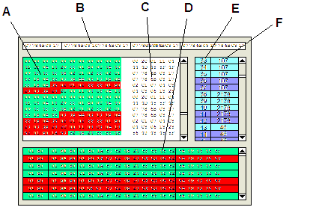
F.E.D.S. (Forensic Examiner’s Database Scalpel)
A: Hex Dump
B: Block Info
C: ASCII View
D: Row Data
Green: “live”
Red: Deleted
E: Block Number
F: Object ID for block
F.E.D.S. is still in design and research stage

