Slide 1
Responsible Disclosure
Michael Kemp
Senior Security Consultant

Slide 2
Who am I?
Responsible Disclosure
Over five years experience in IT security
Have been a consultant, researcher and technical specialist – know the vulnerability disclosure process from both sides
Have worked with some of the best security researchers in the world (and some of the laziest developers – not, it should be mentioned in the same place)
Do not have a huge number of published vulnerabilities for many reasons…

Slide 3
Disclaimer
Responsible Disclosure
It should be noted that any ideas, views or opinions expressed in this presentation or supporting materials, are in to way indicative, reflective or representative of the views, opinions, or ideas held by my current employer.
/end disclaimer

Slide 4
Responsible Disclosure
“It cannot be too earnestly urged that an acquaintance with real facts will, in the end be better for all parties.”
A. C. Hobbs, Locks and Safes: The Construction of Locks. 1853

Slide 5
Introduction
Responsible Disclosure
Disclosure (“responsible”) or otherwise is divisive
Vendor and researcher expectations are different
There are a host of legal implications
Developing an understanding of what to disclose, when, and to whom is vital

Slide 6
Some History
Responsible Disclosure
Human beings have always kept and shared secrets
Most discussions on vulnerability disclosure refer back only to the locksmith debate of the 19th century
Whether or not to disclose (and indeed what to disclose) is one of the oldest issues in moral history
A Trojan horse is just a bad wooden model without secrecy

Slide 7
Some more History
Responsible Disclosure
The disclosure debate (in relation to computer security) started over ten years ago in the early 90’s
CERT (Computer Emergency Response Team) = the ivory tower
In 1993, Bugtraq was unleashed out of a growing sense of frustration with CERT

Slide 8
Recent History
Responsible Disclosure
The conflict between responsible and full disclosure rumbles on
From 2001 (Excite@Home) Adrian Lamo worked with a variety of vendors – but still found himself on the wrong side of the law
In 2003, David and Mark Litchfield (NGS) were bought into conflict with CERT
In 2004, Michael Zalewski unveiled the MangleMe fuzzer. In 2006, he courted controversy by posting the MSIE (mshtml.dll) OBJECT tag vulnerability without communication with Microsoft

Slide 9
Today
Responsible Disclosure
The OIS (Organisation for Internet Safety) was formed in 2003 by a number of vendors in reaction to Full Disclosure
Oracle and researchers have been battling it out for years, with CSO Mary Ann Davidson wishing to silence researchers – other vendors may well agree…
Private companies (iDefence, Tipping Point, etc.) now pay for undisclosed security vulnerabilities – Security through obscurity = cash?

Slide 10
Current Disclosure Practices
Responsible Disclosure
Full – Tell the world before the vendor
Responsible – Tell the vendor before the world
Profit driven – Tell a paying third party; hope they tell the vendor and the world
Non – Tell no-one

Slide 11


A Vuln is Born
Responsible Disclosure
Every vulnerability that is discovered by a researcher (as opposed to a ‘blackhat’) has a lifecycle:
Discovery
Exploitation
Disclosure?
Fix Release?

Slide 12
A Vuln is Born
Responsible Disclosure
What happens between exploiting and disclosing a vulnerability is where the disclosure process comes in
Researchers may choose to alert a vendor before publication, they may choose to force the vendors hand by a public release, or they may retain vulnerability details for potential later malicious use
The choices made by researchers all rely on the colour of the hat, and the size of the ego…

Slide 13
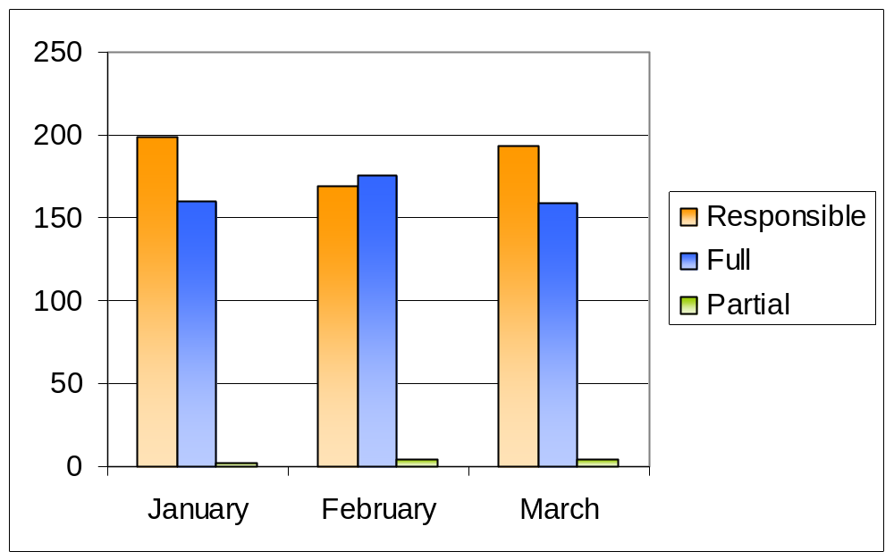
Lies, Damn Lies, and Stats
Responsible Disclosure
Number of Vulnerabilities by Disclosure type: Bugtraq 2006

Slide 14
What the Stats show…
Responsible Disclosure
Overall Bugtraq appears to have moved towards a responsible disclosure model?
Partial disclosure is still not a popular form of disclosure

Slide 15
What the Stats don’t show…
Responsible Disclosure
Included in Full disclosure statistics are those vulnerabilities that make no mention of either contact with vendors or patches
Included in Responsible disclosure statistics are postings from vendors
Obviously one statistic that couldn’t be included in this analysis was the number of zero days in existence…
No differential between enterprise level vulnerabilities and those in ‘friend of a friend’ software packages

Slide 16
“Best” Practices
Responsible Disclosure
Best industry practice for vulnerability disclosure arguably dates back to the ‘Full Disclosure Policy (RFPolicy) v.2.0’ published by Rain Forest Puppy in 2000
Most corporate guidelines for disclosure acknowledge this document as an important source (although NTBugtraq disclosure guidelines http://www.ntbugtraq.com/default.aspx?sid=1&pid=47&aid=48 predate it by a year)

Slide 17
Disclosure according to RFP
Responsible Disclosure
Researcher (Originator) contacts vendor by email (Date of Contact)
Vendor has five days to respond from DoC, if no response, publish
Researcher has to help replicate vulnerability with vendor
If anything in process takes more that five days – publish
Publication should wait until patched, and be joint release between vendor and researcher

Slide 18
Problems with RFP Disclosure policy
Responsible Disclosure
Five days is a long time for a small vendor with one product. For a major vendor with enterprise level software this is nothing
Communications can break down – the five day window doesn’t provide much room for haggling
Disclosure should be about collaboration, setting such time limits may make the process unnecessarily confrontational

Slide 19
Current ‘corporate’ policies – ISS X Force
Responsible Disclosure
Same model as RFP but with no time limitations
Caveats concerning disclosure (e.g. disclosure will occur if the vendor is ’unresponsive’, the media reports the vulnerability, active exploitation of the vulnerability is observed, etc.)
Process is defined; timescales are not (in July 15, 2004 revision)

Slide 20
Current ‘corporate’ policies – Symantec
Responsible Disclosure
Contact with vendor. Response to be received with seven days – or publish
Contact to be maintained every seven days – or publish
Issue to be resolved in thirty days, or publication unless “good faith effort” is made by vendor
For unresponsive vendors, grace period of thirty days may be grated prior to publication (Disclosure policy – January 2006)

Slide 21
‘Corporate’ policies - Conclusions
Responsible Disclosure
Wide variety of timescales, details released, and process
No consistency in either research company policies or indeed in how vendors should respond
All security research companies are interested in being ‘first to market’ with vulnerabilities – disclosure policies seem to be a moveable feast…

Slide 22
This is all really interesting, but…
Responsible Disclosure
As a member of the security industry, you have to know about disclosure
Vulnerabilities are not hard to find – enterprise level vulnerabilities are a different story!
What happens if you find a high risk enterprise level vulnerability during the course of a client engagement??

Slide 23
Vulnerability + Engagement = ?
Responsible Disclosure
All depends on the agreements in place between researcher and client
Does your company have a disclosure policy? If so, who carries legal liabilities that may be involved?
First duty is to complete engagement unless vulnerability is so severe as to cause widespread damage to enterprises
Process and agreement led – your responsibility is to know both…

Slide 24
Dealing with the client
Responsible Disclosure
In anything other than exceptional circumstances – duty of care is to the client
Who takes ownership of the vulnerability that comes from an engagement?
Vulnerability details may need to be sanitised so that the client is not exposed to danger

Slide 25
Dealing with the vendor
Responsible Disclosure
First contact is vital – be technically specific and non-confrontational
Follow guidelines in place by your company policies (if they exist!)
Offer mitigation advice if appropriate
The process is one of collaboration – not about personal glory
Drop the ego!

Slide 26
A less than perfect world?
Responsible Disclosure
The vendor will probably not appreciate your efforts
The vendor may become unresponsive
The vendor may appear to be technically obtuse
The vendor may not have experience in dealing with vulnerabilities
The vendor may wish to communicate insecurely (unencrypted email etc.)
You might be sued…

Slide 27
Less than loose lips…
Responsible Disclosure
Historically there has been a substantial gap between how researchers are perceived by vendors and how they perceive themselves
For a number of years now, researchers have been seen at best a minor consideration, and at worst maliciously inspired miscreants
This attitude is changing (slowly) but remnants of old combativeness may still remain (especially true for those researchers not protected by a corporate shield)

Slide 28
Less than loose lips…
Responsible Disclosure
How do you overcome the combativeness of silence that may greet the news of you latest vulnerability?
Could react according to RFP and other guidelines and force a response by Full disclosure
Not a great idea!
Increasing calls to make researchers responsible legally for publishing vulnerability data

Slide 29
Less than loose lips…
Responsible Disclosure
Politically the climate in Europe and the US has changed where ‘hacking’ can now be considered an act of terrorism. Can’t be long before full disclosure is seen as a terrorist act?
Full disclosure may force the vendor to respond – it will definitely expose enterprises to an increased level of risk
So, other than accepting the decrees of a security naïve vendor, what can the researcher do when faced with resistance?

Slide 30
Vaulting the stone-wall
Responsible Disclosure
Researcher reports vulnerability securely to vendor
Vendor ignores researcher, or communication breaks down
Researcher attempts second contact (detailing intention to publish)
Researcher publishes non-technical advisory (with reasonable opportunity of time for vendor response – attempt vendor contact)
Following time expiration researcher publishes technical advisory (without exploit code)

Slide 31
Vaulting the stone-wall
Responsible Disclosure
Discovery / Vendor notification
Second contact attempt?
Non-technical advisory
10 days?
10 Days?
10 Days?
Third contact attempt?
Full release
2 months?

Slide 32
And this differs how?
Responsible Disclosure
Unlike RFP / most Corporate policies first response is not full disclosure
Generic details, followed by technical advisory with no exploit code that can be misused
Multiple opportunities for vendor response – reduced legal liability?
Timescales need to be considered – three month window?

Slide 33
Problems
Responsible Disclosure
The legal responsibility and liability remains with the researcher (or company)
Still creates combativeness between research and vendor communities
The lack of exploit code, although it may prevent malicious use, may also impair legitimate continued research
Research is published – but where’s the patch / fix?

Slide 34
Solutions?
Responsible Disclosure
Vendors and researchers operating according to their own rules (OIS vs. RFP)
Maybe CERT wasn’t such a bad idea?
Mediating group, that includes vendors, research companies and individual researchers?
The ends may differ but isn’t the aim the same?

Slide 35
Easing the process: Vendors
Responsible Disclosure
Security contacts should be easy to find
Timely security response processes should be in place
Communication with researchers should occur securely
Researchers should receive credit not damnation
Customers should be informed that vulnerabilities have been discovered and provide temporary workaround / timescale to fix

Slide 36
Easing the process: Researchers
Responsible Disclosure
Give the vendor the benefit of the doubt
Communicate securely with the vendor where possible
Provide any technical details requested in a timely manner
Provide assistance with mitigation / resolution if appropriate
Inform the vendor of the methodology / timescales being followed
Don’t put personal ego before enterprise security

Slide 37
Equal parts bravado and stupidity
Responsible Disclosure
The days of Full disclosure are behind us?
Vulnerability purchasing companies and schemes can help separate the researcher from the vendor – this is not motivated by altruism however…
Recent events (Lamo, Cuthbert, McCarty et al) show that the reporting vulns (especially in web applications) can be a risky and potentially damaging process
Because of arguably non-malicious attacks, researchers have lost their career credibility and gone to jail

Slide 38
Risky Business
Responsible Disclosure
As no-one can decide what to report and when, and the risks posed by annoying the wrong parties are severe, why bother reporting anything?
Silence does not increase security
Third party commercial vulnerability purchasing companies do not exist to increase security – they exist to make money
Disclosure helps increase security levels (unless it’s Full in which case the effects can be quite the reverse)

Slide 39
Risky Business
Responsible Disclosure
Non disclosure is not an option to any ethical researcher
Disclosing vulnerability details without giving the vendor adequate response times is also unacceptable
Security research is fraught with risk and legal implications – and it remains the responsibility of the security professional to decide their own limits and actions

Slide 40
Putting away the toys
Responsible Disclosure
Self determination doesn’t work
The computer security ‘industry’ has matured significantly over the last few years – needs to start acting its age?
Is the goal to improve security for all – or turn a fast buck?
Disclosure processes need to be regulated from within and without to ensure that vendors and eager lawyers can’t target individual researchers, and that irresponsible researchers don’t drag us all down to their level

Slide 41
Scary thoughts
Responsible Disclosure
The research community needs regulation and agreed guidelines?
Regulation cannot come from .gov (which may be the way it is headed)
Regulation cannot come solely from industry (OIS anyone?)
Regulation has to come from the community?
If the disclosure models and practices don’t change – security won’t ever be increased (it’s hard to conduct research from a cell…)

Slide 42
Propping up the sky?
Responsible Disclosure
When legitimate researchers go to jail, and zero days are being used in anger – something isn’t working
Responsible disclosure is so loosely defined now, that it may not ever be workable?
A solution needs to be found – and can arguably only be found in collaboration
Time to evangelise to vendors and beyond, as well as trying to clean our own house?

Slide 43
Thanks
Responsible Disclosure
Questions?
Comments?
Random abuse?

Slide 44
Acknowledgements
Responsible Disclosure
My boss; for the time
My colleagues; for putting up with me
Melanie Flynn
Researchers and vendors everywhere; for fighting the good fight

