Slide 1

Security Topologies
Presented by
Mr. Nicholas Lemonias
M.Sc in Information Security
University of Derby, BCL Faculty
2012-2013
Duration: 15' minutes.

Slide 2
Part I Objectives
Understand concepts of networking and how different technologies are used to construct different types of networks.
Understand how computers are organised in networks and how these networks support data transmission.
Show how networks can be extended with different topologies.

Slide 3
Overview of Part I
Introduction
Transmission over a Physical Medium
Network perimeter security and organizational policies.
Network Address Translation (NAT vs PAT)
Tunneling
Virtual Local Area Networks

Slide 4
1. Introduction
1.1 Motivation for Networking
1.2 Classification of Networks
1.3 Conceptual view of a Secure Topology

Slide 5
Introduction: ISO 27001 - CIA
Information security is an emerging field that incorporates the efforts of people, policies, training, certification, awareness and a variety of technologies to improve:
The Confidentiality of data transmission.
The Integrity of data in transmission and storage.
And the Availability of Data in transit.
(ISO 27001)

Slide 6
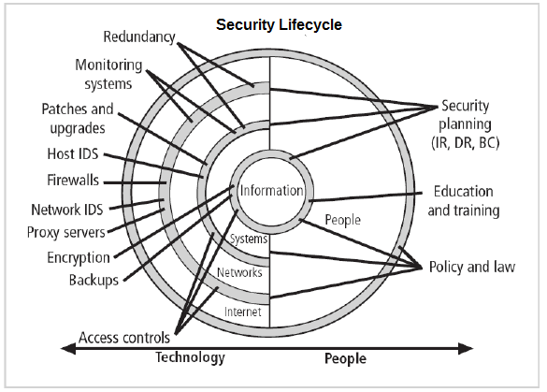
Information Security Lifecycle

Slide 7
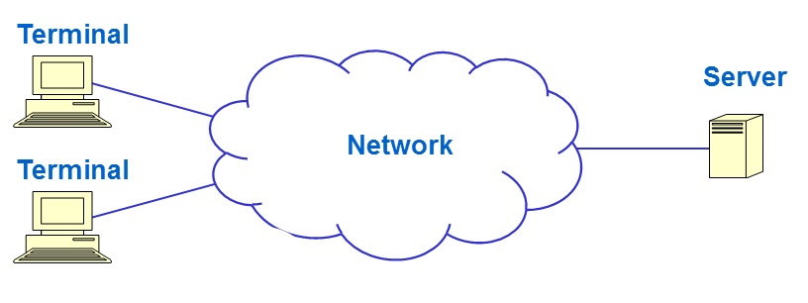
1.1 Motivation for Networking
The development of networks began in the early 1960's when computers were scarce and expensive.
Most research was funded by the U.S Department of Defense Advanced Research Project Agency (ARPA).

Slide 8
Motivation for Networking
Local networks were encouraged by sharing data for:
Storage
Printing
A rapid growth of and spread of networks have lead to a large number of network-orientated applications. .
Computer communication is essential to many corporations.

Slide 9
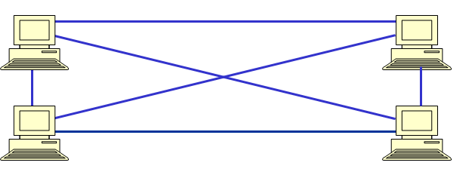
1.2 Classification of Networks
Thus the simplest way to connect hosts is using a direct connection.

Slide 10

Classification of Networks
Connection failure has a minimal impact.
Although most connections could possibly become unused.
connections to connect to
N hosts.

Slide 11
Classification of Networks:
LAN Topologies
Therefore the classification of LAN's (Local Area Networks) could be further classified in accordance to how active hosts in the network, share their connections.
Three topology designs:
Star topology.
Bus topology.
Ring topology.

Slide 12
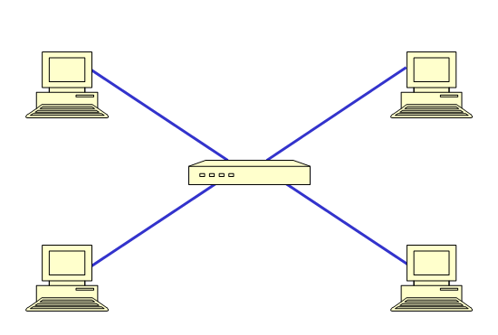
Classification of Networks:
Star Topology
Therefore in the Star Topology each host is connected to a central hub.

Slide 13
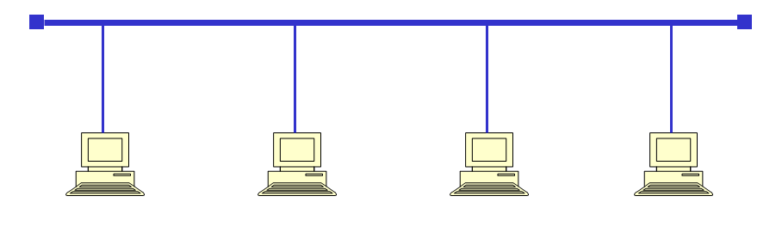
Classification of Networks:
Bus Topology

Slide 14
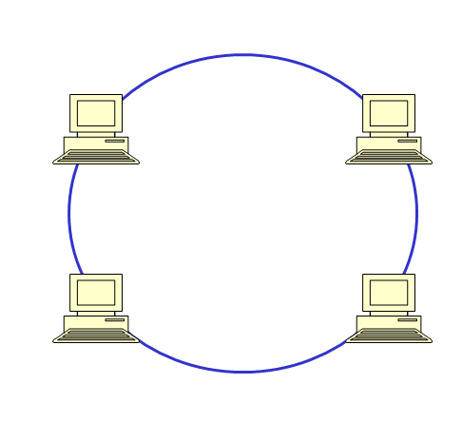
Classification of Networks:
Ring Topology
Hosts connected in a ring loop. Connection failure would disable the whole network.

Slide 15
Classification of Networks:
LAN Topologies
The Hub provisions connection between the engaging hosts by forwarding the data frames to the receiving host.
Connection failure only disconnects an individual host.
This is a typical topology used by cabled LAN's.
This topology is predominantly used by ATM (Asynchronous Transfer Mode) networks.

Slide 16
Classification of Networks:
LAN Topologies
The Hub provisions connection between the engaging hosts by forwarding the data frames to the receiving host.
Connection failure only disconnects an individual host.
This is a typical topology used by cabled LAN's.
This topology is predominantly used by ATM (Asynchronous Transfer Mode) networks.

Slide 17
Classification of Networks:
LAN Topologies
The Hub provisions connection between the engaging hosts by forwarding the data frames to the receiving host.
Connection failure only disconnects an individual host.
This is a typical topology used by cabled LAN's.
This topology is predominantly used by ATM (Asynchronous Transfer Mode) networks.

Slide 18
Classification of Networks:
LAN Topologies
The Hub provisions connection between the engaging hosts by forwarding the data frames to the receiving host.
Connection failure only disconnects an individual host.
This is a typical topology used by cabled LAN's.
This topology is predominantly used by ATM (Asynchronous Transfer Mode) networks.

Slide 19
Classification of Networks:
What makes for a secure topology?
A secure topology is therefore regarded as the arrangement of hardware devices on a network with in regards to internal security requirements and needs for public access. Citing an example of an Internet business that has Web servers that can be accessed by the public for placing orders. The Web servers would need access to:
a) sensitive database servers, with information that should be protected. Important assets, need to be protected. This is a legal requirement too.
b) Chances are that internal employees need access to the various services, but at the same time, they need access to the “outside world, the Internet”.

Slide 20
Classification of Networks:
What makes for a secure topology?
The Network Administrator delegates a global network security policy for a topology , therefore the topology of the network should be categorized as:
Trusted ( Defined in our firewall policy as known).
Semi-Trusted ( Such are the DMZ's which contain resources that are not subject to privacy and confidentiality. Question: Can you give us an example?)
Untrusted (Outside our enterprise network, but we may desire connection to such networks).
Unknown: Neither trusted or untrusted!

Slide 21
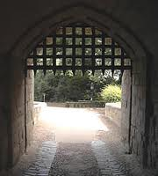
Security Topologies: Introduction to Perimeter Security
Perimeter networks permit communication between the enterprise network and external third parties. Therefore a well-designed network perimeter guards our volatile internal resources from threats , outside the organisation.
Any questions? Think of a portcullis
that guards the internal network
from outside threats, such as:
The Internet;
Other external networks;

Slide 22
Security Topologies: Introduction to Perimeter Security
Therefore the goal of perimeter security is to comply with the company's security policy first; b) To state-fully, and selectively ACCEPT or DENY (remember these very important commands) based on a number of criteria such as:
The type of protocol used in a connection. What is it for?
The originating source of request. Who is it for?
Destination. Is it really for me?
Content. Is this type of content allowed?

Slide 23
Security Topologies
Any interconnected network to our enterprise network, if it is controlled by a third-party network then it poses a security risk.
Firewalls are deployed on the network edge and contain the security policies on the network perimeter.
Security Zones: Such zones provide protection to our topology and such are the Intranet (, the Extranet and the DMZ (Demilitarized zones – should contain our Web, Ftp and Email servers so that the clients can access resources, we need availability of resources.).

Slide 24
Security Topologies: Three-Tier Architecture
The three-tier architecture identifies three integral areas, at least to the architecture of our secure topology.
The Outermost perimeter. ( Most insecure part of a network. Not for sensitive information; The router is placed in this perimeter to separate the network with assets we control, from outside networks.).
An Internal perimeter. (An additional security measure, relative to a specific set of assets).
Our Innermost perimeter (Sensitive resources).

Slide 25
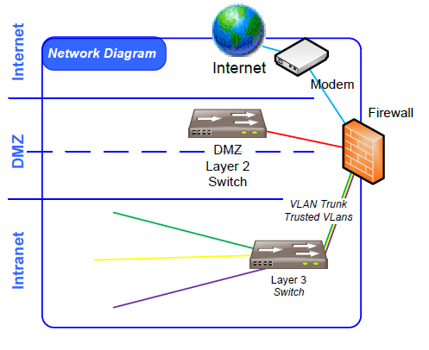
Security Topologies: Three-Tier Architecture Diagram.

Slide 26
Network Architecture: Demilitarized Zones
The demilitarized zone is a type of a security zone that is usually placed between the Internet and the internal network perimeter, which is a often guarded by firewalls and bastion hosts.
The Demilitarized zone contains services that should be available to the Internet.
Some security designs incorporate the use of proxy servers.

Slide 27
Network Architecture: Firewall Architecture
Static Packet Filtering Firewalls. (First generation firewalls, that inspects the IP Header).
Stateful Packet filtering. (The firewall remembers the state of packets and checks the port used by the previous packet).
Application Level firewalls (Also called proxy firewalls – inspects the entire packet according to firewall policies).

Slide 28
Network Architecture: DMZ and Proxy Servers
The ultimate goal of a proxy server is therefore to increase efficiency in network communication, but also for confidentiality purposes. The proxy provisions information from the internet, through a proxy cache instead of directly requesting the information from the Internet, thus limiting the risk to exposure. Proxies operate at the highest layer of the OSI TCP/IP Layer.
The goal is to provide an additional layer of security and thus to protect internal hosts.

Slide 29
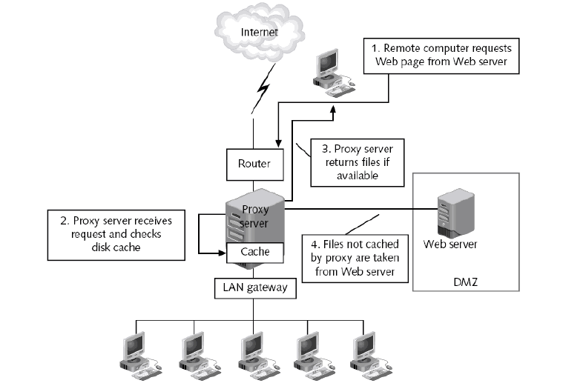
Network Architecture: DMZ and Proxies design diagram.

Slide 30
Network Architecture: DMZ, Security Zone Architecture
The objectives of the Demilitarized Zone are:
To reduce the risk and impact in case of compromise.
To guard sensitive data.
To easily identify the vulnerability.
Provides more interaction with the private segments, in contrast to a bastion host that just forwards data.

Slide 31
Network Architecture: DMZ Security Zone Architecture II
Filtering of the DMZ would provide evidence in a case of compromise, therefore there would be logs of:
Inbound traffic originating from the DMZ
Trigger attempts of a spoofed IP Address (Source IP Address would be different than the DMZ network address.)
The firewall contains the logging policies.

Slide 32
Network Address Translation (NAT)
Network Address Translation (NAT) is a standard, where a networking device such as a firewall, assigns a public address to a computer (or group of computers) inside a private network. The networking device retrieves information on behalf of the private network clients, and then provides the information internally. It performs a network address translation by looking up internally who requested what, and forwards the information securely. NAT prevents knowledge of internal network designs, and allows the use of multiple internal IP addresses for different services, internally. (Static and Dynamic NAT for IP reuse and on demand updates.)
The main goal of NAT is therefore to reduce the number of public IP addresses for an organization, for cost-effectiveness and for confidentiality.

Slide 33
Network Architecture: Tunneling
A secure tunnel allows an ‘α’ network to be interconnected in an encrypted network connection, through a ‘β’ insecure medium, such as the Internet. Therefore a tunnel can be a cost-effective method for connecting two remote locations in two different continents for example, and this allows the use of encryption.
However VPN Tunnels require Authorization and Encryption.

Slide 34
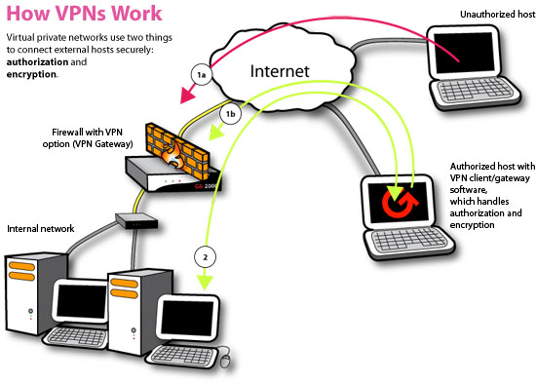
HOW VPN's Work

Slide 35
Virtual Local Area Private Networks: Technology for a Secure Network Topology.
VLAN's are comprised of network switches and are therefore used to divide networks in segments. This approach is cost-effective and provides scalability, performance and some level of security.
VLAN's can be configured to virtually isolate, bad and good traffic. VLAN's are an architectural tool to segment network traffic.

Slide 36
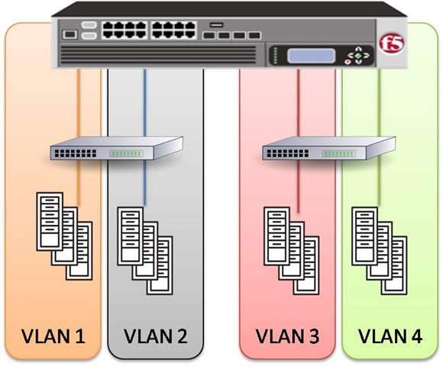
VLAN Diagram

Slide 37
Questions?
Shall you have any questions? Please feel free to ask.
Thank you for watching.

