Slide 1
Federated Learning:A Distributed Learning Approach to reach Nash Equilibrium using Lagrangian Convergence And Merkle tree based verification for untrusted participation
Indian Institute of Technology (BHU) ,Varanasi
Ubiquitous Computing
Dr. Hari Prabhat Gupta
Pranav Verma
19045076
CHE
Rishija Rishi Raj
19155078
MIN
Prathmesh Chaudhari
19045079
CHE
Pranav Mittal
19095076
ECE

Slide 2
Title Slides | 01
Introduction | 03
Purpose | 04
Methods | 05
System Model | 08
Hypothesis | 10
Results | 13
Extension (Trusted FL ) | 15
Conclusion | 17
Suggestions and Limitations | 18
Thesis Presentation Outline

Slide 3
Introduction
01
02
03
04
Background Federated learning (FL) is a decentralized machine
learning approach. In FL, multiple clients cooperatively train
a global model with their local data under the coordination of a central server.
Approach organizations cooperatively train a global model with their local data. The organizations, however, may be heterogeneous in terms of their valuation on the precision of the trained global model and their training cost
Need The computational and communication resources of the organizations are non-excludable public goods. That is, even if and organization does not perform any local training, other organizations cannot prevent that organization from using the outcome of their resources (i.e., the trained global model).
Goals organizations can achieve not only social welfare maximization but also individual rationality and budget balance. Moreover, we propose a distributed algorithm that enables organizations to maximize the social welfare without knowing the valuation and cost of each other.

Slide 4
Purpose
Cross Silo Federated Learning
01
A third party entity acts as the central server and is responsible for the coordination of training.
02
A bunch of associations act as the clients to perform local training. They are likewise the proprietors of the worldwide model and can make utilization of the prepared global model.
03
Each organisation can choose the processing capacity that it allocates for local training. Public goods used in the Cross Silo Federated learning are both non-excludable and non-rivalrous.
04
It is widely used in the field of medical and finance for data analysis . It is also used in the agri-food supply chain. Other industrial examples include drug discovery and medical data mining.

Slide 5
Methodology
A social welfare maximization problem is formulated for cross-silo FL, which is a non convex problem. Then, an incentive mechanism design problem is formulated, taking into account the heterogeneity of the organizations and the public goods feature.
Incentive Mechanism:
The strategic interaction among the organizations is modeled as a non - cooperative game with perfect information . These include social efficiency, individual rationality and budget balance .
Distributed Algorithm: Algorithm that enables the organizations to achieve the NE of the game without knowing the private information of each other in a decentralized manner is proposed.
Performance Evaluation:
The simulation results show that the proposed algorithm converges faster than the conventional Lagrangian method. Also, with the proposed mechanism and algorithm, organizations can increase the social welfare through participating in cross-silo FL.

Slide 6
Research Objectives
Objective #1 How much processing capacity should each organization
allocate for local training?
Objective #2 How much should each organization
be compensated (by other organizations) for its local
training?
Objective #3 a distributed algorithm that enables the organizations
to maximize the social welfare in a decentralized manner.
Objective #4 a distributed algorithm that enables the organizations to achieve the NE of the game without knowing the private information of each
other.

Slide 7
Methodology
Phase 1
Phase 2
Phase 3
Phase 4
a central server helps the organizations with the training. The central server maintains the global model.
Each organization has a local model, which has the same neural network structure as the global model.
Each local model then performs K local updates over the downloaded global model with its dataset Sn, where each local update corresponds to a mini - batch stochastic gradient descent for round r.
The updated model is the local model of organization n, where (Wr)n is the weights of the local model. The central server updates the global model by taking an average over the received weights from all organizations
Each organization n submits a message profile to the central server. Message indicates the number of training rounds that organization n expects to have and the unit monetary transfer per training round that organization n expects to pay or receive. The central server computes and announces the processing capacity vector f and the monetary transfer vector m.

Slide 8
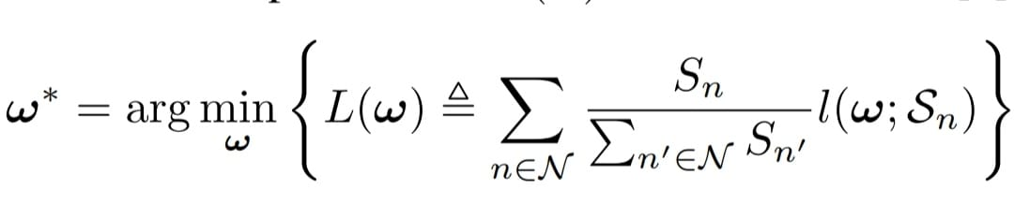
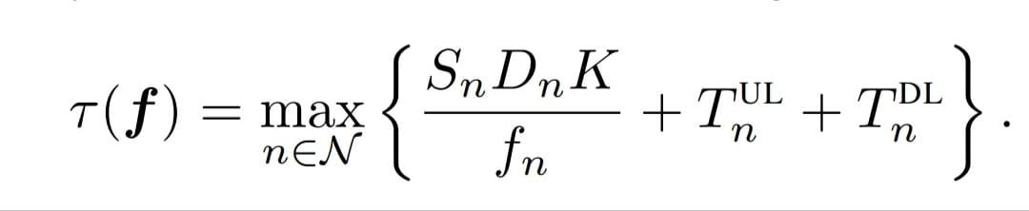
The global model is trained using cross silo FL to learn the collected data. Optimal weight (ω∗) is collected to minimise the expected loss L(ω) over the provided datasets.
System Model
We train a global model using FedAvg algorithm. The weights are initialized to a random variable and then iterated multiple times to find a optimal value.
Finally, the model is updated by taking an average over received weights.
The duration of each training round and the number of training rounds are as follows:-
No. of rounds= r(f) = T /τ (f). Here, fn denotes the processing capacity used by the organisation. T_{UL}n and T _{DL}n denote the time that organization n is required for uploading and downloading the model updates in each training round.

Slide 9
Nash Equilibrium
We aim to design f(γ) and m(γ,π) in the incentive mechanism such that the NE of the game satisfies the following properties P1, P2, and P3:
P1 Social efficiency: The processing capacity vector under NE, i.e., f(γ NE), is the optimal solution of Social Welfare Maximization problem.
P2 Individual rationality: Each organization is no worse off through participating in cross-silo FL, i.e., Vn(fn(γ NE),
r(f(γ NE)), mn(γ NE ,π NE)) ≥ 0 for n ∈ N .
P3 Budget balance: The summation of the monetary transfer of all organizations is zero, i.e., P n∈N mn(γ NE ,π NE) = 0. In other words, the monetary transfer can operate among the organizations without any third party investment.

Slide 10

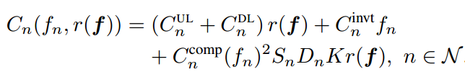
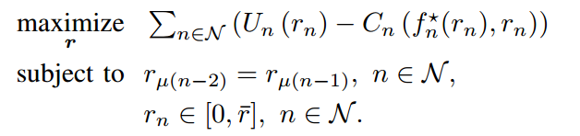
Hypothesis
01
Utility Function
02
Cost
PayOff
03
04
Social Welfare Function
*where un (in dollars per unit of loss) is the unit revenue that organization n can earn from its market by using the trained global model

Slide 11



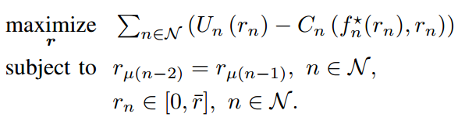

Optimization
Incentive Mechanism
Each organization n in N submits a message profile (γn; πn) to the central server. Message γn indicates the number of training rounds that organization n expects to have. Message πn indicates the unit monetary transfer per training round that organization n expects to pay or receive. The central server computes and announces the processing capacity vector f(γ) = (fn(γ); n in N) and the monetary transfer vector m(γ; π) = (mn(γ; π); n in N).
Incentive
Incentive
Lagrangian of problem
Social Welfare Function
We design a distributed algorithm that converges to the saddle point of the Lagrangian and hence the NE of Game 1.

Slide 12
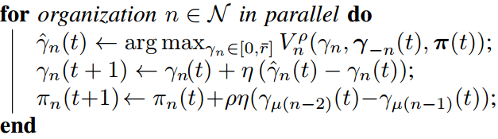
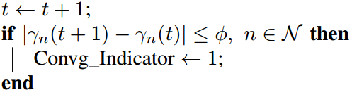
Research Process
Step 03
organizations update message profiles for multiple iterations
until the algorithm converges
Step 01
Step 05 Repeat steps 01-04 until we reach required precision for global model.
01
03
05
02
04
Step 02
Step 04

Slide 13
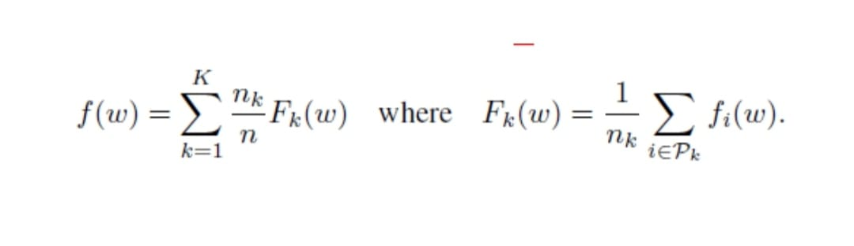
Our FL Model
We will apply the modified FedAvg with momentum, which is implemented on clients that are connected by an undirected graph.
It will be based on stochastic gradient descent. To further reduce the communication cost, we also consider the quantized FedAvg. We prove convergence of the (quantized) FedAvg under trivial assumptions; the convergence rate can be improved when the loss function satisfies the PŁ property. Finally, we numerically verify the efficacy of FedAvg.
Modified FedAvg will improve the convergence rate , accuracy and security.
Here’s the federated averaging equation we are using, it comes one of the pioneering works on federated learning:

Slide 14
Federated Learning Code
#initialize global model
smlp_global = SimpleMLP()
global_model = smlp_global.build(784, 10)
#commence global training loop
for comm_round in range(comms_round):
# get the global model's weights - will serve as the initial weights for all local models
global_weights = global_model.get_weights()
#initial list to collect local model weights after scalling
scaled_local_weight_list = list()
#randomize client data - using keys
client_names= list(clients_batched.keys())
random.shuffle(client_names)
#loop through each client and create new local model
for client in client_names:
smlp_local = SimpleMLP()
local_model = smlp_local.build(784, 10)
local_model.compile(loss=loss,optimizer=optimizer,
metrics=metrics)
#set local model weight to the weight of the global model
local_model.set_weights(global_weights)
#fit local model with client's data
local_model.fit(clients_batched[client], epochs=1, verbose=0)
#scale the model weights and add to list
scaling_factor = weight_scalling_factor(clients_batched, client)
scaled_weights = scale_model_weights(local_model.get_weights(),
scaling_factor)
scaled_local_weight_list.append(scaled_weights)
#clear session to free memory after each communication round
K.clear_session()
#to get the average over all the local model, we simply take the sum of the scaled weights
average_weights = sum_scaled_weights(scaled_local_weight_list)
#update global model
global_model.set_weights(average_weights)
#test global model and print out metrics after each communications round
for(X_test, Y_test) in test_batched:
global_acc, global_loss = test_model(X_test, Y_test, global_model, comm_round)

Slide 15
Distributed Learning Algorithm
def initializeWeights(num_clients=10):
Model=0.16
T=60
TDL=Model/78.26
TUL=Model/42.06
maxRounds=T/(TUL+TDL)
gamma=[list(np.random.rand(num_clients)*maxRounds)]
pi=[list(np.random.rand(num_clients))]
utility=[5,5,5,5,5,10,10,10,10,10]
t=0
convg_indicator=0
eta=0.3 #in 0 to 1
pho=0.005
fi=0.0001
loss=[]
while convg_indicator==0:
gamma_bar=[]
for i in range(num_clients):
gamma_bar=gamma_bar+[arg_max(gamma[t],pi[t],pho,i,utility[i],maxRounds,T,TUL,TDL)]
gamma=gamma+[list(np.array(gamma[t])+eta*(np.array(gamma_bar) - np.array(gamma[t])))]
pi=pi+[list(np.array(pi[t])+eta*pho*(np.concatenate([gamma[t][-2:],gamma[t][:-2]]) - np.concatenate([gamma[t][-1:],gamma[t][:-1]])))]
t=t+1
loss=loss+[np.sum(np.abs(np.array(gamma[t]) - np.array(gamma[t-1])))]
print(t,loss[t-1])
if(all(i < fi for i in np.abs(np.array(gamma[t]) - np.array(gamma[t-1])))):
convg_indicator=1

Slide 16
Code
def arg_max(gamma,pi,pho,i,utility,maxRounds,T,TUL,TDL):
r_tilde=np.average(gamma)
r_bar=maxRounds
sum=-np.inf
r_cap=0
K=5
Dn=0.01
Sn=600
e0=9.82
e1=4.26
Model=0.16
Cninvt=0.22/(3600)
CnUL=3*Model*0.174/3600000
CnDL=3*Model*0.174/3600000
Ccompn=0.22/(3600)
for rn in range(1,int(r_bar)+1):
Un=utility*(e0/e1-e0/(e1+K*rn))
fn=Sn*Dn*K/(T/rn-TUL-TDL)
Cn=(CnUL + CnDL)*rn + Cninvt*fn + Ccompn *fn*fn*Sn*Dn*K*rn
Ln=Un-Cn-(pi[(i+2)%len(pi)]-pi[(i+1)%len(pi)])*rn
p5=pho*np.sum(np.square(np.concatenate([gamma[-2:],gamma[:-2]]) - np.concatenate([gamma[-1:],gamma[:-1]])))
if(Ln-p5 > sum):
sum=Ln-p5
r_cap=rn
return r_cap

Slide 17
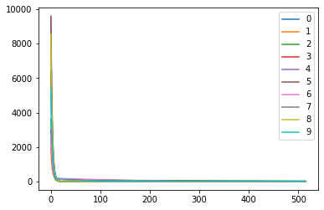
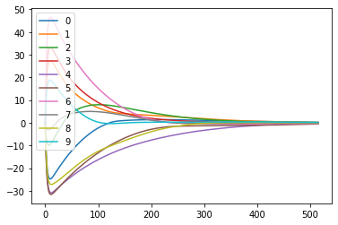
Results
Homogenous Profile (Utility is same )
Loss | Iterations
1 | 17033.33
100 | 3.26
200 | 1.78
300 | 1.019
400 | 0.552
515 | 0.0115
Rounds
ζn= πµ(n+1) − πµ(n+2)
un = 4 for 0 ≤ n ≤ 4 and un = 16 for 5 ≤ n ≤9
Cost πµ(n)
Monetary transfer of the 10 organisations we trained are:
[0.03598416473487054, 0.038631880465888724, 0.035673221615228456, 0.03468094833334501, 0.033872066376512244, -0.019310889512137996, -0.007881981282104988, -0.03647497250979781, -0.057253940050642105, -0.05792049817116207]
We can see that the total monetary transfer is 0 i.e. no organisation is worse than other organization

Slide 18
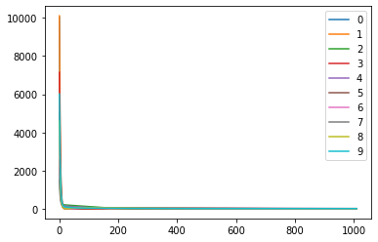
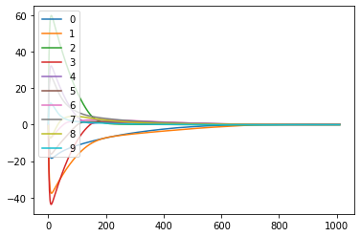
Results
Loss | Iterations
1 | 15980.309
100 | 3.241
200 | 1.151
300 | 0.460
400 | 0.386
500 | 0.316
600 | 0.255
700 | 0.089
800 | 0.394
900 | 0.378
1010 | 8.658e-05
Non Homogenous Profile (Utility is 5 and 10 for 5 organizations )
Rounds
Cost πµ(n)
No of rounds : 10 , Incentive : 0.03598,-0.0364
ζn= πµ(n+1) − πµ(n+2)
un = 4 for 0 ≤ n ≤ 4 and un = 16 for 5 ≤ n ≤9

Slide 19
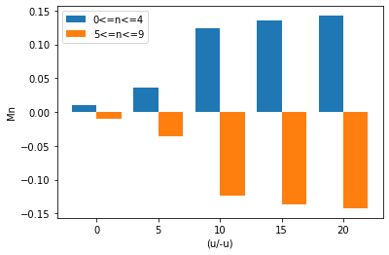
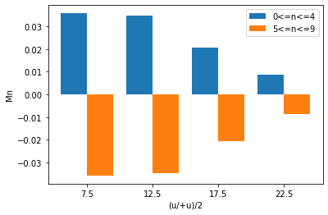
Results
Result #1 As the valuation difference increases, the payment from the organizations with higher valuation (i.e., 5 ≤ n ≤ 9) to those with lower valuation (i.e., 0 ≤ n ≤ 4) increases
Result #2 As the average valuation (u/ + u)=2 increases,the payment from the organizations with higher valuation (i.e.,5 ≤ n ≤ 9) to those with lower valuation (i.e., 0 ≤ n ≤ 4) reduces. This is because the relative valuation difference decreases. The social welfare under NE increases. (We have kept the difference constant 5 )

Slide 20
Other Extensions

Slide 21
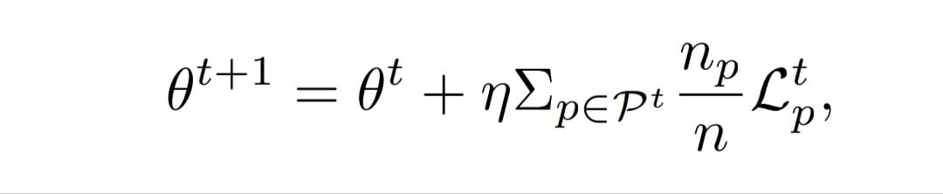
Preventing Fraud and enabling execution
assurance on untrusted participants
Designing a model in trusted execution environment to prevent model poisoning attacks from untrusted/lazy participants which can reduce the efficiency of global model.
Working of the Model:
We use “commit and prove” method
Programs running outside the enclave and inside the enclave are named as Prog o and Prog i.
Prog o:
Stores the hash digests of all model parameters θs.
Sends a commit message to the TEE when all training rounds finish.
Prog i:
requests to check one random training round.
Prog i checks whether these parameters are consistent with the parameters of Prog o.
The latest global model is updated as:

Slide 22
Binary Tree to store hash values of model parameters
Root
Sends the info to Prog i for comparison
Concatenation of its children
Leaf
Leaf
Leaf
Leaf
Hash Values of model parameters

Slide 23
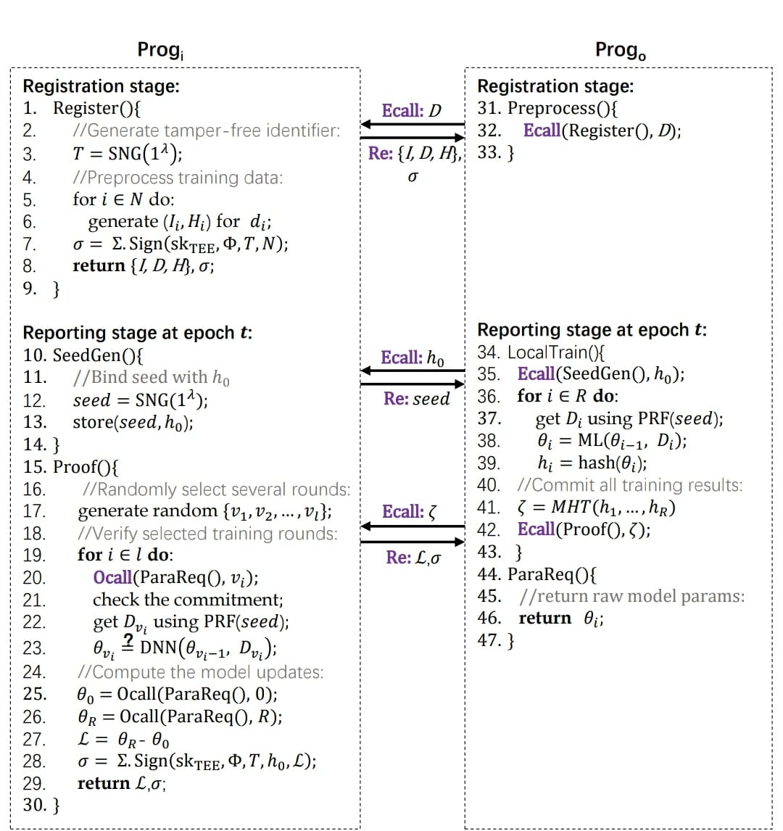

Slide 24
2. Assigning Penalty to an Organization
3. Variable no. of training rounds
and exploring non-identical datasets
Developing a mechanism to assign penalty to an organization when it has been found guilty.
Types of Penalty:
For Sybil Based Cheating.
One Time Penalty.
For Unfresh training results.
For defraud and data manipulation.
Organisations can choose the number of training rounds that they participate in according to their valuation on their precision and their computational and communication costs.
We can explore the non-independent and identically distributed(non i.i.d) data of the organizations.

Slide 25
THANK YOU !

