Slide 1

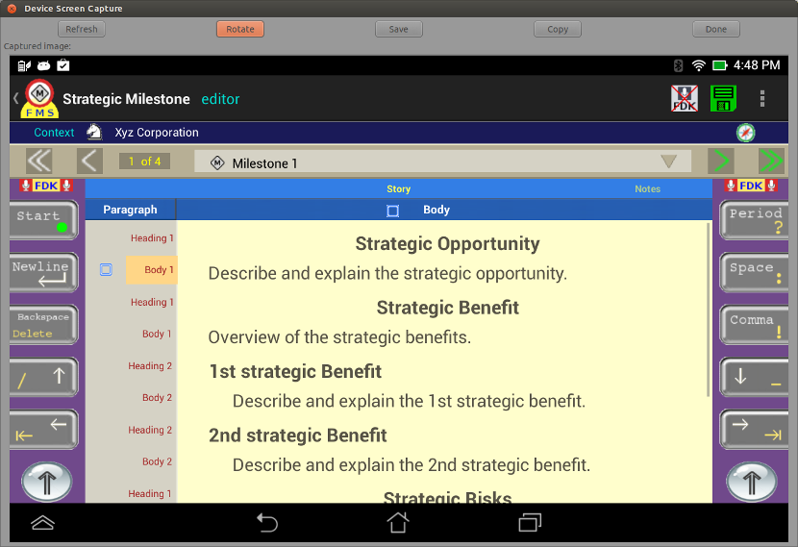
Flywheel Dictation Keyboard Layout
Widget Input – Paragraph

Slide 2
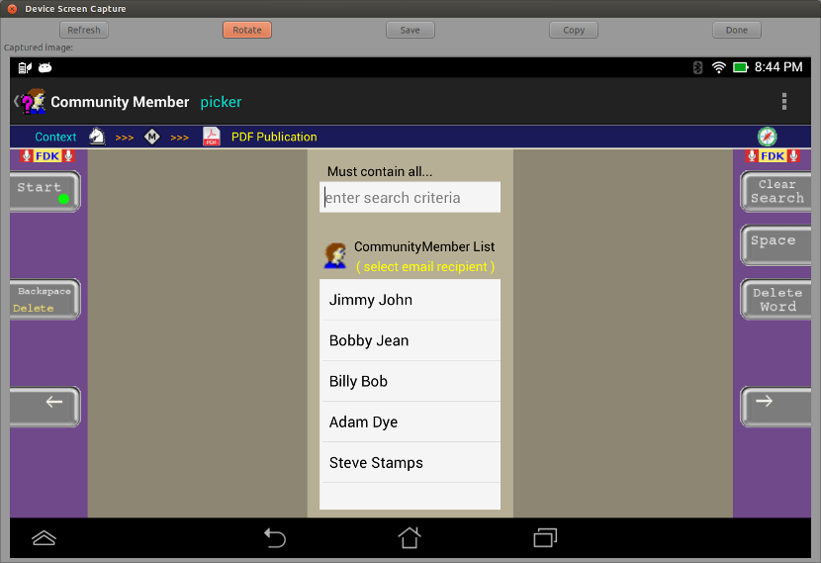
Flywheel Dictation Keyboard Layout
Widget Input – Search

Slide 3
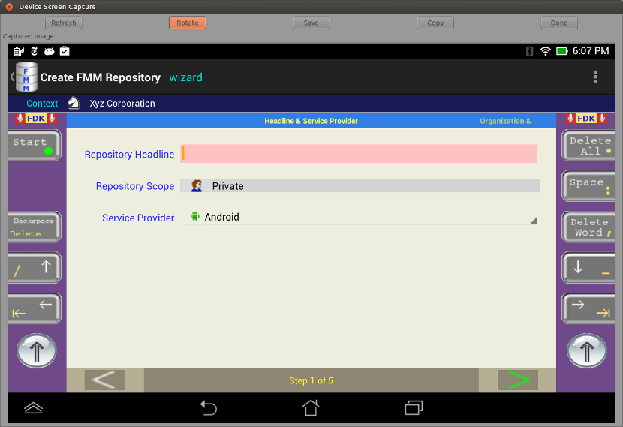
Flywheel Dictation Keyboard Layout
Widget Input – Edit Text

Slide 4
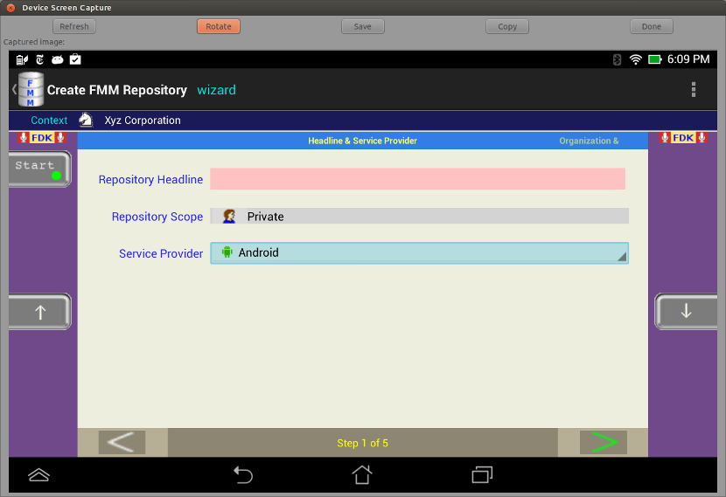
Flywheel Dictation Keyboard Layout
Widget Input – Spinner

Slide 5
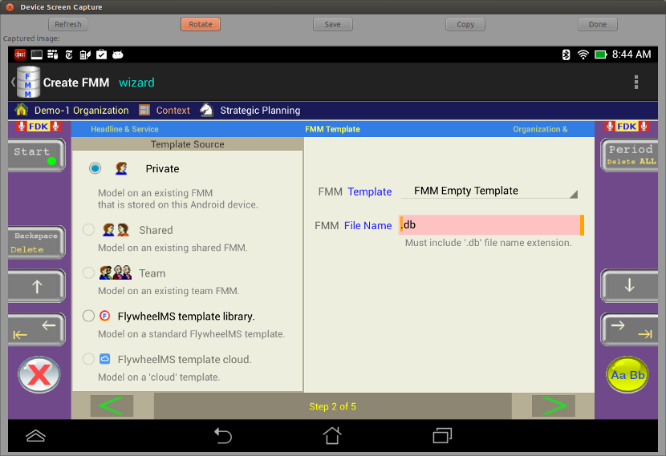
Flywheel Dictation Keyboard Layout
Widget Input – File Name

