Slide 1
WEEK 05
Employee Payroll System

Slide 2
The application will do basic payroll calculations.
You will get information about each Person, such as name, surname, and date of birth.
Also, the information you need to keep about each of your Employees is employee ID and position.

Slide 3
There are three types of employees in the company:
You will calculate the salary for each type of employee.
The Piece Worker works piecemeal, and the employee’s salary is calculated based on the fixed commission he receives from each piece he makes
(num_items * rate),
Hourly Employee is paid for the hour worked. His salary is determined at a fixed rate per hour worked.
(hour * rate),
In addition to the base salary of the Commission Employee, this employee receives its commission on product prices.
(baseSalary + ( num_items * ( item_price * ( commission_rate * .01 ) ) ) ).

Slide 4
MAIN FRAME
On the main screen of the application,
JTable and JScrollPane to list the records of the added employees,
Only the employee's name, surname and salary should be listed in the JTable.
(check slide #13)
JLabel for the title, 4 JRadioButton(all records, only piece worker, only hourly employee, only commission employee) in the filtering section,
JLabel, JTextField and JButton for the search section,
finally, there are JButtons for opening the employee add screen and exiting the application.

Slide 5
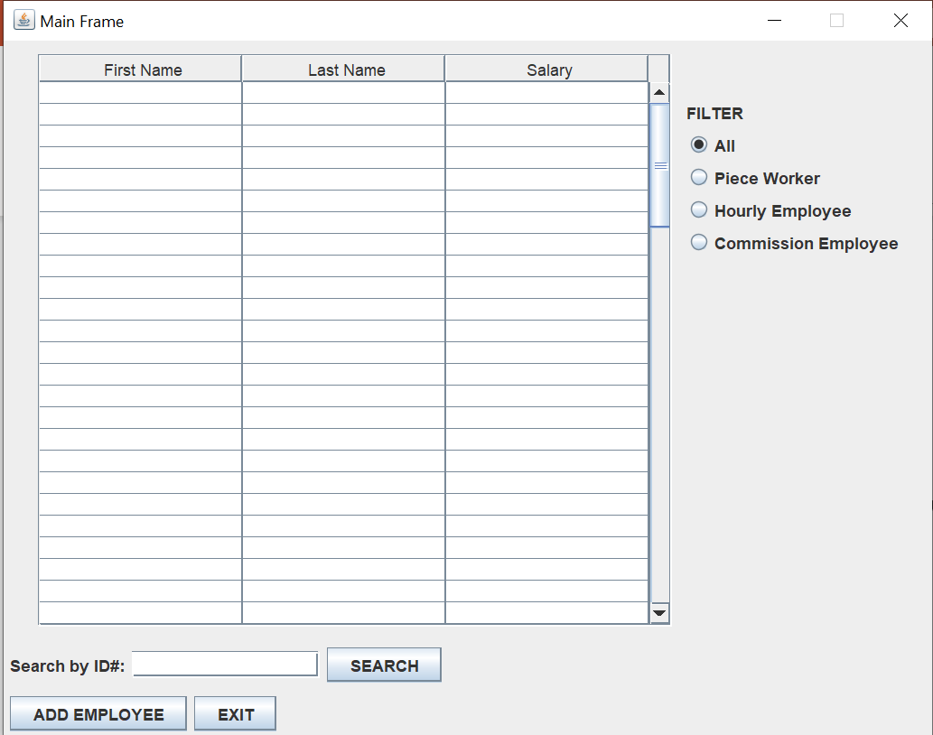

Slide 6
FILTERING SECTION
When any JRadioButton in the filtering section is clicked, the employees in that group should be listed synchronously in the JTable.

Slide 7
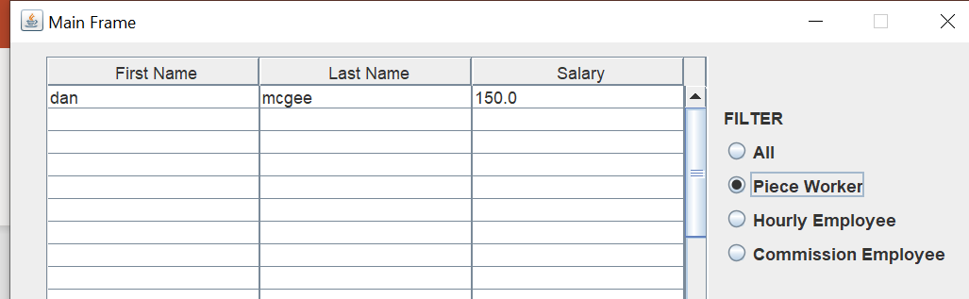
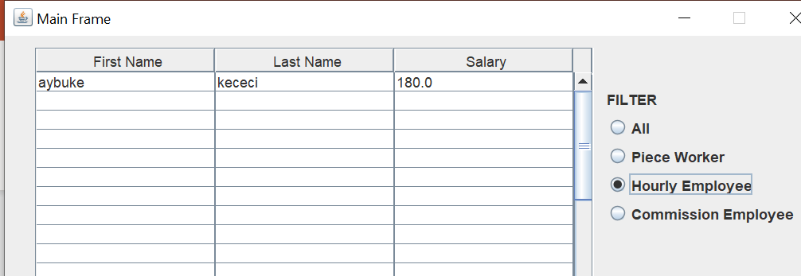
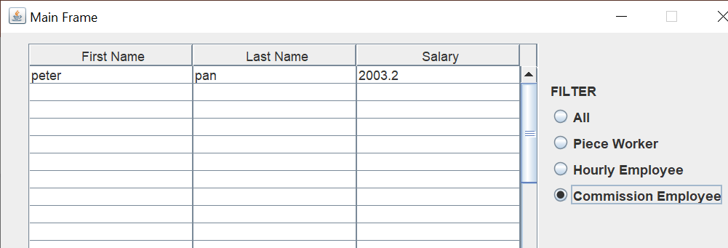

Slide 8
SEARCH SECTION
In the search section, when the employee ID is entered in the JTextField and the JButton is clicked, the information of that employee should be displayed with a new JFrame.

Slide 9
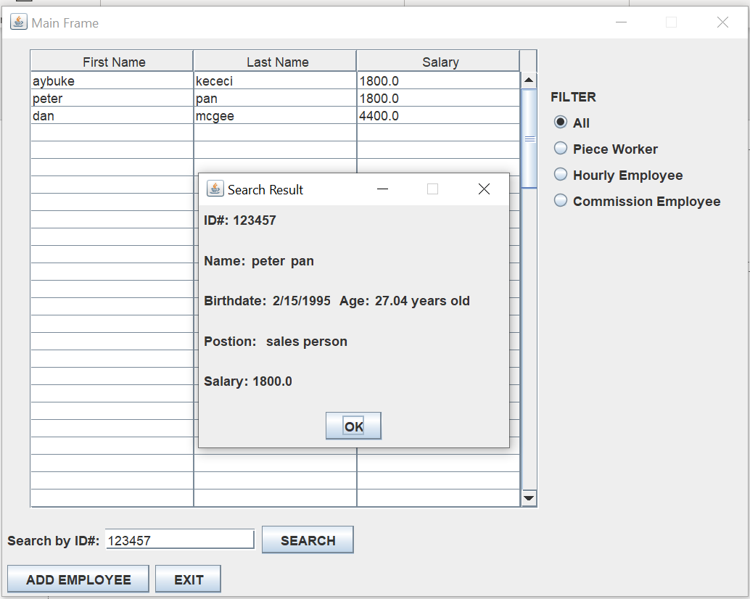

Slide 10
AddEmployee FRAME
On the AddEmployee frame of the application, there is a JLabel - JTextField pair for the employee's name, surname, ID number, position.
The birthday field contains JComboBox for month and JTextFields for day and year.
In the Employee type section, there are JLabels for the title, JRadioButtons for the employee types, and JLabel - JTextFields that change according to the selected types.

Slide 11
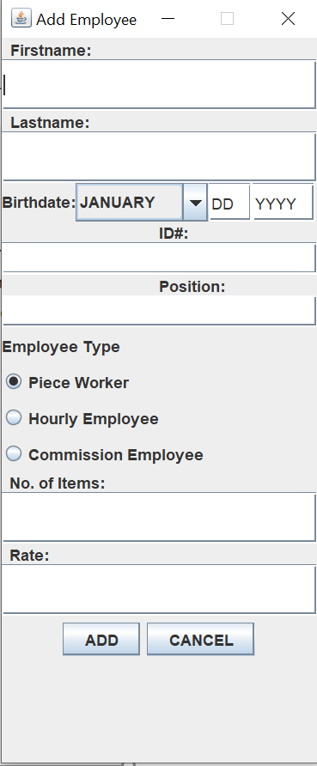
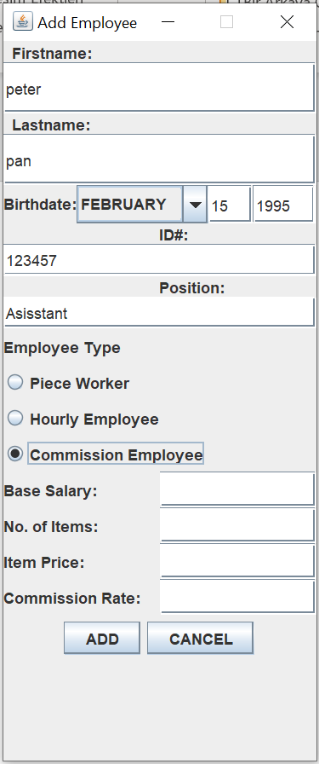
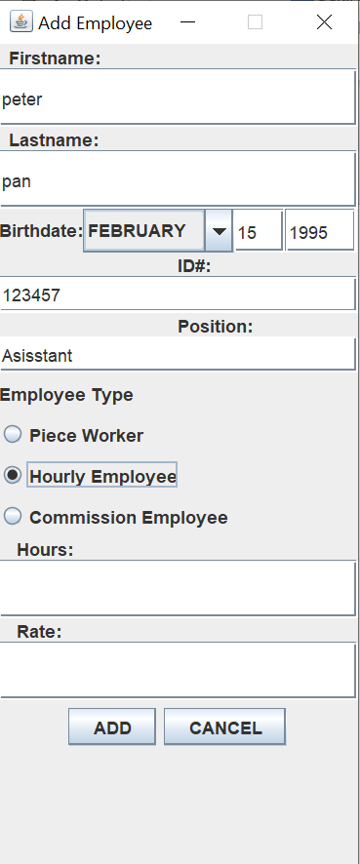

Slide 12
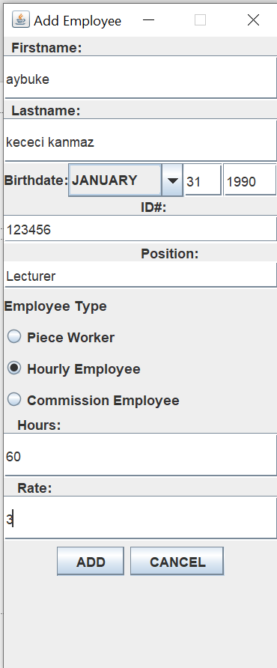
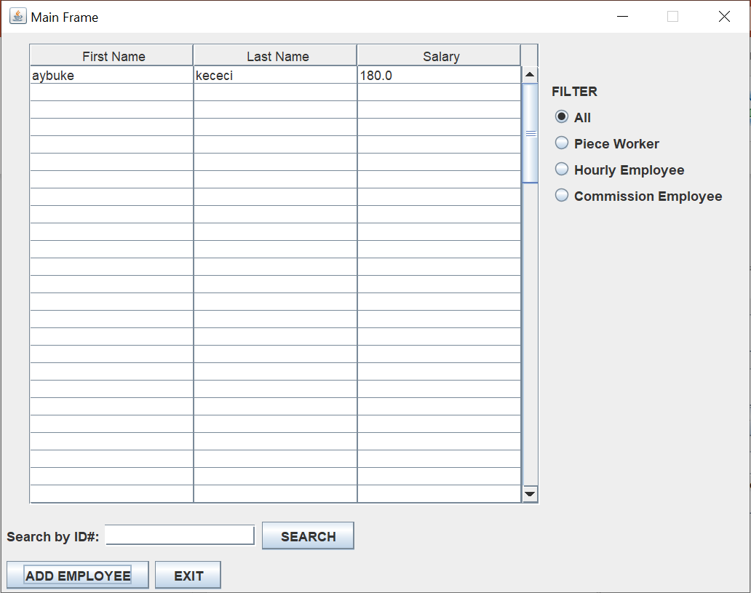

Slide 13
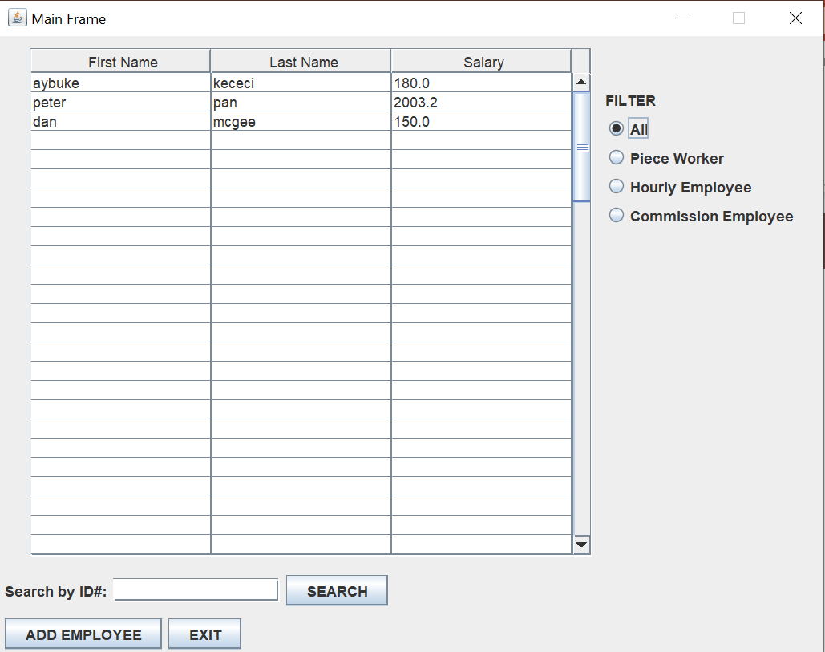

Slide 14
AddEmployee FRAME
If the Add JButton is clicked, the employee information should be written to the file with txt extension.
JTable should be populated with employee information read from this file.

