Slide 1
WEEK10
SEQUENCE DIAGRAM

Slide 2
In this project, you will design and build a fully functional web-based doctor appointment system.
The intended audience includes all stakeholders in the potential system. These include, but are not necessarily limited to, the following: Administrative Staff, doctors, patients and developers.

Slide 3
Customers
book doctor's appointments anywhere globally; this can be done via the web browser.
Payment is made after the appointment.
Doctors
register to this system,
view appointments and
determine available times for appointments, making them more convenient for patients.
Administrators also have
access to the website and
change the information of the website and
have access to the database.

Slide 4
Your system will
Provide
provide an application that enables patients to book an appointment with any available doctor.
View
Doctors will be able to view their appointments and manage them properly.
Coordinate
coordinate various calendars and find available time slots for appointments.
Reserve
reserve equipment and rooms for the appointment.
Alert
alert patients in case there is an earlier available time slot.

Slide 5
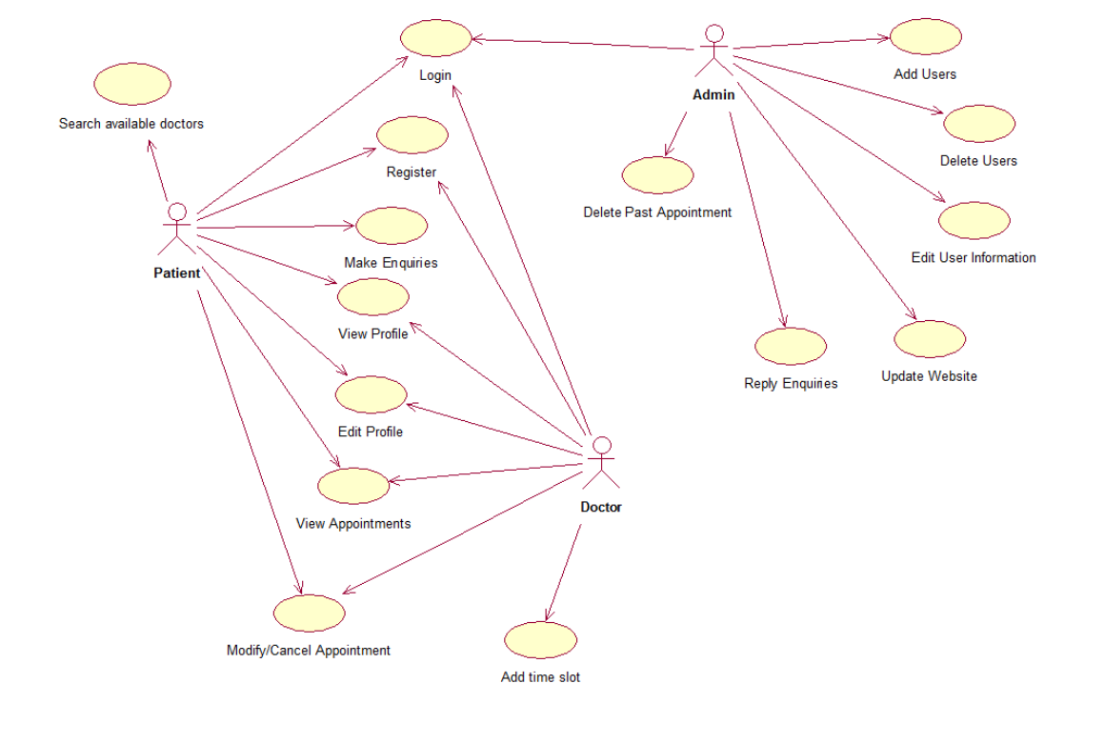
Use case Diagram

Slide 6
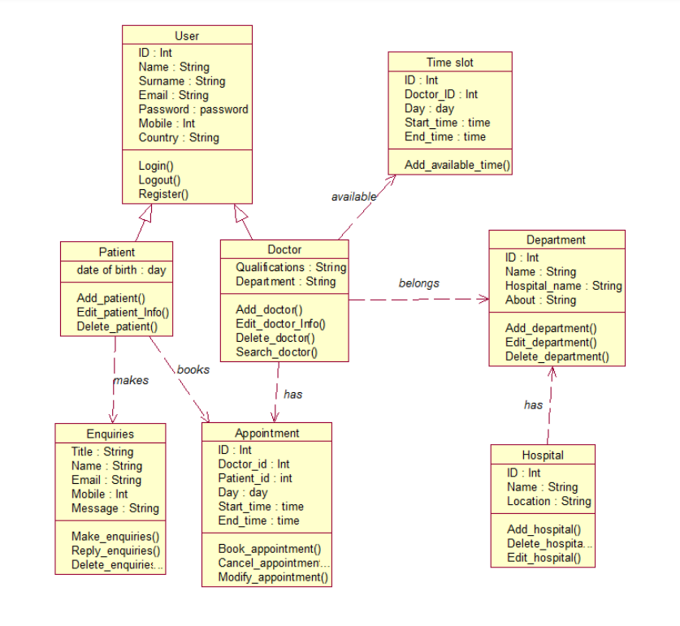
Class Diagram

