Slide 1
SE2226 Software Quality Assurance and Testing Term Project
Muhamed CICAK 21070006208
Melis ÖZVERİ Y20070002011

Slide 2
Overview
1. Problem Definition
3. Black Box Techinques
4. Unit Tests & Automated Testing
2. Application Analysis
(website)

Slide 3
Problem Definition
Analysis and testing of a website through:
Black Box Techniques
Test Cases
Test Automation

Slide 4
Website: Zamaninda.com Bridge through bussinesses and customers
User Registeration
Booking Appointments
Adding working exception
Adding shift

Slide 5
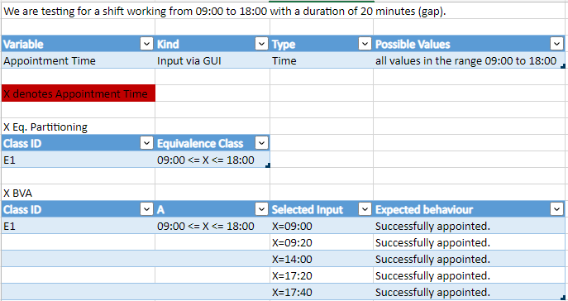
Test Case Design – Equivalence + BVA Appointment Reservation

Slide 6
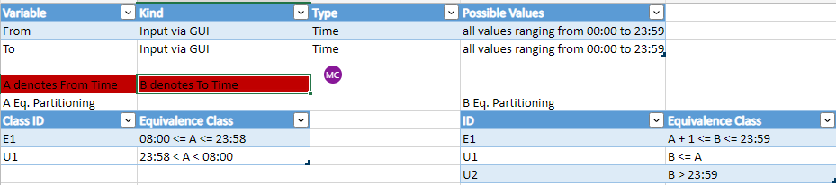
Test Case Design – Equivalence + BVA Adding Shift

Slide 7
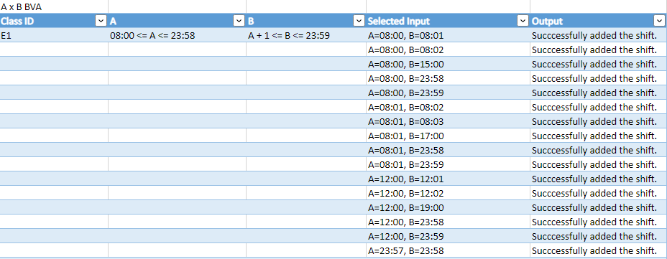
Test Case Design – Equivalence + BVA Adding Shift

Slide 8
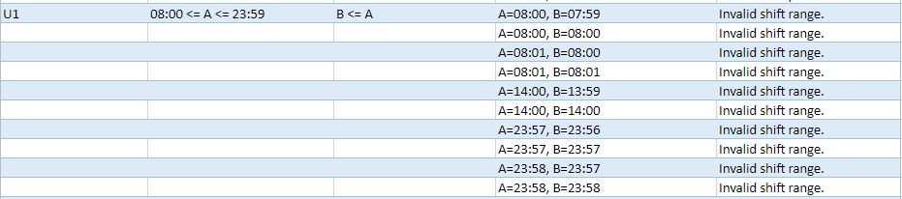
Test Case Design – Equivalence + BVA Adding Shift

Slide 9
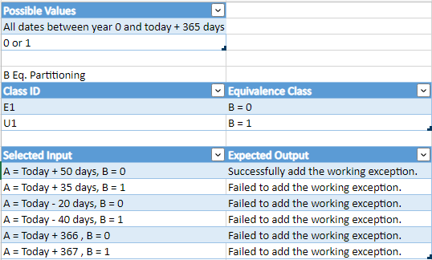
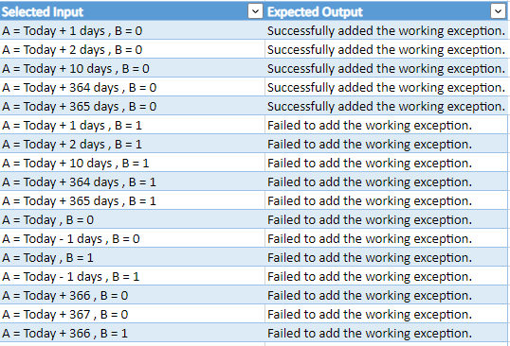
Test Case Design – Equivalence + BVA Adding Work Exception

Slide 10
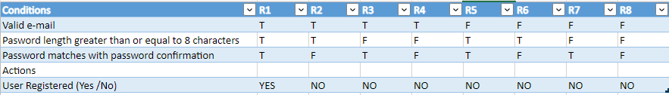
Test Case Design – Decision Table User Registeration

Slide 11
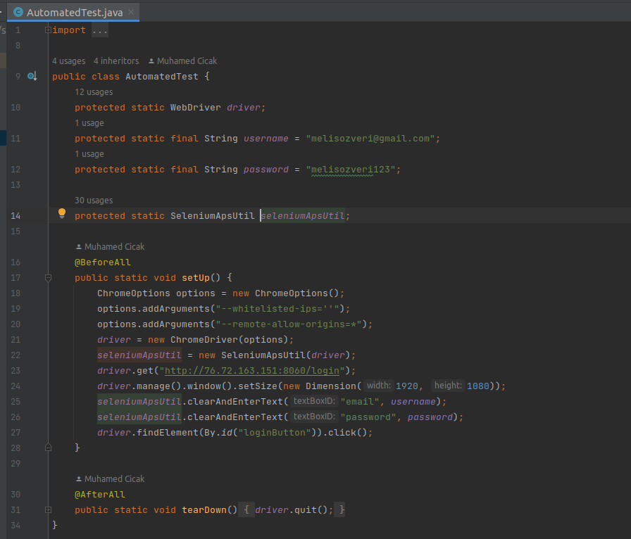
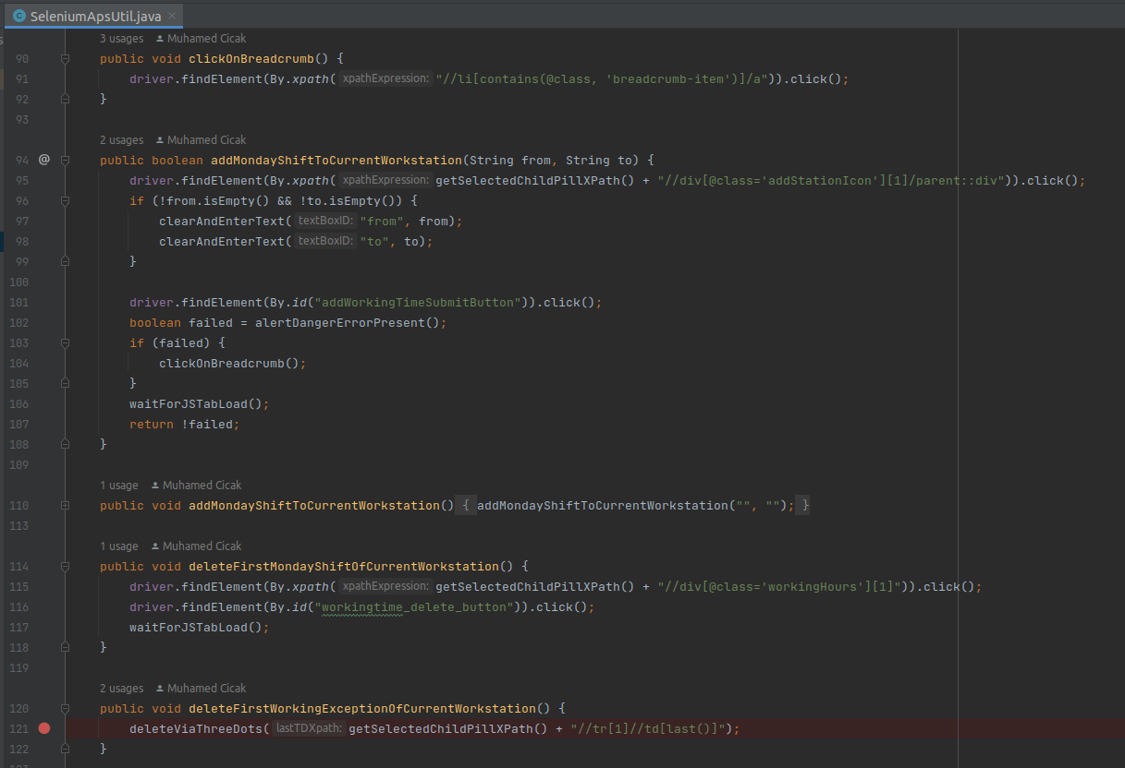
4.1. Code structure

Slide 12
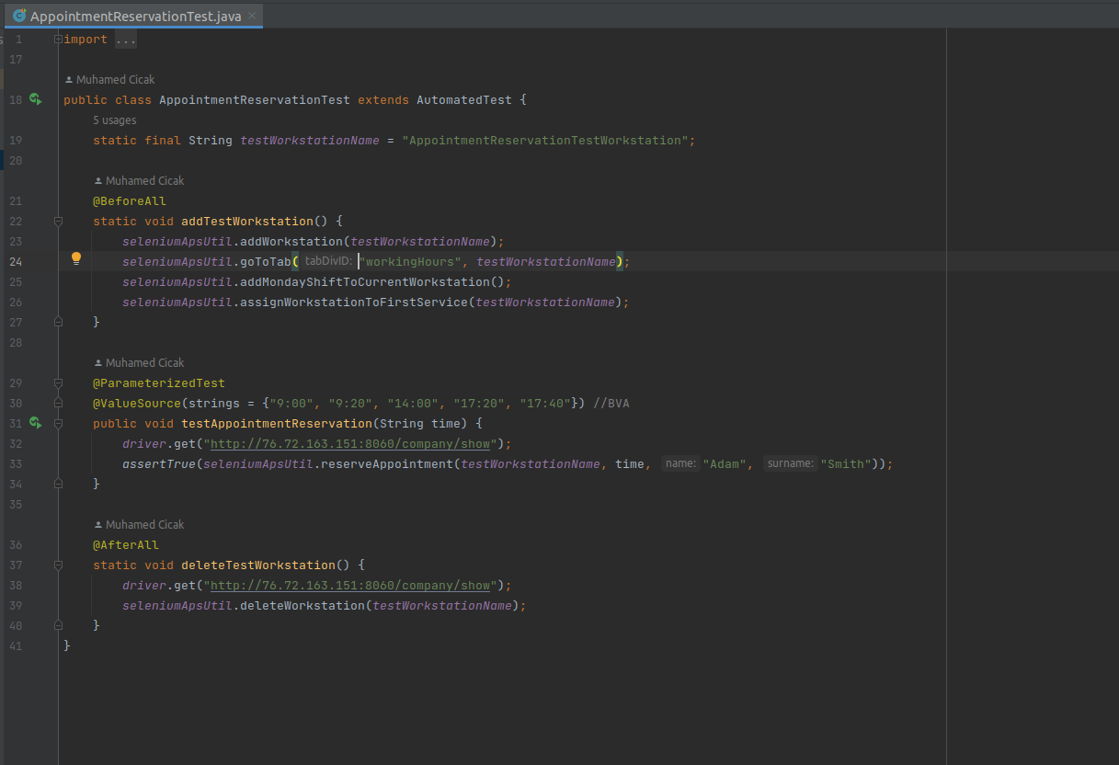
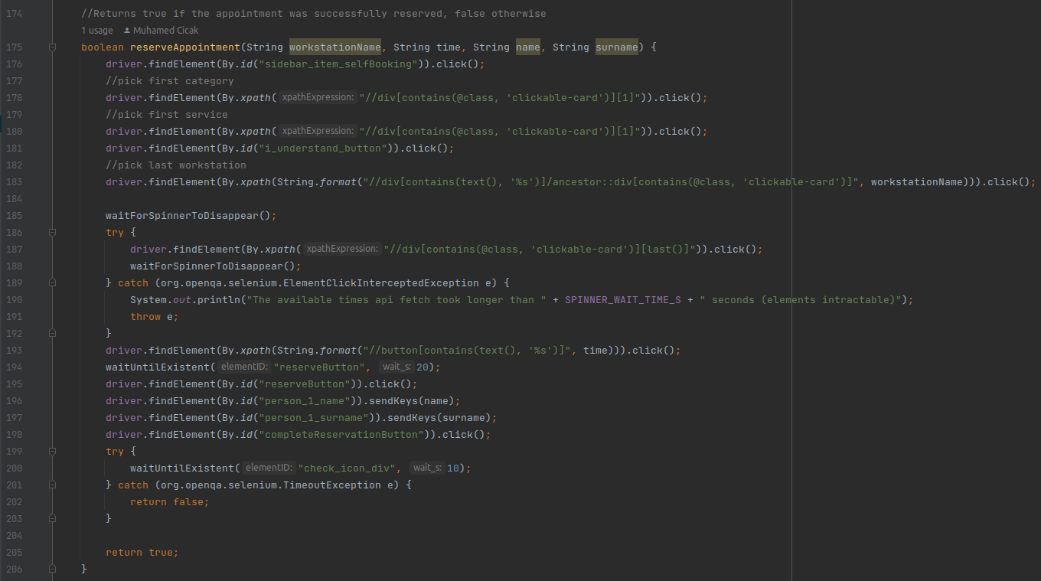
4.2 Appointment Reservation Test

Slide 13
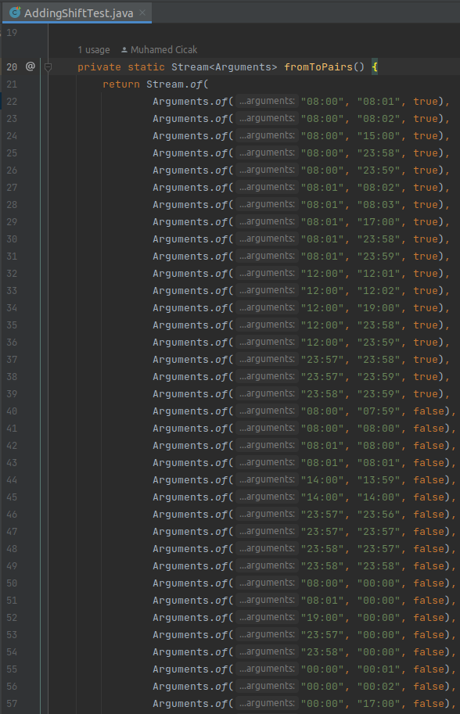
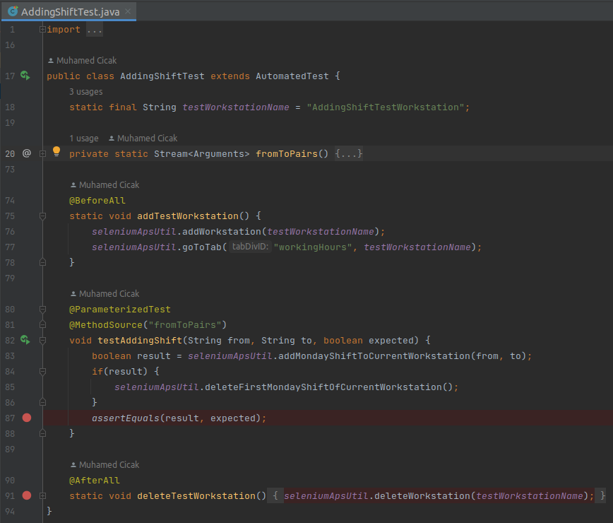
4.3 Adding a shift Test

Slide 14
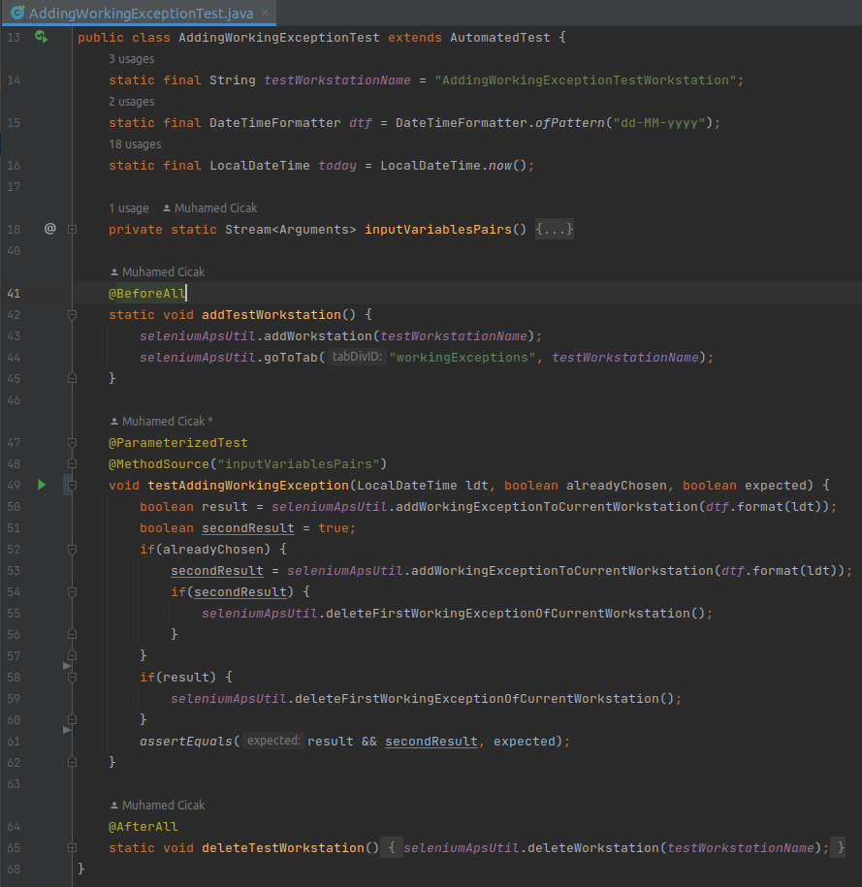
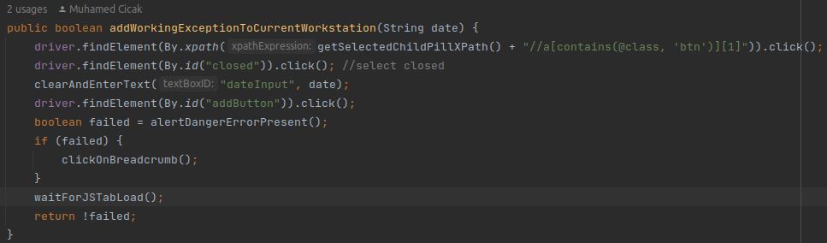
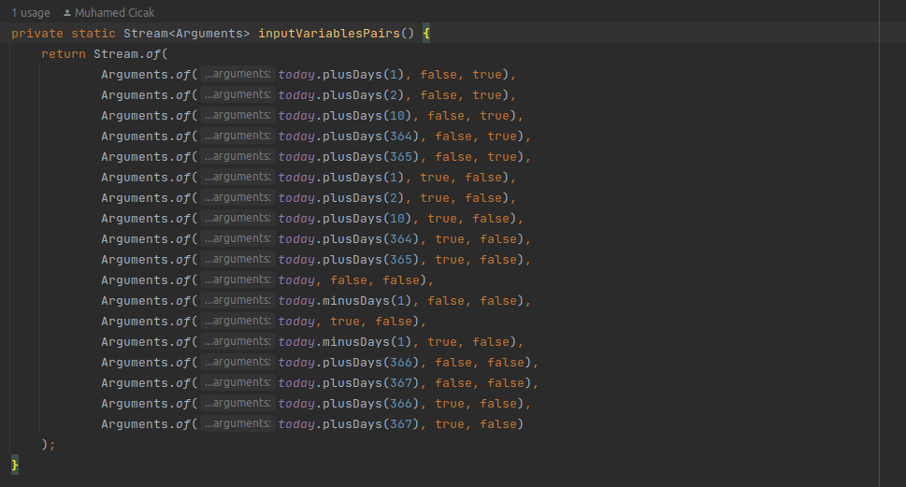
4.4 Adding a Working Exception Test

Slide 15
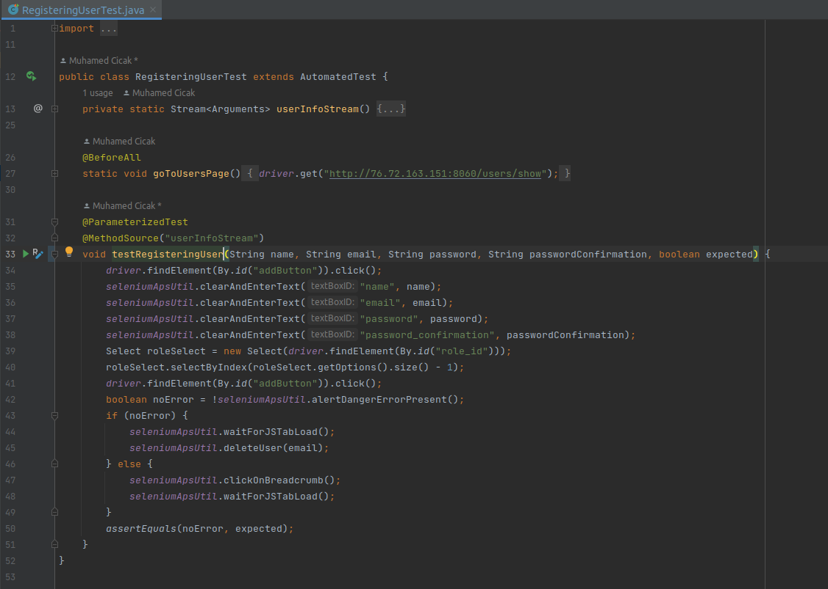
4.5 Registering a User Test

Slide 16
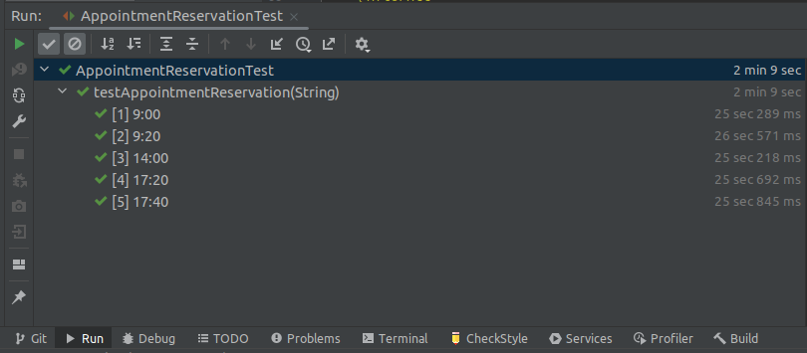
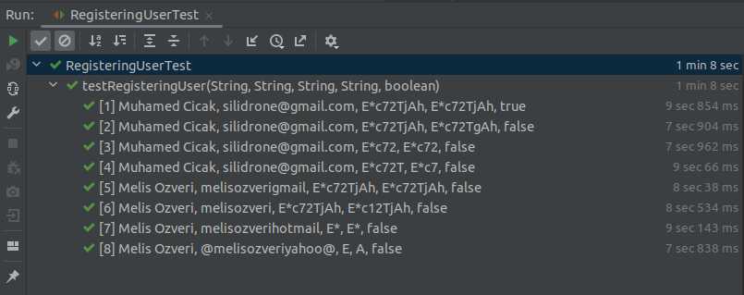
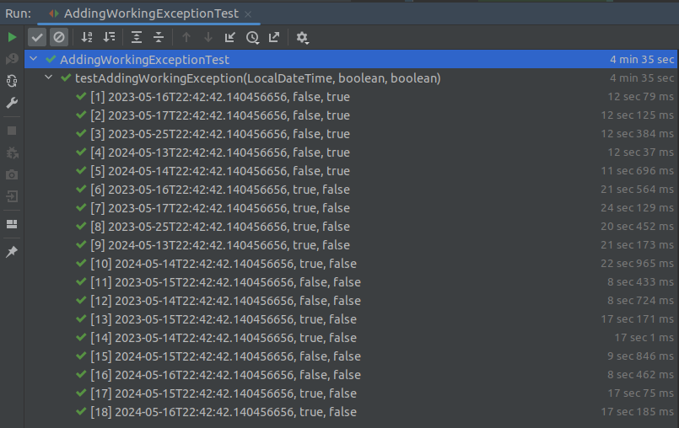
4.6 Running Tests

Slide 17
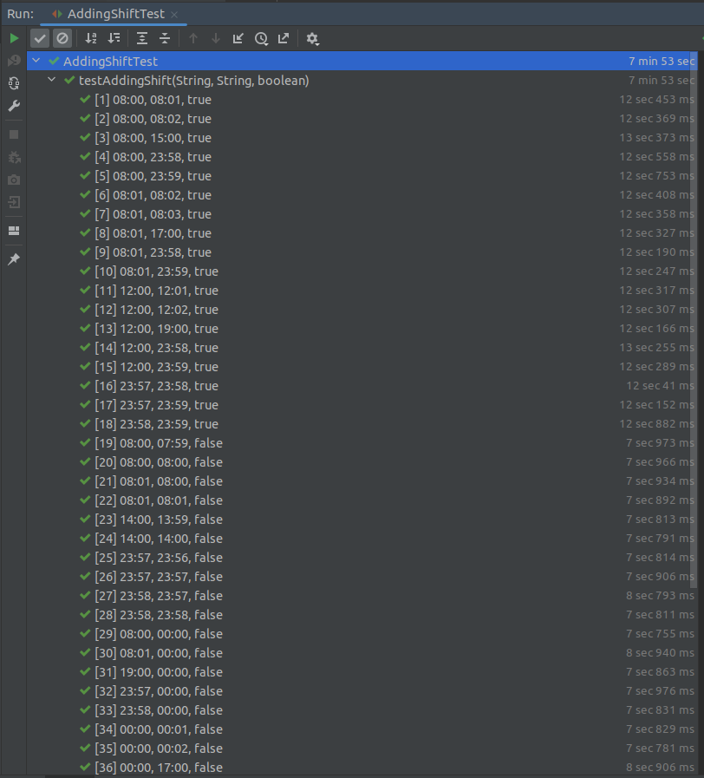
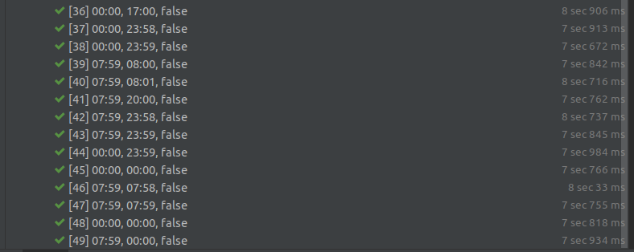
4.6 Running Tests

