Slide 1
Work Readiness Digital Portfolio
Silindokuhle Semani
Student No: 221574581
Diploma in ICT (3rd Year)
Cape Peninsula University of Technology
“Building a professional future in Information Technology.”

Slide 2
Table of Contents
• Introduction
• About Me
• Work Readiness Journey
• Skills Gained
• Artefacts / Evidence
• Career Reflection
• Career Goals
• Conclusion
• References

Slide 3
Introduction
This digital portfolio represents my personal growth and achievements throughout the Work Readiness Training. It showcases the knowledge, skills, and competencies I have gained in preparation for entering the IT industry.

Slide 4
About Me
My name is Silindokuhle Semani, a dedicated and passionate 3rd-year Diploma in ICT student at the Cape Peninsula University of Technology. I am an enthusiastic learner with strong interests in software development, system design, and innovative technology solutions. My goal is to contribute positively to the IT industry through problem-solving, creativity, and teamwork.

Slide 5
Work Readiness Journey
The Work Readiness Training equipped me with practical skills essential for professional environments. Through various activities, I learned how to communicate effectively, collaborate within teams, and present myself confidently during interviews. I also developed a deeper understanding of workplace ethics, time management, and adapting to different professional settings.

Slide 6
Skills Gained
• Communication skills
• Teamwork
• Interview preparation
• Confidence and presentation skills
• Problem-solving
These skills have strengthened my ability to perform efficiently within a team environment and increased my confidence in pursuing professional opportunities in IT.

Slide 7
Artefacts / Evidence
• Curriculum Vitae (CV)
• Matric Certificate
• Academic projects and achievements
The artefacts included in this portfolio serve as evidence of my academic and professional readiness. They reflect my commitment to learning and preparing for a successful career.

Slide 8
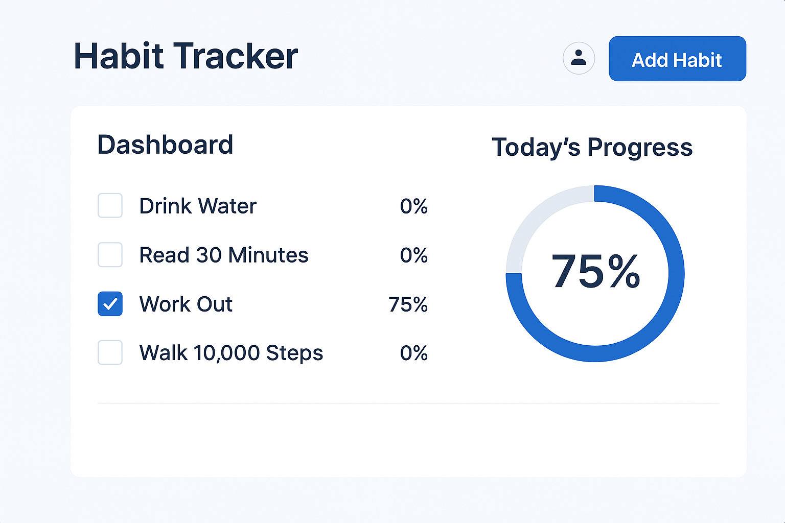

Slide 9
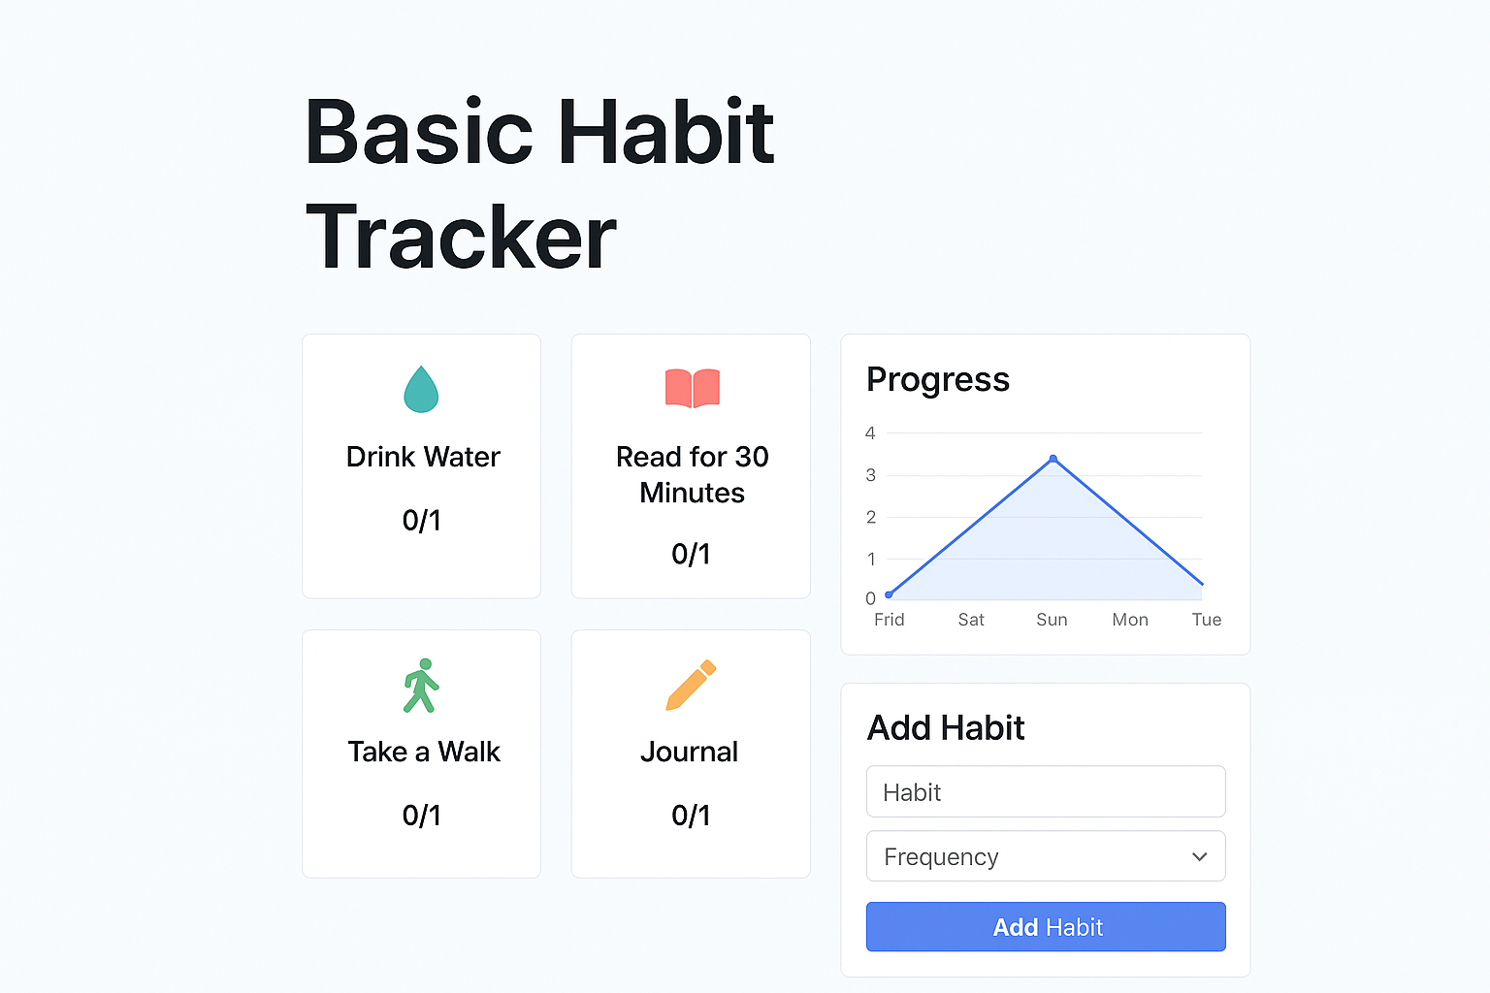

Slide 10
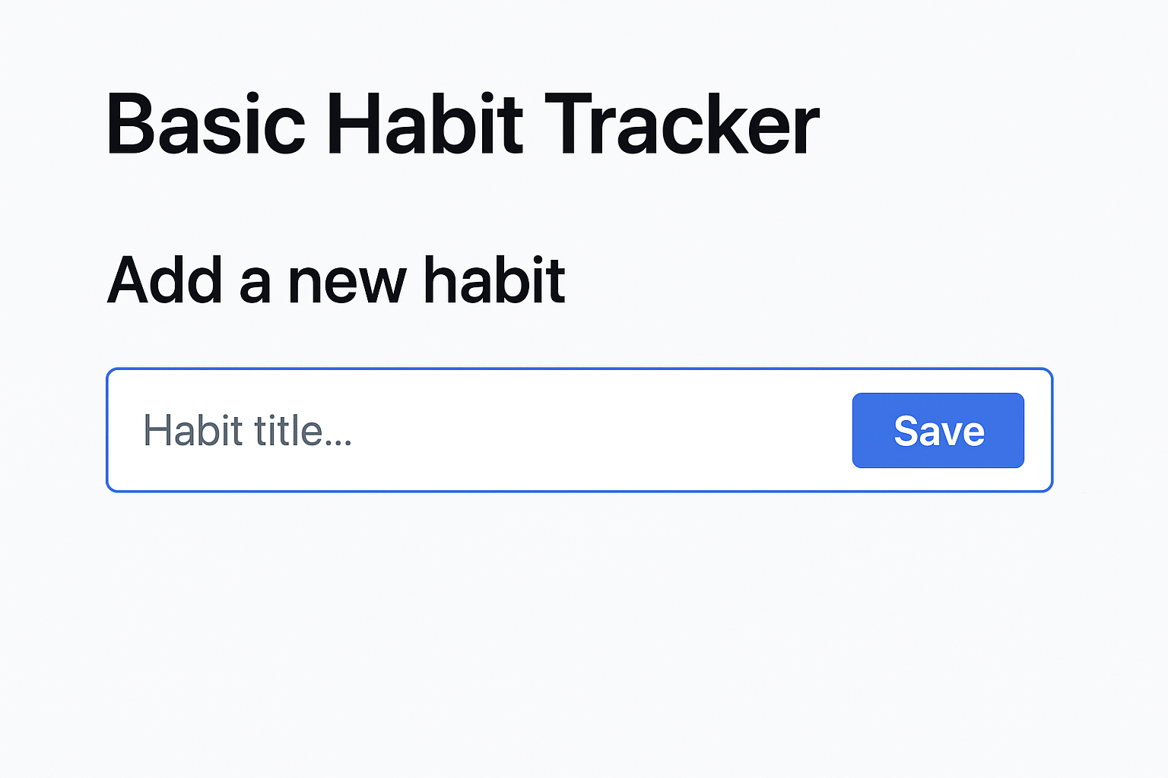

Slide 11
Career Reflection
As I reflect on my progress, I recognize how far I have come in developing the mindset and abilities required in the ICT field. My experience has taught me the importance of continuous learning and self-improvement. I have learned to approach challenges with confidence and to communicate my ideas effectively within technical and collaborative settings.

Slide 12
Career Goals
My ultimate goal is to become a Software Developer. I aspire to work in a dynamic IT environment where I can design, build, and maintain innovative software applications that make a positive impact. I plan to continue learning programming languages, frameworks, and development methodologies to grow as a skilled and adaptable professional.

Slide 13
Conclusion
The Work Readiness Training has prepared me to enter the professional world with confidence and determination. This portfolio is a reflection of my growth, learning, and readiness to contribute meaningfully to the ICT industry.

