Slide 1
Seattle Real Estate Analytics
Seattlers Bank

Slide 2
Executive Summary
The objective of the analysis conducted is to gain an alternative understanding of the Seattle property market for the development of our real estate financing business.
The problematics addressed in the analysis will aim to complement the traditional micro level evaluation for real estate financing.
We are aiming to answer the following questions using regression analysis:
Will price increase provided we keep the living surface constant and increase the grading by 1?
Will price increase provided we increase living surface and keep the living surface constant?
Does price increase if surface living increases beyond our 15 neighbours’ surface?
We will supplement the analysis with the following:
Exploratory Data Analysis (EDA) process
Data Visualization
Model Testing
Conclusions Drawn

Slide 3
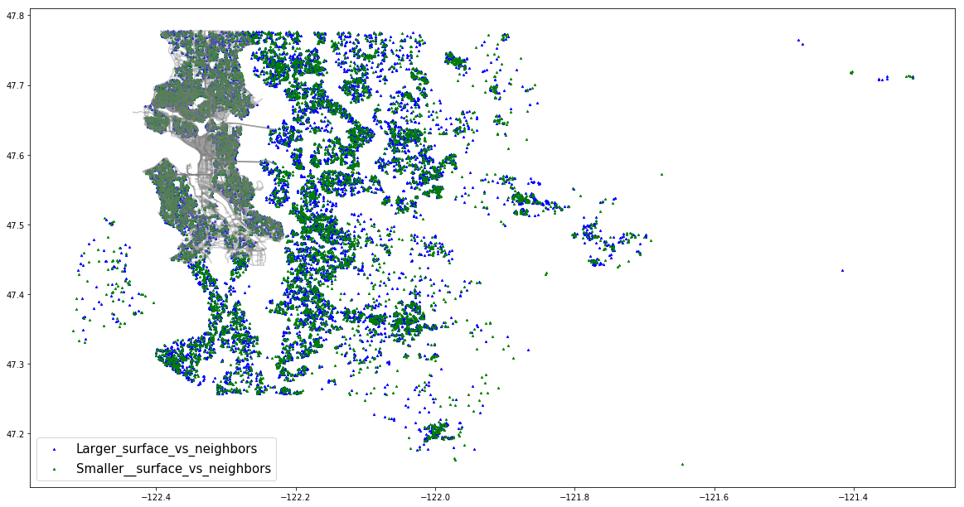
House surface vs 15 closest neighbors

Slide 4
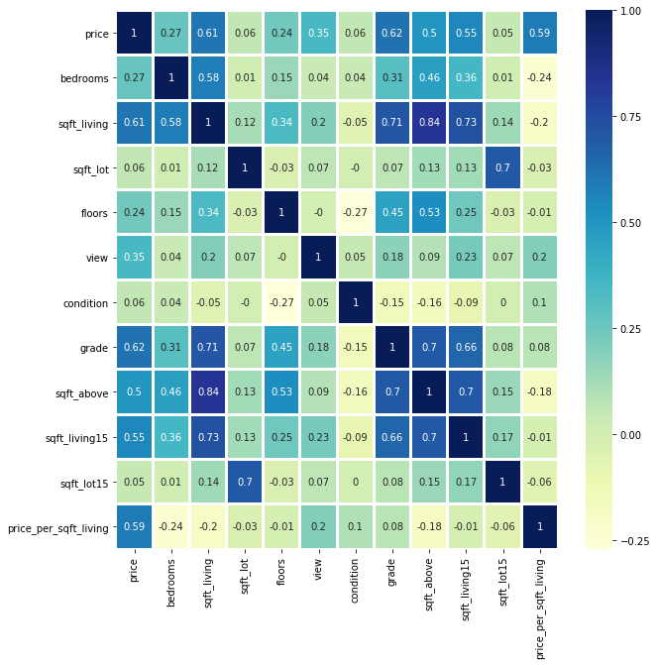
Correlation graph for variable Selection

