Slide 1
Seattle Real Estate Analytics
Seattlers Bank

Slide 2
Executive Summary
The objective of the analysis conducted is to gain an alternative understanding of the Seattle property market for the development of our real estate financing business. This is an experimental in-house analysis.
The problematics addressed in the analysis will aim to complement the traditional micro level evaluation for real estate financing.
We are aiming to answer the following questions using regression analysis:
Will price increase provided we keep the living surface constant and increase the grading by 1?
Will price increase provided we increase living surface and keep the grading constant?
How do the models compare if we proceed with the removal of outlier values in our variables?
We will supplement the analysis with the following:
Exploratory Data Analysis (EDA) process
Data Visualization
Model Testing
Conclusions Drawn

Slide 3
Process Timeline
Step 1: Load the dataset and identify null values
Step 2: Treatment of null values and special characters
Step 3: Exploratory Data Analysis
Step 4: Graph relationship between all relevant variables and price
Step 5: Model Approach
Step 6: Choose variables for regression models
Step 7: Run regression model
Step 8: interpretation of models
Step 9: follows ups, correction and questions

Slide 4
Step 1 & 2: Load the dataset + identify & treat null values
Pandas data frame was used to load and gain an understanding of the Seattle housing market dataset
Data frame composition includes 26 columns and nearly 25,000 rows representing properties
Three approaches to treat null values in waterfront, view, year renovated
We decided to remove the waterfront column as we tested it for correlation with price which was low , possibly impaired by null values
For view, we chose to fill the nulls with 0 value as we the 63 nulls observed represent less than 1% of the dataset
For year renovated, we chose to assume for 0 and nulls that the build year could be used to replace those values

Slide 5
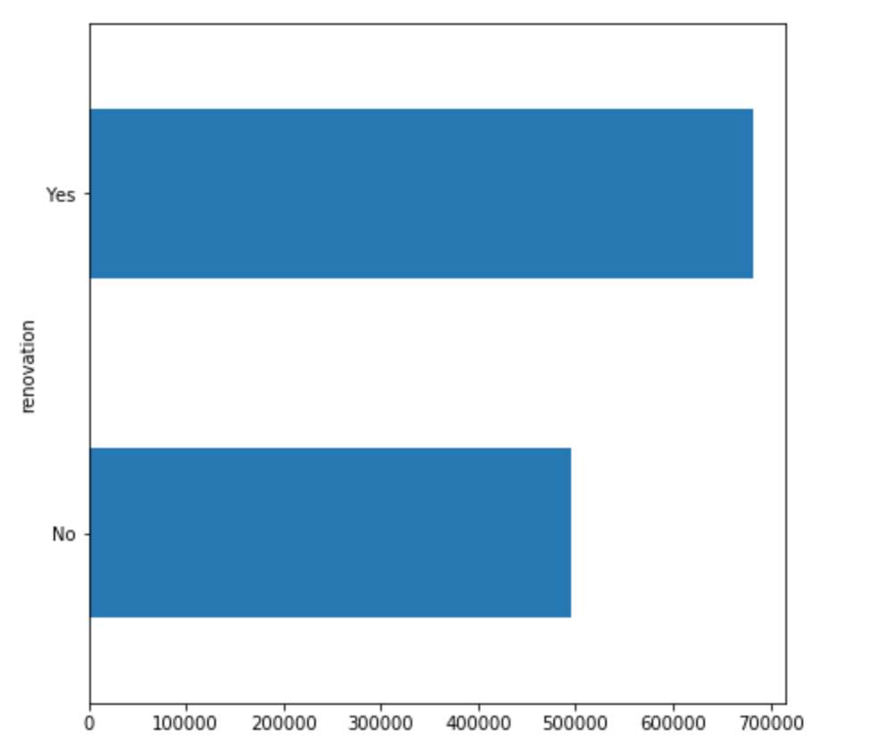
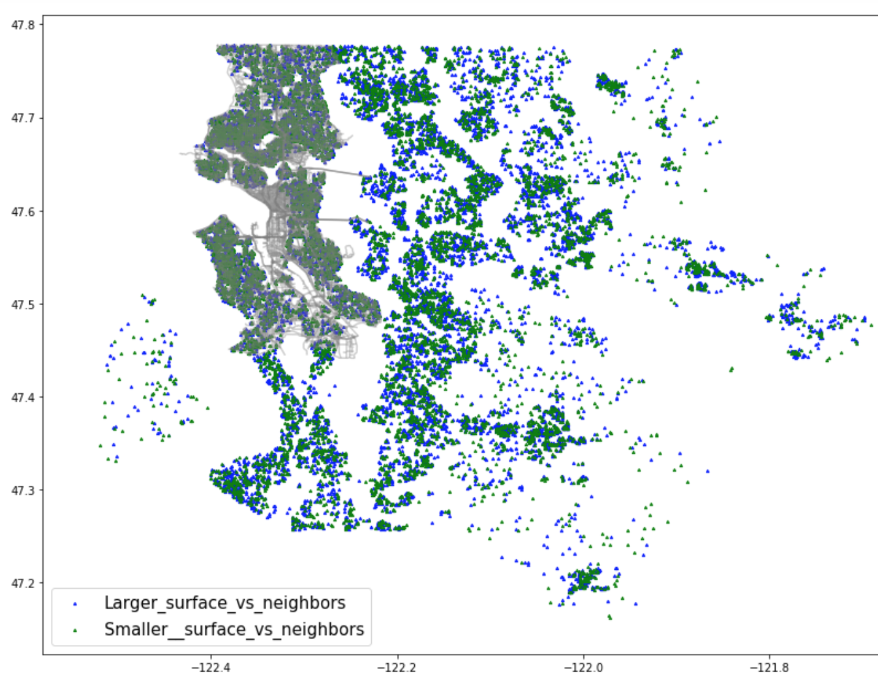
Step 3: EDA
Here are some of the observations and visual representations of the data we made during the EDA phase

Slide 6

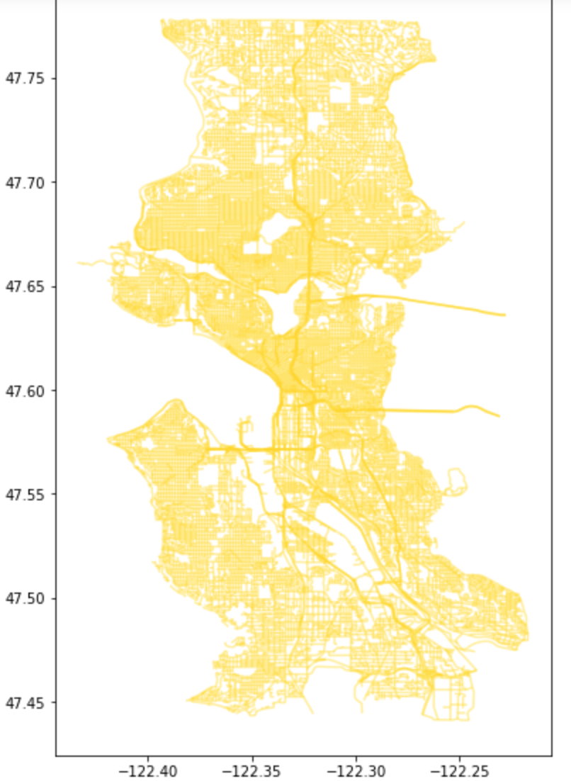




Step 3: EDA (continued)

Slide 7
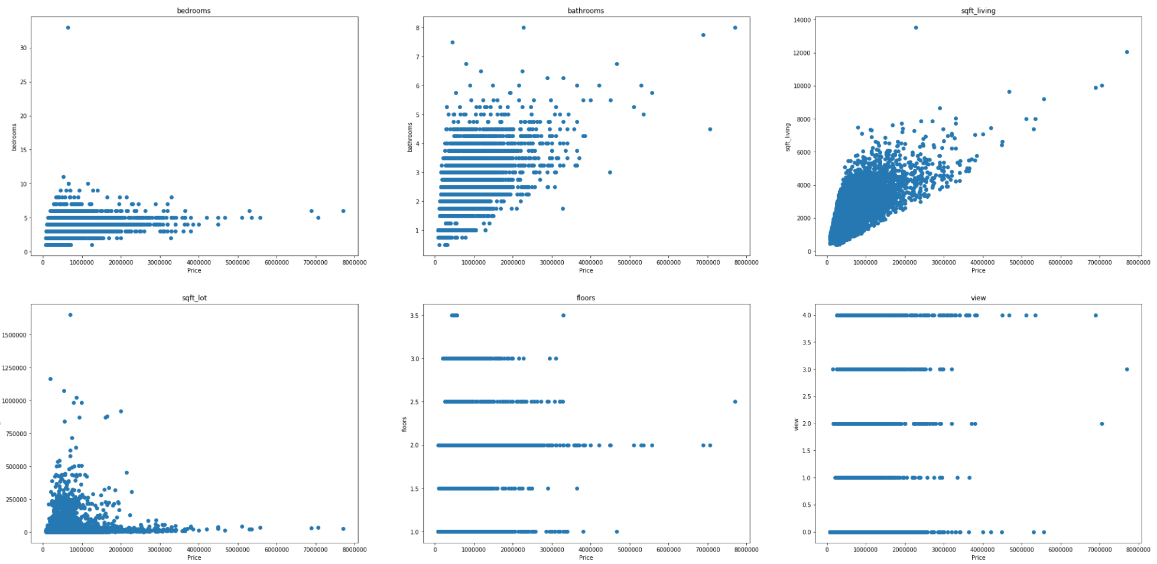
Step 4: Graph relationship between all relevant variables and price
We tested most variables to establish their relationship with price and identify the relevant ones for model testing

Slide 8
Step 5: Model Approach
To answer our questions, we decided to run two models with slight alterations.
Model 1: Run OLS model on price and two independent variables without removing data outliers before selecting our sample
Model 2: Run OLS model on price and two independent variables with outliers removed using standard deviation

Slide 9
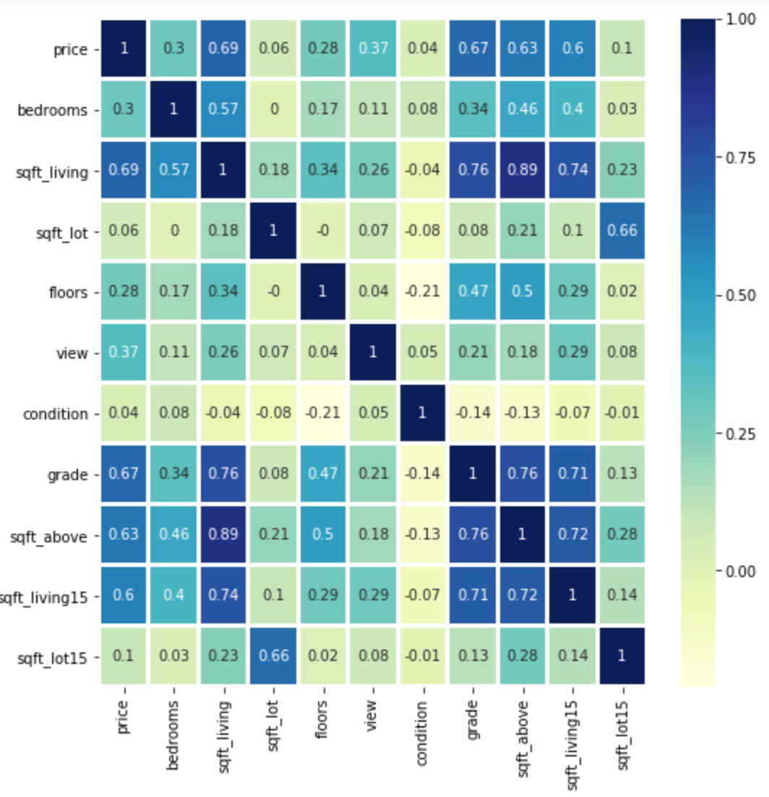
Step 6: Build correlations table and matrix to get an overview variables & elect variables
a correlation table and matrix to determine which variables we would elect.
ELECTED SQFT_LIVING / GRADE AS THE TWO VARIABLES TO TEST.

Slide 10
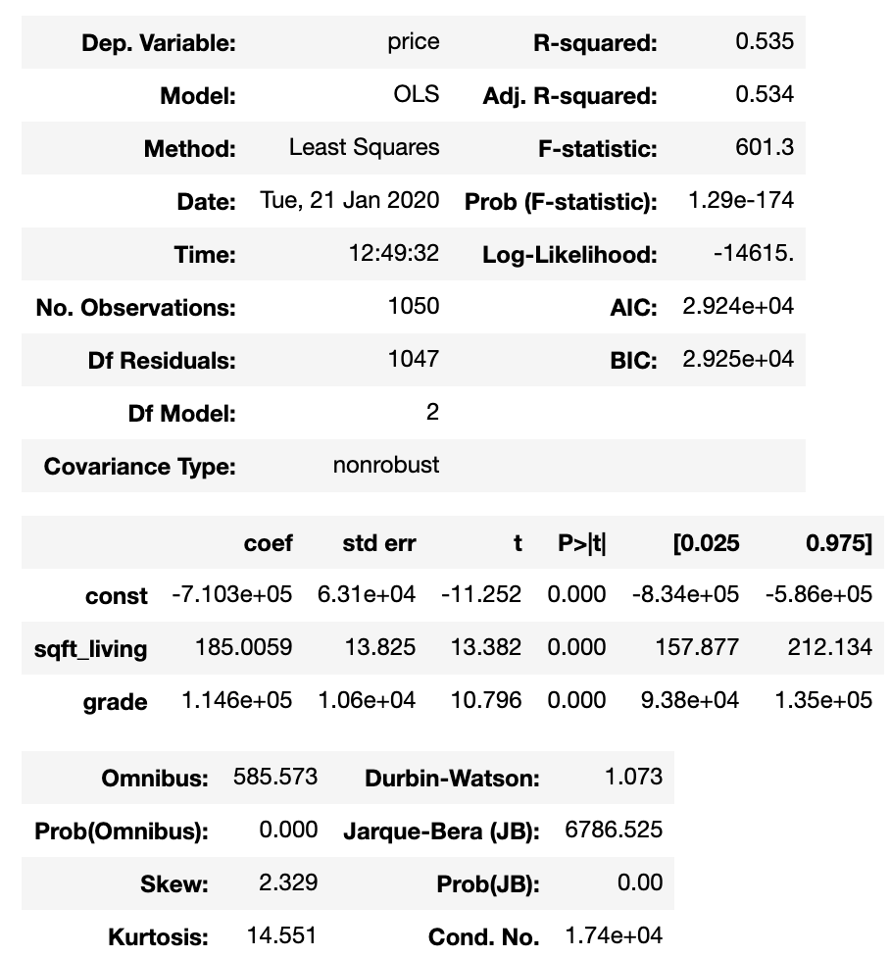
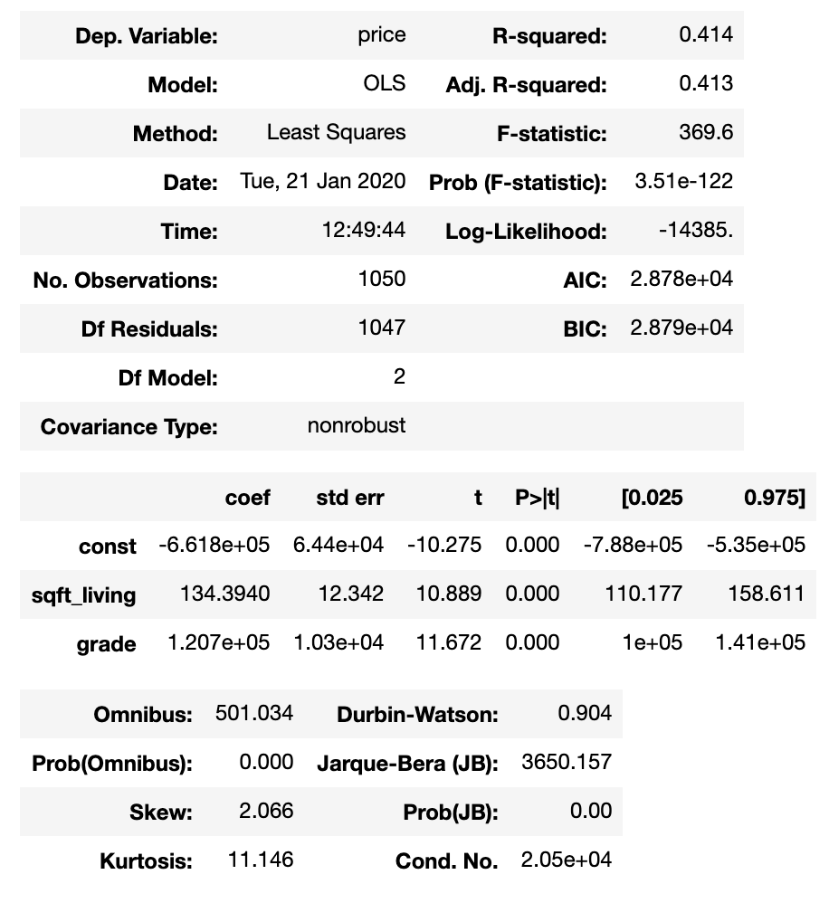
Step 7: Run regression model and interpret the results
Model 1 – Outliers Present in the Data
P = -710,300 + 185 (sqft =+1) + 146,000 (grade =+1)
Model 2 – Outliers Removed from the Data
P = -661,000+ 134 (sqft =+1) + 120,700 (grade =+1)

Slide 11
Step 8: interpretation, follows ups and correction of model
The two models provide us limited conclusions to be drawn.
Price does increase with both square foot living and grading but the models don’t have the best linear fit.
R-Squared is still relatively low and we may have an issue of multicollinearity as both variables are correlated (0.7)
We notice that with outliers removed the model looses precision with R squared dropping despite the distribution of data points getting closer to normal.

Slide 12
Step 9: Future work, correction and questions
Review variable choices – Grade / Square foot living
Apply correct treatment to categorical variable
Develop more specific business questions
Thank you for listening! We will do our best to answer any questions you have.

