Slide 1
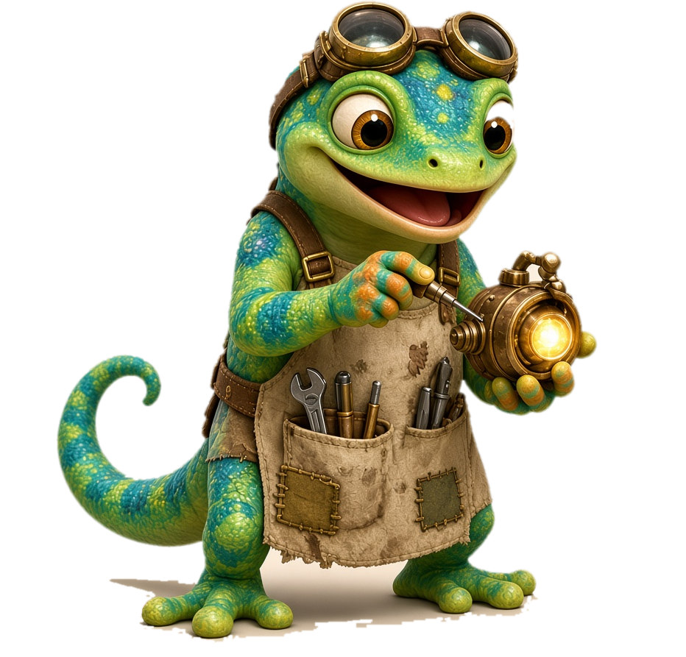
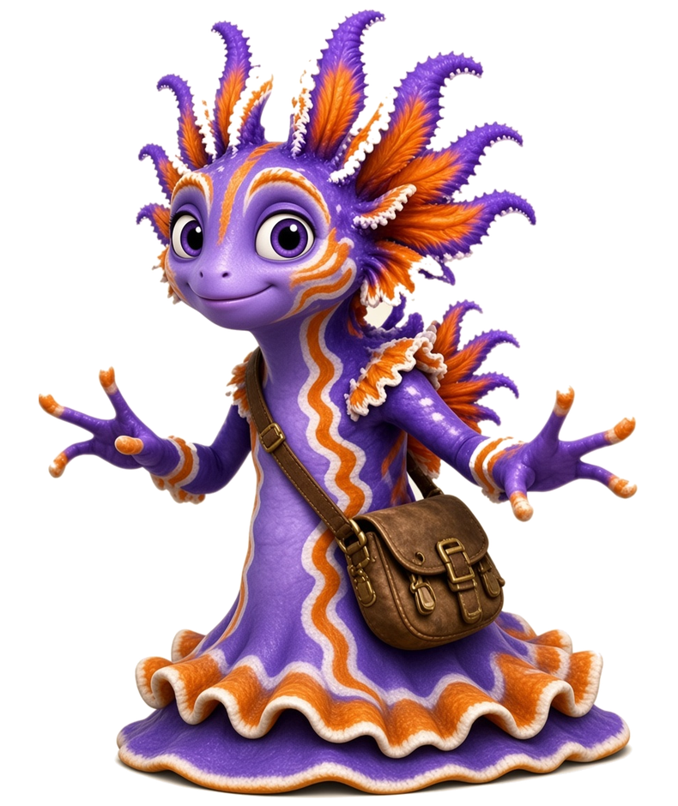
Day 1 - Meet ng
Unit 3 · Lesson 3.1 · ng · Island Readers
Notes:
Day 1 - Meet ng. Divider slide: show while students get materials ready.

Slide 2
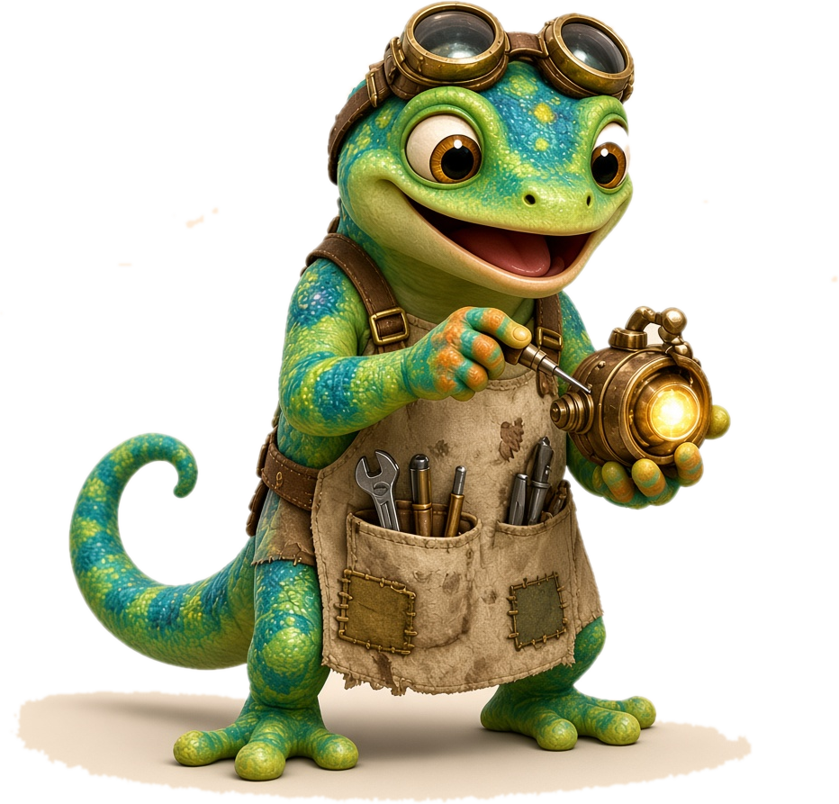
Day 1
Unit 3 · Lesson 3.1 · Day 1
Meet the Nose Hum: ng
Notes:
Day 1: Meet ng. Focus: say ng by itself (no vowel), then learn that a vowel in front of ng makes another glued sound: ing, ang, ong, ung (sounds only). Then add s: sing, sang, song, sung, and read more words for each chunk. Heart words: the, was, what, I, to, a.
Materials: Slides Day 1 · ng sound card · chunk cards ing/ang/ong/ung · whiteboards + markers · Daily Practice Sheets, Day 1 (Picture Match).
GET READY (2 min): packets out, start the class timer.

Slide 3
Day 1
Meet Zip and Frill
Zip
Frill
Notes:
Introduce the mascots. Zip is a gecko inventor. Frill is a dramatic sea slug. Both names are decodable: students can read them!

Slide 4
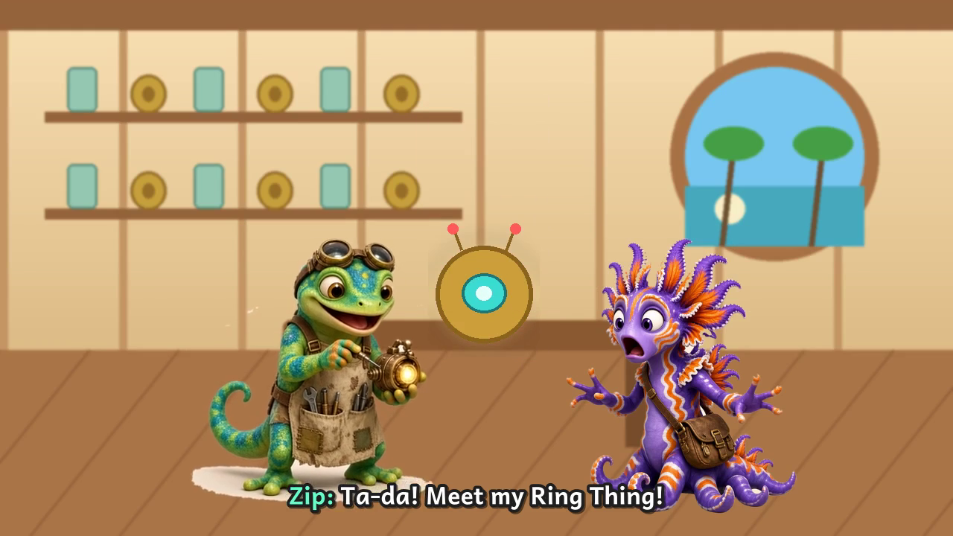
Day 1
Cartoon Time 🎬
▶ Video goes here: ng_cartoon_v3.mp4
Notes:
Opener cartoon (3 min): 'Zip and Frill: The Ring Thing Goes BONK!' (5 Cartoon folder: ng_cartoon_v3.mp4).
INSERT VIDEO: In PowerPoint/Slides use Insert > Video and pick ng_cartoon_v3.mp4, then delete this placeholder box.
BEFORE: 'Zip's gadget only listens to one sound. Help them when they say HELP US!'
DURING: Pause is built in at each Help-us prompt; cheer the class on. AFTER: 'What sound fixed the Ring Thing?' (/ng/)

Slide 5
Day 1
Warm-Up ⚡ Digraph Review
Last unit: digraphs! Two letters, one sound.
sh
ch
th / th
ck
wh
ph
ship
chip
thin
quiet th
duck
when
phone
shop
chin
this
buzzy th
sock
whip
graph
Notes:
WARM-UP · Digraph review (3 min). Quick review of last unit (Unit 05 digraphs).
WARM-UP: 3 sea breaths like Frill (in through the nose, out like a wave).
SAY: 'Last unit we learned digraphs: two letters that make ONE sound.'
TOP ROW: point to each digraph; students say the sound: /sh/, /ch/, /th/, /k/, /w/, /f/.
th / th: 'th has two sounds. Quiet th: put your tongue out and blow, no voice (thin). Buzzy th: same tongue, voice on, feel your throat buzz (this).'
WORDS: point to each word tile; students read it chorally. Then call on 2-3 students to read a column alone.
ERROR FIX: If a child reads the letters separately (s-h), cover one letter: 'These two are a team. They make one sound: /sh/.'
BRIDGE: 'Today we learn a new team: n and g!'

Slide 6
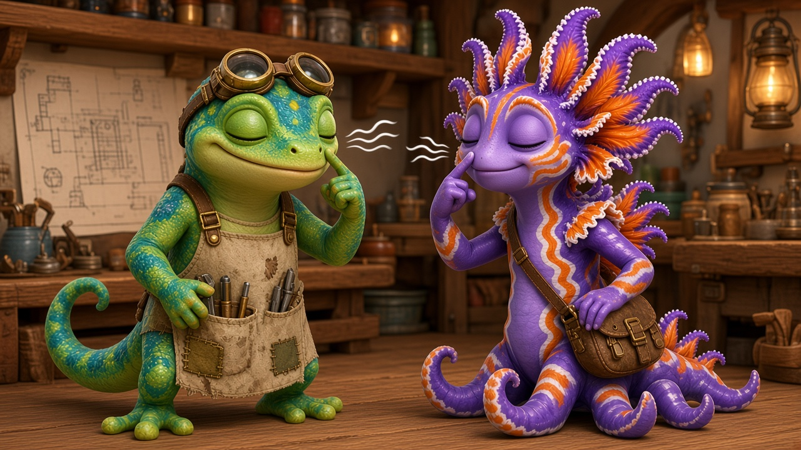
Day 1
Sound Card
ng
Notes:
I DO · Meet ng by itself (2 min). No vowel in front yet.
SAY: 'This is n and g together: ng. Today we say it all by itself, with no vowel in front: /ng/.'
MOUTH CUE: 'Open your mouth a little. Lift the BACK of your tongue up to touch the soft roof at the back of your mouth. Keep it there and hum: /ng/. The sound comes out of your nose, not your mouth.' Touch your nose and feel the buzz.
SAY: 'It is not /n/. For /n/ the tip of the tongue goes up. For /ng/ the back of the tongue goes up. And there is no guh at the end.'
WE DO: Say /ng/ together 3 times: long, short, long. Fingers on noses.
YOU DO: 3-4 students say /ng/ alone.
ERROR FIX: If you hear 'n-guh', say 'Stop before the guh. Just hold the hum: /ng/.' If you hear /n/, say 'Tip of the tongue down, back of the tongue up: /ng/.'

Slide 7
Day 1
Zip's Sound Clue 🔍
n + g = ng
When n and g hold hands, they hum in your nose.
Lift the back of your tongue and hum: ng!
Notes:
Zip's Sound Clue (teacher reads, 1 min). Zip the inventor has a clue about how ng works.
I DO: 'Zip found a clue! When n and g sit together, they hold hands and make ONE new sound: /ng/. You can't hear the n or the g alone. Lift the back of your tongue, put a finger on your nose and hum: /ng/. Feel the buzz? That is the nose hum!'
WE DO: Everyone touches noses and says /ng/ three times, long and short.
ERROR FIX: If a child says /n/ + /g/ ('n-guh'), say 'Glue them! No guh at the end. Listen: /ng/. Your turn.'

Slide 8
Day 1
Vowel + ng 🔍
i a o u + ng
When you put a vowel in front of ng,
it makes another glued sound!
Notes:
I DO · A vowel in front of ng (1-2 min).
SAY: 'ng can say its sound all alone: /ng/. When you put a vowel in front of ng, it makes another glued sound.'
Point to i, a, o, u: 'These are vowels. When a vowel sits in front of ng, the vowel and ng stick together like glue. We do not pull them apart. We say them as one chunk.'
SAY: 'Next we will hear four glued sounds. Just the sounds. No words yet!'
WE DO: Students say 'Vowel in front: glued sound!' and clap once.
ERROR FIX: If a child starts reading words, smile and say 'Sounds only for now. Words come next!'

Slide 9
Day 1
Glued Sounds 🔊
ing
ang
ong
ung
Say each glued sound.
Just the sounds. No words yet!
Notes:
I DO / WE DO / YOU DO · The four glued sounds, sounds only (2 min). Say them in this order: ing, ang, ong, ung.
I DO: Point to each box. 'i in front of ng: ing.' Students echo: 'ing.' 'a in front of ng: ang.' Echo. 'o in front of ng: ong.' Echo. 'u in front of ng: ung.' Echo. Keep the hum to the end; no /g/ pop.
WE DO: Say all four together in order twice: ing, ang, ong, ung. Then point out of order.
YOU DO: Call on students to say the one glued sound you point to.
Do NOT add letters or read words yet. That is the next slide.
ERROR FIX: If a child splits it ('i-n-g'), cover the box and slide your hand open: 'Glued! My turn: ing. Your turn.' If they mix up ang and ung, say 'Look at the vowel first. a says /a/: ang.'

Slide 10
Day 1
Add an s in Front ➕
sing
sang
song
sung
Add an s in front of each glued sound.
Now it is a word!
Notes:
I DO / WE DO / YOU DO · Add an s (2 min).
SAY: 'Now let's add an s in front.' Point to sing: '/s/ … ing … sing!' Sweep under the word.
Then: '/s/ … ang … sang.' '/s/ … ong … song.' '/s/ … ung … sung.'
WE DO: Read all four together: sing, sang, song, sung. Ask: 'What changed? Only the vowel!'
YOU DO: Point in random order; students read each word alone.
ERROR FIX: If a child reads sing for sang, cover the s: 'What glued sound? ang. Add /s/: sang.'

Slide 11
Day 1
Blend It
k
+
ing
=
king
Notes:
I DO / WE DO: 'New first sound! /k/ … ing … king!' Slide your hand under the chunk first, then sweep the whole word.
SAY: 'Same glued sound, new letter in front. Let's read more ing words.'

Slide 12
Day 1
Practice: ing ⚡
king
ring
sing
wing
thing
sting
bring
swing
Glue chunk: ing
Notes:
Word list: ing words only (no mixing yet).
I DO: Point to the colored chunk. 'Every word here has ing.' Read ring slowly: front sound, then ing, then the whole word.
WE DO: Read every word together: tap the front sound, swipe under ing, read the whole word.
YOU DO: Each child reads 2 words alone, then partners read the whole list.
ERROR FIX: If a child misreads, point to the chunk: 'What's the glue chunk? (ing). Now add the front sound.' Cover the front sound, say ing, then uncover and re-read.

Slide 13
Day 1
Practice: ang ⚡
bang
sang
rang
fang
hang
gang
clang
slang
Glue chunk: ang
Notes:
Word list: ang words only (no mixing yet).
I DO: Point to the colored chunk. 'Every word here has ang.' Read sang slowly: front sound, then ang, then the whole word.
WE DO: Read every word together: tap the front sound, swipe under ang, read the whole word.
YOU DO: Each child reads 2 words alone, then partners read the whole list.
ERROR FIX: If a child misreads, point to the chunk: 'What's the glue chunk? (ang). Now add the front sound.' Cover the front sound, say ang, then uncover and re-read.

Slide 14
Day 1
Practice: ong ⚡
long
song
gong
strong
prong
dong
Glue chunk: ong
Notes:
Word list: ong words only (no mixing yet).
I DO: Point to the colored chunk. 'Every word here has ong.' Read song slowly: front sound, then ong, then the whole word.
WE DO: Read every word together: tap the front sound, swipe under ong, read the whole word.
YOU DO: Each child reads 2 words alone, then partners read the whole list.
ERROR FIX: If a child misreads, point to the chunk: 'What's the glue chunk? (ong). Now add the front sound.' Cover the front sound, say ong, then uncover and re-read.

Slide 15
Day 1
Practice: ung ⚡
rung
sung
hung
lung
stung
flung
clung
swung
Glue chunk: ung
Notes:
Word list: ung words only (no mixing yet).
I DO: Point to the colored chunk. 'Every word here has ung.' Read sung slowly: front sound, then ung, then the whole word.
WE DO: Read every word together: tap the front sound, swipe under ung, read the whole word.
YOU DO: Each child reads 2 words alone, then partners read the whole list.
ERROR FIX: If a child misreads, point to the chunk: 'What's the glue chunk? (ung). Now add the front sound.' Cover the front sound, say ung, then uncover and re-read.

Slide 16
Day 1
Mixed Practice: We Do 🤝
king
rang
song
sung
wing
fang
Notes:
WE DO (choral, then partners): 'Find the glue chunk first. Then add the front sound. k … ing … king!' Pre-correct before choral reading.

Slide 17
Day 1
Mixed Practice: You Do 🦎
sing
bang
long
hung
ring
gong
Notes:
YOU DO: students whisper-read each word, then read to a partner. Circulate and listen to 4–5 students.

Slide 18
Day 1
Heart Words ❤️
the
was
what
I
❤
❤
❤
❤
to
a
❤
❤
See it · Say it · Spell it · Say it again
Notes:
Heart Words (2 min): the, was, what, I, to, a. These words have a tricky part we learn by heart. We will see them in our sentences and story.
For each word: SEE IT (point), SAY IT (students repeat), SPELL IT (say each letter while tapping), SAY IT AGAIN.
HEART: point to the tricky part and draw a heart over it (the e in 'the' says /uh/; the a in 'was' and 'what' says /u/; the o in 'to' says /oo/; 'I' and 'a' are one-letter words). 'The rest of the word follows the rules; the heart part we just have to know.'
Quick flash: point to the words out of order; students read them fast.

Slide 19
Day 1
Practice on Your Own 🌟
Now try it on your own
in your Daily Practice Sheets 📘
Day 1 · Picture Match
✓ Find the chunk first ✓ Go slow
✓ Check your work ✓ Ask for help
Notes:
PRACTICE ON YOUR OWN · Independent practice (5-8 min). Students now do independent work.
SAY: 'Now try it on your own in your Daily Practice Sheets. Turn to Day 1: Picture Match.'
Amount: 1-2 practice pages, about 5-8 minutes. Read the directions together, do item 1 together, then students work alone.
TEACHER: circulate; listen to 2-3 students read their words aloud. Prompt with Power Moves (find the chunk, go slow, re-read). Do not correct for them; point and say 'Check that one.'
FINISH: each student shares one win and one Power Move they used, then ticks the checklist (the checklist).
Not finished? It goes home as extra practice.

Slide 20
Day 1
Great Work! 🏆
Day 1 done!
⭐ Color your map 🔥 Streak +1
Notes:
GREAT WORK (1 min): 'You completed Day 1!' Color Day 1 on the Progress Map, add 1 to the streak, name one Power Move you used. Celebrate effort, not speed.

Slide 21
Day 2 - Build & Read
Unit 3 · Lesson 3.1 · ng · Island Readers
Notes:
Day 2 - Build & Read. Divider slide: show while students get materials ready.

Slide 22
Day 2
Unit 3 · Lesson 3.1 · Day 2
Build & Read
Notes:
Day 2: Build & Read. Focus: chunk chains (change only the vowel), missing chunk, word building with new starting letters, mixed words, island sort, phrases and short sentences, quick check. Heart words: no, of, is, the, a.
Materials: Slides Day 2 · chunk cards · letter tiles s r h b k l t w · whiteboards · Daily Practice Sheets, Day 2.
GET READY (2 min): packets out, start the class timer.

Slide 23
Day 2
Warm-Up ⚡
ing
ang
ong
ung
sang
sung
Notes:
WARM-UP (3 min): 5 frill waves: wave both arms slowly over your head.
Then point to each tile; students say the sound or read the word (choral).

Slide 24
Day 2
Chunk Chains 🔗
sing → sang → song → sung
ring → rang → rung
ping → pang → pong
hang → hung long → lung
Notes:
Chunk chains (3 min): change only ONE thing, the vowel.
I DO: Read the first chain: 'sing. Change i to a: sang. Change a to o: song. Change o to u: sung.' Touch the vowel each time.
WE DO: Read each chain together. After each word, students name the vowel that changed.
YOU DO: Partners read a chain to each other, then build it with letter tiles, changing one tile at a time.
ERROR FIX: If a child reads the old word again, point to the vowel: 'What is the vowel now? So the glued sound is…?'

Slide 25
Day 2
Missing Chunk 🧩
ang
ing
ong
ung
Which glued chunk is missing?
k _ _ _ s _ _ _ l _ _ _ h _ _ _
Notes:
Missing chunk (3 min).
I DO: 'I say king. k… what is missing? I hear ing.' Point to the ing box.
WE DO: Say sang, long, hung. Students repeat the word, then point to the missing chunk on the slide (ang, ong, ung).
YOU DO: Say wing, rang, gong, stung, bring, clang. Students write ONLY the missing chunk on whiteboards; show on 'Show me!'.
ERROR FIX: If they write 'n' alone, say 'Feel the nose hum: that is ng, two letters glued.' Re-say the word slowly, then rewrite.

Slide 26
Day 2
Blend It
b
+
ang
=
bang
Notes:
Word building (keep the glued chunk, change the starting letter).
I DO / WE DO: '/b/ … ang … bang!' Slide your hand under the chunk first, then sweep the whole word.
BUILD: With letter tiles, keep ang and swap the first letter: bang → hang → rang → sang → fang. Students read each new word.

Slide 27
Day 2
More ang! 🦎
clang
slang
sprang
bang
hang
rang
fang
Glue chunk: ang
Notes:
Practice: -ang words only.
I DO: Point to the colored chunk. 'This is ang. It is glued: we say it together, never split it.' Read clang slowly: front sound, then ang, then the whole word.
WE DO: Read every word together: tap the front sound, swipe under the ang chunk, then read the whole word.
YOU DO: Each child reads 2 words alone. Then partners take turns reading the row.
ERROR FIX: If a child says 'clan', point and say, 'My turn: clang. Your turn.' Have them cover the front sound, say 'ang', then add it back and re-read.

Slide 28
Day 2
Blend It
l
+
ong
=
long
Notes:
I DO / WE DO: '/l/ … ong … long!' Slide your hand under the chunk first, then sweep the whole word.

Slide 29
Day 2
Blend It
h
+
ung
=
hung
Notes:
I DO / WE DO: '/h/ … ung … hung!' Slide your hand under the chunk first, then sweep the whole word.

Slide 30
Day 2
Practice: ung ⚡
sung
hung
rung
lung
stung
clung
flung
swung
Glue chunk: ung
Notes:
Practice: -ung words only.
I DO: Point to the colored chunk. 'This is ung. It is glued: we say it together, never split it.' Read hung slowly: front sound, then ung, then the whole word.
WE DO: Read every word together: tap the front sound, swipe under the ung chunk, then read the whole word.
YOU DO: Each child reads 2 words alone. Then partners take turns reading the row.
ERROR FIX: If a child says 'hang', point and say, 'My turn: hung. Your turn.' Have them cover the front sound, say 'ung', then add it back and re-read.

Slide 31
Day 2
Mix It Up! 🏝️
king
fang
song
lung
sang
wing
gong
hung
Glue chunk: ang · ing · ong · ung
Notes:
Mixed practice: ang, ing, ong, ung.
I DO: 'Now the chunks are mixed up! I find the glue chunk first, then I read.' Model the first word.
WE DO: Read each word together: name the chunk (ang/ing/ong/ung), then read the word.
YOU DO: Children read the words in a random order you point to. Fast finishers sort them by chunk.
ERROR FIX: If a child swaps vowels (sang→sung), point to the vowel: 'What sound is a? ... ang. Now read it.' Then re-read the word.

Slide 32
Day 2
Mix It Up Again! 🏝️
strong
clung
swing
clang
rung
thing
long
sprang
Glue chunk: ang · ing · ong · ung
Notes:
Mixed practice: ang, ing, ong, ung.
I DO: 'Now the chunks are mixed up! I find the glue chunk first, then I read.' Model the first word.
WE DO: Read each word together: name the chunk (ang/ing/ong/ung), then read the word.
YOU DO: Children read the words in a random order you point to. Fast finishers sort them by chunk.
ERROR FIX: If a child swaps vowels (sang→sung), point to the vowel: 'What sound is a? ... ang. Now read it.' Then re-read the word.

Slide 33
Day 2
Island Sort 🏝️
ang
ing
ong
ung
song
hung
bang
king
long
sang
lung
ring
Notes:
I DO: sort 2 words aloud ('song … ong … ong island'). WE DO: students say which island for the rest. Fast finishers: Word Sort page (Day 2 practice sheets).

Slide 34
Day 2
Heart Words ❤️
no
of
is
the
❤
❤
❤
❤
a
❤
See it · Say it · Spell it · Say it again
Notes:
Heart Words (2 min): no, of, is, the, a. We will see these in today's phrases and sentences.
For each word: SEE IT (point), SAY IT (students repeat), SPELL IT (say each letter while tapping), SAY IT AGAIN.
HEART: point to the tricky part and draw a heart over it (the o in 'no' says its name; the o in 'of' says /u/ and the f says /v/; the s in 'is' says /z/; the e in 'the' says /uh/; 'a' is a one-letter word). 'The rest of the word follows the rules; the heart part we just have to know.'
Quick flash: point to the words out of order; students read them fast.

Slide 35
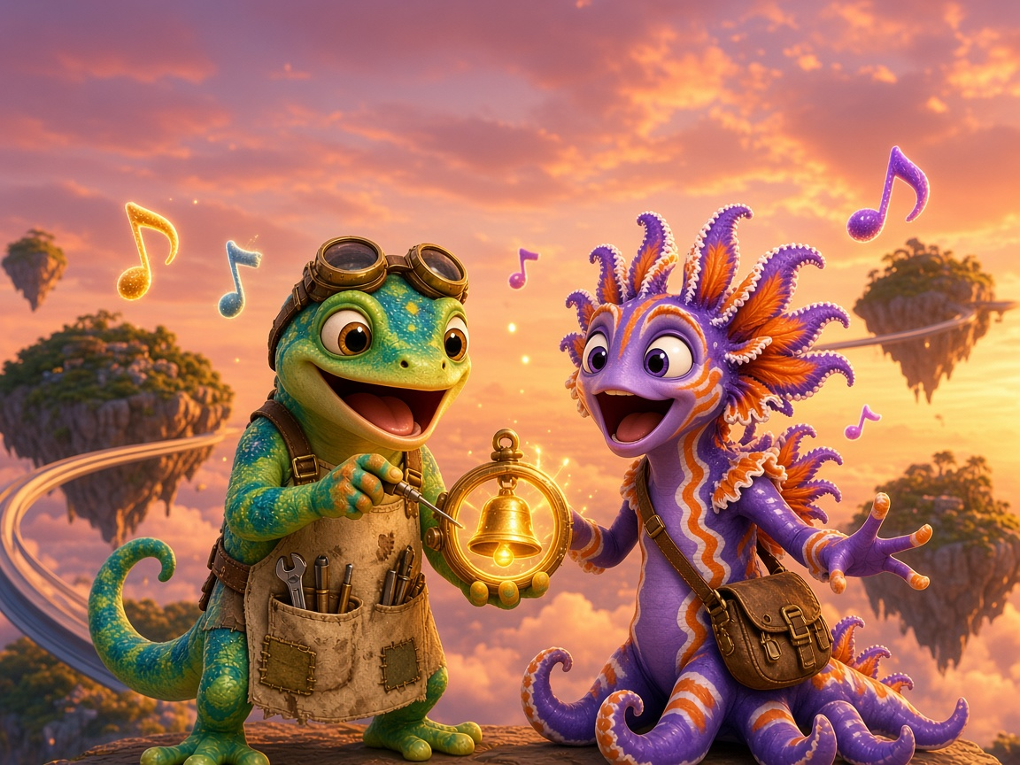
Day 2
Read It!
The king sang a long song.
Notes:
Read It! Finger under each word. I DO: read it once. WE DO: read it together. YOU DO: whisper-read it to a partner.
Point out the ng words: king, sang, long, song. Find the glued chunk in each.

Slide 36
Day 2
Phrase Strips 1 🚝
a long song
sing a song
a king and a ring
bang the gong
Notes:
Phrase strips (fluency in chunks).
I DO: Read each phrase smoothly, sweeping a finger under it: 'I read it like I talk.'
WE DO: Echo read each phrase, then choral read.
YOU DO: Partners read all 4 phrases twice; second time faster and smoother.
ERROR FIX: Choppy word-by-word reading: model the phrase in one breath, then 'My turn, your turn.'

Slide 37
Day 2
Read the Sentences 📖
The king sang a song.
A bug stung Zip.
Frill hung on a string.
Bang the long gong!
Notes:
Read short sentences (3 min).
I DO: Read each sentence smoothly, sweeping a finger under it: 'I find the glued chunk, then I read like I talk.'
WE DO: Echo read each sentence, then choral read.
YOU DO: Partners read all 4 sentences twice; second time smoother.
ERROR FIX: Stop at a missed ng word, cover the front sound, read the chunk, then the word, then re-read the whole sentence.

Slide 38
Day 2
Quick Check ✅
thing
swing
strong
✓ or ✗
Notes:
QUICK CHECK (2 min): call on 3 students, one word each: thing, swing, strong. Mark ✓ or ✗ on your record sheet.
If a student misses: 'Find the glued chunk first' and re-read. Note who needs extra practice before Day 3.

Slide 39
Day 2
Practice on Your Own 🌟
Now try it on your own
in your Daily Practice Sheets 📘
Day 2 · Practice pages
✓ Find the chunk first ✓ Go slow
✓ Check your work ✓ Ask for help
Notes:
PRACTICE ON YOUR OWN · Independent practice (5-8 min). Students now do independent work.
SAY: 'Now try it on your own in your Daily Practice Sheets. Turn to Day 2.'
Amount: 1-2 practice pages, about 5-8 minutes. Read the directions together, do item 1 together, then students work alone.
TEACHER: circulate; listen to 2-3 students read their words aloud. Prompt with Power Moves (find the chunk, go slow, re-read). Do not correct for them; point and say 'Check that one.'
FINISH: each student shares one win and one Power Move they used, then ticks the checklist (the checklist).
Not finished? It goes home as extra practice.

Slide 40
Day 2
Great Work! 🏆
Day 2 done!
⭐ Color your map 🔥 Streak +1
Notes:
GREAT WORK (1 min): 'You completed Day 2!' Color Day 2 on the Progress Map, add 1 to the streak, name one Power Move you used. Celebrate effort, not speed.

Slide 41
Day 3 - Story & Celebrate
Unit 3 · Lesson 3.1 · ng · Island Readers
Notes:
Day 3 - Story, Check & Celebrate. Divider slide: show while students get materials ready.

Slide 42
Day 3
Unit 3 · Lesson 3.1 · Day 3
Story, Check & Celebrate
Notes:
Day 3: Story, Check & Celebrate. Focus: read the comic story in 3 parts, re-read it for fluency, Show What You Know check (10 items), celebrate Song Island.
Materials: Slides Day 3 · story page · Unit Check page (one per child) · class record sheet · Progress Map · Daily Practice Sheets, Day 3.
GET READY (2 min): packets out, start the class timer.

Slide 43
Day 3
Warm-Up ⚡
thing
strong
swing
fang
gong
hung
Notes:
WARM-UP (3 min): 3 sea breaths, then a silent cheer.
Then point to each tile; students say the sound or read the word (choral).

Slide 44
Day 3
Speed Run ⏱️ 1 minute
sing
bang
long
hung
king
rang
song
lung
wing
fang
gong
rung
thing
sang
strong
stung
ring
hang
dong
clung
Notes:
WARM-UP · 1-minute speed run.
I DO: Model reading row 1 smoothly (not racing).
YOU DO: Start a 1-minute timer. Students read rows left to right, then start again at the top. Mark the last word read. Record the score in the Power Level chart.
Try 2: Re-read to beat your own score (personal best, never compare with others).
ERROR FIX: Teacher points to a missed word, says it, student repeats and keeps going.
Today the comic is read as a whole: after Part 3, students re-read Parts 1-3 together for fluency.

Slide 45
Day 3
Heart Words ❤️ Story Words
go
I
you
was
❤
❤
❤
❤
the
what
a
❤
❤
❤
See it · Say it · Spell it · Say it again
Notes:
Heart Words for the story (2 min): go, I, you, was, the, what, a. Quick review of words from Days 1 and 2 too: to, no, of, is.
For each word: SEE IT (point), SAY IT (students repeat), SPELL IT (say each letter while tapping), SAY IT AGAIN.
HEART: point to the tricky part and draw a heart over it (the a in 'what' and 'was' says /u/; 'I' and 'a' are one-letter words). 'The rest of the word follows the rules; the heart part we just have to know.'
Quick flash: point to the words out of order; students read them fast. Then go straight to the story.

Slide 46
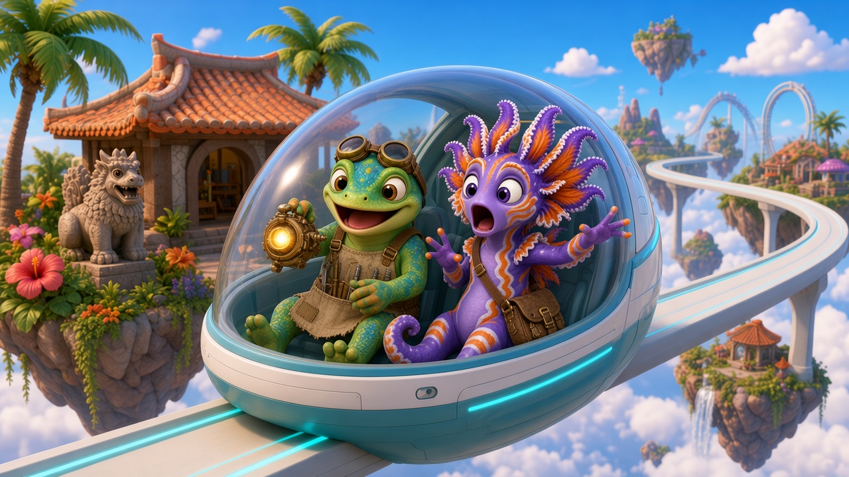
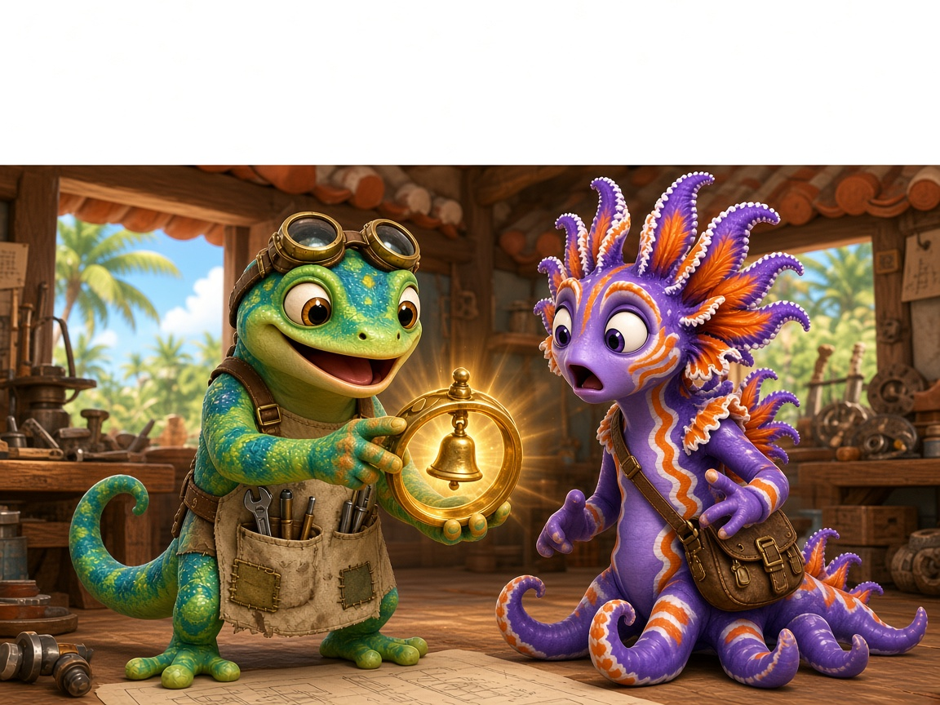
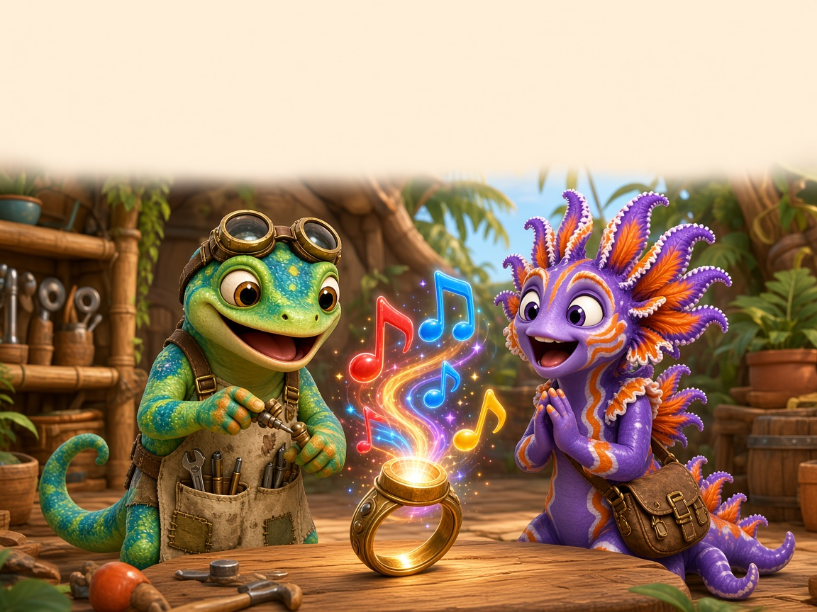
Day 3
Comic Part 1: Zip and the Ring Thing 📖
Zip: Frill! I got a thing to bring!
Frill: What thing?
Zip: It is a Ring Thing. It can sing!
Frill: No! A thing can not sing!
Ding! Dong! Ding!
Frill: It sang a song!
Read it 3 times: ⭐ 1 ⭐ 2 ⭐ 3
Notes:
Comic Part 1 (panels 1–3), repeated reading 3x.
READ 1 (I do): Teacher reads, students track with a finger. Point out the ng words.
READ 2 (we do): Choral read. Frill's lines one group, Zip's lines the other.
READ 3 (you do): Partner read with expression; swap roles. Color a star after each read.
ERROR FIX: Stop at a missed ng word, cover the front sound, read the chunk, then the word, then re-read the whole sentence.
Comic text: Zip: Frill! I got a thing to bring! Frill: What thing? | Zip: It is a Ring Thing. It can sing! Frill: No! A thing can not sing! | Ding! Dong! Ding! Frill: It sang a song!
COMIC PLAN: On Day 3 read all three parts, 2-3 reads each: (1) teacher models, (2) choral read, (3) each student reads alone or to a partner.

Slide 47
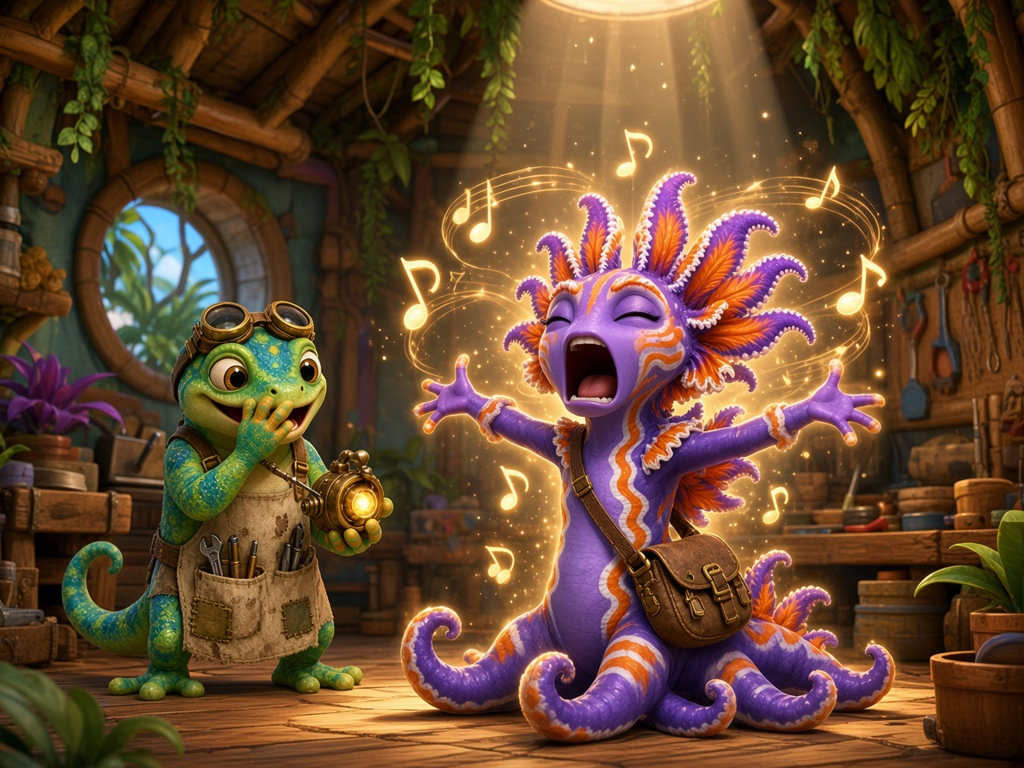
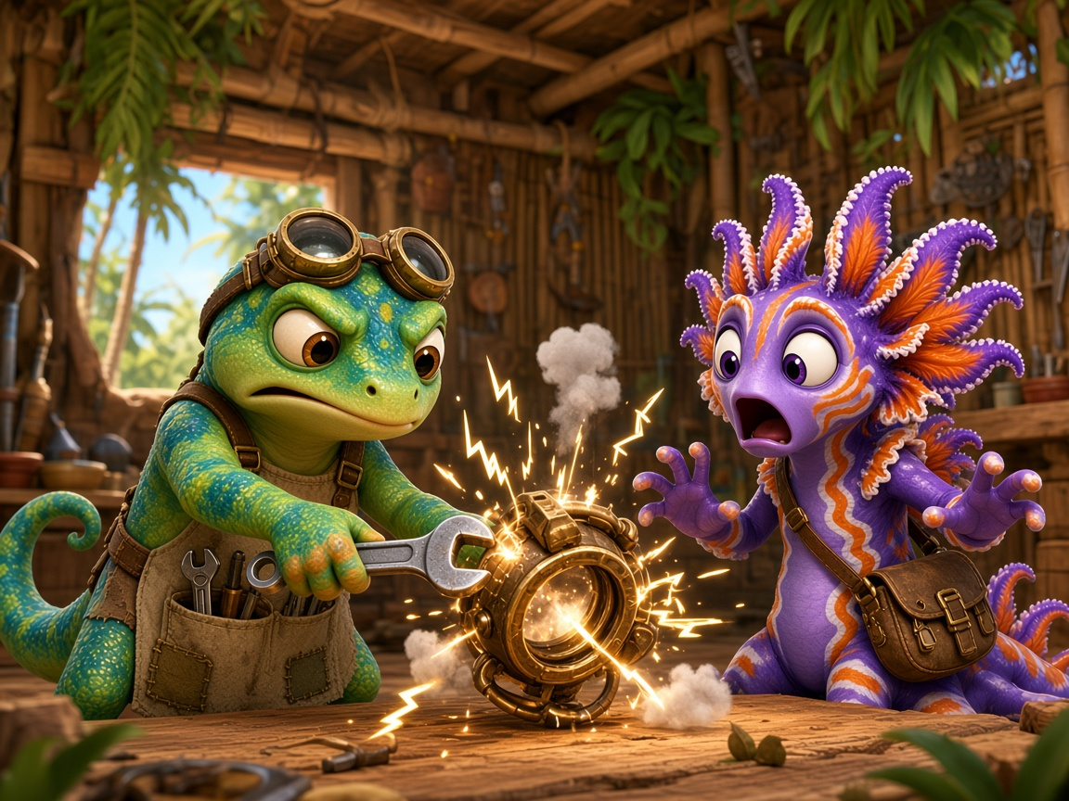
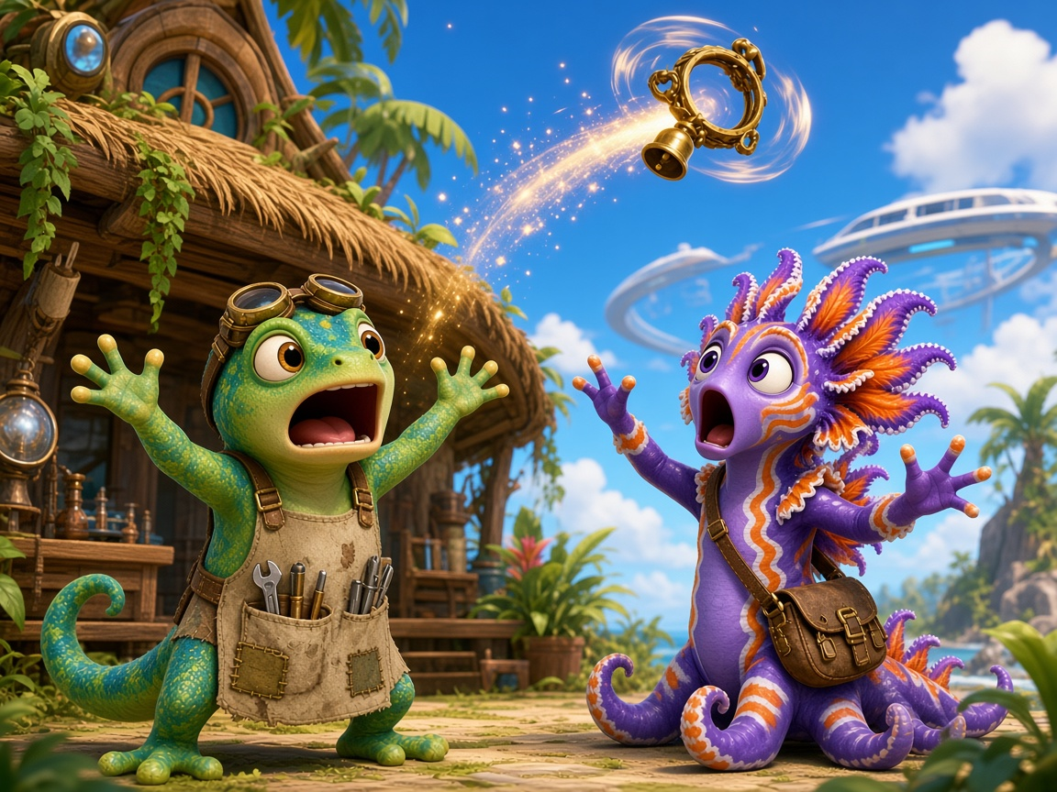
Day 3
Comic Part 2: Zip and the Ring Thing 📖
Zip: That is a lot of song!
Frill: I will sing with it! A long, long song!
Zip: It is stuck on a bad song!
Frill: Zip! Fix it!
Bang! Bong! Clang!
Zip: It flung off!
Frill: The Ring Thing is up, up, up! Zing!
Read it 3 times: ⭐ 1 ⭐ 2 ⭐ 3
Notes:
Comic Part 2 (panels 4–6), repeated reading 3x.
READ 1 (I do): Teacher reads, students track with a finger. Point out the ng words.
READ 2 (we do): Choral read. Frill's lines one group, Zip's lines the other.
READ 3 (you do): Partner read with expression; swap roles. Color a star after each read.
ERROR FIX: Stop at a missed ng word, cover the front sound, read the chunk, then the word, then re-read the whole sentence.
Comic text: Zip: That is a lot of song! Frill: I will sing with it! A long, long song! | Zip: It is stuck on a bad song! Frill: Zip! Fix it! Bang! Bong! Clang! | Zip: It flung off! Frill: The Ring Thing is up, up, up! Zing!
COMIC PLAN: On Day 3 read all three parts, 2-3 reads each: (1) teacher models, (2) choral read, (3) each student reads alone or to a partner.

Slide 48
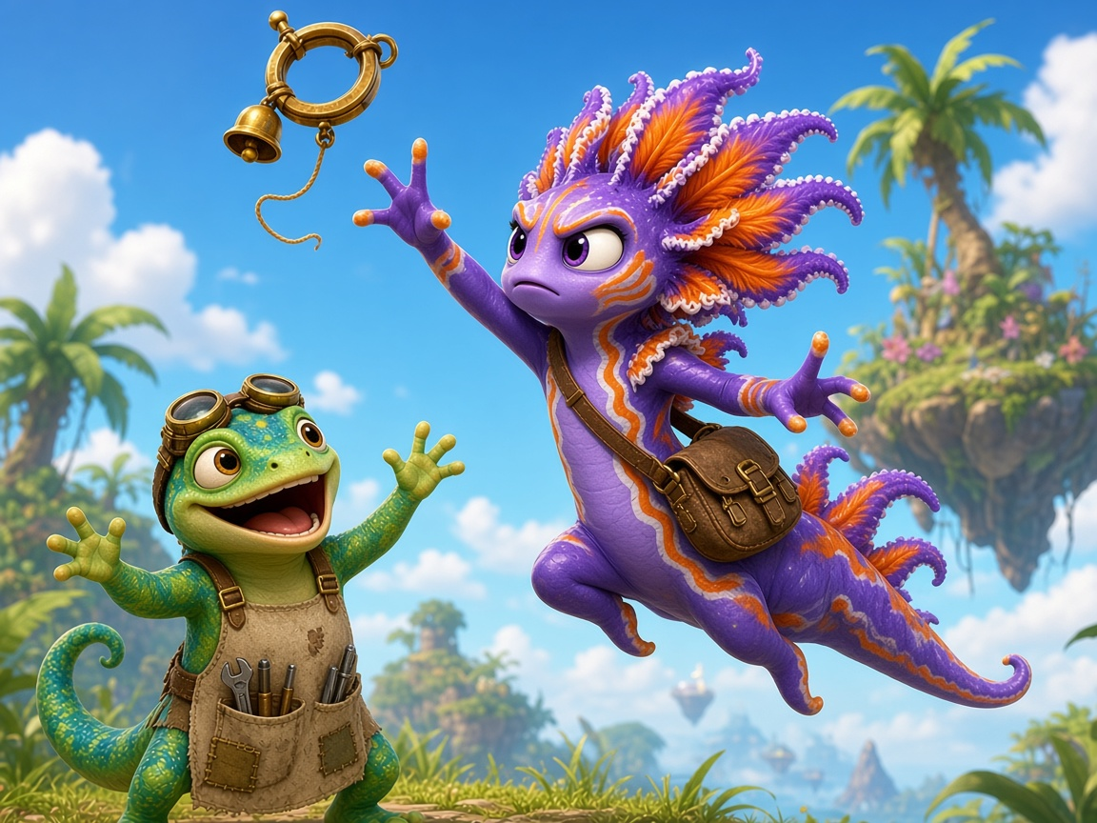
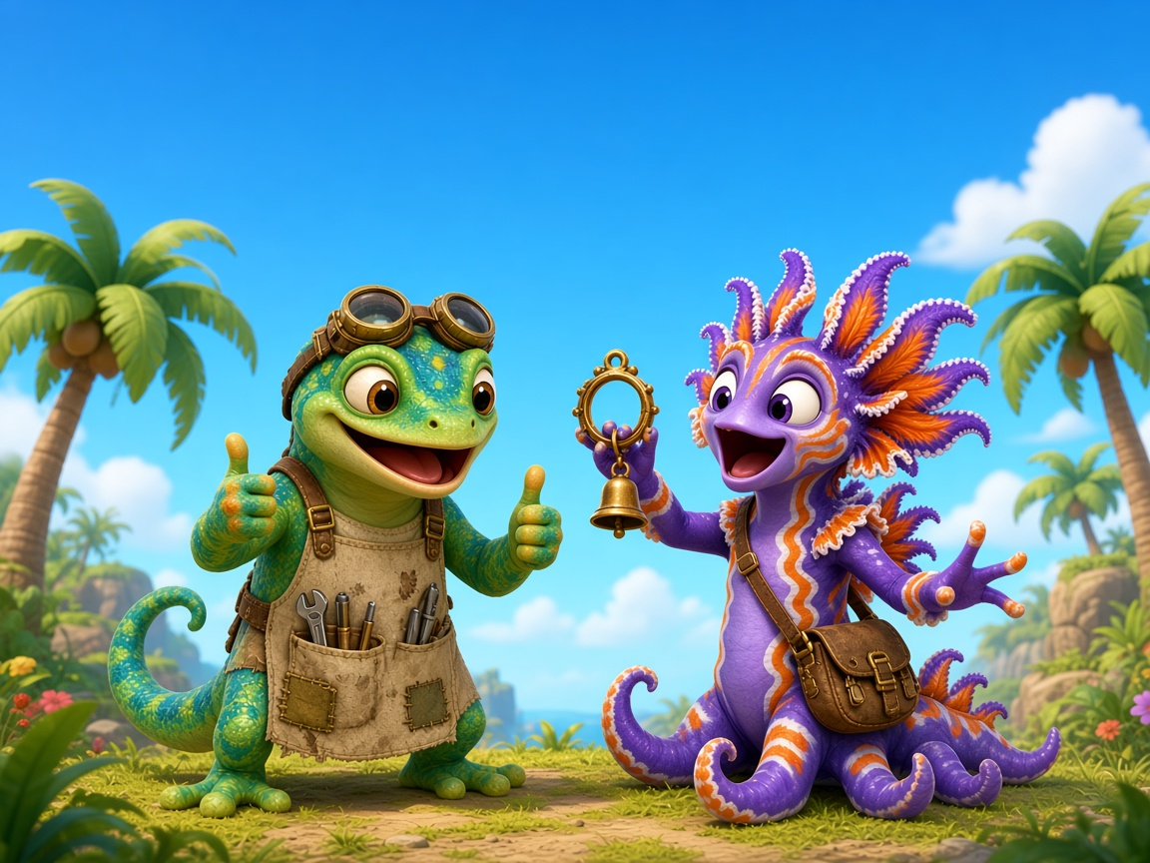
Day 3
Comic Part 3: Zip and the Ring Thing 📖
Zip: Go, Frill!
Frill: I am long! I can get it!
Zip: You did it, Frill! That was strong!
Frill: I got the string!
Zip: Ding, dong! Sing a song!
Frill: What a fun thing!
Read it 3 times: ⭐ 1 ⭐ 2 ⭐ 3
Notes:
Comic Part 3 (panels 7–9), repeated reading 3x.
READ 1 (I do): Teacher reads, students track with a finger. Point out the ng words.
READ 2 (we do): Choral read. Frill's lines one group, Zip's lines the other.
READ 3 (you do): Partner read with expression; swap roles. Color a star after each read.
ERROR FIX: Stop at a missed ng word, cover the front sound, read the chunk, then the word, then re-read the whole sentence.
Comic text: Zip: Go, Frill! Frill: I am long! I can get it! | Zip: You did it, Frill! That was strong! Frill: I got the string! | Zip: Ding, dong! Sing a song! Frill: What a fun thing!
COMIC PLAN: On Day 3 read all three parts, 2-3 reads each: (1) teacher models, (2) choral read, (3) each student reads alone or to a partner.
DAY 3: After Part 3, go to the Re-read slide and read ALL THREE parts in a row for fluency.

Slide 49
Day 3
Re-read the Story 🔁
Read it again!
Parts 1, 2 and 3
Read the whole story with a partner.
Swap Zip and Frill. Use your best voice!
Notes:
Re-read the whole story (4 min).
SAY: 'Now we read all three parts in a row, like a real book.'
WE DO: Choral read Parts 1-3 (go back to the comic slides). YOU DO: Partners re-read; one reads Zip, one reads Frill, then swap. Color a star after each read.
TEACHER: listen for smooth reading of the ng words. ERROR FIX: point to the glued chunk, student reads the word, then re-reads the sentence.

Slide 50
Day 3
10-Word Check ✅
Check time!
Get your check page.
Read 10 words to your teacher.
Do your best!
Notes:
Show What You Know: 10-item check (6 Check folder: check page in unit_ng.pdf).
One-to-one: student reads each word; mark ✓ or ✗. No help, no hints. Items: 1 sing 2 bang 3 long 4 hung 5 king 6 strong 7 wing 8 rang 9 song 10 lung.
SCORE: 9-10 = move on to the next unit (nk). 7-8 = review with the Day 2 slides. 6 or below = re-teach Day 1 in a small group.
The rest of the class re-reads the story with partners.

Slide 51
Day 3
Show What You Know 🏆
king
song
hung
ring
Find the glue chunk. Then read!
Notes:
SHOW WHAT YOU KNOW: one-to-one with the check page. No prompting. Student finds the glued chunk, then reads.
SCORE: 9-10 move on to nk · 7-8 review (Day 2 slides) · 6 or below re-teach (Day 1 slides, small group).

Slide 52
Day 3
Practice on Your Own 🌟
Now try it on your own
in your Daily Practice Sheets 📘
Day 3 · Practice pages
✓ Find the chunk first ✓ Go slow
✓ Check your work ✓ Ask for help
Notes:
PRACTICE ON YOUR OWN · Independent practice (5-8 min). Students now do independent work.
SAY: 'Now try it on your own in your Daily Practice Sheets. Turn to Day 3.'
Amount: 1-2 practice pages, about 5-8 minutes. Read the directions together, do item 1 together, then students work alone.
TEACHER: circulate; listen to 2-3 students read their words aloud. Prompt with Power Moves (find the chunk, go slow, re-read). Do not correct for them; point and say 'Check that one.'
FINISH: each student shares one win and one Power Move they used, then ticks the checklist (the checklist).
Not finished? It goes home as extra practice.

Slide 53
Day 3
Song Island: done! 🎉
Notes:
CELEBRATE: Song Island is done! Everyone colors the last star on the Progress Map and adds 1 to the streak.
Name the effort, not the score: 'You found the glued chunk every time!'

