Slide 1
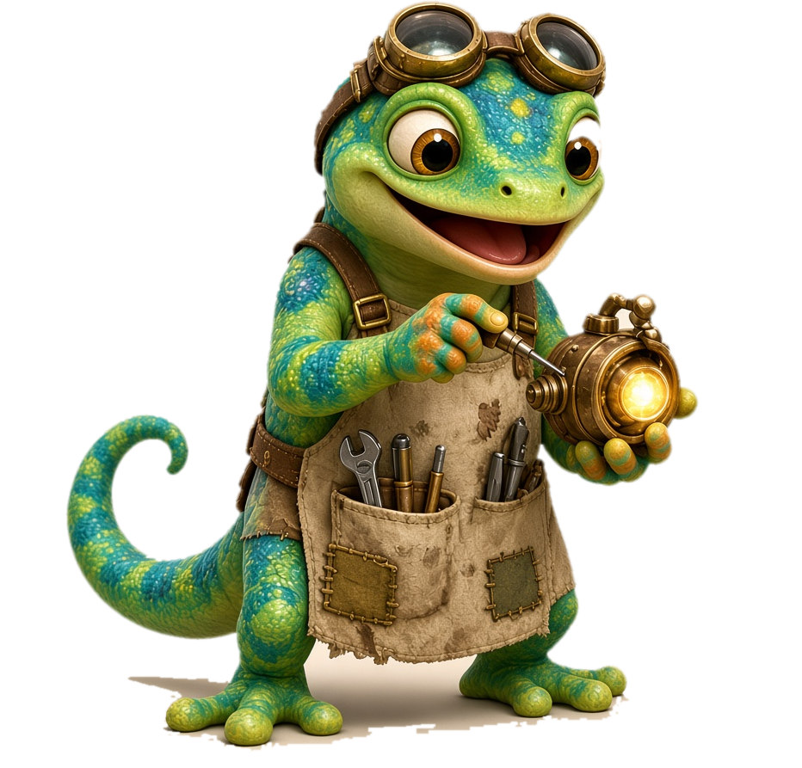
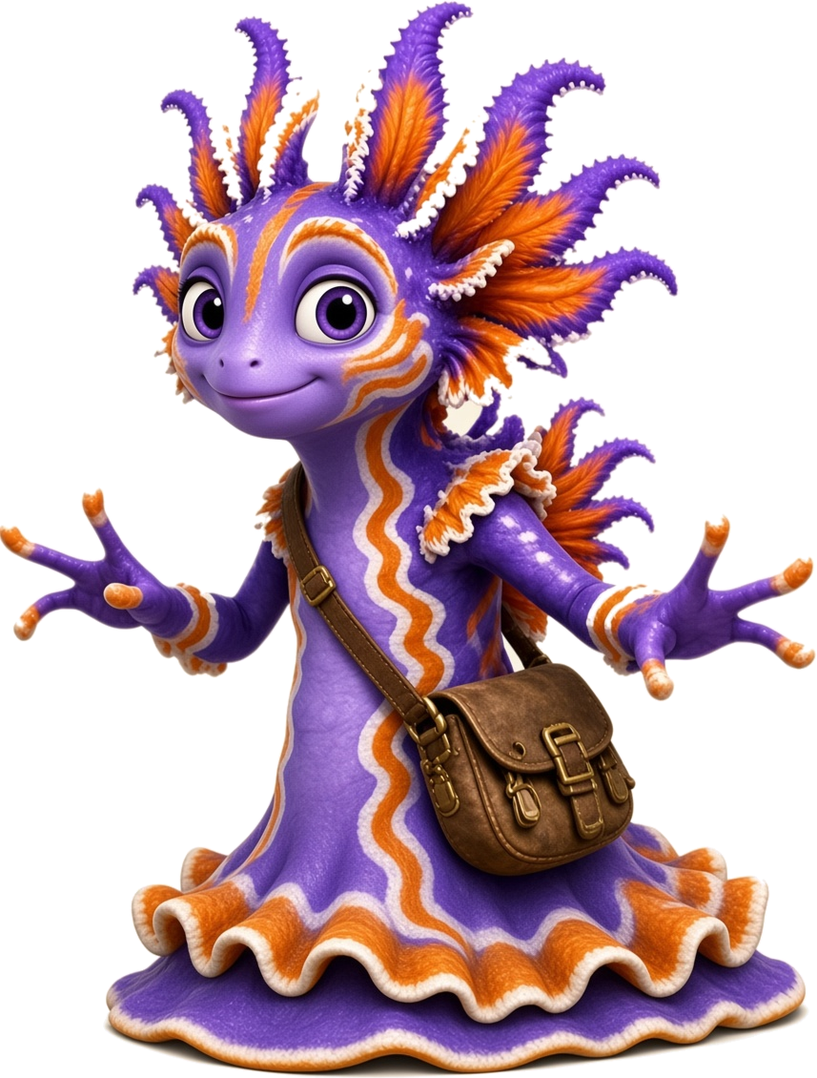
Day 1 - Teach
Unit 3 · Lesson 3.1 · ng · Island Readers
Notes:
Day 1 - Teach. Divider slide: show while students get materials ready.

Slide 2
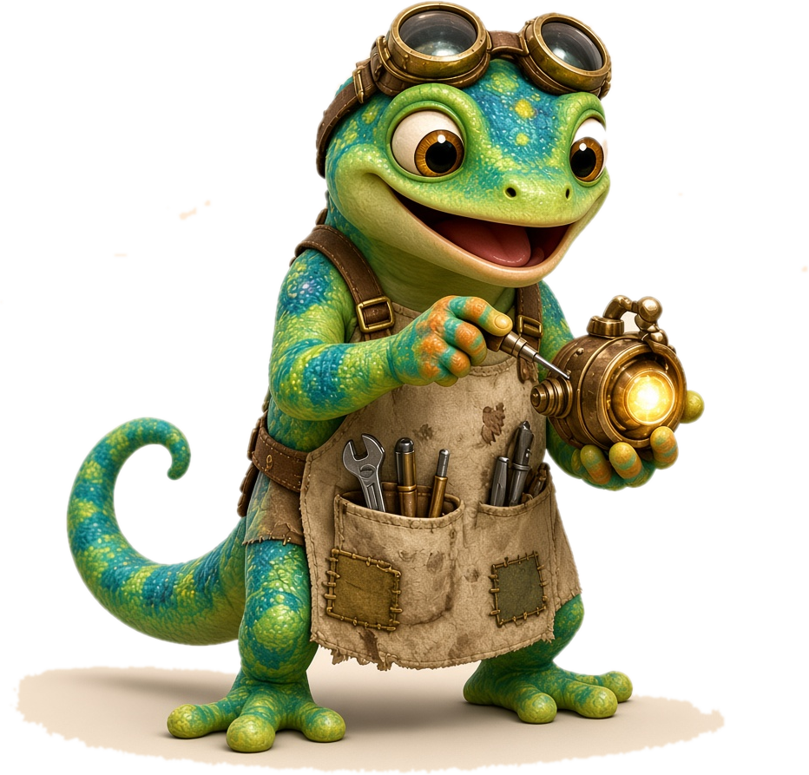
Day 1
Unit 3 · Lesson 3.1 · Day 1
Meet the Nose Hum: ng
Notes:
Day 1: Meet the Nose Hum: ng. Focus: Introduce ng and the 4 glued chunks (ang, ing, ong, ung). Materials: Slides Day 1 · ng sound card · chunk cards ang/ing/ong/ung · whiteboards + markers · Picture Match page.
Get ready (2 min): packets out, start the class timer.

Slide 3
Day 1
Meet Zip and Frill
Zip
Frill
Notes:
Introduce the mascots. Zip is a gecko inventor. Frill is a dramatic sea slug. Both names are decodable: students can read them!

Slide 4
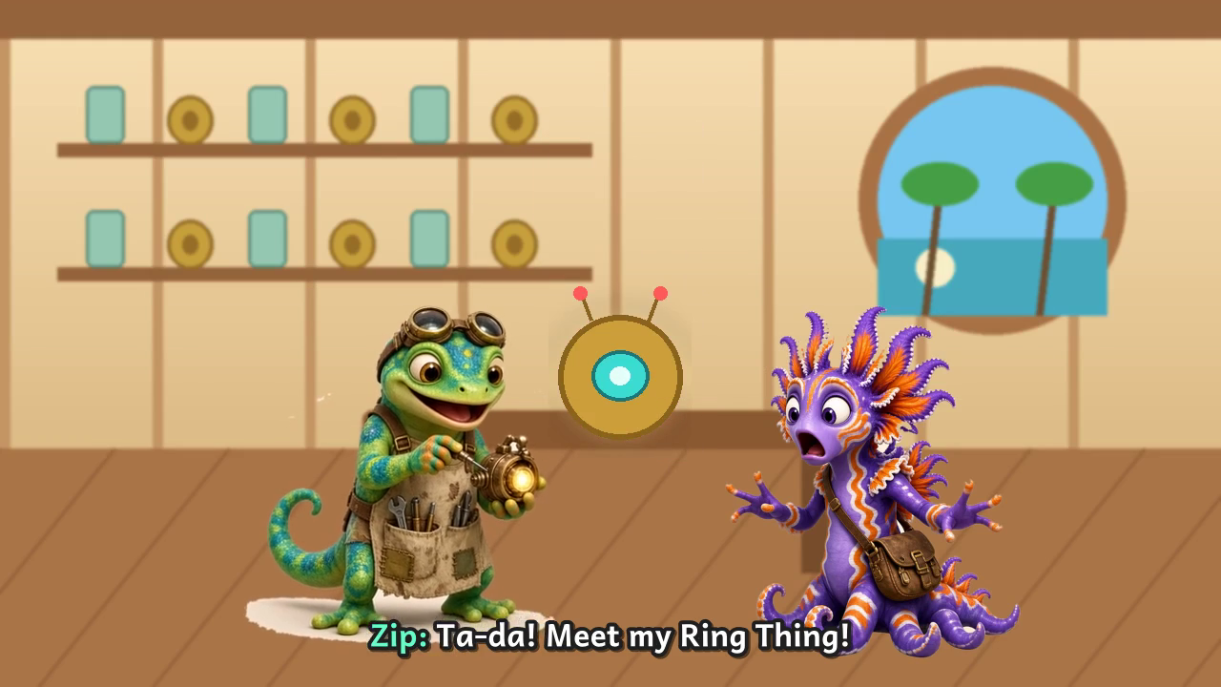
Day 1
Cartoon Time 🎬
▶ Video goes here: ng_cartoon_v3.mp4
Notes:
Opener cartoon (3 min): 'Zip and Frill: The Ring Thing Goes BONK!' (5 Cartoon folder: ng_cartoon_v3.mp4).
INSERT VIDEO: In PowerPoint/Slides use Insert > Video and pick ng_cartoon_v3.mp4, then delete this placeholder box.
BEFORE: 'Zip's gadget only listens to one sound. Help them when they say HELP US!'
DURING: Pause is built in at each Help-us prompt; cheer the class on. AFTER: 'What sound fixed the Ring Thing?' (/ng/)

Slide 5
Day 1
Power-Up ⚡ Digraph Review
Last unit: digraphs! Two letters, one sound.
sh
ch
th / th
ck
wh
ph
ship
chip
thin
quiet th
duck
when
phone
shop
chin
this
buzzy th
sock
whip
graph
Notes:
Digraph review (3 min). Quick review of last lesson (Lesson 2.2 digraphs).
WARM-UP: 3 sea breaths like Frill (in through the nose, out like a wave).
SAY: 'Last unit we learned digraphs: two letters that make ONE sound.'
TOP ROW: point to each digraph; students say the sound: /sh/, /ch/, /th/, /k/, /w/, /f/.
th / th: 'th has two sounds. Quiet th: put your tongue out and blow, no voice (thin). Buzzy th: same tongue, voice on, feel your throat buzz (this).'
WORDS: point to each word tile; students read it chorally. Then call on 2-3 students to read a column alone.
ERROR FIX: If a child reads the letters separately (s-h), cover one letter: 'These two are a team. They make one sound: /sh/.'
BRIDGE: 'This week we learn a new team: n and g!'

Slide 6
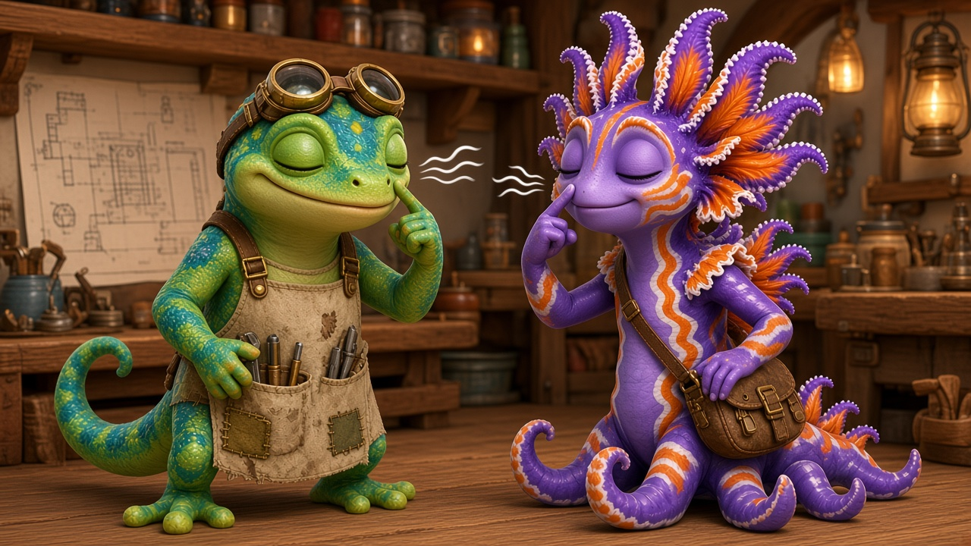
Day 1
Sound Card
ng
Notes:
I DO: 'Look: n and g. When they sit together they make ONE sound: /ng/. It hums in your nose. Touch your nose: /ng/. Feel it buzz?' Students echo 3 times.

Slide 7
Day 1
Zip's Sound Clue 🔍
n + g = ng
When n and g hold hands, they hum in your nose.
Zip's Ring Thing only listens to that hum!
Notes:
Zip's Sound Clue (teacher reads, 1 min). Zip the inventor has a clue about how ng works.
I DO: 'Zip found a clue! When n and g sit together, they hold hands and make ONE new sound: /ng/. You can't hear the n or the g alone. Put a finger on your nose and hum: /ng/. Feel the buzz? That is the nose hum!'
WE DO: Everyone touches noses and says /ng/ three times, long and short.
ERROR FIX: If a child says /n/ + /g/ ('n-guh'), say 'Glue them! No guh at the end. Listen: /ng/. Your turn.'

Slide 8
Day 1
Sound Card: ang
ang
🐍
fang
Rawr! I have a fang… no I don’t.
Notes:
Meet the glue chunk ang.
I DO: 'This is ang. The vowel glues onto ng and we say it as one chunk: ang.' Touch your nose and feel the hum. Point to the picture: 'fang. I hear ang at the end: f … ang … fang.'
WE DO: Say ang together 3 times, then fang together while you sweep under the word.
YOU DO: Each child says ang, then reads fang alone.
ERROR FIX: If a child splits it ('a-n-g'), cover the word and say, 'Glued! My turn: ang. Your turn.' If they add a hard /g/ at the end, have them hold the nose hum and stop.

Slide 9
Day 1
Practice: ang ⚡
bang
sang
rang
fang
hang
gang
clang
slang
Glue chunk: ang
Notes:
Word list: ang words only (no mixing yet).
I DO: Point to the colored chunk. 'Every word here has ang.' Read sang slowly: front sound, then ang, then the whole word.
WE DO: Read every word together: tap the front sound, swipe under ang, read the whole word.
YOU DO: Each child reads 2 words alone, then partners read the whole list.
ERROR FIX: If a child misreads, point to the chunk: 'What's the glue chunk? (ang). Now add the front sound.' Cover the front sound, say ang, then uncover and re-read.

Slide 10
Day 1
Sound Card: ing
ing
💍
ring
Bling, ring, ding!
💍
Notes:
Meet the glue chunk ing.
I DO: 'This is ing. The vowel glues onto ng and we say it as one chunk: ing.' Touch your nose and feel the hum. Point to the picture: 'ring. I hear ing at the end: r … ing … ring.'
WE DO: Say ing together 3 times, then ring together while you sweep under the word.
YOU DO: Each child says ing, then reads ring alone.
ERROR FIX: If a child splits it ('i-n-g'), cover the word and say, 'Glued! My turn: ing. Your turn.' If they add a hard /g/ at the end, have them hold the nose hum and stop.

Slide 11
Day 1
Blend It
s
+
ing
=
sing
SIIING! La la! 🎵
Notes:
I DO / WE DO: '/s/ … ing … sing!' Slide your hand under the chunk first, then sweep the whole word.

Slide 12
Day 1
Practice: ing ⚡
king
ring
sing
wing
thing
sting
bring
swing
Glue chunk: ing
Notes:
Word list: ing words only (no mixing yet).
I DO: Point to the colored chunk. 'Every word here has ing.' Read ring slowly: front sound, then ing, then the whole word.
WE DO: Read every word together: tap the front sound, swipe under ing, read the whole word.
YOU DO: Each child reads 2 words alone, then partners read the whole list.
ERROR FIX: If a child misreads, point to the chunk: 'What's the glue chunk? (ing). Now add the front sound.' Cover the front sound, say ing, then uncover and re-read.

Slide 13
Day 1
Sound Card: ong
ong
🔔
gong
🔔
GONG! Oops… too loud.
Notes:
Meet the glue chunk ong.
I DO: 'This is ong. The vowel glues onto ng and we say it as one chunk: ong.' Touch your nose and feel the hum. Point to the picture: 'gong. I hear ong at the end: g … ong … gong.'
WE DO: Say ong together 3 times, then gong together while you sweep under the word.
YOU DO: Each child says ong, then reads gong alone.
ERROR FIX: If a child splits it ('o-n-g'), cover the word and say, 'Glued! My turn: ong. Your turn.' If they add a hard /g/ at the end, have them hold the nose hum and stop.

Slide 14
Day 1
Practice: ong ⚡
long
song
gong
strong
prong
dong
Glue chunk: ong
Notes:
Word list: ong words only (no mixing yet).
I DO: Point to the colored chunk. 'Every word here has ong.' Read song slowly: front sound, then ong, then the whole word.
WE DO: Read every word together: tap the front sound, swipe under ong, read the whole word.
YOU DO: Each child reads 2 words alone, then partners read the whole list.
ERROR FIX: If a child misreads, point to the chunk: 'What's the glue chunk? (ong). Now add the front sound.' Cover the front sound, say ong, then uncover and re-read.

Slide 15
Day 1
Sound Card: ung
ung
🫁
lung
Big breath… full lungs!
Notes:
Meet the glue chunk ung.
I DO: 'This is ung. The vowel glues onto ng and we say it as one chunk: ung.' Touch your nose and feel the hum. Point to the picture: 'lung. I hear ung at the end: l … ung … lung.'
WE DO: Say ung together 3 times, then lung together while you sweep under the word.
YOU DO: Each child says ung, then reads lung alone.
ERROR FIX: If a child splits it ('u-n-g'), cover the word and say, 'Glued! My turn: ung. Your turn.' If they add a hard /g/ at the end, have them hold the nose hum and stop.

Slide 16
Day 1
Practice: ung ⚡
rung
sung
hung
lung
stung
flung
clung
swung
Glue chunk: ung
Notes:
Word list: ung words only (no mixing yet).
I DO: Point to the colored chunk. 'Every word here has ung.' Read sung slowly: front sound, then ung, then the whole word.
WE DO: Read every word together: tap the front sound, swipe under ung, read the whole word.
YOU DO: Each child reads 2 words alone, then partners read the whole list.
ERROR FIX: If a child misreads, point to the chunk: 'What's the glue chunk? (ung). Now add the front sound.' Cover the front sound, say ung, then uncover and re-read.

Slide 17
Day 1
Mixed Practice: We Do 🤝
king
rang
song
sung
wing
fang
Notes:
WE DO (choral, then partners): 'Find the glue chunk first. Then add the front sound. k … ing … king!' Pre-correct before choral reading.

Slide 18
Day 1
Mixed Practice: You Do 🦎
sing
bang
long
hung
ring
gong
Hmm… a gong that sang?
Notes:
YOU DO: students whisper-read each word, then read to a partner. Circulate and listen to 4–5 students.

Slide 19
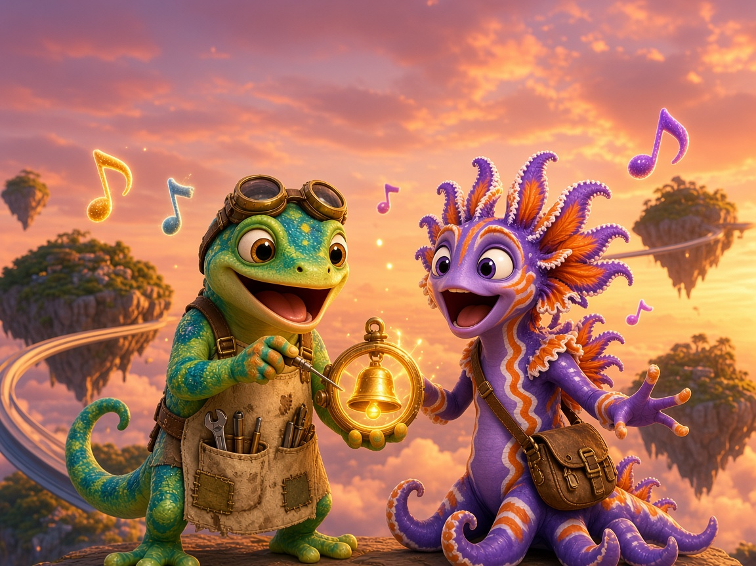
Day 1
Read It!
The king sang a long song.
Notes:
Read the sentence: finger under each word. Then Picture Match (S1).

Slide 20
Reflect 🌟 Your Turn!
Now try it on your own
in your Student Workbook 📘
Page 5 · Picture Match
✓ Find the chunk first ✓ Go slow
✓ Check your work ✓ Ask for help
Notes:
Independent practice (5-8 min). Students now do independent work.
SAY: 'Now try it on your own in your Student Workbook. Turn to Page 5 · Picture Match.'
Amount: 1-2 workbook pages, about 5-8 minutes. Read the directions together, do item 1 together, then students work alone.
TEACHER: circulate; listen to 2-3 students read their words aloud. Prompt with Power Moves (find the chunk, go slow, re-read). Do not correct for them; point and say 'Check that one.'
FINISH: each student shares one win and one Power Move they used, then ticks the Reflect Checklist (workbook page 6).
Not finished? It goes home as extra practice.

Slide 21
Day 1
Kudos 🏆
Day 1 done!
⭐ Color your map 🔥 Streak +1
Notes:
Celebrate (1 min): 'You completed Day 1!' Color Day 1 on the Progress Map, add 1 to the streak, name one Power Move you used. Celebrate effort, not speed.

Slide 22
Day 2 - Practice
Unit 3 · Lesson 3.1 · ng · Island Readers
Notes:
Day 2 - Practice. Divider slide: show while students get materials ready.

Slide 23
Day 2
Unit 3 · Lesson 3.1 · Day 2
Chunk Chains
Notes:
Day 2: Chunk Chains. Focus: Review chunks; word chains change one part at a time. Materials: Slides Day 2 · chunk cards · letter tiles s r h b k l t w · Missing Chunks page.
Get ready (2 min): packets out, start the class timer.

Slide 24
Day 2
Power-Up ⚡
ang
ing
ong
ung
king
song
Notes:
Movement break (3 min): 5 frill waves: wave both arms slowly over your head.
Then point to each tile; students say the sound or read the word (choral).

Slide 25
Day 2
Sound Card: ang
ang
🐍
fang
Bang! (it was just a pot)
🍳
Notes:
Meet the glue chunk ang.
I DO: 'This is ang. The vowel glues onto ng and we say it as one chunk: ang.' Touch your nose and feel the hum. Point to the picture: 'fang. I hear ang at the end: f … ang … fang.'
WE DO: Say ang together 3 times, then fang together while you sweep under the word.
YOU DO: Each child says ang, then reads fang alone.
ERROR FIX: If a child splits it ('a-n-g'), cover the word and say, 'Glued! My turn: ang. Your turn.' If they add a hard /g/ at the end, have them hold the nose hum and stop.

Slide 26
Day 2
Blend It
b
+
ang
=
bang
Notes:
I DO / WE DO: '/b/ … ang … bang!' Slide your hand under the chunk first, then sweep the whole word.

Slide 27
Day 2
Practice: ang ⚡
bang
sang
hang
rang
fang
gang
pang
tang
Glue chunk: ang
Notes:
Practice: -ang words only.
I DO: Point to the colored chunk. 'This is ang. It is glued: we say it together, never split it.' Read sang slowly: front sound, then ang, then the whole word.
WE DO: Read every word together: tap the front sound, swipe under the ang chunk, then read the whole word.
YOU DO: Each child reads 2 words alone. Then partners take turns reading the row.
ERROR FIX: If a child says 'sing', point and say, 'My turn: sang. Your turn.' Have them cover the front sound, say 'ang', then add it back and re-read.

Slide 28
Day 2
More ang! 🦎
clang
slang
sprang
bang
hang
rang
fang
Glue chunk: ang
Notes:
Practice: -ang words only.
I DO: Point to the colored chunk. 'This is ang. It is glued: we say it together, never split it.' Read clang slowly: front sound, then ang, then the whole word.
WE DO: Read every word together: tap the front sound, swipe under the ang chunk, then read the whole word.
YOU DO: Each child reads 2 words alone. Then partners take turns reading the row.
ERROR FIX: If a child says 'clan', point and say, 'My turn: clang. Your turn.' Have them cover the front sound, say 'ang', then add it back and re-read.

Slide 29
Day 2
Sound Card: ing
ing
💍
ring
My ring is on my tail!
Notes:
Meet the glue chunk ing.
I DO: 'This is ing. The vowel glues onto ng and we say it as one chunk: ing.' Touch your nose and feel the hum. Point to the picture: 'ring. I hear ing at the end: r … ing … ring.'
WE DO: Say ing together 3 times, then ring together while you sweep under the word.
YOU DO: Each child says ing, then reads ring alone.
ERROR FIX: If a child splits it ('i-n-g'), cover the word and say, 'Glued! My turn: ing. Your turn.' If they add a hard /g/ at the end, have them hold the nose hum and stop.

Slide 30
Day 2
Practice: ing ⚡
ring
sing
king
wing
thing
ding
zing
ping
Glue chunk: ing
Notes:
Practice: -ing words only.
I DO: Point to the colored chunk. 'This is ing. It is glued: we say it together, never split it.' Read king slowly: front sound, then ing, then the whole word.
WE DO: Read every word together: tap the front sound, swipe under the ing chunk, then read the whole word.
YOU DO: Each child reads 2 words alone. Then partners take turns reading the row.
ERROR FIX: If a child says 'kin-g', point and say, 'My turn: king. Your turn.' Have them cover the front sound, say 'ing', then add it back and re-read.

Slide 31
Day 2
More ing! 🦎
sting
bring
swing
cling
fling
sling
string
spring
Glue chunk: ing
Notes:
Practice: -ing words only.
I DO: Point to the colored chunk. 'This is ing. It is glued: we say it together, never split it.' Read swing slowly: front sound, then ing, then the whole word.
WE DO: Read every word together: tap the front sound, swipe under the ing chunk, then read the whole word.
YOU DO: Each child reads 2 words alone. Then partners take turns reading the row.
ERROR FIX: If a child says 'swin', point and say, 'My turn: swing. Your turn.' Have them cover the front sound, say 'ing', then add it back and re-read.

Slide 32
Day 2
Sound Card: ong
ong
🔔
gong
Ding dong! Is it lunch?
🔔
Notes:
Meet the glue chunk ong.
I DO: 'This is ong. The vowel glues onto ng and we say it as one chunk: ong.' Touch your nose and feel the hum. Point to the picture: 'gong. I hear ong at the end: g … ong … gong.'
WE DO: Say ong together 3 times, then gong together while you sweep under the word.
YOU DO: Each child says ong, then reads gong alone.
ERROR FIX: If a child splits it ('o-n-g'), cover the word and say, 'Glued! My turn: ong. Your turn.' If they add a hard /g/ at the end, have them hold the nose hum and stop.

Slide 33
Day 2
Practice: ong ⚡
long
song
gong
bong
dong
prong
strong
along
Glue chunk: ong
Notes:
Practice: -ong words only.
I DO: Point to the colored chunk. 'This is ong. It is glued: we say it together, never split it.' Read song slowly: front sound, then ong, then the whole word.
WE DO: Read every word together: tap the front sound, swipe under the ong chunk, then read the whole word.
YOU DO: Each child reads 2 words alone. Then partners take turns reading the row.
ERROR FIX: If a child says 'sing', point and say, 'My turn: song. Your turn.' Have them cover the front sound, say 'ong', then add it back and re-read.

Slide 34
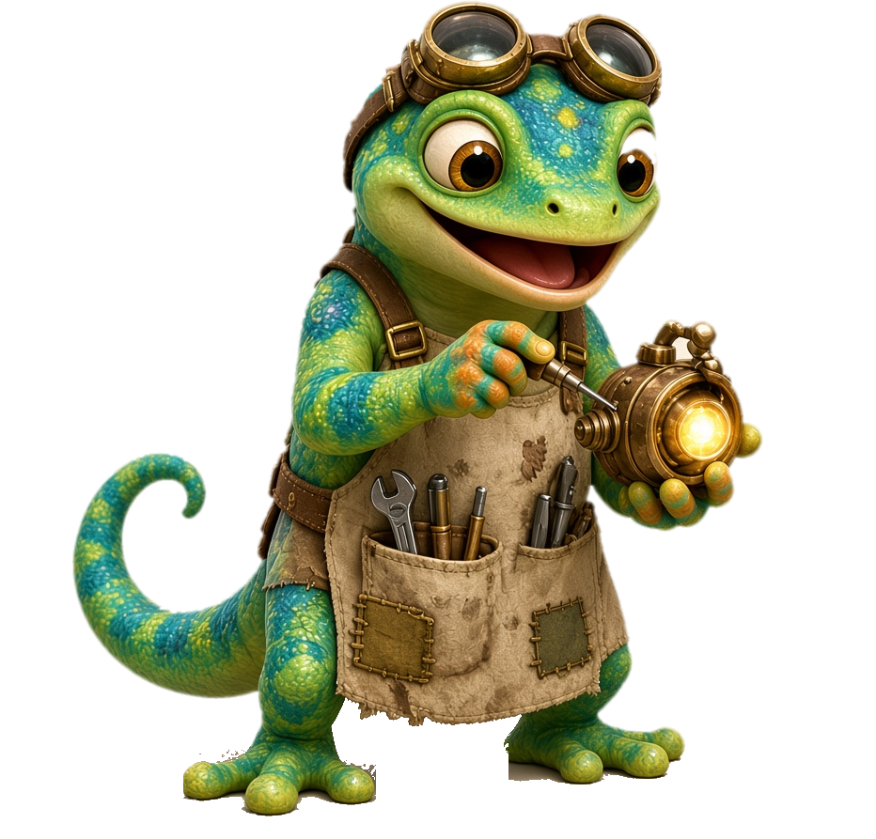
Day 2
Sound Card: ung
ung
🫁
lung
I hung from a vine!
Notes:
Meet the glue chunk ung.
I DO: 'This is ung. The vowel glues onto ng and we say it as one chunk: ung.' Touch your nose and feel the hum. Point to the picture: 'lung. I hear ung at the end: l … ung … lung.'
WE DO: Say ung together 3 times, then lung together while you sweep under the word.
YOU DO: Each child says ung, then reads lung alone.
ERROR FIX: If a child splits it ('u-n-g'), cover the word and say, 'Glued! My turn: ung. Your turn.' If they add a hard /g/ at the end, have them hold the nose hum and stop.

Slide 35
Day 2
Practice: ung ⚡
hung
lung
rung
sung
stung
slung
strung
sprung
Glue chunk: ung
Notes:
Practice: -ung words only.
I DO: Point to the colored chunk. 'This is ung. It is glued: we say it together, never split it.' Read sung slowly: front sound, then ung, then the whole word.
WE DO: Read every word together: tap the front sound, swipe under the ung chunk, then read the whole word.
YOU DO: Each child reads 2 words alone. Then partners take turns reading the row.
ERROR FIX: If a child says 'sing', point and say, 'My turn: sung. Your turn.' Have them cover the front sound, say 'ung', then add it back and re-read.

Slide 36
Day 2
Mixed Practice: We Do 🤝
clang
bring
strong
stung
sling
prong
Notes:
WE DO (choral, then partners): 'Find the glue chunk first. Then add the front sound. b-r … ing … bring!' Pre-correct before choral reading.

Slide 37
Day 2
Mixed Practice: You Do 🦎
fang
spring
prong
swung
sang
lung
A king sang to a gong?!
Notes:
YOU DO: students whisper-read each word, then read to a partner. Circulate and listen to 4–5 students.

Slide 38
Day 2
Heart Words ❤️ Comic Part 1
I
to
what
is
❤
❤
❤
❤
no
a
❤
❤
See it · Say it · Spell it · Say it again
Notes:
Heart Words for Comic Part 1 (2 min). These words are in today's comic part and have a tricky part we must learn by heart: I, to, what, is, no, a.
For each word: SEE IT (point), SAY IT (students repeat), SPELL IT (say each letter while tapping), SAY IT AGAIN.
HEART: point to the tricky part and draw a heart over it (e.g. the o in 'of' says /u/; the a in 'what' and 'was' says /u/ or /o/; 'I' and 'a' are one-letter words). 'The rest of the word follows the rules; the heart part we just have to know.'
Quick flash: point to words out of order; students read them fast. Then go straight to the comic.

Slide 39
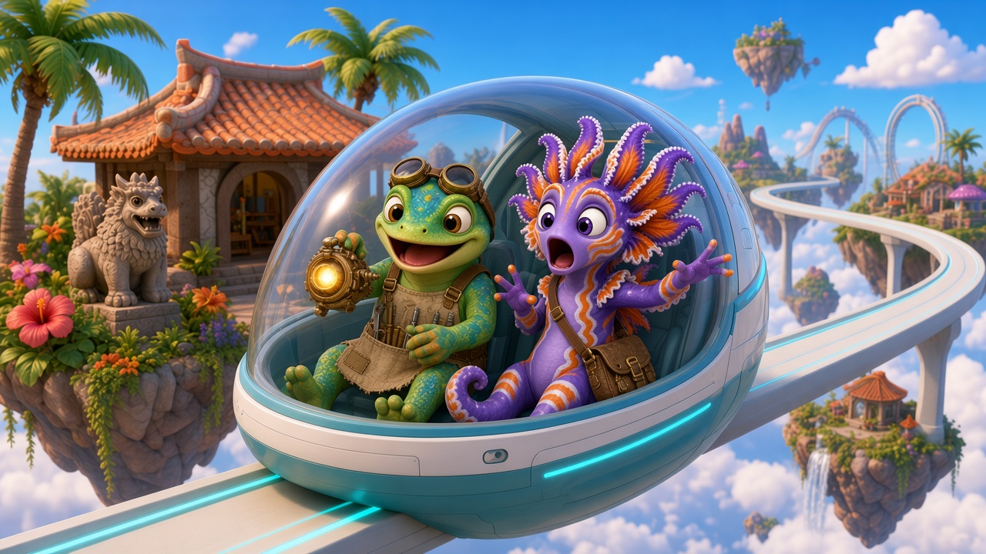
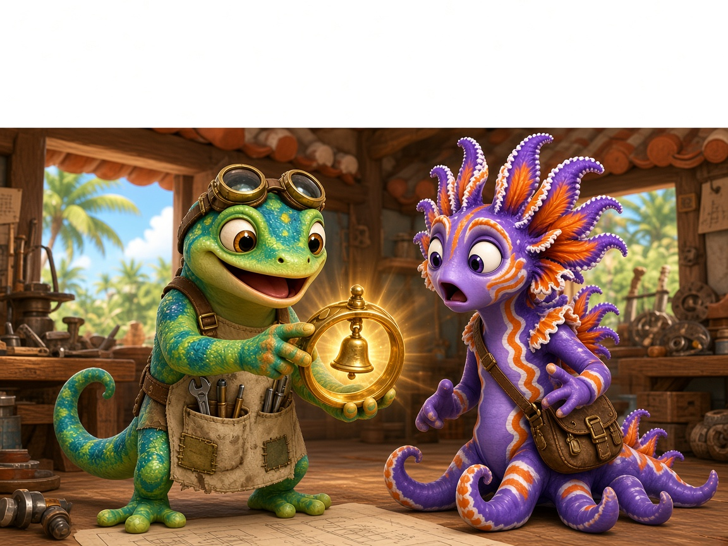
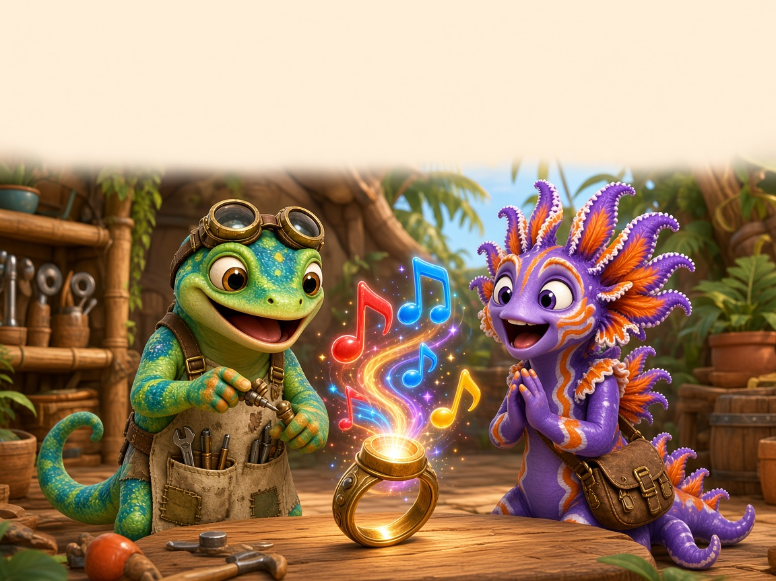
Day 2
Comic Part 1: Zip and the Ring Thing 📖
Zip: Frill! I got a thing to bring!
Frill: What thing?
Zip: It is a Ring Thing. It can sing!
Frill: No! A thing can not sing!
Ding! Dong! Ding!
Frill: It sang a song!
Read it 3 times: ⭐ 1 ⭐ 2 ⭐ 3
Notes:
Comic Part 1 (panels 1–3), repeated reading 3x.
READ 1 (I do): Teacher reads, students track with a finger. Point out the ng words.
READ 2 (we do): Choral read. Frill's lines one group, Zip's lines the other.
READ 3 (you do): Partner read with expression; swap roles. Color a star after each read.
ERROR FIX: Stop at a missed ng word, cover the front sound, read the chunk, then the word, then re-read the whole sentence.
Comic text: Zip: Frill! I got a thing to bring! Frill: What thing? | Zip: It is a Ring Thing. It can sing! Frill: No! A thing can not sing! | Ding! Dong! Ding! Frill: It sang a song!
COMIC PLAN: Read this part on the day it is assigned, 2-3 reads: (1) teacher models, (2) choral read, (3) each student reads alone or to a partner.

Slide 40
Reflect 🌟 Your Turn!
Now try it on your own
in your Student Workbook 📘
Page 8 · Missing Chunks
✓ Find the chunk first ✓ Go slow
✓ Check your work ✓ Ask for help
Notes:
Independent practice (5-8 min). Students now do independent work.
SAY: 'Now try it on your own in your Student Workbook. Turn to Page 8 · Missing Chunks.'
Amount: 1-2 workbook pages, about 5-8 minutes. Read the directions together, do item 1 together, then students work alone.
TEACHER: circulate; listen to 2-3 students read their words aloud. Prompt with Power Moves (find the chunk, go slow, re-read). Do not correct for them; point and say 'Check that one.'
FINISH: each student shares one win and one Power Move they used, then ticks the Reflect Checklist (workbook page 6).
Not finished? It goes home as extra practice.

Slide 41
Day 2
Kudos 🏆
Day 2 done!
⭐ Color your map 🔥 Streak +1
Notes:
Celebrate (1 min): 'You completed Day 2!' Color Day 2 on the Progress Map, add 1 to the streak, name one Power Move you used. Celebrate effort, not speed.

Slide 42
Day 3 - Build
Unit 3 · Lesson 3.1 · ng · Island Readers
Notes:
Day 3 - Build. Divider slide: show while students get materials ready.

Slide 43
Day 3
Unit 3 · Lesson 3.1 · Day 3
Read & Draw + Heart Words
Notes:
Day 3: Read &amp; Draw + Heart Words. Focus: Read ng words in sentences; heart words of, to, was, said, what. Materials: Slides Day 3 · heart word cards · Read &amp; Draw page · crayons.
Get ready (2 min): packets out, start the class timer.

Slide 44
Day 3
Power-Up ⚡
sing
sang
song
sung
hung
king
Notes:
Movement break (3 min): Zip’s gadget squeeze: squeeze fists for 3, relax for 3. Do it 3 times.
Then point to each tile; students say the sound or read the word (choral).

Slide 45
Day 3
Blend It
l
+
ong
=
long
Notes:
I DO / WE DO: '/l/ … ong … long!' Slide your hand under the chunk first, then sweep the whole word.

Slide 46
Day 3
Practice: ong ⚡
long
song
gong
dong
strong
prong
tong
pong
Glue chunk: ong
Notes:
Practice: -ong words only.
I DO: Point to the colored chunk. 'This is ong. It is glued: we say it together, never split it.' Read song slowly: front sound, then ong, then the whole word.
WE DO: Read every word together: tap the front sound, swipe under the ong chunk, then read the whole word.
YOU DO: Each child reads 2 words alone. Then partners take turns reading the row.
ERROR FIX: If a child says 'sung', point and say, 'My turn: song. Your turn.' Have them cover the front sound, say 'ong', then add it back and re-read.

Slide 47
Day 3
Blend It
h
+
ung
=
hung
Notes:
I DO / WE DO: '/h/ … ung … hung!' Slide your hand under the chunk first, then sweep the whole word.

Slide 48
Day 3
Practice: ung ⚡
sung
hung
rung
lung
stung
clung
flung
swung
Glue chunk: ung
Notes:
Practice: -ung words only.
I DO: Point to the colored chunk. 'This is ung. It is glued: we say it together, never split it.' Read hung slowly: front sound, then ung, then the whole word.
WE DO: Read every word together: tap the front sound, swipe under the ung chunk, then read the whole word.
YOU DO: Each child reads 2 words alone. Then partners take turns reading the row.
ERROR FIX: If a child says 'hang', point and say, 'My turn: hung. Your turn.' Have them cover the front sound, say 'ung', then add it back and re-read.

Slide 49
Day 3
Chunk Dictation ✏️
ang
ing
ong
ung
I say a word. You say it.
You write the glued chunk!
Notes:
Encoding 1: chunk dictation.
I DO: 'I say a word, I listen for the end chunk. hung… I hear ung. I write u-n-g.'
WE DO: Say: song, wing, bang, lung. Students repeat the word, finger-tap, name the chunk and point to it on the slide.
YOU DO: Say: long, sting, rung, fang, gong, cling. Students write ONLY the chunk on whiteboards; show on 'Show me!'.
ERROR FIX: If they write 'n' alone, say 'Feel the nose hum: that is ng, two letters glued.' Re-say the word slowly, then rewrite.

Slide 50
Day 3
Word Dictation ✏️
1. ____________
2. ____________
3. ____________
4. ____________
5. ____________
6. ____________
Notes:
Encoding 2: whole words (say, tap, write, check).
I DO: Model 'king': say it, tap k-ing, write k + ing, check.
WE DO: 'sang', 'hung'.
YOU DO: Dictate: 1 long 2 ring 3 sung 4 bang 5 strong 6 swing. Reveal each and students self-check with a tick or fix.
ERROR FIX: Wrong vowel (sing/sang): say both words, ask 'Which vowel do you hear?' Fix only the vowel.

Slide 51
Day 3
Sentence Dictation ✏️
_____ _____ _____ _ _____ _____ .
✔ Capital ✔ Spaces ✔ Period
Check: The king sang a long song.
Notes:
Encoding 3: sentence dictation.
Say: 'The king sang a long song.' Students repeat it twice, count the words on fingers (6), then write. Remind: capital letter, finger spaces, period.
Check together by revealing the sentence (click the box). Heart words: the, a.
ERROR FIX: Missing word? Re-say the sentence and point to each word line.

Slide 52
Day 3
Quick Check ✅
thing
swing
strong
✓ or ✗
Notes:
QUICK CHECK: 3 students, one word each.

Slide 53
Reflect 🌟 Your Turn!
Now try it on your own
in your Student Workbook 📘
Page 10 · Read & Draw
✓ Find the chunk first ✓ Go slow
✓ Check your work ✓ Ask for help
Notes:
Independent practice (5-8 min). Students now do independent work.
SAY: 'Now try it on your own in your Student Workbook. Turn to Page 10 · Read & Draw.'
Amount: 1-2 workbook pages, about 5-8 minutes. Read the directions together, do item 1 together, then students work alone.
TEACHER: circulate; listen to 2-3 students read their words aloud. Prompt with Power Moves (find the chunk, go slow, re-read). Do not correct for them; point and say 'Check that one.'
FINISH: each student shares one win and one Power Move they used, then ticks the Reflect Checklist (workbook page 6).
Not finished? It goes home as extra practice.

Slide 54
Day 3
Kudos 🏆
Day 3 done!
⭐ Color your map 🔥 Streak +1
Notes:
Celebrate (1 min): 'You completed Day 3!' Color Day 3 on the Progress Map, add 1 to the streak, name one Power Move you used. Celebrate effort, not speed.

Slide 55
Day 4 - Mix
Unit 3 · Lesson 3.1 · ng · Island Readers
Notes:
Day 4 - Mix. Divider slide: show while students get materials ready.

Slide 56
Day 4
Power-Up ⚡
rang
ring
rung
long
lung
sting
Notes:
Movement break (3 min): Stretch up to the sky like a palm tree, then sway 5 times.
Then point to each tile; students say the sound or read the word (choral).

Slide 57
Day 4
Mix It Up! 🏝️
strong
clung
swing
clang
rung
thing
long
sprang
Glue chunk: ang · ing · ong · ung
Mix it! Shake it!
Notes:
Mixed practice: ang, ing, ong, ung.
I DO: 'Now the chunks are mixed up! I find the glue chunk first, then I read.' Model the first word.
WE DO: Read each word together: name the chunk (ang/ing/ong/ung), then read the word.
YOU DO: Children read the words in a random order you point to. Fast finishers sort them by chunk.
ERROR FIX: If a child swaps vowels (sang→sung), point to the vowel: 'What sound is a? ... ang. Now read it.' Then re-read the word.

Slide 58
Day 4
Island Sort 🏝️
ang
ing
ong
ung
song
hung
bang
king
long
sang
lung
ring
Notes:
I DO: sort 2 words aloud ('song … ong … ong island'). WE DO: students say which island for the rest. Then Word Sort page (S4).

Slide 59
Day 4
Phrase Strips 1 🚝
a long song
sing a song
a king and a ring
bang the gong
Notes:
Phrase strips (fluency in chunks).
I DO: Read each phrase smoothly, sweeping a finger under it: 'I read it like I talk.'
WE DO: Echo read each phrase, then choral read.
YOU DO: Partners read all 4 phrases twice; second time faster and smoother.
ERROR FIX: Choppy word-by-word reading: model the phrase in one breath, then 'My turn, your turn.'

Slide 60
Day 4
Phrase Strips 2 🚝
hung on a string
a strong lung
a bug stung
a wing and a fang
Notes:
Phrase strips (fluency in chunks).
I DO: Read each phrase smoothly, sweeping a finger under it: 'I read it like I talk.'
WE DO: Echo read each phrase, then choral read.
YOU DO: Partners read all 4 phrases twice; second time faster and smoother.
ERROR FIX: Choppy word-by-word reading: model the phrase in one breath, then 'My turn, your turn.'

Slide 61
Day 4
Heart Words ❤️ Comic Part 2
I
of
is
the
❤
❤
❤
❤
a
❤
See it · Say it · Spell it · Say it again
Notes:
Heart Words for Comic Part 2 (2 min). These words are in today's comic part and have a tricky part we must learn by heart: I, of, is, the, a.
For each word: SEE IT (point), SAY IT (students repeat), SPELL IT (say each letter while tapping), SAY IT AGAIN.
HEART: point to the tricky part and draw a heart over it (e.g. the o in 'of' says /u/; the a in 'what' and 'was' says /u/ or /o/; 'I' and 'a' are one-letter words). 'The rest of the word follows the rules; the heart part we just have to know.'
Quick flash: point to words out of order; students read them fast. Then go straight to the comic.

Slide 62
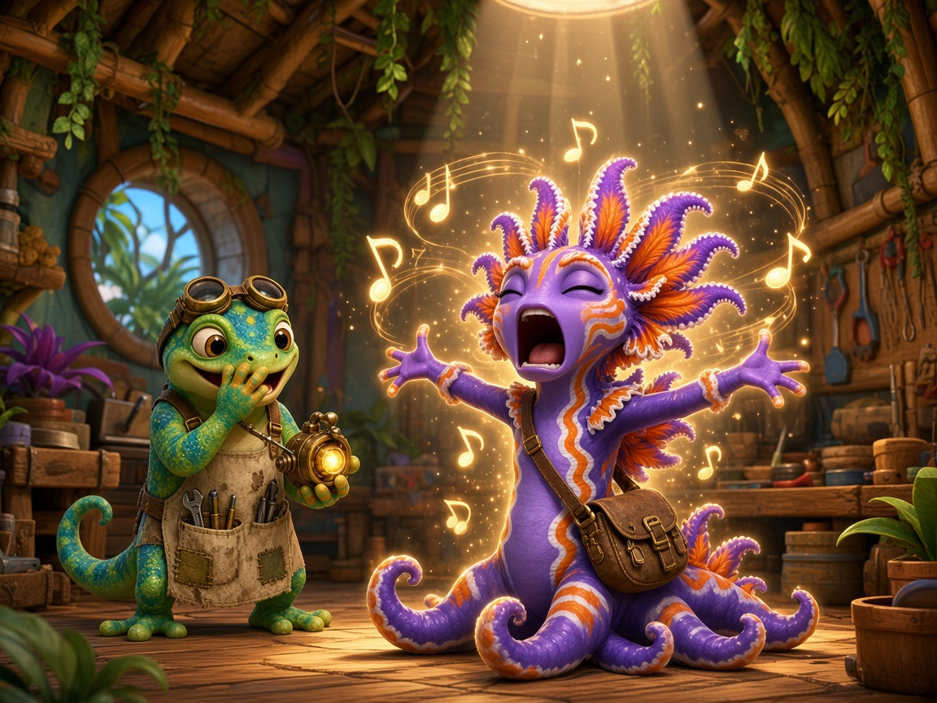
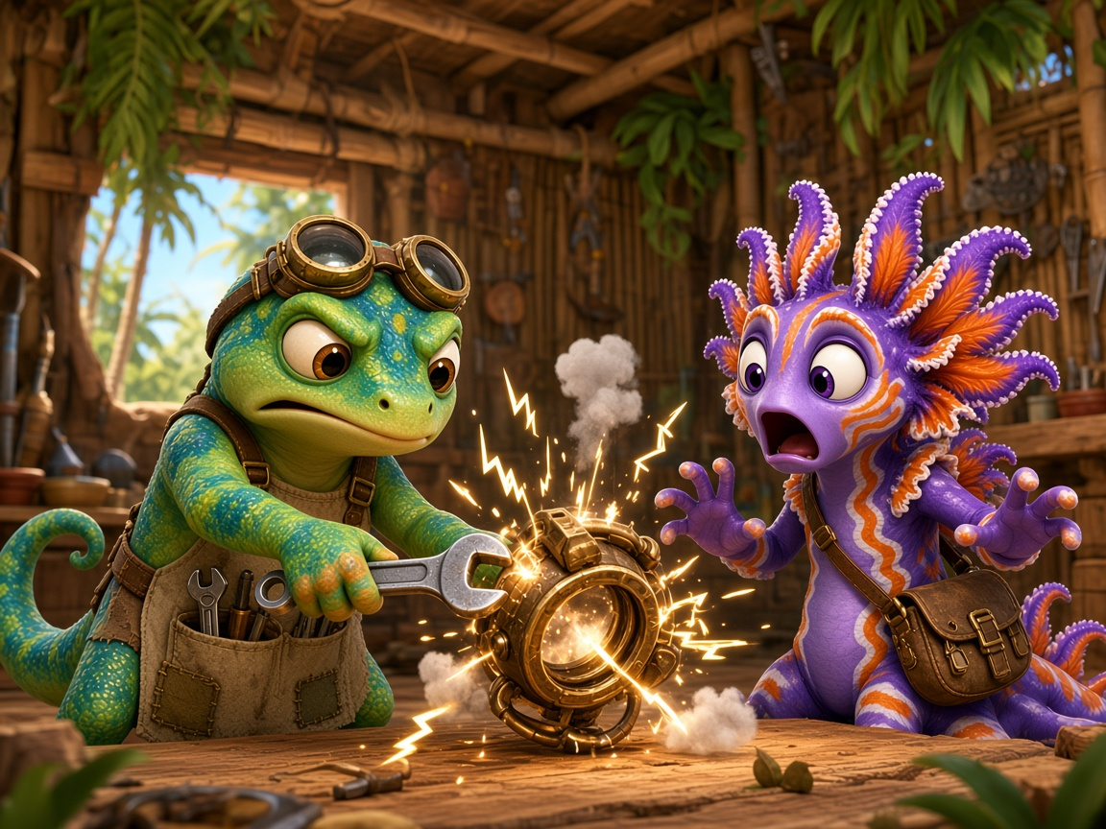
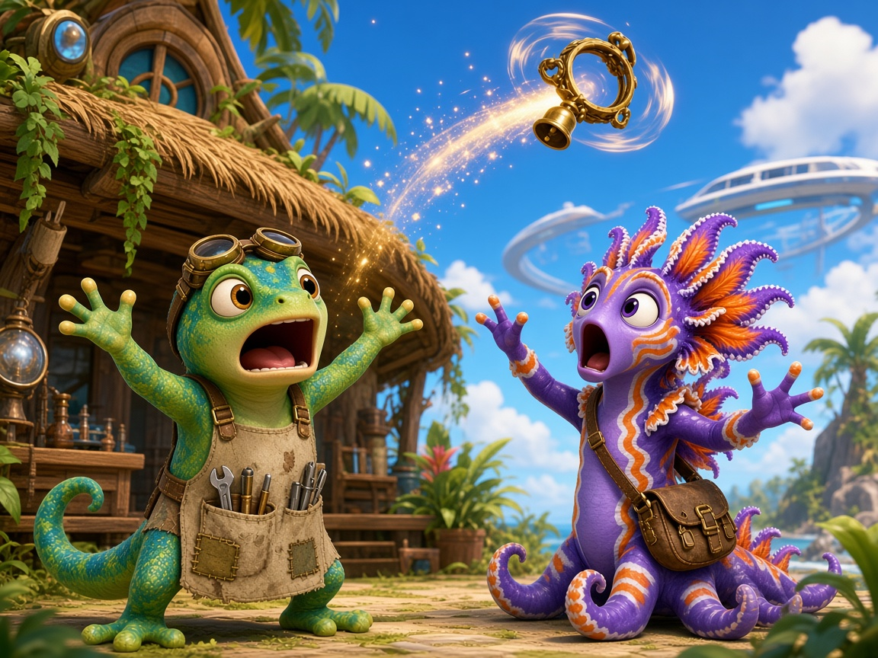
Day 4
Comic Part 2: Zip and the Ring Thing 📖
Zip: That is a lot of song!
Frill: I will sing with it! A long, long song!
Zip: It is stuck on a bad song!
Frill: Zip! Fix it!
Bang! Bong! Clang!
Zip: It flung off!
Frill: The Ring Thing is up, up, up! Zing!
Read it 3 times: ⭐ 1 ⭐ 2 ⭐ 3
Notes:
Comic Part 2 (panels 4–6), repeated reading 3x.
READ 1 (I do): Teacher reads, students track with a finger. Point out the ng words.
READ 2 (we do): Choral read. Frill's lines one group, Zip's lines the other.
READ 3 (you do): Partner read with expression; swap roles. Color a star after each read.
ERROR FIX: Stop at a missed ng word, cover the front sound, read the chunk, then the word, then re-read the whole sentence.
Comic text: Zip: That is a lot of song! Frill: I will sing with it! A long, long song! | Zip: It is stuck on a bad song! Frill: Zip! Fix it! Bang! Bong! Clang! | Zip: It flung off! Frill: The Ring Thing is up, up, up! Zing!
COMIC PLAN: Read this part on the day it is assigned, 2-3 reads: (1) teacher models, (2) choral read, (3) each student reads alone or to a partner.

Slide 63
Reflect 🌟 Your Turn!
Now try it on your own
in your Student Workbook 📘
Page 11 · Word Sort
✓ Find the chunk first ✓ Go slow
✓ Check your work ✓ Ask for help
Notes:
Independent practice (5-8 min). Students now do independent work.
SAY: 'Now try it on your own in your Student Workbook. Turn to Page 11 · Word Sort.'
Amount: 1-2 workbook pages, about 5-8 minutes. Read the directions together, do item 1 together, then students work alone.
TEACHER: circulate; listen to 2-3 students read their words aloud. Prompt with Power Moves (find the chunk, go slow, re-read). Do not correct for them; point and say 'Check that one.'
FINISH: each student shares one win and one Power Move they used, then ticks the Reflect Checklist (workbook page 6).
Not finished? It goes home as extra practice.

Slide 64
Day 4
Kudos 🏆
Day 4 done!
⭐ Color your map 🔥 Streak +1
Notes:
Celebrate (1 min): 'You completed Day 4!' Color Day 4 on the Progress Map, add 1 to the streak, name one Power Move you used. Celebrate effort, not speed.

Slide 65
Day 5 - Show What You Know
Unit 3 · Lesson 3.1 · ng · Island Readers
Notes:
Day 5 - Show What You Know. Divider slide: show while students get materials ready.

Slide 66
Day 5
Unit 3 · Lesson 3.1 · Day 5
Re-read, Check & Celebrate
Notes:
Day 5: Re-read, Check &amp; Celebrate. Focus: Fluency re-read; 10-item check; progress map. Materials: Slides Day 5 · Story page · Lesson 3.1 Check (one per child) · class record sheet · Progress Map.
Get ready (2 min): packets out, start the class timer.

Slide 67
Day 5
Power-Up ⚡
thing
strong
swing
fang
gong
hung
Notes:
Movement break (3 min): 3 sea breaths, then a silent cheer.
Then point to each tile; students say the sound or read the word (choral).

Slide 68
Day 5
Speed Run ⏱️ 1 minute
sing
bang
long
hung
king
rang
song
lung
wing
fang
gong
rung
thing
sang
strong
stung
ring
hang
dong
clung
Notes:
1-minute speed run.
I DO: Model reading row 1 smoothly (not racing).
YOU DO: Start a 1-minute timer. Students read rows left to right, then start again at the top. Mark the last word read. Record the score in the Power Level chart.
Try 2: Re-read to beat your own score (personal best, never compare with others).
ERROR FIX: Teacher points to a missed word, says it, student repeats and keeps going.
Today the comic is read as a whole: after Part 3, students re-read Parts 1-3 together for fluency.

Slide 69
Day 5
Heart Words ❤️ Comic Part 3
go
I
you
was
❤
❤
❤
❤
the
what
a
❤
❤
❤
See it · Say it · Spell it · Say it again
Notes:
Heart Words for Comic Part 3 (2 min). These words are in today's comic part and have a tricky part we must learn by heart: go, I, you, was, the, what, a.
For each word: SEE IT (point), SAY IT (students repeat), SPELL IT (say each letter while tapping), SAY IT AGAIN.
HEART: point to the tricky part and draw a heart over it (e.g. the o in 'of' says /u/; the a in 'what' and 'was' says /u/ or /o/; 'I' and 'a' are one-letter words). 'The rest of the word follows the rules; the heart part we just have to know.'
Quick flash: point to words out of order; students read them fast. Then go straight to the comic.

Slide 70
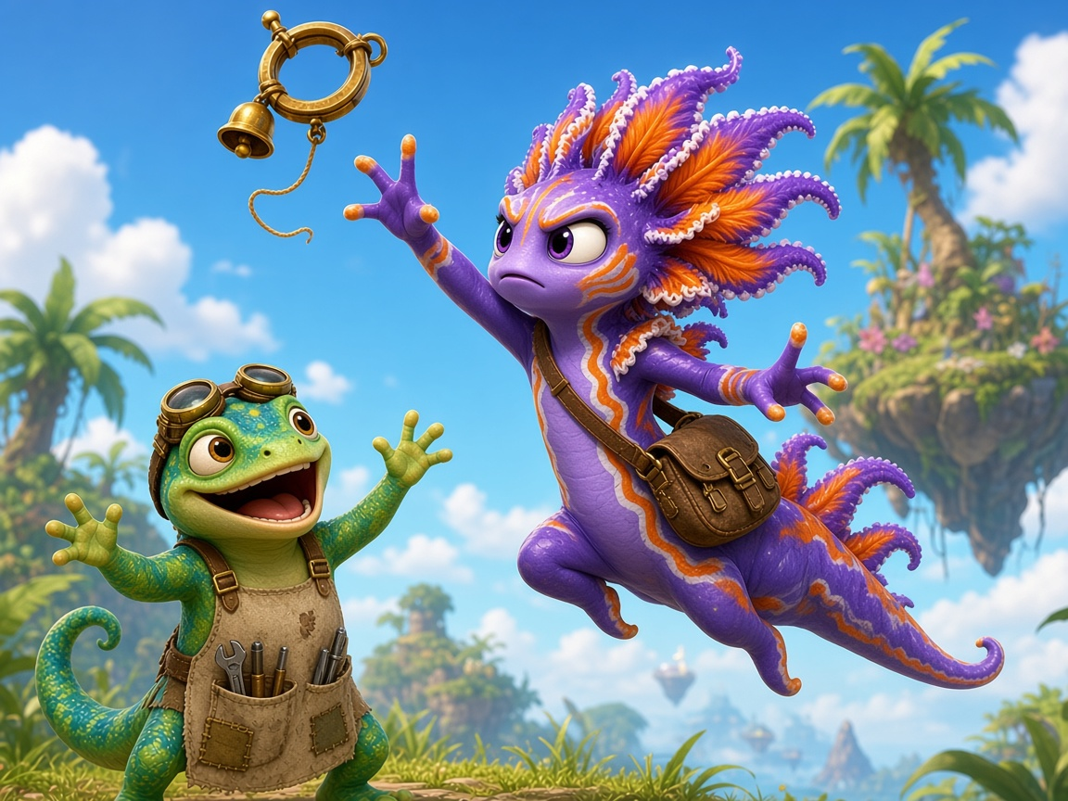
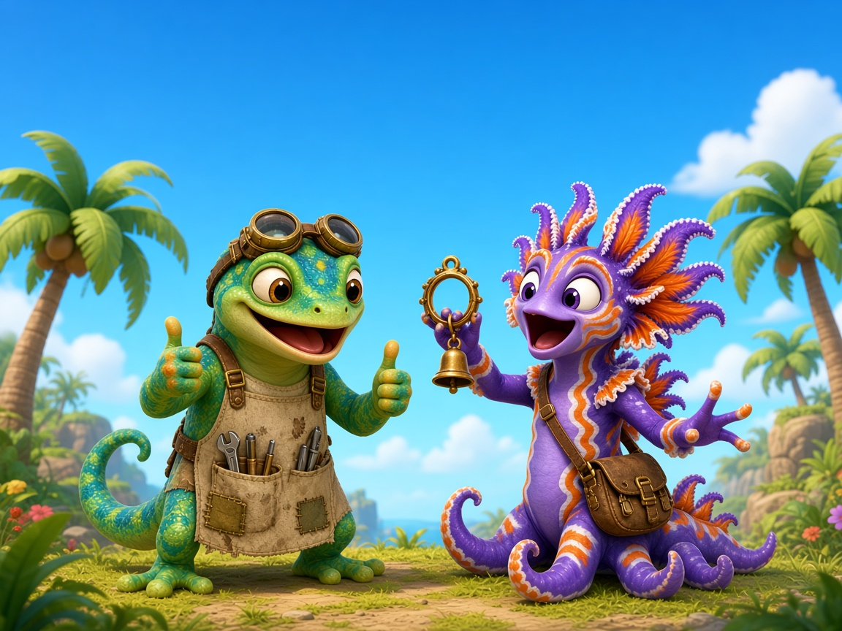
Day 5
Comic Part 3: Zip and the Ring Thing 📖
Zip: Go, Frill!
Frill: I am long! I can get it!
Zip: You did it, Frill! That was strong!
Frill: I got the string!
Zip: Ding, dong! Sing a song!
Frill: What a fun thing!
Read it 3 times: ⭐ 1 ⭐ 2 ⭐ 3
Notes:
Comic Part 3 (panels 7–9), repeated reading 3x.
READ 1 (I do): Teacher reads, students track with a finger. Point out the ng words.
READ 2 (we do): Choral read. Frill's lines one group, Zip's lines the other.
READ 3 (you do): Partner read with expression; swap roles. Color a star after each read.
ERROR FIX: Stop at a missed ng word, cover the front sound, read the chunk, then the word, then re-read the whole sentence.
Comic text: Zip: Go, Frill! Frill: I am long! I can get it! | Zip: You did it, Frill! That was strong! Frill: I got the string! | Zip: Ding, dong! Sing a song! Frill: What a fun thing!
COMIC PLAN: Read this part on the day it is assigned, 2-3 reads: (1) teacher models, (2) choral read, (3) each student reads alone or to a partner.
DAY 5: After Part 3, read ALL THREE parts in a row for the speed run / fluency re-read.

Slide 71
Day 5
10-Word Check ✅
Check time!
Get your check page.
Read 10 words to your teacher.
Do your best!
Notes:
10-item check (6 Check folder: check page in unit_ng.pdf).
One-to-one: student reads each word; mark ✓ or ✗. No help, no hints. Items: 1 sing 2 bang 3 long 4 hung 5 king 6 strong 7 wing 8 rang 9 song 10 lung.
8+/10 = ready for nk. 6–7 = reteach with the practice slides. Under 6 = small group re-do Days 2–3.
The rest of the class re-reads the comic with partners.

Slide 72
Day 5
Show What You Know 🏆
king
song
hung
ring
Find the glue chunk. Then read!
Notes:
UNIT CHECK: one-to-one with the S6 page. No prompting. 9–10 move on to nk · 7–8 review 2–3 days · 6 or below re-teach.

Slide 73
Reflect 🌟 Your Turn!
Now try it on your own
in your Student Workbook 📘
Page 21 · Bonus Quests (pick 1)
✓ Find the chunk first ✓ Go slow
✓ Check your work ✓ Ask for help
Notes:
Independent practice (5-8 min). Students now do independent work.
SAY: 'Now try it on your own in your Student Workbook. Turn to Page 21 · Bonus Quests (pick 1).'
Amount: 1-2 workbook pages, about 5-8 minutes. Read the directions together, do item 1 together, then students work alone.
TEACHER: circulate; listen to 2-3 students read their words aloud. Prompt with Power Moves (find the chunk, go slow, re-read). Do not correct for them; point and say 'Check that one.'
FINISH: each student shares one win and one Power Move they used, then ticks the Reflect Checklist (workbook page 6).
Not finished? It goes home as extra practice.

Slide 74
Day 5
Song Island: done! 🎉
Notes:
CELEBRATE: everyone colors the last star on the map. Name the effort, not the score: 'You found the chunk every time!'

