Slide 1
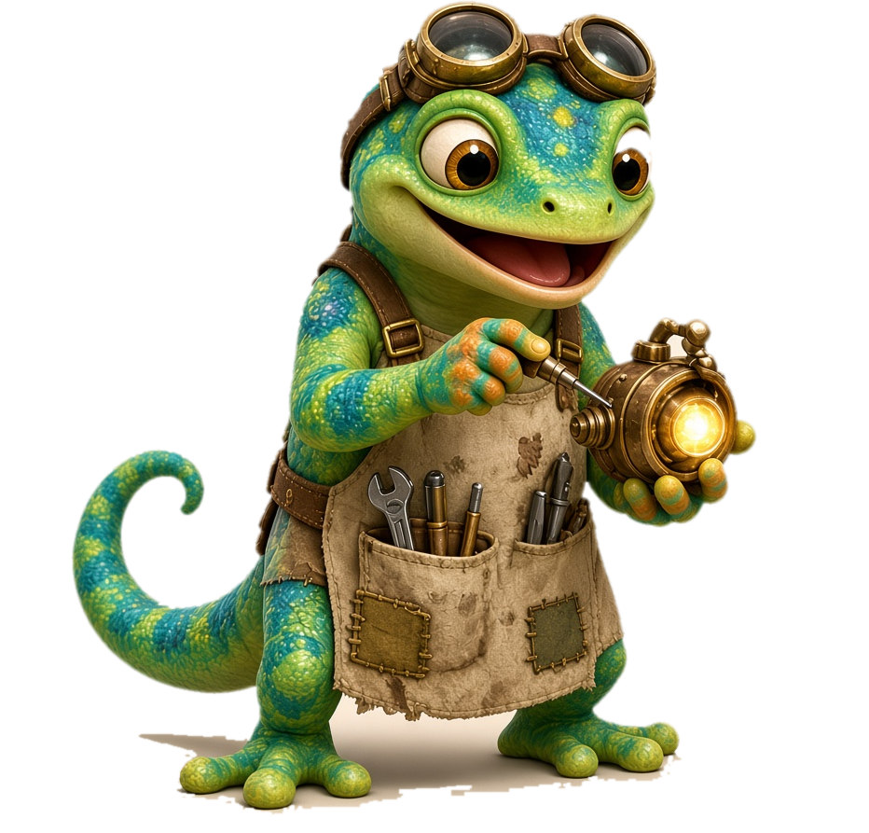
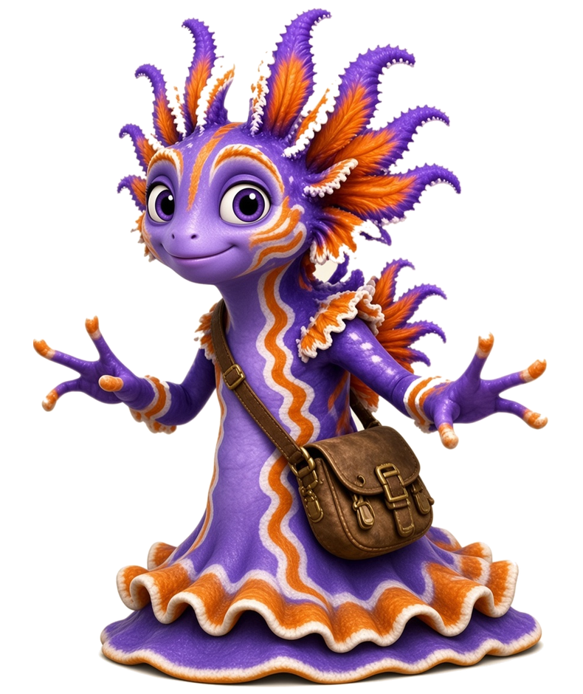
Day 1 - Meet nk
Unit 3 · Lesson 3.2 · nk · Island Readers
Notes:
Day 1 · Meet nk. Show this slide while students get ready: booklet (Lesson 3.2 · Day 1), whiteboard, marker.
Materials: nk sound card, chunk cards ink / ank / onk / unk, letter tiles, whiteboards.

Slide 2
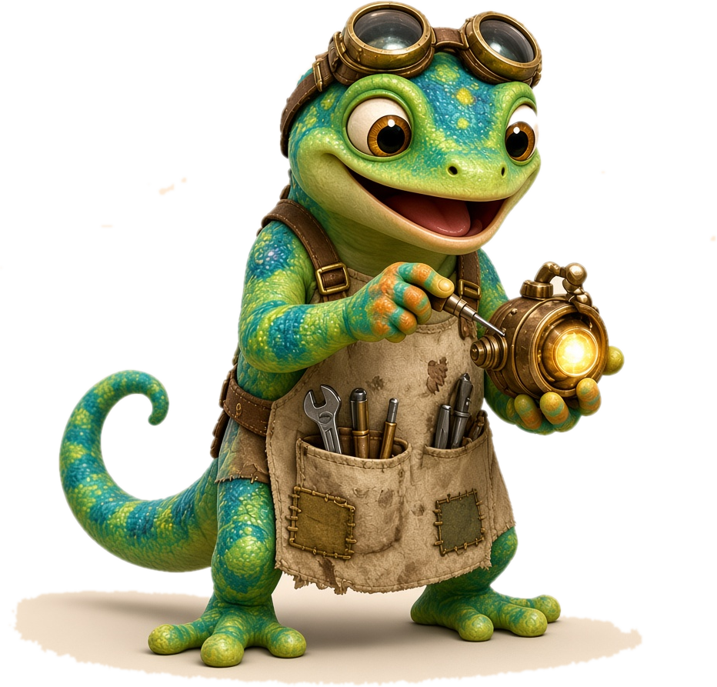
Day 1
Unit 3 · Lesson 3.2 · Day 1
Meet nk: ink ank onk unk
Notes:
GET READY (1 min). SAY: 'Today we meet a new team: n and k. Together they make nk. You will hear it in ink, ank, onk and unk.'
Goal for today: hear nk, read the four glued chunks, and read nk words.

Slide 3
Day 1
Meet Zip and Frill
Zip
Frill
Notes:
Meet our friends (30 sec). SAY: 'Zip the gecko and Frill are back! They will help us read nk words this week.'
Point to each name. Students read: Zip, Frill.

Slide 4
Day 1
Warm-Up ⚡ Digraph Review
Last lesson: ng! Two letters, one sound.
sh
ch
th / th
ck
wh
ng
ship
chip
thin
quiet th
duck
when
sing
shop
chin
this
buzzy th
sock
whip
long
Notes:
WARM-UP (3 min) · Review ng and our digraphs. Two letters, one sound.
I DO: point to each header and say the sound: /sh/, /ch/, /th/ (quiet and buzzy), /ck/, /wh/, /ng/.
WE DO: say each sound together, then read the two words under it.
YOU DO: call on students to read one column each.
ERROR FIX: if a child says each letter (s-h), cover one letter: 'Two letters, one sound: /sh/.' For ng: 'Back of the tongue up, hum in your nose.'

Slide 5
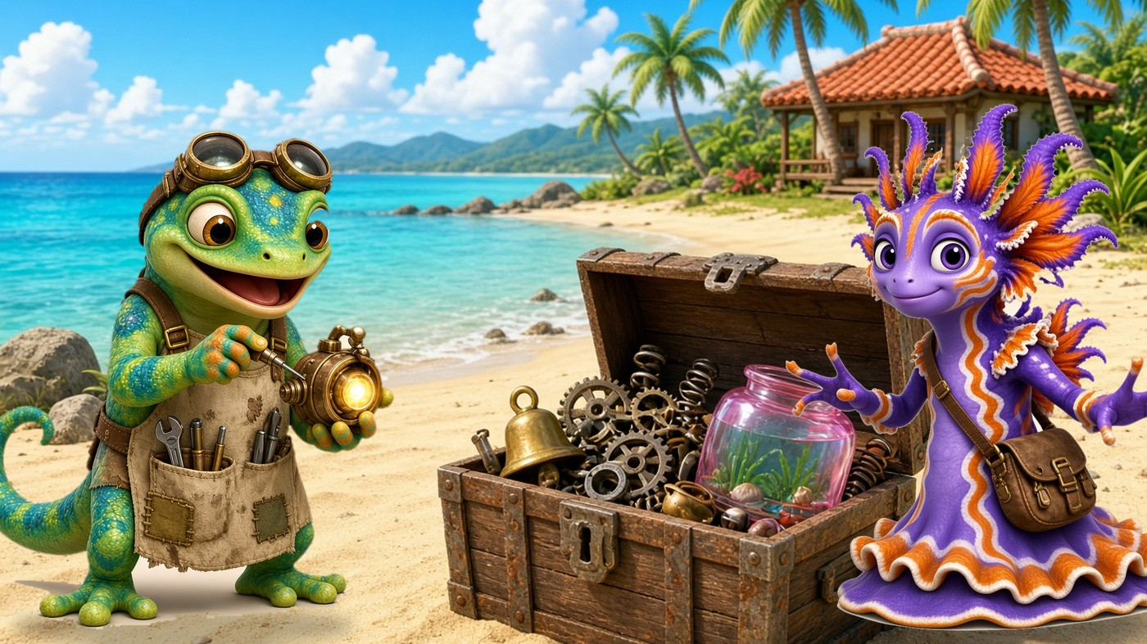
Day 1
Sound Card
nk
Notes:
I DO · Sound card (2 min). SAY: 'This is n and k: nk. When n sits in front of k, the n hums like ng. Then we add a quick /k/.'
Model: 'ng... k: nk.' Hold the hum, then a short click.
WE DO: say nk together 3 times. Hand on your throat: hum, then click.
ERROR FIX: if you hear a plain /n/ + /k/, say 'Back of the tongue goes up first, hum like ng, then /k/. My turn, your turn.'

Slide 6
Day 1
Zip's Sound Clue 🔍
n + k = nk
When n sits with k, the n hums like ng.
Hum ng, then a quick k: nk!
Notes:
Zip's Sound Clue (1 min). I DO: read the clue. 'n + k makes nk. The n hums like ng, then k pops at the end.'
WE DO: everyone says the clue: 'Hum ng, then a quick k: nk!'
ERROR FIX: if students say 'en-kay', smile and say 'Those are the letter names. Say the sound: nk.'

Slide 7
Day 1
Vowel + nk 🔍
i a o u + nk
When you put a vowel in front of nk,
it makes a glued sound!
Notes:
I DO · Vowel + nk (1-2 min). SAY: 'nk almost always has a vowel in front. The vowel and nk stick together like glue. We say them as one chunk.'
Point to i, a, o, u. 'These vowels will be our four glued sounds.'
WE DO: students say 'Vowel in front: glued sound!' and clap once.
ERROR FIX: if a child starts reading words, say 'Sounds only for now. Words come next!'

Slide 8
Day 1
Glued Sounds 🔊
ink
ank
onk
unk
Say each glued sound.
Just the sounds. No words yet!
Notes:
I DO / WE DO / YOU DO · Glued sounds only (2 min). Order: ink, ank, onk, unk.
I DO: 'i in front of nk: ink.' Echo. 'a: ank.' Echo. 'o: onk.' Echo. 'u: unk.' Echo.
WE DO: say all four together twice, then point out of order.
YOU DO: each student says the chunk you point to.
ERROR FIX: if a child splits it (i-n-k), sweep your hand under the box: 'Glued! My turn: ink. Your turn.' If ank and unk get mixed, point to the vowel first.

Slide 9
Day 1
Add s in Front ➕
sink
sank
honk
sunk
Add s in front. Now it is a word!
onk gets an h: honk!
Notes:
I DO / WE DO / YOU DO · Add a letter in front (2 min).
I DO: '/s/ ... ink ... sink!' Sweep under the word. Then sank and sunk.
SAY: 'sonk is not a real word, so onk gets an h: /h/ ... onk ... honk!'
WE DO: read all four together. YOU DO: point in random order; students read alone.
ERROR FIX: if a child reads sink for sank, cover the s: 'What glued chunk? ank. Add /s/: sank.'

Slide 10
Day 1
Blend It
p
+
ink
=
pink
Notes:
I DO / WE DO · Blend it. '/p/ ... ink ... pink!' Slide your hand under the p, then the chunk, then sweep the whole word.
YOU DO: students blend it 2 times alone.
ERROR FIX: if they say 'pin-k', say 'Keep ink glued: p ... ink. pink.'

Slide 11
Day 1
Practice: ink ⚡
pink
sink
wink
rink
link
ink
drink
blink
Glue chunk: ink
Notes:
Practice ink (2 min). I DO: read pink. WE DO: read the row together. YOU DO: go around the group, one word each.
Tip: find the glued chunk first, then add the front sound.
ERROR FIX: for drink and blink, cover ink, blend the two front sounds (dr, bl), then add ink.

Slide 12
Day 1
Blend It
t
+
ank
=
tank
Notes:
I DO / WE DO · Blend it. '/t/ ... ank ... tank!'
YOU DO: students blend tank alone, then change t to b: bank.
ERROR FIX: if a child says 'tan-k', say 'ank is glued: t ... ank. tank.'

Slide 13
Day 1
Practice: ank ⚡
bank
sank
tank
thank
drank
blank
plank
Glue chunk: ank
Notes:
Practice ank (2 min). I DO: read bank. WE DO: read each word together. YOU DO: one word each.
thank starts with th (quiet th). drank, blank and plank start with a blend: say the blend, then ank.
ERROR FIX: point to the vowel: 'a in front: ank.' Then re-blend.

Slide 14
Day 1
Practice: onk ⚡
honk
monk
bonk
Glue chunk: onk
Notes:
Practice onk (1 min). SAY: 'onk is in only a few words. Here are three: honk, monk, bonk.'
WE DO: read them together. YOU DO: each child reads one. Ask: 'What says honk?' (a car horn, a goose).
ERROR FIX: if they read hunk for honk, point to the o: 'o in front: onk.'

Slide 15
Day 1
Practice: unk ⚡
sunk
bunk
junk
trunk
skunk
chunk
dunk
hunk
Glue chunk: unk
Notes:
Practice unk (2 min). I DO: read sunk. WE DO: read each word together. YOU DO: one word each.
trunk and skunk start with blends; chunk starts with ch.
ERROR FIX: if a child reads sink for sunk, point to the u: 'u says /u/: unk. sunk.'

Slide 16
Day 1
Mixed Practice: We Do 🤝
pink
bank
honk
junk
sank
wink
Notes:
WE DO · Mixed practice (2 min). Point to each word. Students find the glued chunk, then read the word together.
Read the row 2 times; second time a bit faster.
ERROR FIX: tap the vowel and ask 'Which glued chunk?' then re-blend.

Slide 17
Day 1
Mixed Practice: You Do 🦎
sink
tank
bunk
monk
rink
thank
Notes:
YOU DO · Mixed practice (2 min). Call on one student per word. Others whisper-read along.
thank: remind 'quiet th'.
ERROR FIX: same steps: vowel first, glued chunk, front sound, whole word. Praise the effort: 'You found the chunk!'

Slide 18
Day 1
Heart Words ❤️
the
was
what
you
❤
❤
❤
❤
to
is
❤
❤
See it · Say it · Spell it · Say it again
Notes:
Heart words (2 min): the, was, what, to, you, is.
For each word: SEE IT (point), SAY IT (students echo), SPELL IT (tap each letter), SAY IT AGAIN. Draw a heart over the tricky part. The rest of the word follows the rules.
Tricky parts: e in the; a in was and what says /u/; o in to says /oo/; ou in you; s in is says /z/.

Slide 19
Day 1
Practice on Your Own 🌟
Do work in
student booklet 📘
Lesson 3.2 · Day 1
✓ Find the chunk first ✓ Go slow
✓ Check your work ✓ Ask for help
Notes:
PRACTICE ON YOUR OWN (5-8 min). Students open the student booklet: Lesson 3.2 · Day 1.
Walk the room. Remind them: find the chunk first, go slow, check your work, ask for help.
Note students who still split nk (n + k) for a re-teach tomorrow.

Slide 20
Day 1
Great Work! 🏆
Day 1 done!
⭐ You read nk words!
Notes:
GREAT WORK (1 min). SAY: 'You met nk today! You read ink, ank, onk and unk words.' Name a real effort you saw: 'You found the glued chunk every time.'

Slide 21
Day 2 - Build & Read
Unit 3 · Lesson 3.2 · nk · Island Readers
Notes:
Day 2 · Build & Read. Show this slide while students get ready: booklet (Lesson 3.2 · Day 2), whiteboard, marker, letter tiles.

Slide 22
Day 2
Unit 3 · Lesson 3.2 · Day 2
Build, Read & Spell
Notes:
GET READY (1 min). Focus: chunk chains, missing chunk, building words, sorting, phrases and sentences, quick check, then spelling and dictation.
Heart words today: the, a, is, you, I.

Slide 23
Day 2
Warm-Up ⚡
ink
ank
onk
unk
sink
honk
Notes:
WARM-UP (2 min). Read the four glued chunks, then sink and honk.
WE DO first, then YOU DO with one student per box.
ERROR FIX: 'Vowel first, then nk, glued together.'

Slide 24
Day 2
Chunk Chains 🔗
sink → sank → sunk
bank → bunk → junk
tank → thank → think
wink → link → pink
Notes:
Chunk chains (3 min). Change only ONE thing each time.
I DO: 'sink. Change i to a: sank. Change a to u: sunk.' Touch the part that changed.
WE DO: read each chain together and name what changed. Row 3: t to th, then a to i.
YOU DO: partners build one chain with letter tiles.
ERROR FIX: if a child reads the old word again, point to the changed letter: 'What is it now?'

Slide 25
Day 2
Missing Chunk 🧩
ank
ink
onk
unk
Which glued chunk is missing?
p _ _ _ t _ _ _ h _ _ _ j _ _ _
Notes:
Missing chunk (3 min). I DO: 'I say pink. p ... what is missing? I hear ink.' Point to ink.
WE DO: say tank, honk, junk. Students repeat and point to the missing chunk.
YOU DO: say wink, bank, bunk. Students write only the chunk on whiteboards, then 'Show me!'
ERROR FIX: if they write only n or only k, say 'nk is two letters: n then k.' Re-say the word slowly.

Slide 26
Day 2
Blend It
b
+
ank
=
bank
Notes:
I DO / WE DO · Build words. '/b/ ... ank ... bank!'
BUILD with tiles: keep ank and change the first letter: bank → tank → sank → thank. Students read each new word.

Slide 27
Day 2
More ank! 🦎
bank
tank
thank
drank
blank
plank
sank
Glue chunk: ank
Notes:
More ank (2 min). WE DO: read each word together. YOU DO: one word each.
Point out blends: dr, bl, pl. Say the blend, then ank.
ERROR FIX: if a child drops a letter in a blend (bank for blank), point to each letter: 'b, l, ank: blank.'

Slide 28
Day 2
Blend It
h
+
onk
=
honk
Notes:
I DO / WE DO · Blend it. '/h/ ... onk ... honk!' Make a honk sound together for fun.
ERROR FIX: if they say hunk, point to the o: 'onk.'

Slide 29
Day 2
Blend It
j
+
unk
=
junk
Notes:
I DO / WE DO · Blend it. '/j/ ... unk ... junk!'
BUILD: change j to b (bunk), to s (sunk), to tr (trunk).

Slide 30
Day 2
Practice: unk ⚡
skunk
chunk
trunk
bunk
junk
sunk
dunk
hunk
Glue chunk: unk
Notes:
Practice unk (2 min). WE DO then YOU DO.
skunk and trunk: blend first. chunk: ch says one sound.
ERROR FIX: point to the u: 'u says /u/: unk.'

Slide 31
Day 2
Mix It Up! 🏝️
think
blank
honk
skunk
drink
plank
chunk
blink
Glue chunk: ink · ank · onk · unk
Notes:
Mix it up (2 min). All four chunks are mixed now. Students say the chunk, then read the word.
YOU DO: partner A reads row 1, partner B reads row 2, then swap.
ERROR FIX: vowel first, glued chunk, whole word.

Slide 32
Day 2
Mix It Up Again! 🏝️
thank
trunk
link
monk
drank
rink
bunk
wink
Glue chunk: ink · ank · onk · unk
Notes:
Mix it up again (2 min). Same routine; try a little faster this time.
Praise smooth reading: 'You read it like you talk!'

Slide 33
Day 2
Island Sort 🏝️
ink
ank
onk
unk
honk
sink
junk
bank
skunk
pink
tank
monk
Notes:
Island sort (3 min). Students read each word and say which chunk it has. Point or drag the word under its chunk (on paper: sort word cards).
Answers: ink: sink, pink · ank: bank, tank · onk: honk, monk · unk: junk, skunk.
ERROR FIX: 'Look at the vowel in front of nk. That tells you the chunk.'

Slide 34
Day 2
Heart Words ❤️
you
I
is
the
❤
❤
❤
❤
a
❤
See it · Say it · Spell it · Say it again
Notes:
Heart words (2 min): the, a, is, you, I. We see these in today's phrases and sentences.
For each word: SEE IT (point), SAY IT (students echo), SPELL IT (tap each letter), SAY IT AGAIN. Draw a heart over the tricky part. The rest of the word follows the rules.
I and a are one-letter words; s in is says /z/; ou in you.

Slide 35
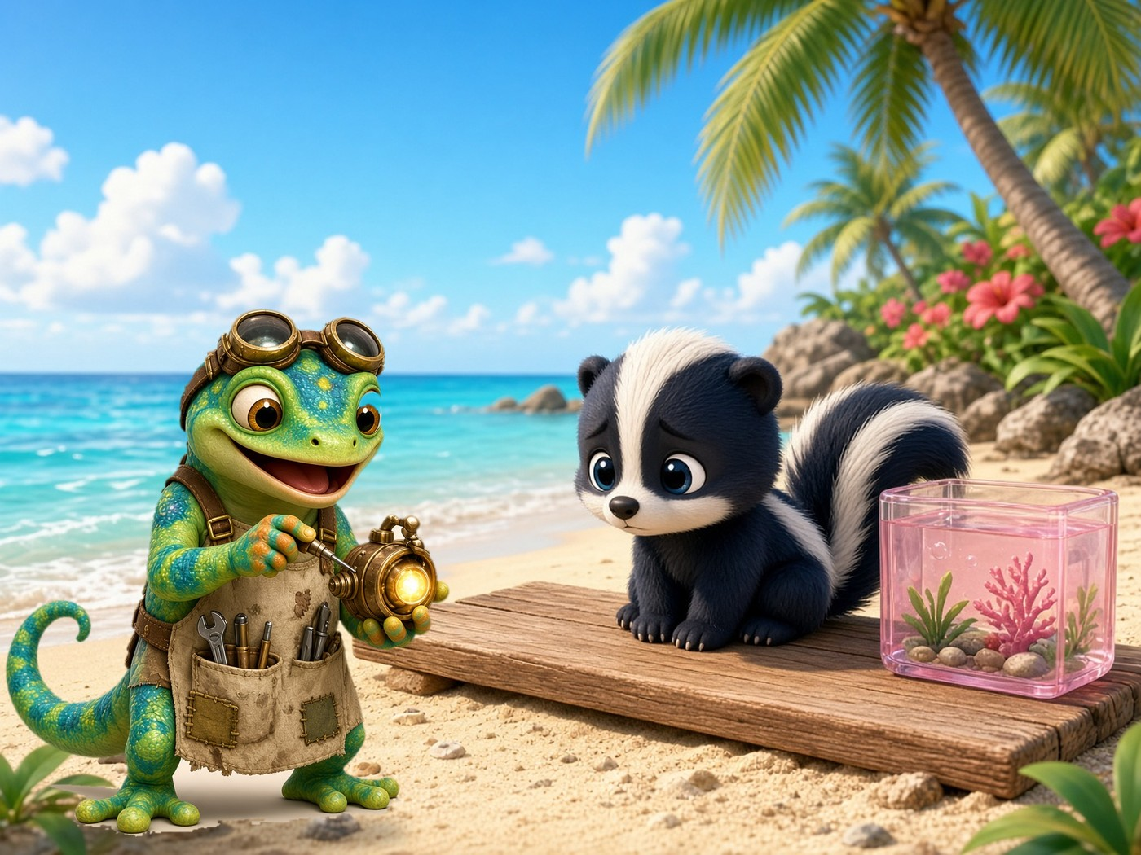
Day 2
Read It!
The skunk sat on the plank.
Notes:
Read it (2 min). I DO: read it once, finger under each word. WE DO: read it together. YOU DO: whisper-read to a partner.
Find the nk words: skunk, plank. Find the heart word: the.

Slide 36
Day 2
Phrase Strips 🚝
a pink drink
the junk trunk
thank you!
a skunk on a plank
Notes:
Phrase strips (3 min). I DO: read each phrase smoothly. WE DO: echo read. YOU DO: partners read all four, two times.
ERROR FIX: stop at a missed nk word, read the chunk, then the word, then re-read the whole phrase.

Slide 37
Day 2
Read the Sentences 📖
The ship sank.
Zip can wink and blink.
Frill drank a pink drink.
The skunk is in the trunk!
Notes:
Read the sentences (3 min). I DO: 'I find the glued chunk, then I read like I talk.' WE DO: echo, then choral read.
YOU DO: partners read all four sentences two times.
ERROR FIX: same as phrase strips. Point to the end mark: 'Stop at the dot. Excited voice at the !'

Slide 38
Day 2
Quick Check ✅
think
plank
skunk
✓ or ✗
Notes:
QUICK CHECK (2 min). Call on 3 students, one word each: think, plank, skunk. Mark ✓ or ✗ on your record sheet.
If a student misses, prompt 'Find the glued chunk first' and re-read. Note who needs more practice before spelling.

Slide 39
Day 2
Spell It! ✏️
ank
ink
onk
unk
I say a word. You tap it. You write it!
1 ______ 2 ______ 3 ______ 4 ______
Notes:
SPELL IT (5 min) · Word dictation. Students struggled with spelling in ng, so go slow and use the same steps every time.
Words: 1 sink 2 bank 3 honk 4 junk. Bonus: think, plank, trunk, drink.
Steps: I SAY the word. YOU SAY it. TAP the sounds (s ... ink). WRITE it. CHECK it with my model.
The chunk boxes stay on the screen as a helper.
ERROR FIX: if a child writes 'sik' or 'sinc', say 'Hum it: the hum is n, the click is k. nk.' Show the chunk card, then rewrite.

Slide 40
Day 2
Sentence Dictation ✏️
Listen. Say it.
Write it!
Capital letter · spaces · end mark
Find the nk chunk in each word.
Notes:
SENTENCE DICTATION (4 min). Say each sentence 2 times. Students repeat it, count the words on their fingers, then write.
Sentence 1: I think the ship sank. Sentence 2: The skunk is in the trunk.
CHECK together: capital letter, spaces between words, end mark, nk spelled n-k.
ERROR FIX: model one word at a time on the board; students fix with a check mark, not an eraser.

Slide 41
Day 2
Practice on Your Own 🌟
Do work in
student booklet 📘
Lesson 3.2 · Day 2
✓ Find the chunk first ✓ Go slow
✓ Check your work ✓ Ask for help
Notes:
PRACTICE ON YOUR OWN (5-8 min). Students open the student booklet: Lesson 3.2 · Day 2.
Walk the room. Remind them: find the chunk first, go slow, check your work, ask for help.

Slide 42
Day 2
Great Work! 🏆
Day 2 done!
⭐ You read and spelled nk words!
Notes:
GREAT WORK (1 min). SAY: 'You built, read and spelled nk words today!' Name a real effort you saw.

Slide 43
Day 3 - Story & Celebrate
Unit 3 · Lesson 3.2 · nk · Island Readers
Notes:
Day 3 · Story & Celebrate. Show this slide while students get ready: booklet (Lesson 3.2 · Day 3), check page, record sheet.

Slide 44
Day 3
Unit 3 · Lesson 3.2 · Day 3
Story, Check & Celebrate
Notes:
GET READY (1 min). Focus: warm-up, speed run, heart and story words, read the 3-part comic, re-read, 10-word check, celebrate.

Slide 45
Day 3
Warm-Up ⚡
ink
ank
onk
unk
think
skunk
Notes:
WARM-UP (2 min). Read the four chunks, then think and skunk. WE DO, then YOU DO.
ERROR FIX: 'Vowel first, then nk.'

Slide 46
Day 3
Mix It Up! 🏝️
pink
tank
honk
junk
blink
thank
monk
bunk
Glue chunk: ink · ank · onk · unk
Notes:
Mix it up (2 min). Students say the chunk, then read the word. Partners take turns by row.
ERROR FIX: tap the vowel, say the chunk, re-blend.

Slide 47
Day 3
Speed Run ⏱️ 1 minute
pink
bank
honk
junk
sink
tank
monk
bunk
wink
thank
think
skunk
rink
drank
chunk
link
blank
trunk
drink
plank
Notes:
SPEED RUN (1 minute). Partners: one reads, one points and counts. Start the timer. Read across each row. If you finish, start again.
Then swap. Count words read correctly; try to beat your own score (not a partner's).
ERROR FIX: the partner points to the chunk; the reader tries again, then keeps going.

Slide 48
Day 3
Heart Words ❤️ for the Story
was
I
you
is
❤
❤
❤
❤
the
what
a
to
❤
❤
❤
❤
See it · Say it · Spell it · Say it again
Notes:
Heart words for the story (2 min): I, a, the, is, what, you, was, to.
For each word: SEE IT (point), SAY IT (students echo), SPELL IT (tap each letter), SAY IT AGAIN. Draw a heart over the tricky part. The rest of the word follows the rules.
Quick review: these are the same heart words from Days 1 and 2. No new ones today.

Slide 49
Day 3
Story Words ⭐
trunk
junk
tank
skunk
plank
drink
bunk
thank
Find the glued chunk first!
Notes:
Story words (2 min). These nk words are in today's comic. WE DO: read each one together. YOU DO: one word each.
ERROR FIX: find the glued chunk first, then the front sounds.

Slide 50
Day 3
Story Phrases 🚝
a big trunk
fun junk
a pink tank
a skunk on a plank
Notes:
Story phrases (2 min). Echo read, then choral read. These phrases are in the story.
ERROR FIX: stop at the missed word, read the chunk, re-read the phrase.

Slide 51
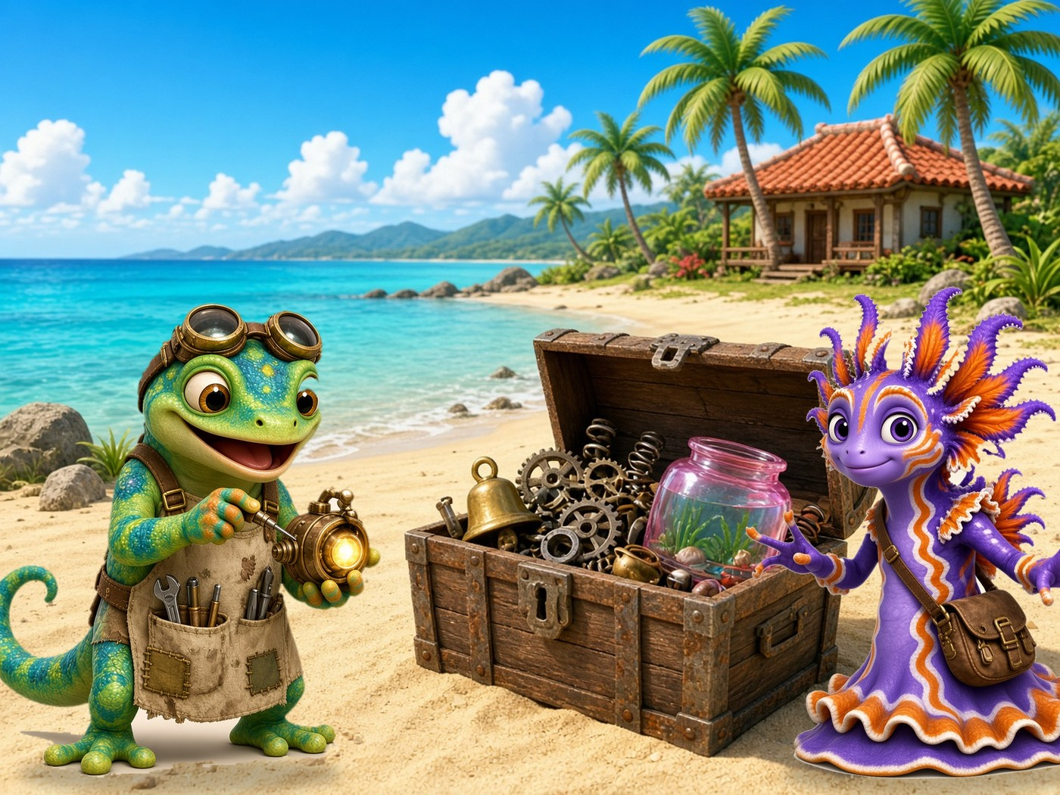
Day 3
Story Peek 👀
What is in the trunk?
Notes:
Story peek (1 min). Read the question together: 'What is in the trunk?'
Ask students to guess from the picture. 'Let's read and find out!'

Slide 52
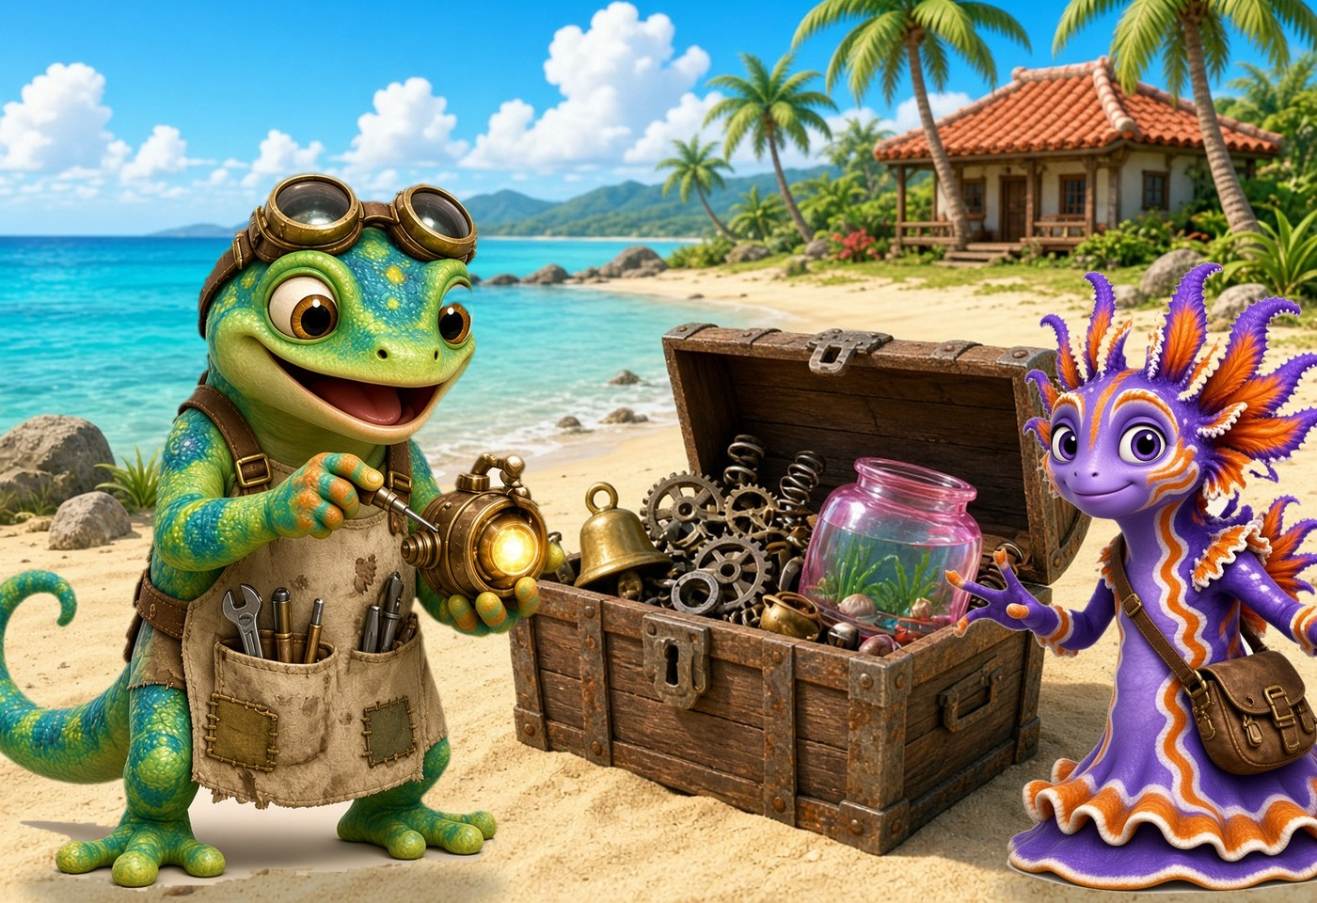
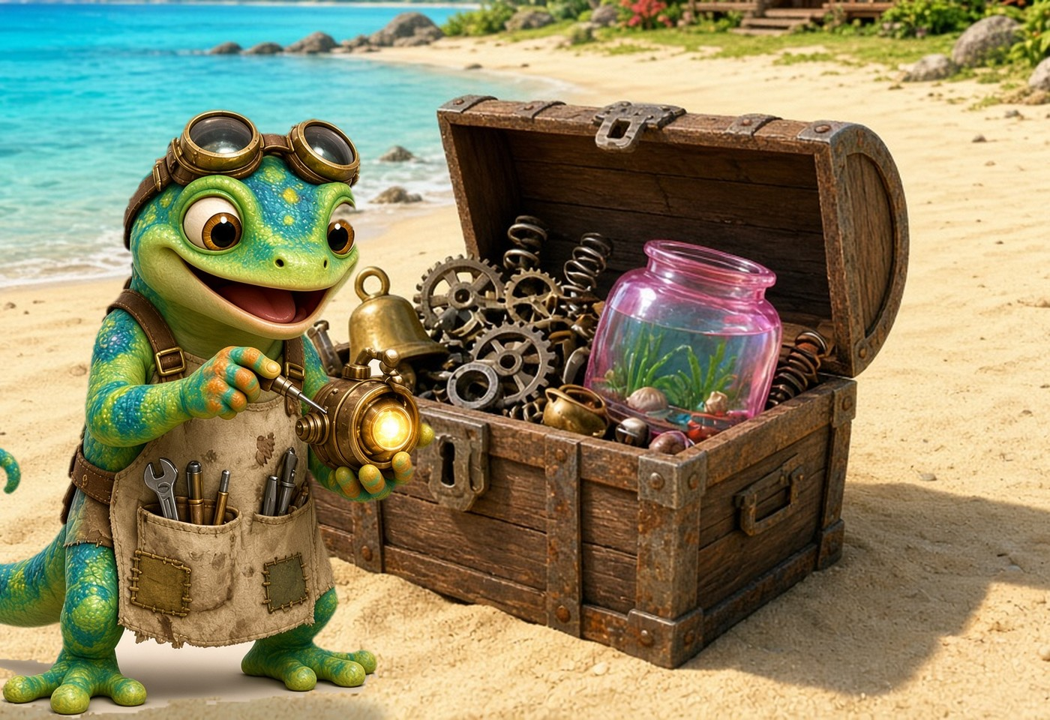
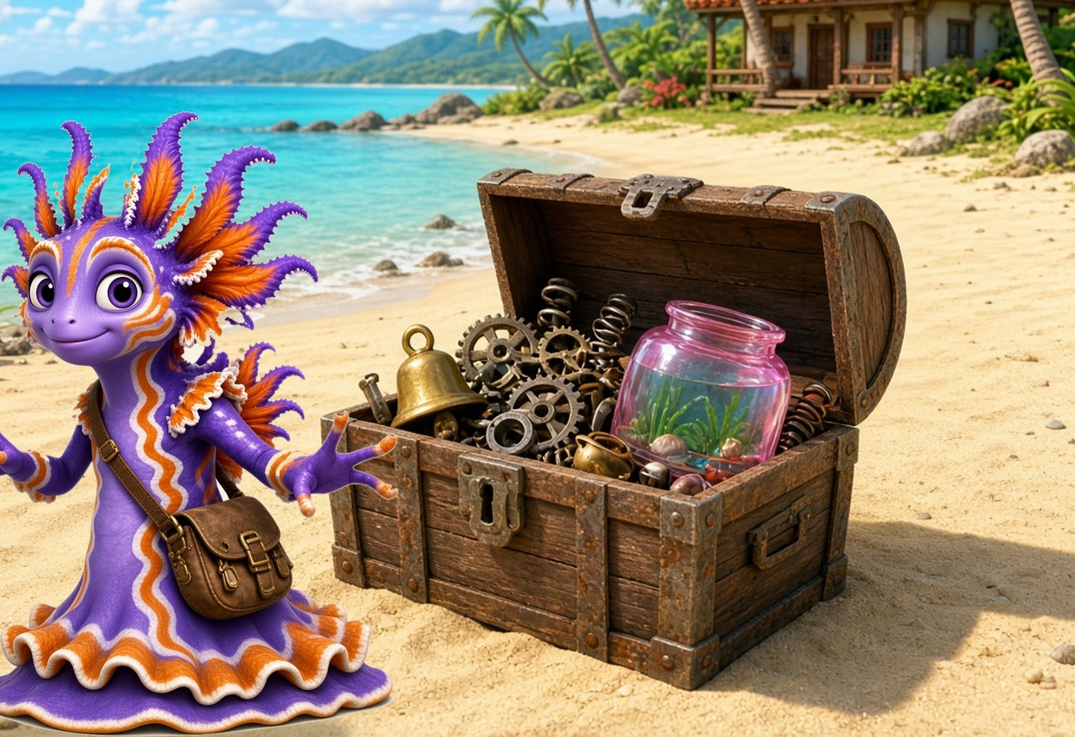
Day 3
Comic Part 1: The Junk Trunk 📖
Zip: I got a big trunk!
Frill: What is in it?
Zip: Junk! A pink tank and a bell!
Frill: I think it is fun junk!
Clink! Clank! Clunk!
Frill: I can fill the pink tank.
Read it 3 times: ⭐ 1 ⭐ 2 ⭐ 3
Notes:
Comic Part 1 (3 min). I DO: read each panel, finger under the words. WE DO: echo read. YOU DO: partners read; one is Zip, one is Frill.
Color a star after each read.
Talk: What is in the trunk? (junk, a pink tank, a bell).
ERROR FIX: point to the chunk in the missed word, read the word, re-read the sentence.

Slide 53
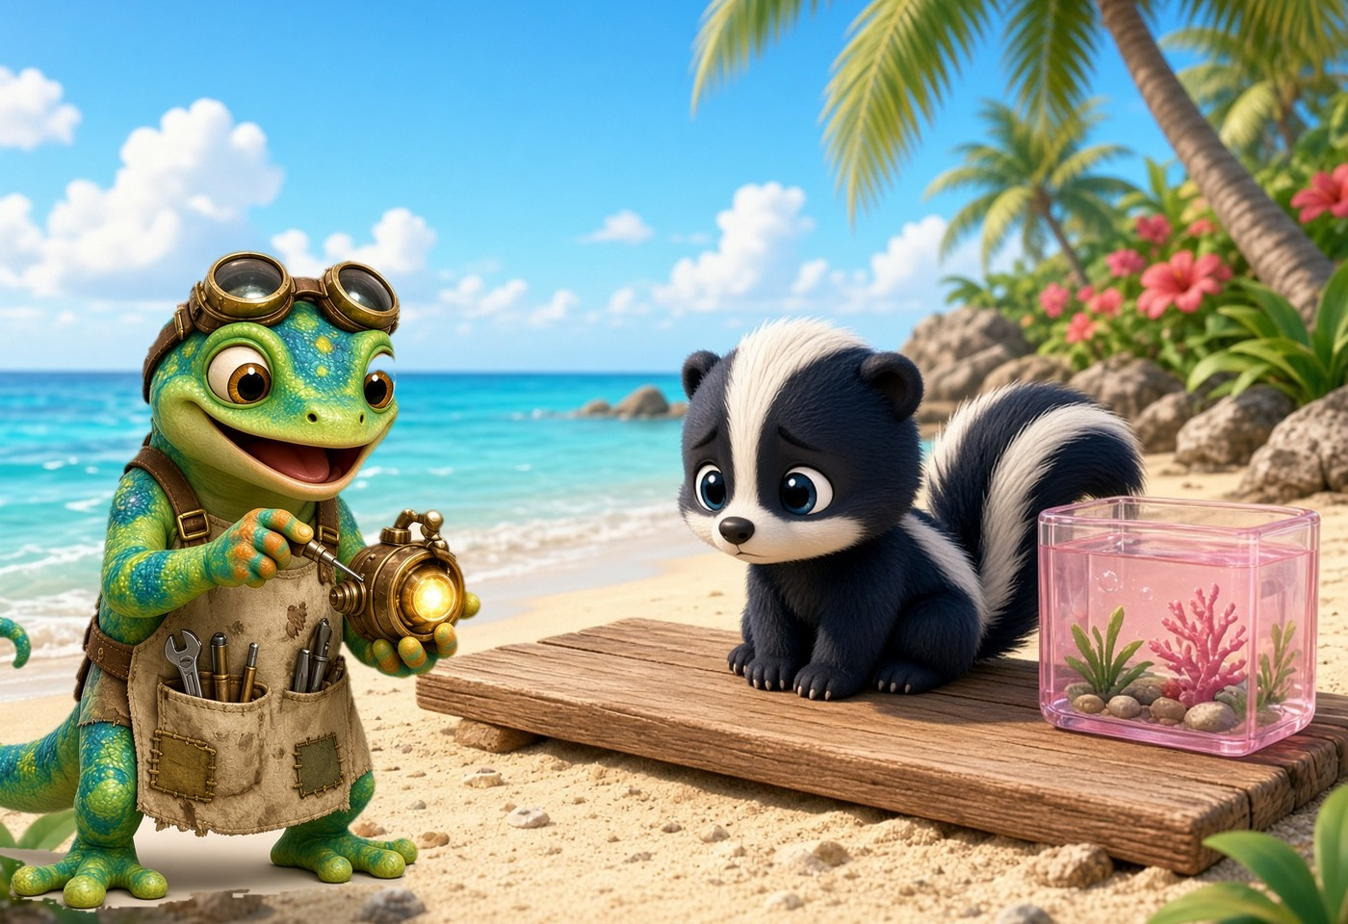
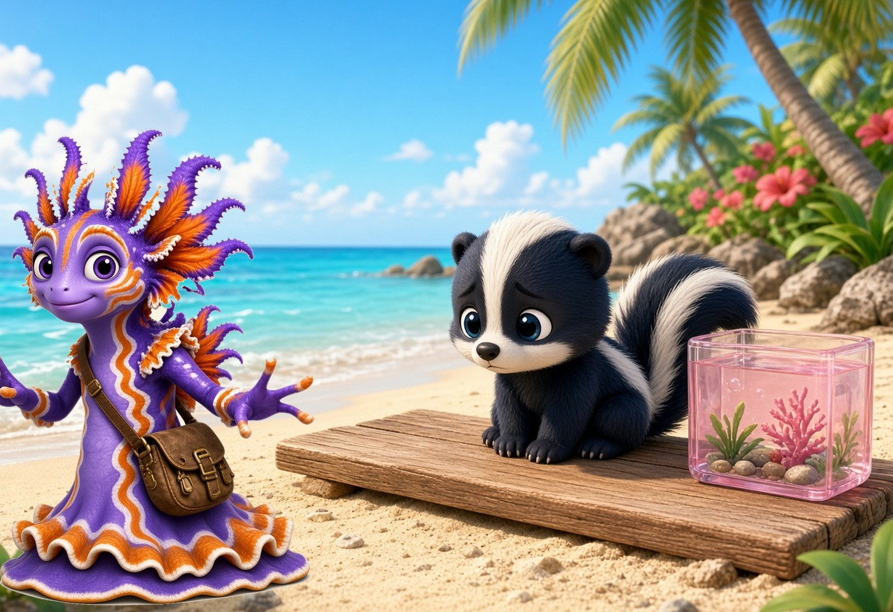
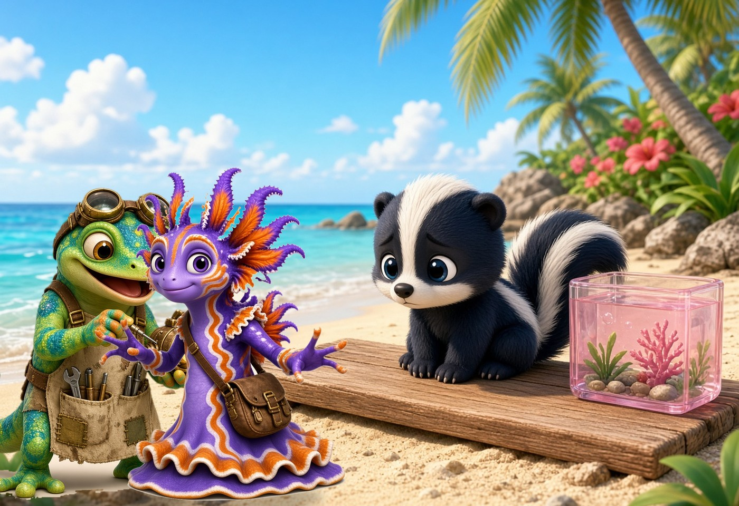
Day 3
Comic Part 2: The Sad Skunk 📖
A skunk sat on a plank.
Zip: A skunk! It can stink!
Frill: Shh! The skunk is sad.
Frill: It must drink.
Frill: You can drink, skunk!
The skunk drank and drank.
Read it 3 times: ⭐ 1 ⭐ 2 ⭐ 3
Notes:
Comic Part 2 (3 min). Same routine: I DO, WE DO, YOU DO with parts.
Talk: Why is the skunk sad? What does Frill do to help? (Frill gives it a drink.)
Kind voice for Frill, surprised voice for Zip.

Slide 54
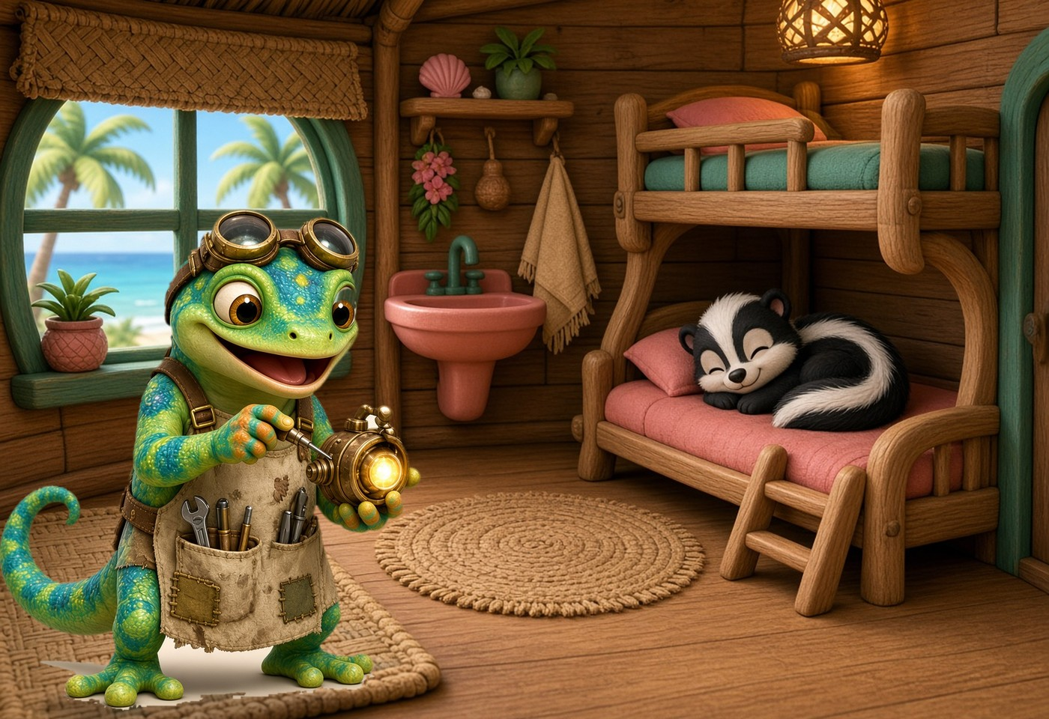
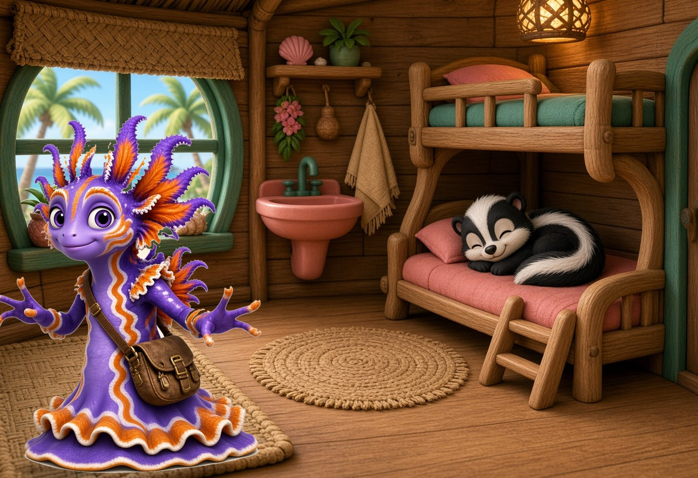
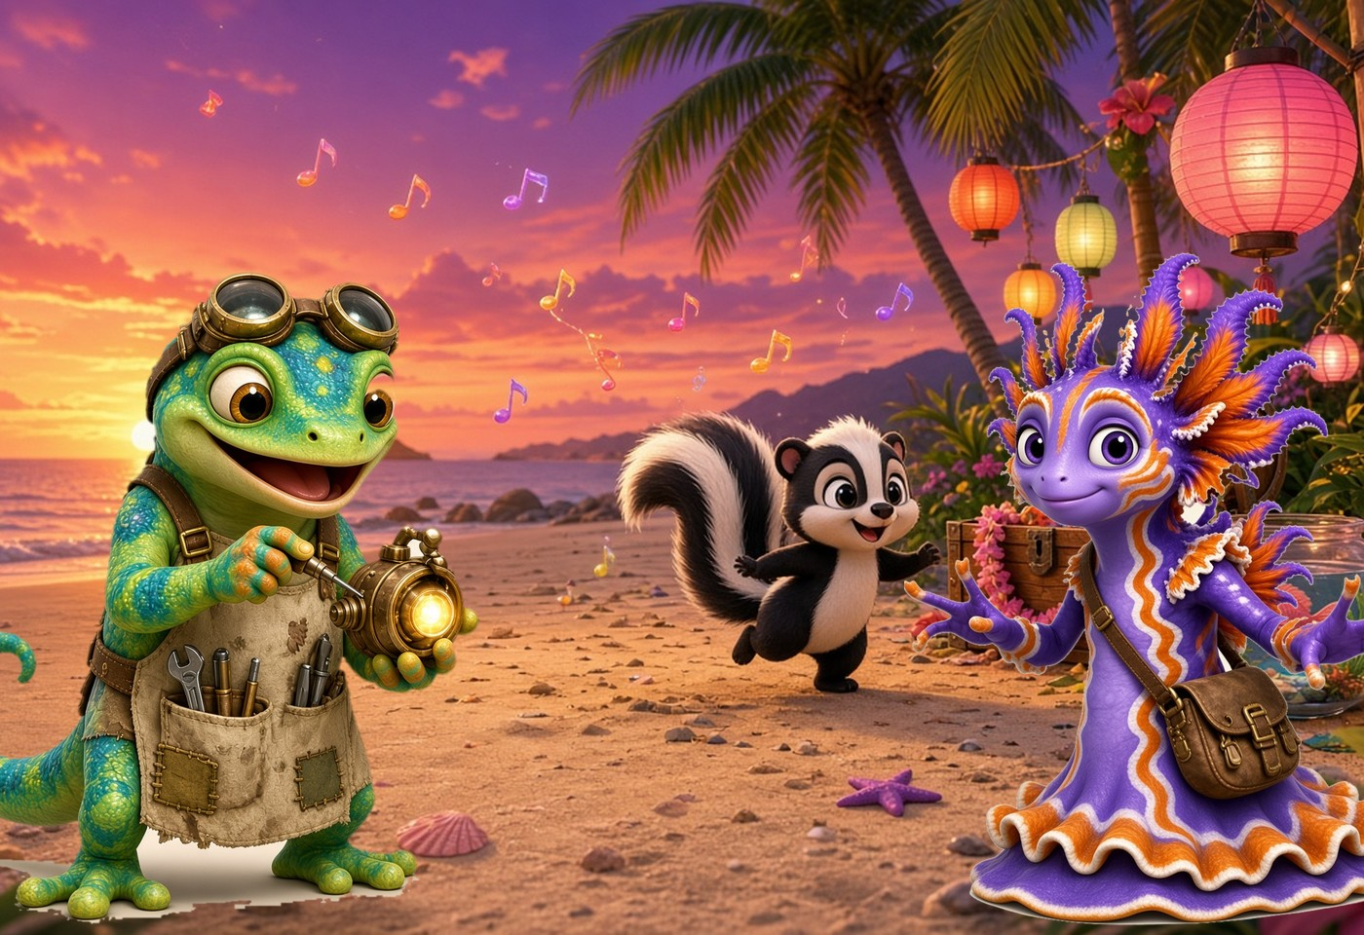
Day 3
Comic Part 3: Thank You! 📖
The skunk got in the bunk.
Zip: It can nap in the bunk!
Wink! Blink!
Skunk: Thank you, Zip and Frill!
Frill sang to the skunk.
Zip was glad. What a fun trunk!
Read it 3 times: ⭐ 1 ⭐ 2 ⭐ 3
Notes:
Comic Part 3 (3 min). Same routine.
Talk: How does the skunk say thank you? How does Zip feel at the end? (glad).
ERROR FIX: same steps; praise smooth reading.

Slide 55
Day 3
Re-read the Story 🔁
Read it again!
Parts 1, 2 and 3
Read the whole story with a partner.
Swap Zip and Frill. Use your best voice!
Notes:
RE-READ the whole story (4 min). Go back to Parts 1-3. Choral read once, then partners re-read and swap parts.
Listen for smooth reading of nk words. ERROR FIX: point to the chunk, student reads the word, then re-reads the sentence.

Slide 56
Day 3
Read Like a Storyteller 📖
Clink! Clank! Clunk!
The skunk drank and drank.
Thank you, Zip and Frill!
What a fun trunk!
Notes:
Read like a storyteller (2 min). These lines are from the story. Model expression: loud and fun for 'Clink! Clank! Clunk!', kind for 'Thank you'.
WE DO: echo read with expression. YOU DO: partners read with expression.

Slide 57
Day 3
10-Word Check ✅
Check time!
Get your check page.
Read 10 words to your teacher.
Do your best!
Notes:
10-WORD CHECK. One-to-one: student reads each word; mark ✓ or ✗. No hints.
Words: 1 pink 2 bank 3 honk 4 junk 5 think 6 plank 7 skunk 8 drink 9 thank 10 trunk.
SCORE: 9-10 = ready for the next lesson. 7-8 = review with the Day 2 slides. 6 or below = re-teach Day 1 in a small group.
The rest of the class re-reads the story with partners.

Slide 58
Day 3
Show What You Know 🏆
think
plank
skunk
honk
Find the glue chunk. Then read!
Notes:
SHOW WHAT YOU KNOW (2 min). Whole group: students read each word, then tell a partner the glued chunk (ink, ank, unk, onk).
Celebrate every try: 'You found the chunk!'

Slide 59
Day 3
Practice on Your Own 🌟
Do work in
student booklet 📘
Lesson 3.2 · Day 3
✓ Find the chunk first ✓ Go slow
✓ Check your work ✓ Ask for help
Notes:
PRACTICE ON YOUR OWN (5-8 min). Students open the student booklet: Lesson 3.2 · Day 3.
Finish the 10-word check with any students you have not heard yet.

Slide 60
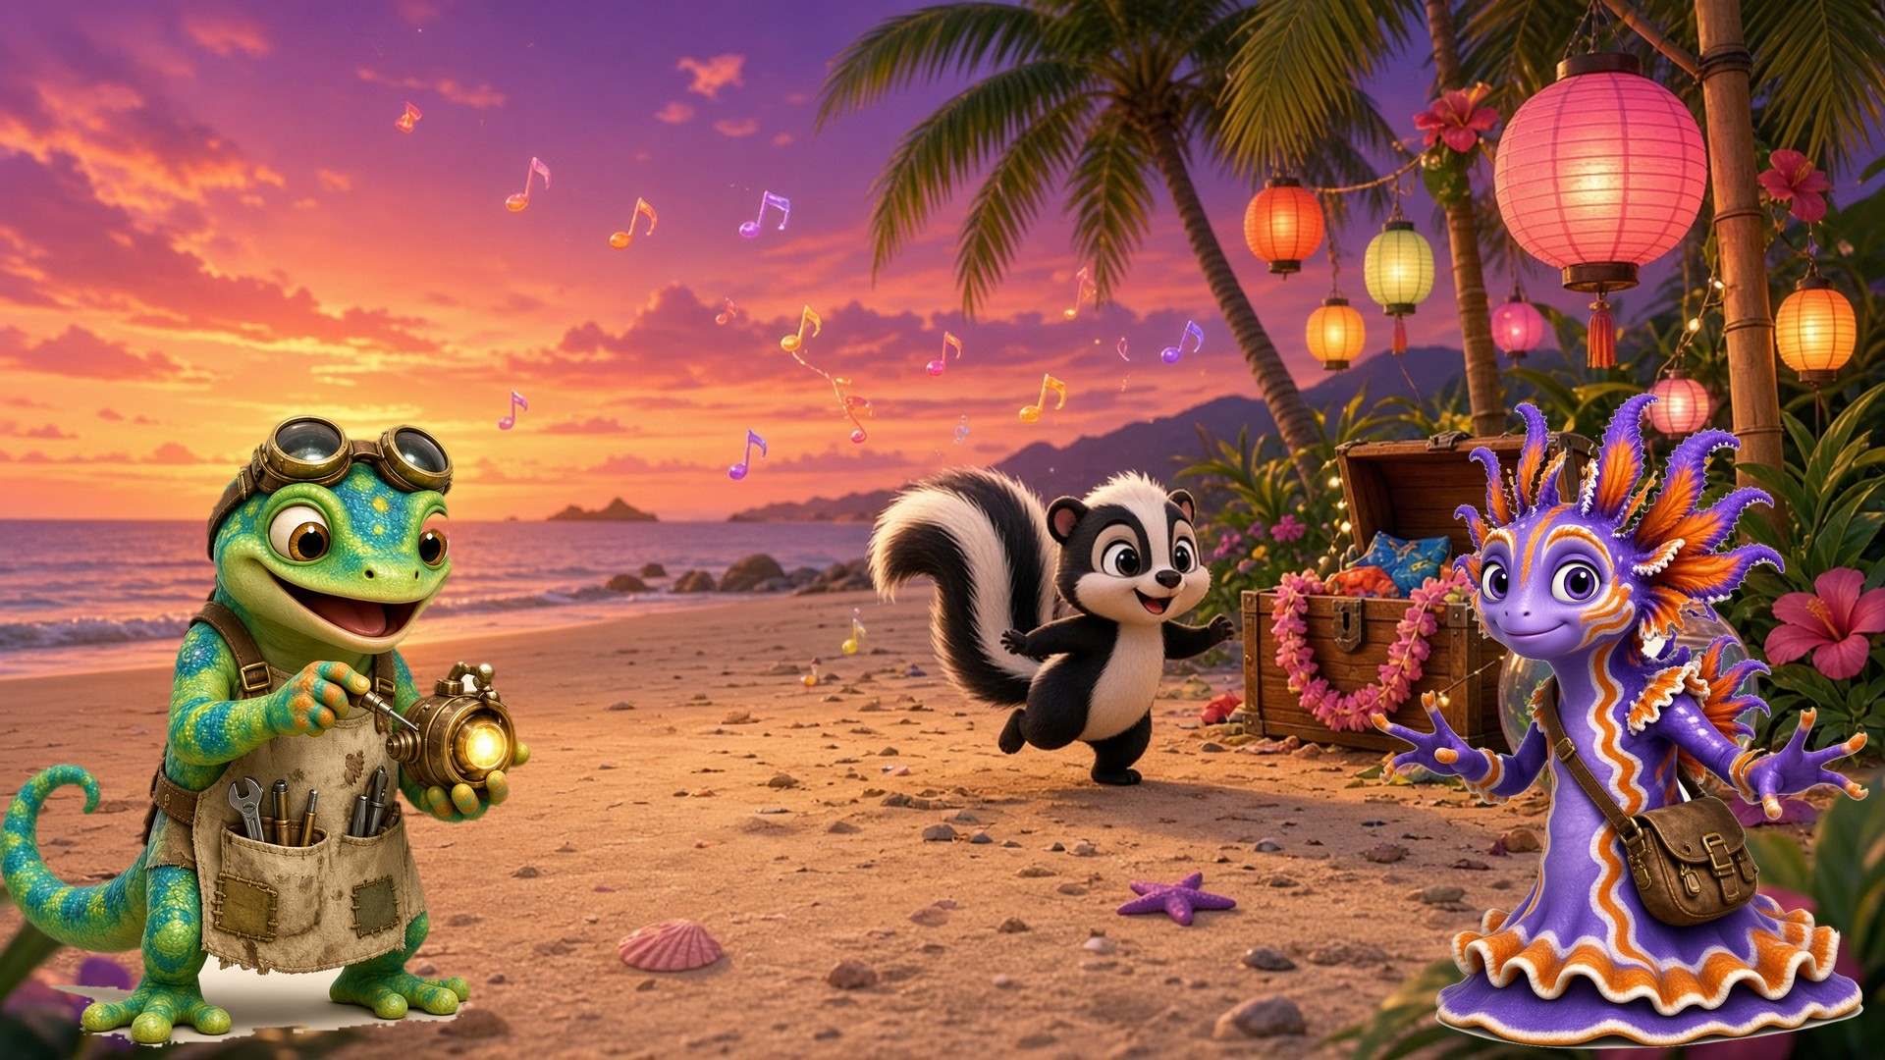
Day 3
Lesson 3.2: done! 🎉
Notes:
CELEBRATE (1 min). SAY: 'Lesson 3.2 is done! You can read and spell nk words.'
Name the effort, not the score: 'You kept trying, and you found the glued chunk every time!'

