Slide 1

Predicting Whether Movie Reviews Contain Spoilers
Manuel Albrizzio, Adnan Cihan Cakar, Jared Grove, Johnny Joyce
Snape kills Dumbledore

Slide 2
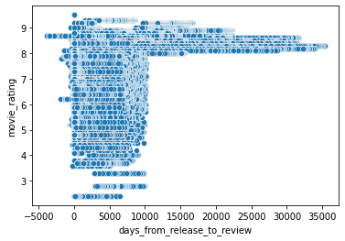
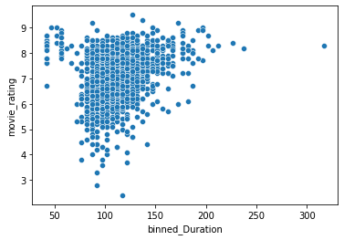
Exploratory Analysis

Slide 3
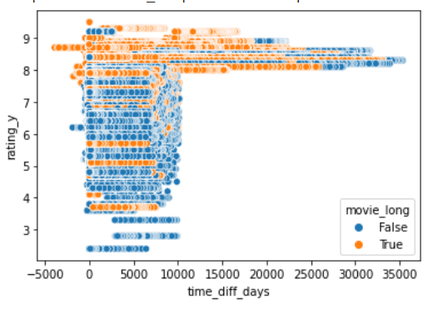
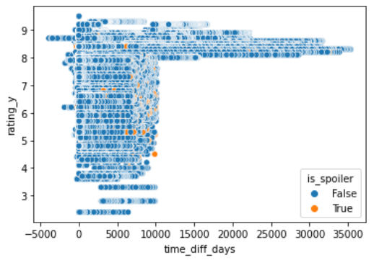
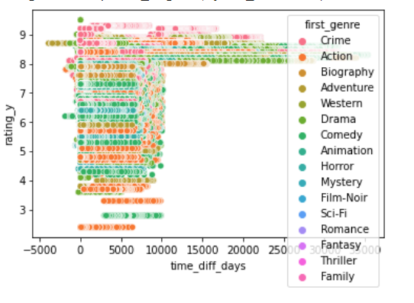

Slide 4
Pre-processing
Goal is to transform the review body into a list of “meaningful” words
“Stop words” were removed
Words were “stemmed” (grouped by meaning)
Columns containing dates were changed into integers
This took too long!!!!!!!!!!!!! :(
Had to cut the data down by over 90%

Slide 5
After processing: encoding
Want to change each list of words into a vector
We can use “one-hot encoding”
E.g. “This movie rocks” “This” -> [0, ... , 1, 0, 0, ... , 0] “movie” -> [0, ... , 0, 1, 0, ... , 0] “rocks” -> [0, ... , 0, 0, 1, ... , 0] —--------------------------------------------- “This movie rocks” -> [0, ... , 1, 1, 1, ... , 0]

Slide 6
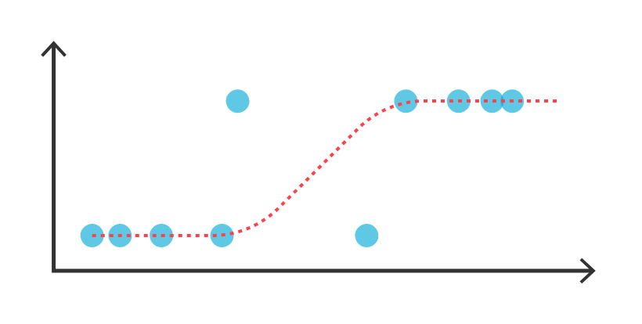
Model 1
Spoiler Alert! This model did not work well…
Calculated distances between plot summary and review summary as two vectors in words space
Fit Logistic Regression as this distance as independent variable and being spoiler as the response
Predicted all False
The words space is too large so the data points are too distant.
Possible correction is to use Jaccard Distance
This did not improve model because it is very rare (1 in 5) that review and plot include same word and it is much more rare they include significant amount of same words.
Conclusion: We can not tell if a review includes spoiler just by looking at the common words in review and the plot summary

Slide 7
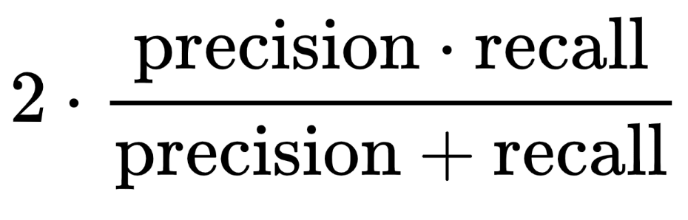
F₁-Score
≈570 000 reviews, ≈150 000 are spoilers
Always guessing “not spoiler” gives ≈74% accuracy.
Precision: Number of correctly-identified spoilers / Number of reviews labeled as spoiler by model
Recall: Number of correctly-identified spoilers/ Number of reviews that contain a spoiler
F₁-Score: Harmonic mean of precision and recall
F₁-Score of always guessing “not spoiler” is 0.

Slide 8
Model 2: Logistic Regression
Input: 1-Hot Encoded values for Plot Summary and Review Summary, Length of the movie (minutes), Days from release to Review
Test Accuracy: 0.7
Test F₁ Score: 0.81 for No Spoilers, 0.16 for Spoilers Class
Conclusion: Works ok for guessing non-spoilers, not as good for spoilers

Slide 9
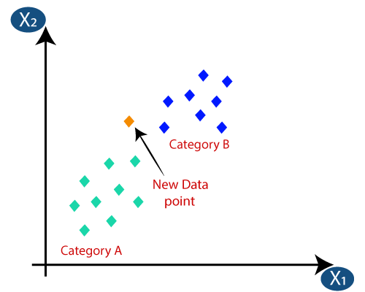
Model 3: KNNeighbors Classifier
Input: 1-Hot Encoded Data with review summary and plot summary, Length of the movie (minutes), Days from release to Review
K= 5
Accuracy: 0.713
F1 score= 0.828 for No Spoiler Class, 0.133 for spoiler class
Conclusion: Works good for guessing No spoilers, not well for spoilers.

Slide 10
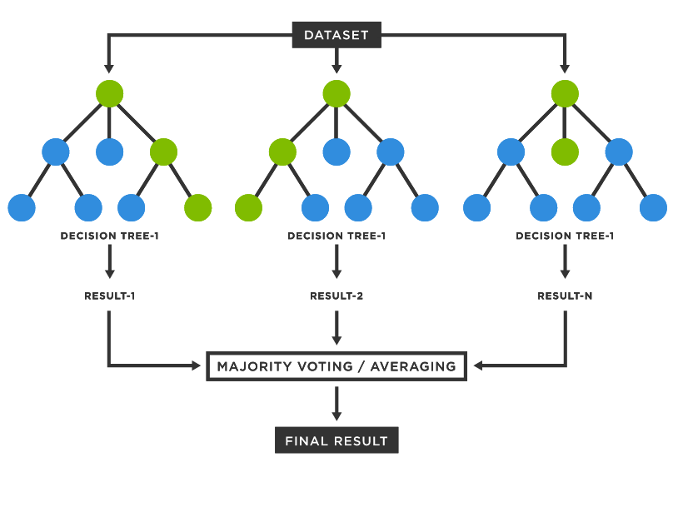
Models 4&5: (K=50)NN Classifier & Random Forest Classifier
Input: 1-Hot Encoded values for Plot Summary and Review Summary, Length of the movie (minutes), Days from release to Review
Test Accuracy: 0.71
Test F₁ Score: 0 - Undefined because True Positive + False Positive = 0
Predicts everything to be Not a Spoiler
Conclusion: Does not work well. Predicts everything to be not a spoiler. K=50 is way too big hen there are so many more negatives than positives

Slide 11
Models 6&7: Linear Regression & Lasso
Input: 1-Hot Encoded values for Plot Summary and Review Summary, Length of the movie (minutes), Days from release to Review
Test Accuracy:
Test F₁ Score: 0 - Undefined because True Positive + False Positive = 0
Predicts everything to be Not a Spoiler
Conclusion: Does not work well. Predicts everything to be not a spoiler

Slide 12
Models 8&9: Linear Regression & Lasso - Classification
Input: 1-Hot Encoded values for Plot Summary and Review Summary, Length of the movie (minutes), Days from release to Review
If output <0 Predict no spoiler, if output >0 predict spoiler
Test Accuracy: 0.612, 0.629
Test F₁ Score: Predicts everything to be Not a Spoiler
Conclusion: Predicts worse than always guessing not a spoiler

Slide 13
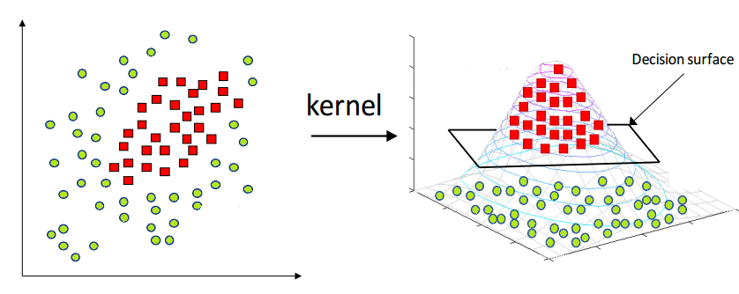
Models 10&11: Support Vector Machines
Input: 1-Hot Encoded values for Plot Summary and Review Summary, Length of the movie (minutes), Days from release to Review
With the RBF and Default Kernels
Test Accuracy: 0.708
Test F₁ Score: 0.0494
Conclusion: Does not work well. Accuracy is worse than naive with only slight F₁ gains

Slide 14
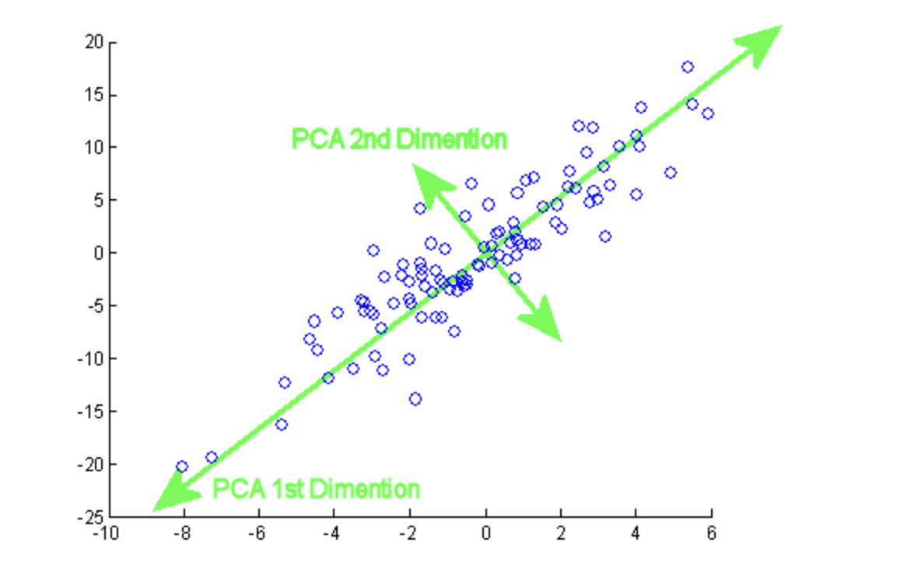
Model 12: Logistic Regression + PCA
Input: 1-Hot Encoded values for Plot Summary and Review Summary, Length of the movie (minutes), Days from release to Review
Perform PCA on data, reduce from 5841 variables to 800 while explaining ~80% of variance
Test Accuracy: 0.708
Test F₁ Score: 0.824 for No Spoilers, 0.136 for Spoilers Class
Conclusion: Works ok for guessing non-spoilers, not as good for spoilers. PCA didn’t help as much as I would like

Slide 15
Summary
Most challenging aspect was pre-processing
Models had varying levels of success (Best: KNN and one of the logistic regression models)
Possible directions for the future: spend more time on more advanced models, scale up amount of data after pre-processing

