Slide 1
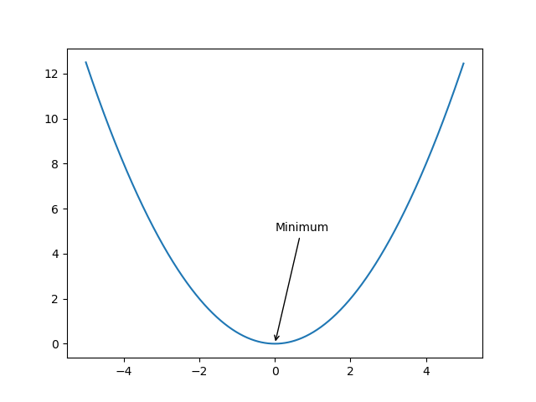
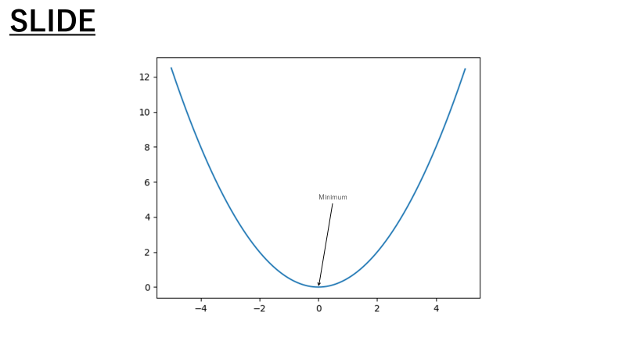
What’s figppx?
Matplotlib to PowerPoint.
How?
func: rasterize
Send ``Figure``
as an image.
func: send
Most parts are rasterized, but
some (e.g. label texts) are as Object.
func: transcribe
Send ``Figure``
as Objects.
Edit via PowerPoint.

Slide 2
Overview
To Image
rasterize
Generate an image from Artist.
Shape
(msoPicture)
send
figpptx attempts to
transfer Artists.
Separator
Classify Artists
transcribe
Convert Artists
to Objects of PowerPoint.
To Object
LEGEND
ConverterManager
If the function is registered for Artist,
apply it.
CrudeRenderer
Fallback method to convert any Artists.
converter functions
Invoked by users directly.
Register
Expected to be extended
by users for their situations
Libraries' functionality.
Shapes
Shapes

