Slide 1

Notes:
Title

Slide 2
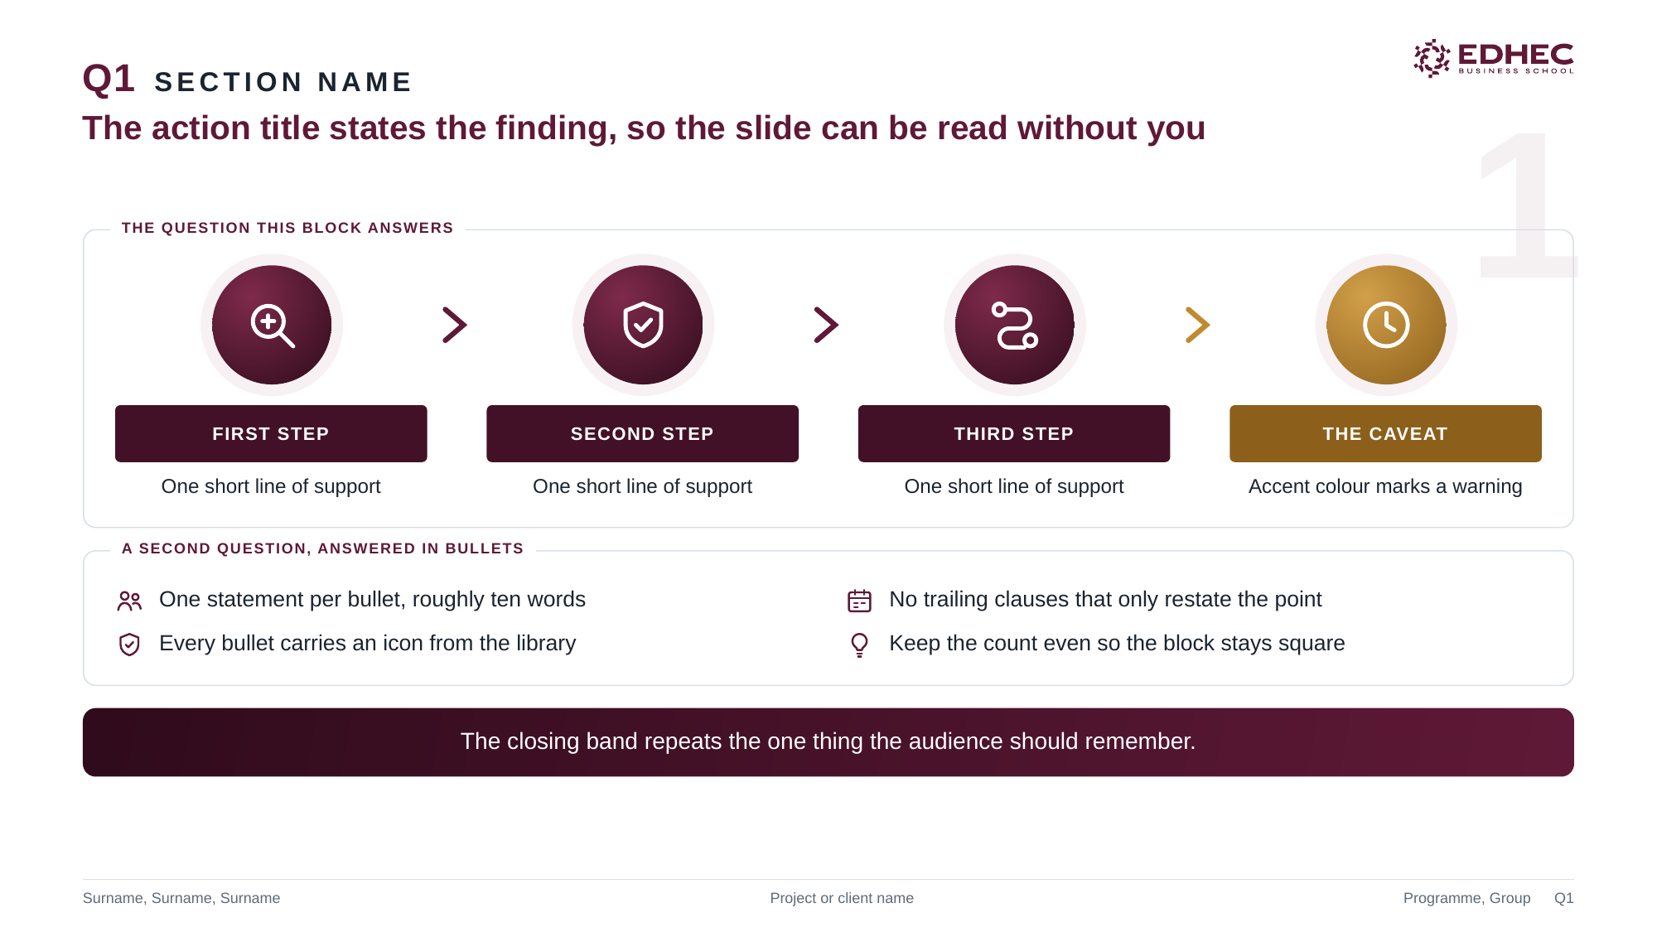
Notes:
Chain and bullets

Slide 3
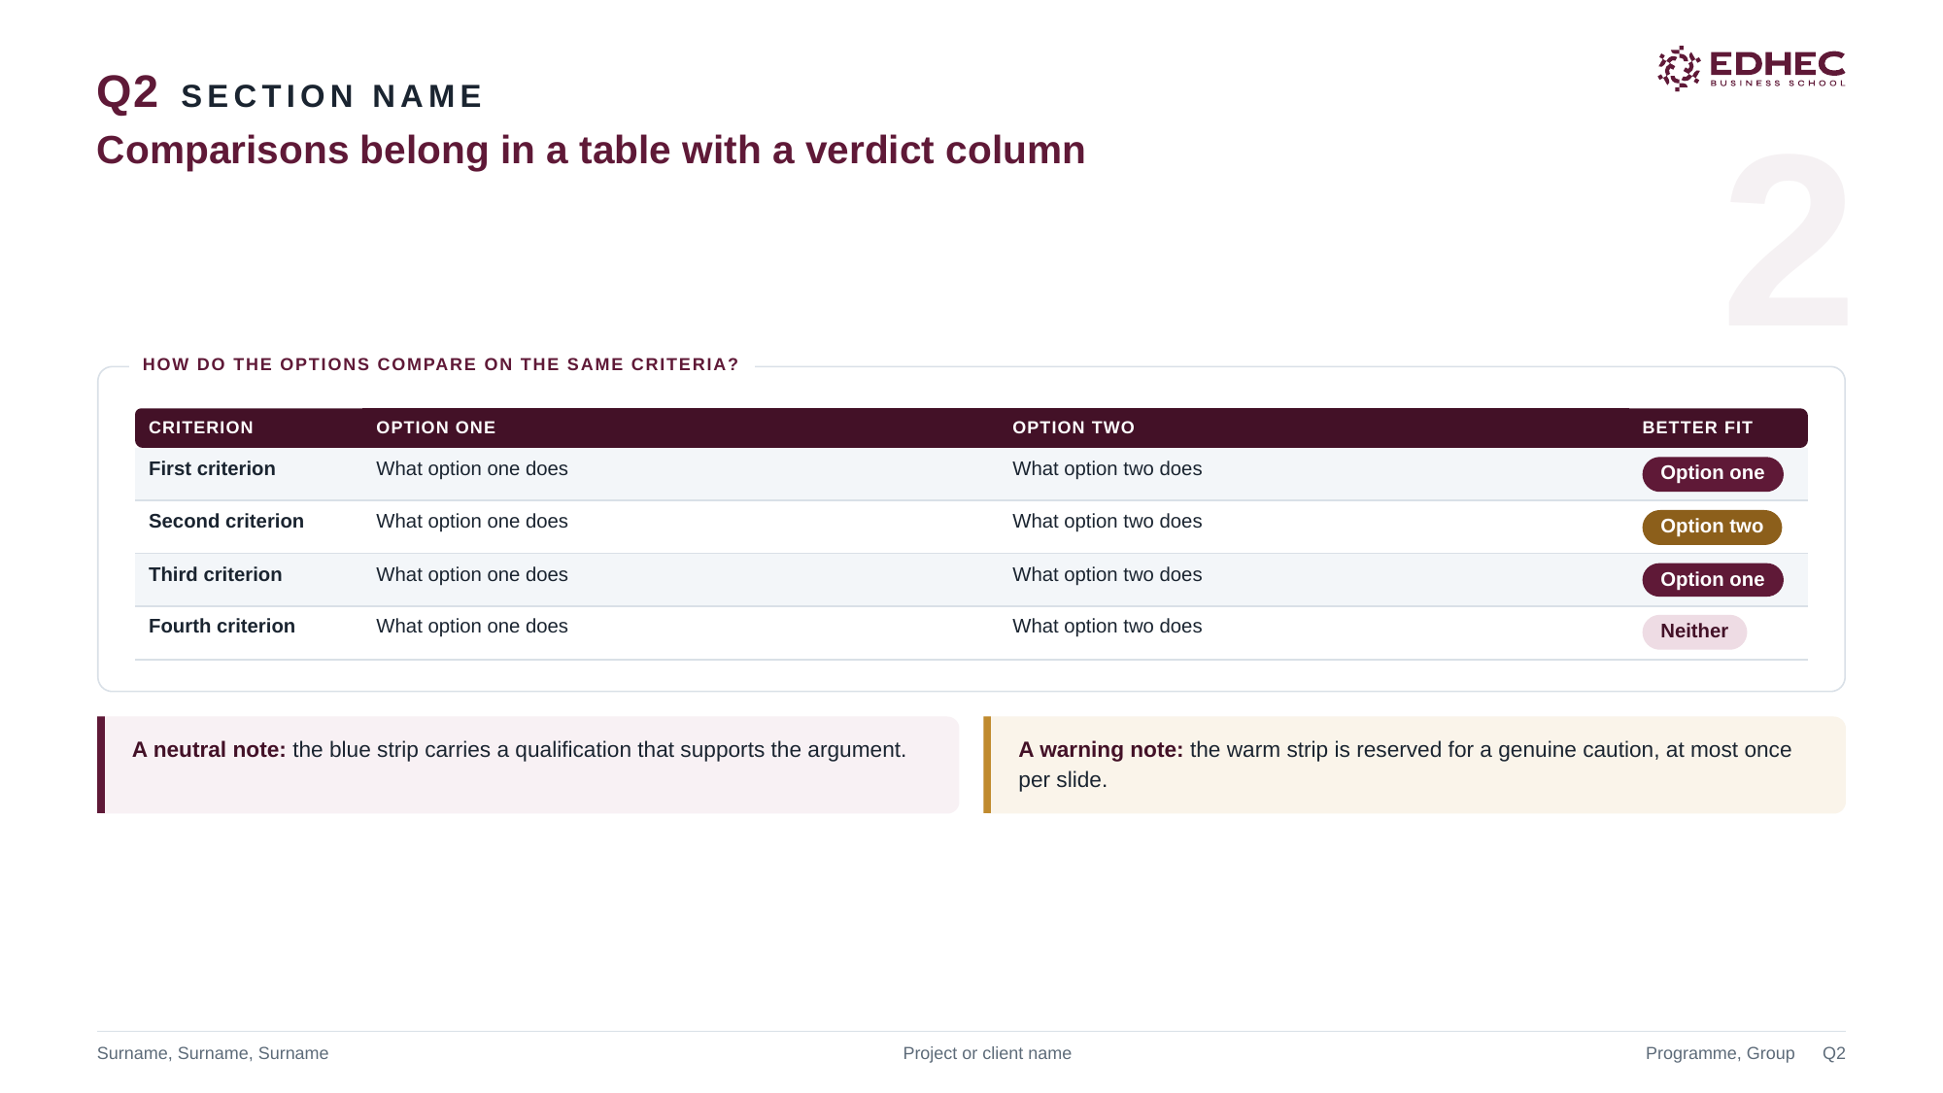
Notes:
Table and chips

Slide 4
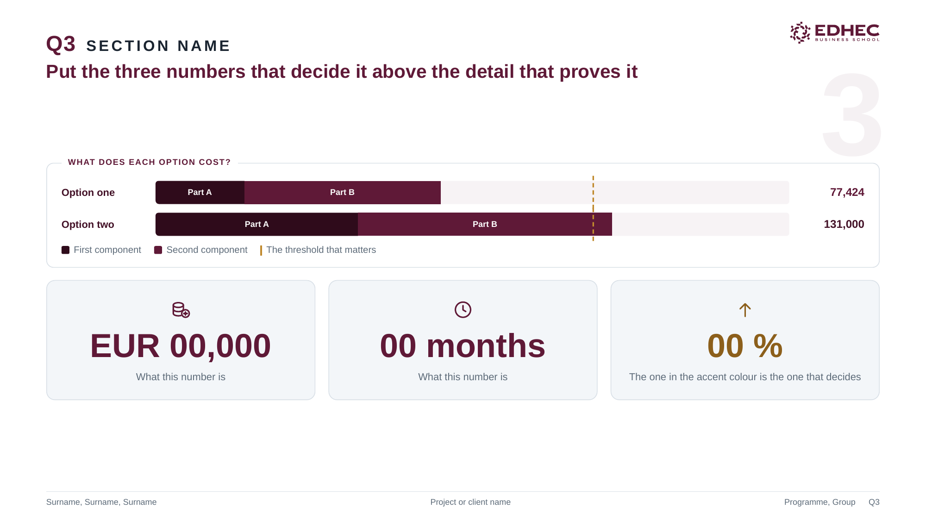
Notes:
Numbers

Slide 5
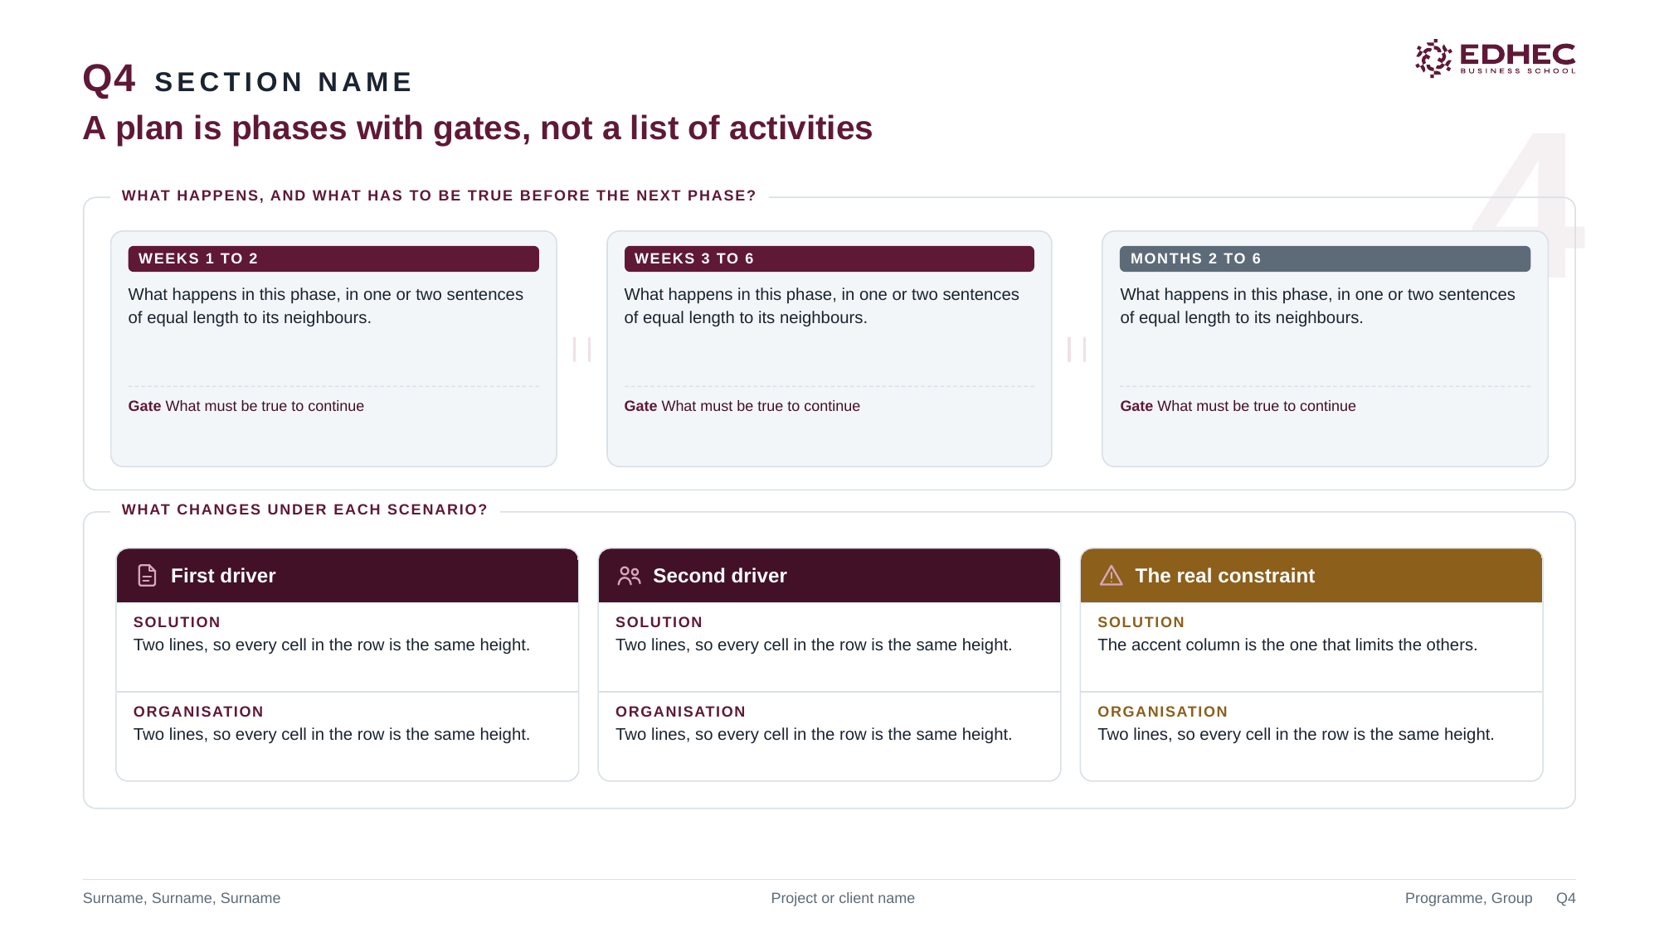
Notes:
Roadmap and scenarios

Slide 6

Notes:
Recommendation

