Slide 1
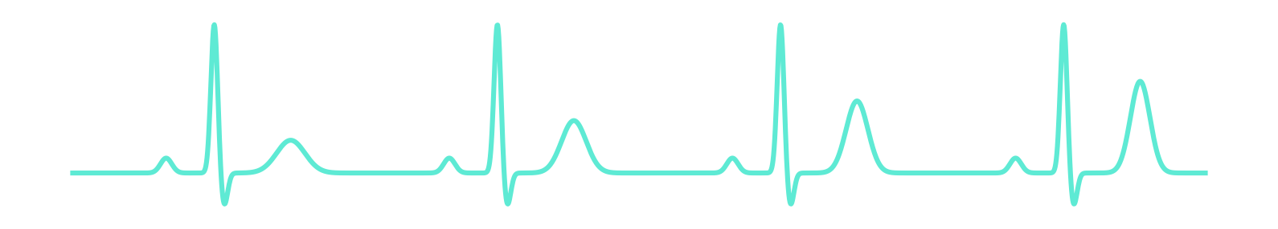
Antaral
K⁺
अंतराल · the interval
A digital twin for the gap between dialysis sessions
Team Between Beats
Nishant Majumdar · B.Tech CSE, VIT Bhopal University
Digital Twin Challenge 2026 · Happiest Health
Notes:
Hi, I'm Nishant from VIT Bhopal, and this is Antaral, which means 'the interval' in Hindi. For a person on dialysis, the interval between sessions is where the danger lives. Antaral is a digital twin that watches that interval, predicts dangerous potassium before it happens, and helps the dialysis unit decide who needs a chair first.

Slide 2
THE PROBLEM
The danger lives in the gap between sessions
~30%
Silent
Day after
Blind
of patients at one Bengaluru dialysis centre were on twice-weekly dialysis, with higher weight gains and lower dialysis adequacy [3]
Potassium builds up between sessions. Too much can trigger a fatal arrhythmia, often with no warning symptoms
the long gap: deaths and cardiovascular hospitalisations cluster after the longest interval between sessions [1]
Clinics check potassium on a monthly lab, and every patient keeps fixed weekdays whatever their potassium is doing
[1] Foley et al., NEJM 2011 [3] Mukherjee et al., Indian J Nephrol 2016
Notes:
In India many patients dialyse twice a week instead of three times, because of cost and machine shortages. At one Bengaluru centre it was about thirty percent. Between sessions potassium builds up silently, and high potassium can stop the heart. A large US study showed deaths cluster on the day after the long gap. And yet clinics are nearly blind in between: a monthly lab and fixed weekdays.

Slide 3
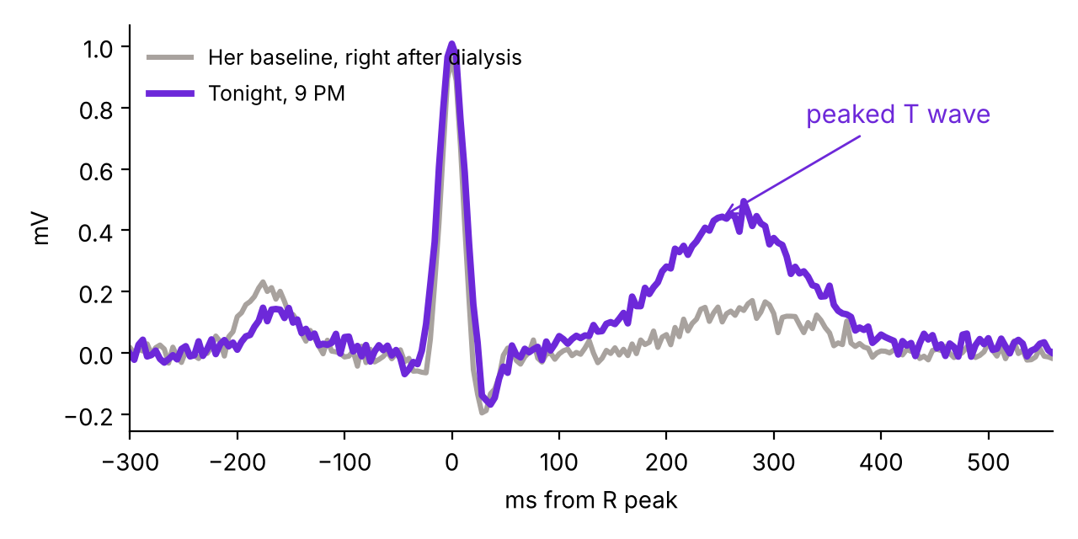
MEET LAKSHMI (SYNTHETIC)
Tuesday, 9 PM. Is she safe until Thursday?
58, diabetic, on an ARB. Dialysis Mon & Thu.
Drank tender coconut water on Monday and Tuesday, and logged it.
Tonight her smartwatch T wave is far taller than her post-dialysis baseline.
Her next potassium lab is weeks away.
The nephrologist's question tonight
Should she come in tomorrow, or wait until Thursday?
Smartwatch median beat: her baseline vs tonight
All patients and data in Antaral are synthetic, generated by its own simulator.
Notes:
Let me make this concrete. Lakshmi is one of our synthetic patients: 58, diabetic, on an ARB, dialysis Monday and Thursday. She drank coconut water twice, which many people think is healthy, but it's loaded with potassium. Tonight her smartwatch ECG shows a peaked T wave. Her next lab is weeks away. Should she come in tomorrow?

Slide 4
WHAT ANTARAL IS
Three twins, one evening decision
1
2
3
4
Patient twin
Risk layer
Unit twin
Doctor approves
A potassium model personalised from the EHR, corrected hour by hour by labs and a smartwatch ECG (Kalman filter)
→
A calibrated model on top of the twin: risk of K ≥ 6.0 before the next session, with reasons
→
Every night at 9 PM, re-plans tomorrow's chairs so the patients heading for danger go first
→
Dashboard with suggestions, what-if panel and explanations. Nothing changes without a clinician
Same machines. Same number of sessions per patient. Smarter timing, earlier warnings.
Notes:
Antaral works at three levels. A patient twin that tracks each person's potassium. A risk layer that turns it into a calibrated warning with reasons. And a unit twin, which is the twist: every evening it re-plans tomorrow's chairs. Finally the doctor approves. Nothing happens automatically.

Slide 5
DATA FUSION
Static record + live signals, fused hourly
Static EHR
Wearables & home
Dialysis unit
Age, sex, dry weight
Diagnosis: diabetic nephropathy, CKD of unknown aetiology…
ACE-i / ARB, beta-blocker
Residual urine output, bicarbonate
Dialysis pattern: 2× or 3× a week
Smartwatch single-lead ECG, twice a day
Smart-scale morning weight
Steps, resting HR, HRV, sleep, BP
Food diary: coconut water, banana, dry fruits, aloo sabzi
Session times and length
Pre-dialysis weight
Potassium lab, about monthly
Chairs and shifts available
Sandbox rules: no real patient data. Antaral's own simulator generates the EHRs, the hidden physiology, the ECG waveforms and the wearables. Next: validation on MIMIC-IV.
Notes:
The brief asked for fusion of static and dynamic data. Static: the EHR, including drugs that raise potassium and residual urine output. Dynamic: a smartwatch ECG twice a day, weight, steps, heart rate, sleep, and a food diary with very Indian potassium sources. Plus the unit's own records. Everything is synthetic, generated by our simulator, which also hides physiology the twin never sees, so the evaluation is honest.

Slide 6
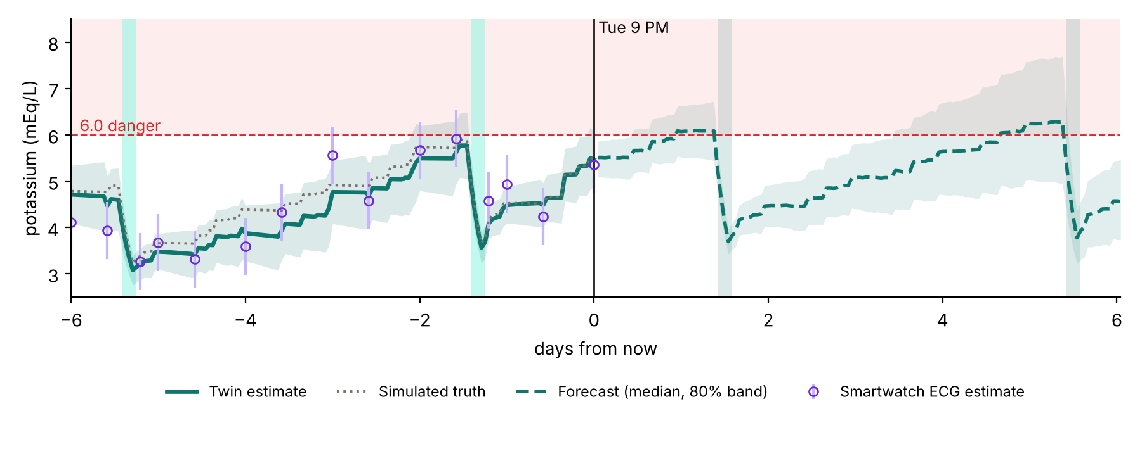
1 · PATIENT TWIN
A Kalman filter around real potassium physiology
Model
dK/dt = (absorbed intake − renal + tissue release) / V
Hidden state
potassium K and a personal drift b, learned over days
Corrected by
monthly labs (precise) and smartwatch-ECG estimates (noisy)
What-if
Monte Carlo rollouts for any session time, food, binder or diet call
Lakshmi's twin: estimate tracks the simulated truth (dotted); forecast crosses 6.0 before Thursday and again before Monday
Notes:
The patient twin is a mechanistic model of potassium: what you eat, minus what your gut and any remaining kidney function remove, spread over a buffering volume. Dialysis pulls it down toward the bath and it rebounds after. A Kalman filter corrects the model every hour with labs and ECG estimates, and learns a personal drift. Here's Lakshmi: the twin, solid line, tracks the hidden truth, dotted, and the forecast shows danger before Thursday.

Slide 7
SMARTWATCH AS A POTASSIUM SENSOR
Reading potassium from a peaked T wave
0.50
mEq/L mean absolute error on held-out patients
0.82
correlation with true potassium
0.70 → 0.62
error (RMSE) after personalising to the patient's own baseline
High potassium: taller, narrower T wave; longer PR; wider QRS. Each beat is compared with the patient's own post-dialysis beat.
Deliberately noisy, like a real watch: the twin trusts it less than a lab. Deep learning on 2-lead ECGs has detected hyperkalaemia with AUROC 0.85–0.88 in large CKD cohorts [2].
[2] Galloway et al., JAMA Cardiology 2019
Notes:
This is the bloodless potassium sensor. High potassium makes the T wave taller and narrower. We measure features from the smartwatch's median beat and compare them with the patient's own beat right after dialysis, when potassium is known to be low. Mean error is half a mEq per litre, which is noisy on purpose, so the twin treats it as a weak sensor. Mayo Clinic research showed deep learning can detect hyperkalaemia from ECGs, so this is grounded in real evidence.

Slide 8
OUTCOME 1 · PREDICTION
Fusion beats every single data stream
89%
of dangerous nights caught at 90% specificity
vs 70% with the last monthly lab
0.85
within-patient AUROC: spots her dangerous weeks
vs 0.56 for the lab
13,000
patient-nights on held-out patients
95% CI for AUROC: 0.955–0.975
Notes:
Results on two hundred synthetic patients the models never saw. Today's practice, the last monthly lab, scores an AUROC of 0.899. The ECG alone is noisy at 0.84. Our physics-only twin is 0.91. Fusing it with wearables gets 0.937, and the final model 0.966. At ninety percent specificity we catch 89 percent of dangerous nights versus 70. And the key number is 0.85 within a patient: the lab knows who runs high; Antaral knows when.

Slide 9
OUTCOME 2 · UNIT TWIN
Re-timing chairs, not adding sessions
Every night at 9 PM an integer programme picks tomorrow's chairs:
Maximise danger-hours avoided (K ≥ 6, weighted up at 6.5 and 7.0)
Same chairs, same sessions per patient, safe minimum and maximum gaps
Looks at both upcoming gaps: moving a session earlier makes the next gap longer
Riskiest patients get the earliest shift
6 replicate units × 8 weeks, identical patients, meals, illnesses and session counts. Fewer arrivals with K ≥ 6 in all 6 units.
Notes:
Now the twist. Each evening an integer programme decides tomorrow's chairs, using the twin's what-if forecasts. It never adds sessions or machines. It looks at both upcoming gaps, because pulling someone in early makes their next gap longer. In simulation, fifteen percent fewer patients arrive at dialysis with dangerous potassium, consistent across all six replicate units. Notice the last bar: it does not reduce time above 7. I'll come back to that honestly.

Slide 10
BACK TO LAKSHMI
An AI that knows when NOT to move a patient
Keep Thursday
Move to Wednesday
48
expected danger-hours over her next two gaps
55
danger-hours: her next gap would stretch to 5 days, until Monday
So Antaral keeps her on Thursday, uses Wednesday's spare chairs for two patients it can actually help, and flags Lakshmi under "high risk, schedule kept: consider other action". In the what-if panel the doctor compares a potassium binder or a dietitian call about the coconut water.
Notes:
Back to Lakshmi. The obvious answer is to bring her in tomorrow. The twin disagrees: moving her to Wednesday stretches her next gap to five days and makes things worse overall. So it keeps Thursday, gives Wednesday's chairs to two patients it can really help, and flags Lakshmi for a different action, like a binder or a call about the coconut water. That's the value of a twin over a classifier: it reasons about consequences.

Slide 11
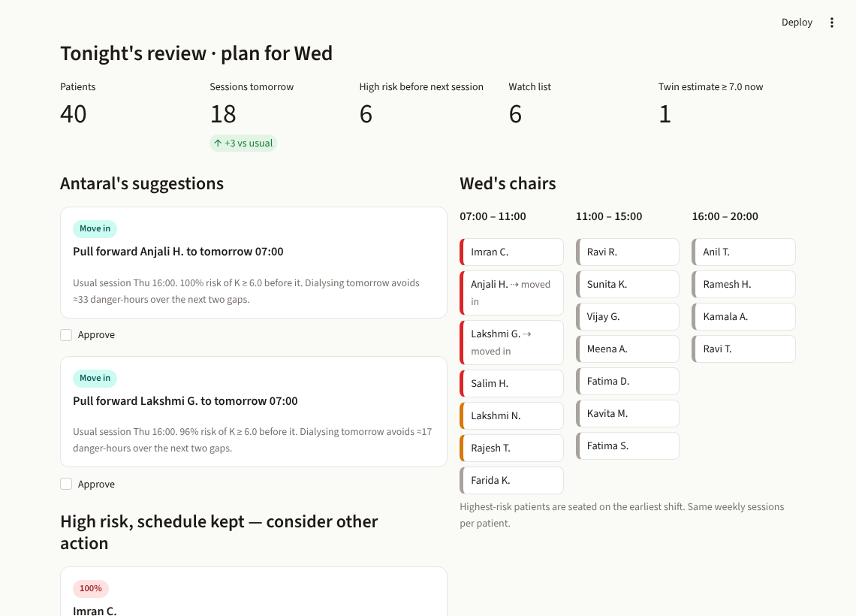
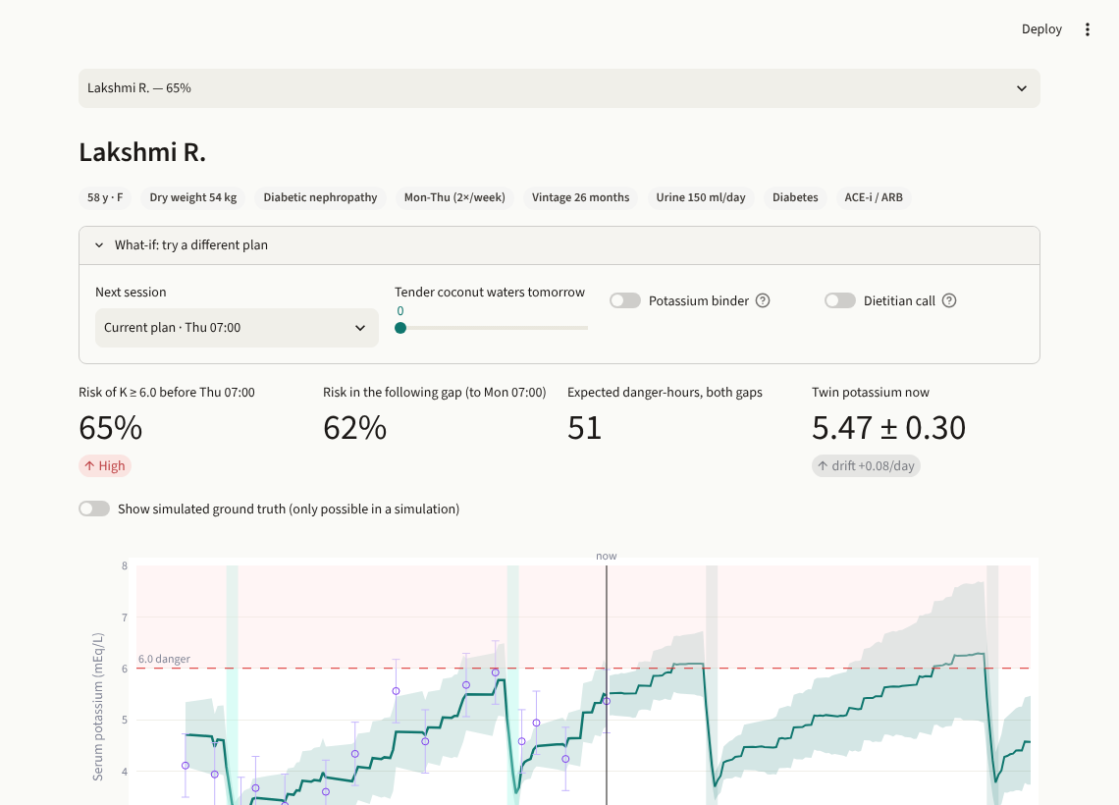
THE DOCTOR'S DASHBOARD
How a doctor works with the virtual patient
Unit tonight: suggestions to approve, tomorrow's chair board, risk for every patient
Patient twin: trajectory, forecast, ECG vs baseline, reasons, what-if panel
Notes:
This is the working prototype, built in Streamlit. On the left, tonight's review for the whole unit: suggested moves the doctor approves, a chair board for tomorrow, and a risk table. On the right, Lakshmi's twin with her potassium history, the forecast, her ECG against her baseline, and a what-if panel. I'll demo it live in the video.

Slide 12
HONEST LIMITS · NEXT STEPS
What the simulation taught us, and what comes next
Limits we found
Next
Re-timing does not cut hours above 7.0: those patients need more dialysis, not different timing
Too many schedule changes for a real unit today; the stability setting needs tuning with clinicians
All results are on synthetic data, not clinical validation
A tuned ML model without the twin comes close on accuracy; the twin's edge is what-if reasoning
Validate on MIMIC-IV: dialysis patients with potassium labs and linked ECGs
Real smartwatch ECG exports in place of synthetic beats
Dose alerts for chronically high patients: extra session or prescription review
Pilot with an Indian dialysis unit, DPDP-compliant, clinician approval on every change
Notes:
I want to be honest about limits. Re-timing doesn't reduce the most extreme hours, because those patients need more dialysis. The scheduler still makes more changes than a real unit would accept. And everything is synthetic. Next steps: validate on MIMIC-IV, use real smartwatch ECG exports, add dose alerts, and pilot with an Indian dialysis unit.

Slide 13
K⁺
Same chairs. Same sessions.
Fewer people arriving in danger.
Antaral · Team Between Beats · Nishant Majumdar, VIT Bhopal University
github.com/SillyMarvellousChad/BetweenBeats_VIT-Bhopal-University
Research prototype for clinician decision support. Synthetic data only. Not a medical device.
Notes:
Antaral: same chairs, same sessions, fewer people arriving in danger. Everything is open source on GitHub. Thank you.

